Slide 1
Catechism
Apologetics; Existence of God
Lesson 2
Notes:
By U5K0 - Own work, CC BY-SA 4.0, https://commons.wikimedia.org/w/index.php?curid=36129151

Slide 2
Psalm 14:1,2
1.The fool says in his heart, “There is no God.”
They are corrupt, their horrid deeds they cherish;
not one of them does good, while just men perish.
None calls upon the Lord, none sings his laud
or fears his rod.
2. The Lord looks down from heaven’s holy throne
to see if anyone has understanding.
Not one seeks God, but wickedness intending,
the sons of men, to sin and evil prone,
his law disown.

Slide 3
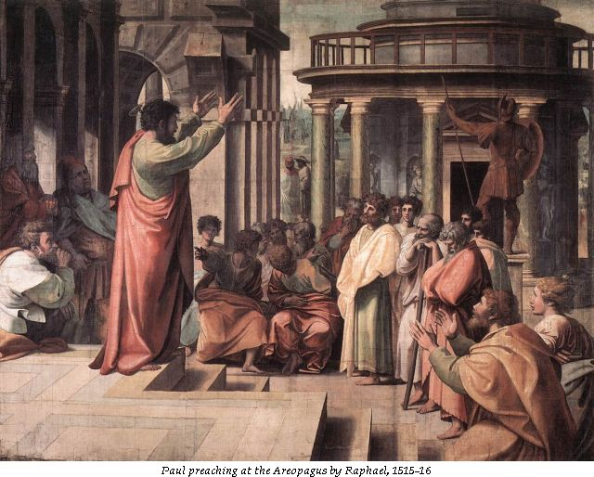
Bible Study: Acts 17 & 1Cor 1&2

Slide 4
Bible Study: Acts 17 & 1Cor 1&2
1. The city was full of idols
2. He reasoned with Jews, devout people (Greeks who believe in Yahweh) and whoever happened to be in the marketplace.
3. Talking about and listening to the latest ideas
(this was before the Internet…)
4. To present his teaching
5. He was prepared to do so.
6. He began with their situation, and tried to expand their horizon. He chose a non-confrontational approach to have them change their mind.

Slide 5
Bible Study: Acts 17 & 1Cor 1&2
7. When he mentioned the resurrection of the dead
8. Because Greeks believe that the body is a prison of the spirit, true life is spiritual. So a resurrection of the dead is ridiculous…
9. Because it doesn’t make human sense (victory through dying) and seems very weak (death).
10. Wisdom. Something that makes sense and is appealing.
11. In the Lord.
12. Lofty speech or superior wisdom
13. In weakness, in fear and much trembling.

Slide 6
Bible Study: Acts 17 & 1Cor 1&2
14. We are to be non-confrontational, stand our ground, go by God’s standards, and boast in God.

Slide 7
Three Approaches
Evidentialism
Philosophical & Presuppositionalism
Fideism
Notes:
Begin by asking how one might do apologetics.

Slide 8
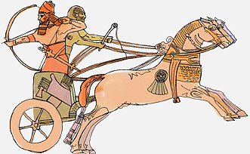
Evidentialism
Evidentialism seeks to prove that your faith is correct.
Method: use means acceptable to the opponent.
Common forms:
- archaeological evidence for Bible history
- scientific proof for Bible doctrine

Slide 9
Evidentialism
Drawbacks:
- not everything has been proven
- not everything can be proven (miracles)
- overstating one’s case (fundamentalism)

Slide 10
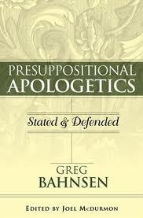
Philosophical & Presuppositionalism
The philosophical approach seeks to prove your faith true/most probable.
Presuppositionalism seeks to convince another that his faith makes no sense and yours does.
Method: use reasoning.

Slide 11
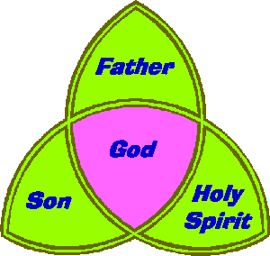
Presuppositionalism
Drawbacks:
- reasoning is circular
- some Biblical truths are beyond reason
?

Slide 12
Fideism
Fideism is accepting you can’t prove your faith; all you can do is describe it.
Method: describe your faith and invite others in.

Slide 13
Fideism
Drawbacks:
- implies relativism: you can believe whatever you want (faith in faith)
- won’t convince anyone

