Slide 1
Catechism
Existence of God
Lesson 3

Slide 2
Psalm 96:1,3
Sing to the Lord with exultation.
O sing a new song, all creation.
Sing to the Lord and bless his name.
Day after day with joy proclaim
the wondrous deeds of his salvation.
All gods revered by other nations
are merely idols, man’s creation.
Our God made all the heav’ns’ extent,
and glory dwells within his tent.
Before him kneel in adoration.

Slide 3
Three Approaches
Evidentialism
Philosophical & Presuppositionalism
Fideism
Notes:
Begin by asking how one might do apologetics.

Slide 4
Useful or not?
It is unwise to make just one approach your only approach.
The approach that works best will depend on the issue, the situation, and the opponent.
In coming lessons we’ll see the various apologetic approaches at work.

Slide 5
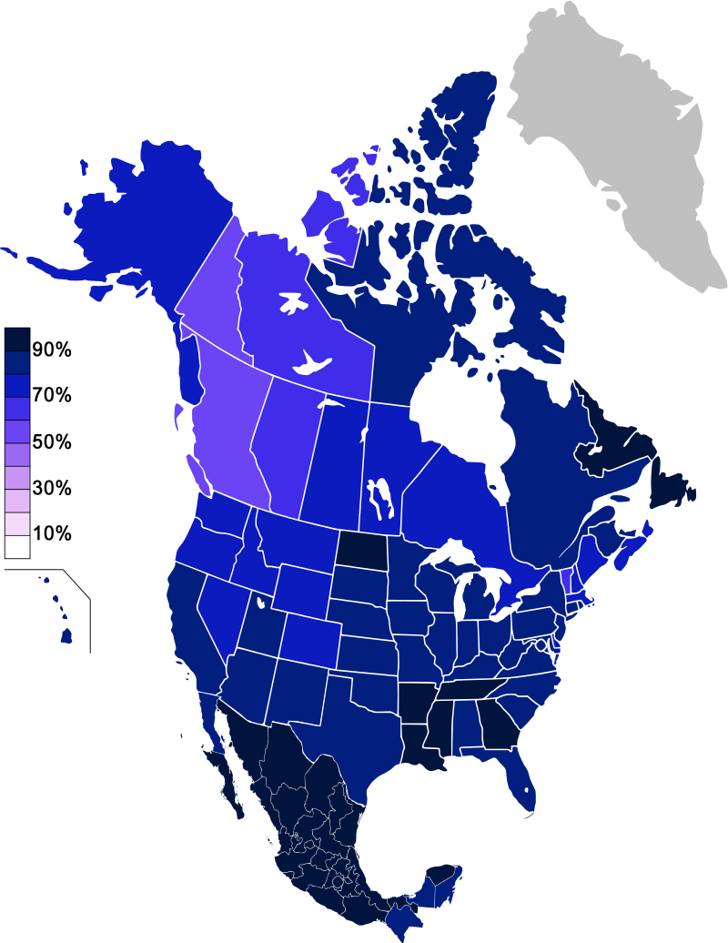
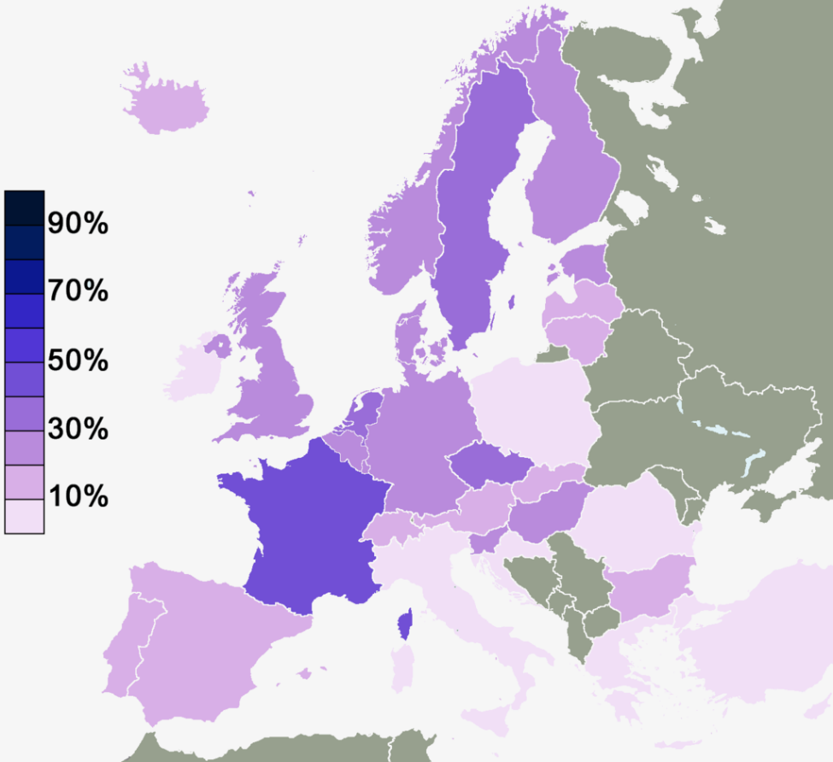
Belief in the existence of a divine being
North America – 2010-2012
Light = atheist / not religious
Europe – 2010
Dark = atheist / not religious
Notes:
Source: Wikipedia

Slide 6
Views on the existence of God
Theism: Yes, there’s something out there
Atheism: No, God does not exist
Agnosticism: Maybe, we cannot know whether God exists
Apatheism: It’s not important.

Slide 7
An e-mail – summer 2012
Hi I'm a former church going Christian. But I have many questions that I haven't been able to find answers to so far, so I thought I should ask some of the churches I have attended some of my questions. I want both sides of the argument before I make my decision. Just a little background on me, I used to attend a Can RC church for around the first 20 years of my life. Since then I have gone off to explore the world, I am in the military and have seen some messed up stuff that doesn't make sense if there was a God. Also God doesn't seem to be logical or stand up to any rational logic. I don't have any fancy degrees, but I am very open minded and a logical thinker, and think I am pretty smart. 1. The biggest question I have: Is there a God? If so prove it.
What’s a good response?

Slide 8
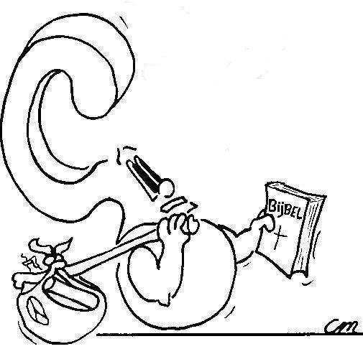
Proving the existence of God
Maybe we should first ask: can we?
How can I prove that God exists?

Slide 9
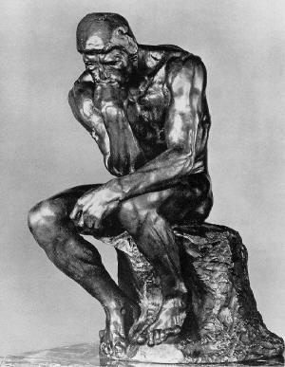
Proving the existence of God
Philosophical approach:
use reasoning, common starting point
Presuppositional approach:
use reasoning, different starting points
Scientific approach
use senses, common starting point
Faith approach
use senses, different starting points

Slide 10
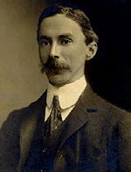
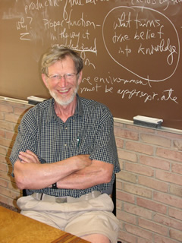
Philosophical approach
Common starting point: thought as a source of knowledge.
Common methodology: the use of logic as a means to knowledge.
Basic Arguments:
For: I can think of God, therefore God exists
Against: I can fantasize, therefore God does not exist
Atheist Bertrand Russell
Theist Alvin Plantinga .

Slide 12
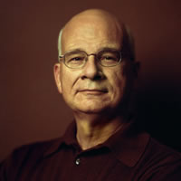
Presuppositional Approach
Using the presuppositions of the opposition, prove their position untenable (=not able to be held)
Then come with your own presuppositions, and prove your position tenable (=able to be held)
Conclusion: It is more likely that there is a God than that there is no God.
Today this approach is popularized, among others, by Rev. Tim Keller.

Slide 13
The Reason for God
Notes:
5:29

Slide 14
Philosophy and Presuppositionalism
Philosophy focuses on the truth of a proposition. Is it true or false?
Presuppositionalism is more refined, as it focuses on the probability of a proposition. What is the likelihood of it being true or false?
Which do you figure works better and why?
Jot down some thoughts and we’ll discuss

Slide 15
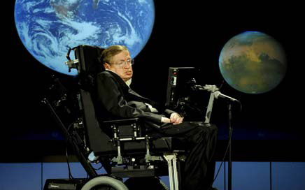
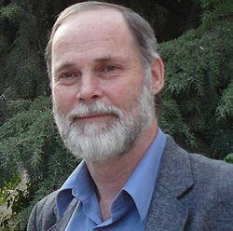
Scientific Approach
Common starting point: observations lead to truth
Common methodology: use the senses
Generally, scientists will seek to prove or disprove scientific data in Scripture.
The most famous atheist scientists are Stephen Hawking and Richard Dawkins
Among theists is Dr. John Byl

Slide 16
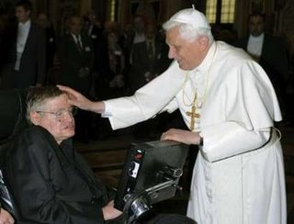
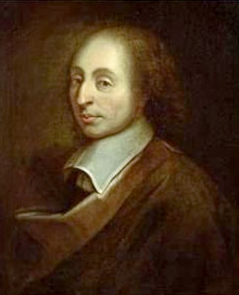
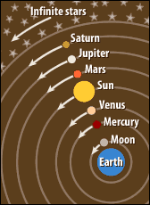
Faith Approach
There are two variants:
Dualism: A distinction is made between the physical and the metaphysical. There are two truths: the observable and the spiritual.
Blaise Pascal:
Monism: The claims of philosophy and science are ignored. Truth is only known via divine revelation.
Geo-centrism:

Slide 17
A mixture of approaches…

Slide 18
Scientific & Faith Approaches
Evolutionism
Theistic Evolution
Intelligent Design
Creationism
Geo-centrism
Flat Earth Society

Slide 19
Evidentialism and Fideism
What flaws do you find with evidentialism?
What flaws do you find with fideism?
Jot down some thoughts and we’ll discuss.

