Slide 1
Catechism The Need for Faith
Lesson 7 – LD 5b-6a
God Sends The True Mediator

Slide 2
Hymn 23:1,2,3
Let us of Christ our Lord and Saviour sing,
for, though God’s equal, though eternal King,
he did not to his rightful glory cling.
Hallelujah, hallelujah!
Himself he emptied that he us might save;
himself for us, God’s chosen ones, he gave,
and, born as man, our Lord became a slave.
Hallelujah, hallelujah!

Slide 3
Hymn 23:1,2,3
He bore the weakness of our human frame
and he obedient unto death became,
for on a cross he died, in bitter shame.
Hallelujah, hallelujah!

Slide 4
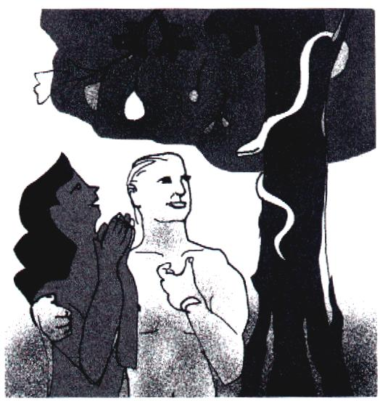
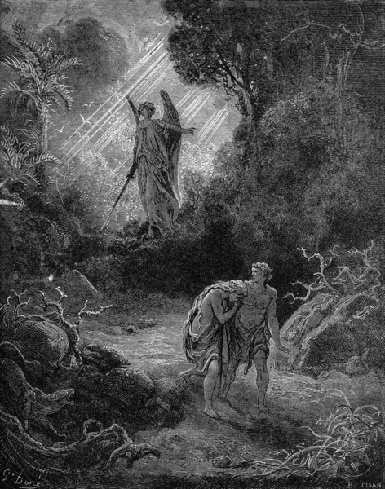
What we have seen so far
Through the Fall into Sin, Sin and Death entered the world.
God is just: sin will be punished.
Atonement is only possible by complete payment.
Neither we humans nor another creature can pay that price.
Notes:
Don’t dawdle during the first few slides – you need your time at the end of the lesson.

Slide 5
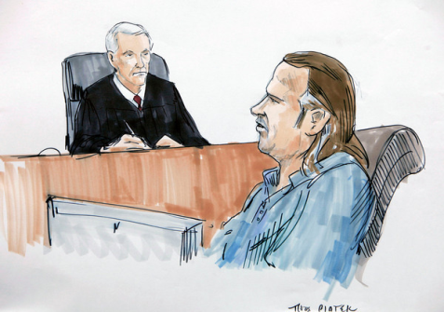
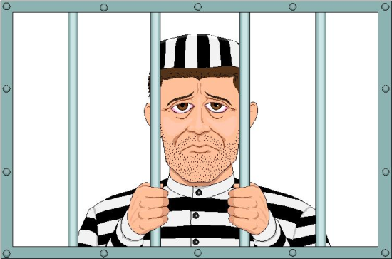
What is needed for a real Mediator
Man sinned so man must pay the penalty
Therefore, the mediator must be a true man.

Slide 6
What is needed for a real Mediator
Man owes God perfect love
Therefore, the mediator must be a righteous man.
X
?

Slide 7
What is needed for a real Mediator
The penalty to be undergone is eternal death
Therefore, the mediator must have power beyond that of creatures, He must be true God.

Slide 8
What makes a good mediator?

Man sinned so man must pay the penalty
Therefore, the mediator must be a true man.
Man owes God perfect love
Therefore, the mediator must be a righteous man.
The penalty to be undergone is eternal death
Therefore, the mediator must have power beyond that of creatures, he must be true God.

Slide 9
Catechism
15. Q. What kind of mediator and deliverer must we seek?
A. One who is a true and righteous man,
and yet more powerful than all creatures;
that is, one who is at the same time true God.

Slide 10
Given by God

God sent His Son to save us.
This is proof of God’s love for us.
For God so loved the world that He gave His only-begotten Son, that whoever believes in Him should not perish but have eternal life.
John 3:16
Greater love has no one than this, that someone lay down his life for his friends.
John 15:13

Slide 11
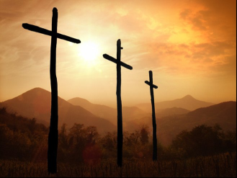
What Jesus did

Though God, He became a human being
Would you be prepared to become a worm to save all worms?
He was born into the poorest of families
If you had everything, would you be willing to give it up?
He lived a life of popularity and rejection
Would you tell the truth, or try to keep your friends?
He died the most ignoble of deaths
Would you be prepared to die for a good cause?

Slide 12
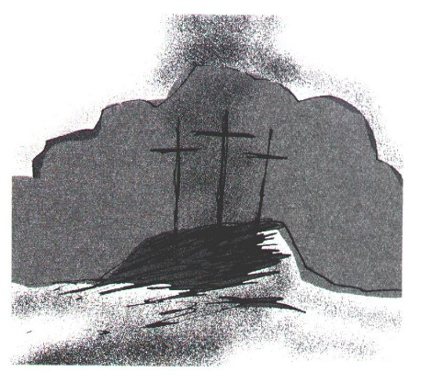
Delivered

It is through Christ’s death on the cross that true atonement for sin was made.
His blood flowed, that ours might never have to flow.
God put forward Christ Jesus as a propitiation (sacrifice of atonement) by his blood, to be received by faith. This was to show God’s righteousness because in His divine forbearance He had passed over former sins.
Romans 3:25a

Slide 13
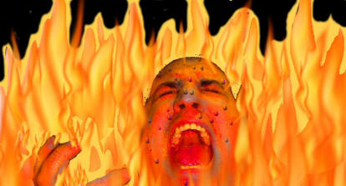
The chasm bridged
Jesus Christ
God
Us
sin

Slide 14
Catechism
18. Q. But who is that Mediator who at the same time is true God and a true and righteous man?
A. Our Lord Jesus Christ,
who has become for us wisdom from God – that is,
our righteousness, holiness and redemption (1 Corinthians 1:30).

Slide 15
Mediator

The position of Jesus Christ is that He stands between God and God’s people.
That’s why He is called the Mediator.
He covers us in the sight of God.

Slide 16
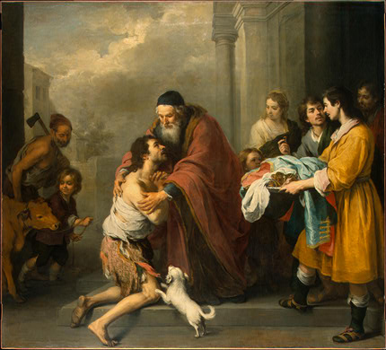
True Atonement is

- that everything is good again between God and people; God and man are reconciled
- that Jesus the Christ has born the penalty for our sins and now has us changed to become perfectly loving and loyal people.

Slide 17
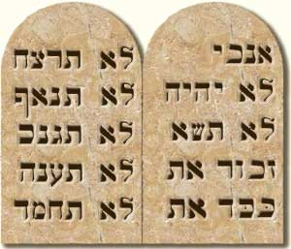
Moses and Jesus
Moses is sometimes referred to as the mediator of the Old Covenant.
In actual fact, Moses is a proto-type of Jesus, who is the true Mediator.
A mediator
1. mediates between two persons or parties
2. pleads the case like a lawyer
3. brings about reconciliation

Slide 18
Between two parties
Moses
Exodus 19:7
He brings God’s Word to the people
Exodus 19:8-9
He brings the reaction of Israel to God
Jesus
John 3:34
He speaks the Word of God
John 14:6
He is the Way to the Father
Notes:
Have different students look up a text and read it out

Slide 19
Pleading the people’s case with God
Moses
Exodus 32:11b-13
.
He pleads the people’s case before God, asking God not to destroy Israel.
Jesus
Romans 8:34
1 John 2:1
He pleads before God’s throne on behalf of the children of God.

Slide 20
Reconciliation or Atonement
Moses
Exodus 32:30
Because of his own sinfulness, Moses is not allowed to take the place of Israel.
He cannot make true reconciliation happen
Jesus
2 Corinthians 5:18
Jesus committed no sin, and thus was called to take our place.
He can (and did!) make true reconciliation happen.

Slide 21
The true mediator is

Jesus the Christ
the Son of God.

