Slide 1
Catechism Essentials of Faith
Lesson 9
The Holy Spirit

Slide 2
Hymn 50:1
The Spirit came, as promised,
in God’s appointed hour
And now to each believer,
He comes in love and power.
And by His Holy Spirit,
God seals us as His own,
And through the Son and Spirit
makes access to His throne.
CCLI: 11344914 (WH)

Slide 3
Canons of Dort II.8
God chose (elected) those who are to live eternally with Him.
God further willed
That Christ should save all the elect
That Christ should give the elect faith
That Christ should cleanse the elect from sin
That Christ should preserve the elect through life
That Christ should present the elect to Himself as perfect

Slide 4
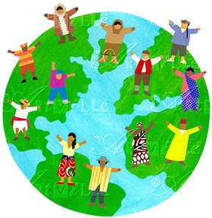
For whom did Christ die?
Many Scripture texts say God saves “all” or wants to save “all”. In many of these passages “all” doesn’t mean “every single person” but “all types of people”. No one is excluded on the basis of gender, sexual orientation, ethnicity, social standing, or whatever.

Slide 5
The Holy Spirit
Of the Persons of the Trinity, the Holy Spirit is probably the most obscure.
Ontologically He is co-equal with the Father and the Son.
Economically He is subordinate to the Father and the Son.
Within the Trinity, the Spirit is the ‘labourer’, He does the ‘trades’.

Slide 6
The Spirit at work
Answer question 1 on the worksheet.
Next we read together BC article 11, LD 20 and CoD III/IV art 6 & 10-13
Then we’ll look at the remaining questions on the worksheet.

Slide 7
Power or Person?
Those who deny the Trinity will argue the Spirit of God is simply the power or energy of God.
However, Scripture teaches the Spirit is a Person.
1. The Spirit has emotions.
Isaiah 61:3: Yet they grieved His Holy Spirit
Ephesians 4:30: do not grieve the Holy Spirit of God
2. The Spirit is grammatically an ‘it’ in the Greek language, but in the Bible we’ll often read ‘He’.
3. He has the same task as the Son of God.
John 14:16-17: The Father will give you another Helper – even the Spirit of truth.

Slide 8
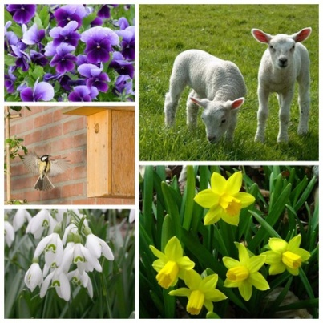
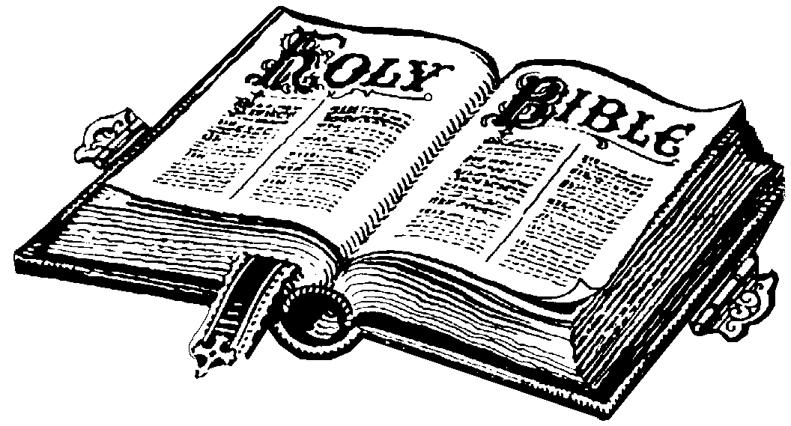
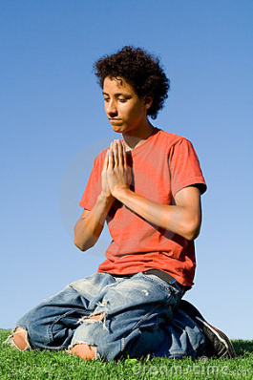
!!! The Work of the Spirit !!!
The Spirit has three duties:
1. He gives life and existence to all things
Psalm 104:30: “When you send your Spirit, they are created”
2. He communicates the truths of God and existence
2 Peter 1:21: “Men spoke from God as they were carried along by the Holy Spirit”
3. He makes men serve God, granting faith and good works
1 Corinthians 12:3: “No one can say ‘Jesus is Lord’ except by the Holy Spirit

Slide 9
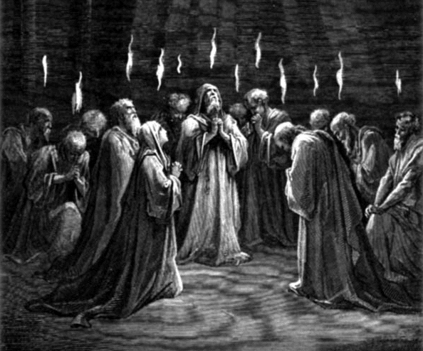
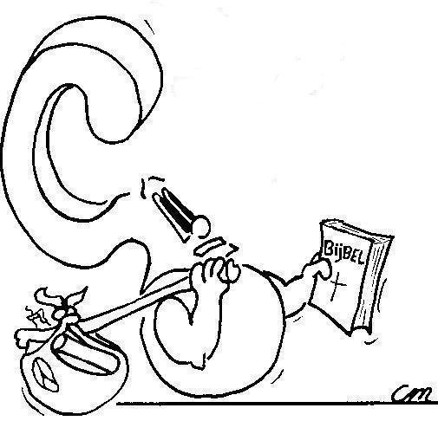
Pentecost
What does it mean that the Spirit came at Pentecost?

