Slide 1
Catechism Essentials of Faith
Lesson 10
The Holy Spirit in Christianity Today

Slide 2
Hymn 47:5
Counsellor, O Holy Spirit,
you who were from heaven sent,
may you with our Saviour’s merit
fill the earth’s remotest end.
O revive, refresh, and nourish
all that here may fade and fail!
Let your healing wind prevail,
causing love and zeal to flourish.
To new life let us be raised.
Holy Spirit, you be praised!

Slide 3
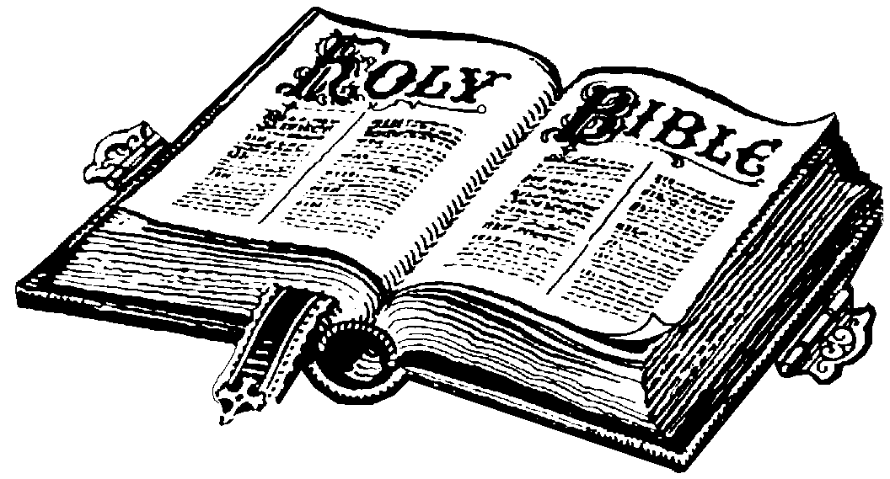
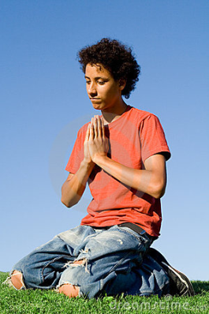
!!! The Work of the Spirit !!!
The Spirit has three duties:
1. He gives life and existence to all things
Psalm 104:30: “When you send your Spirit, they are created”
2. He communicates the truths of God and existence
2 Peter 1:21: “Men spoke from God as they were carried along by the Holy Spirit”
3. He makes men serve God, granting faith and good works
1 Corinthians 12:3: “No one can say ‘Jesus is Lord’ except by the Holy Spirit

Slide 4
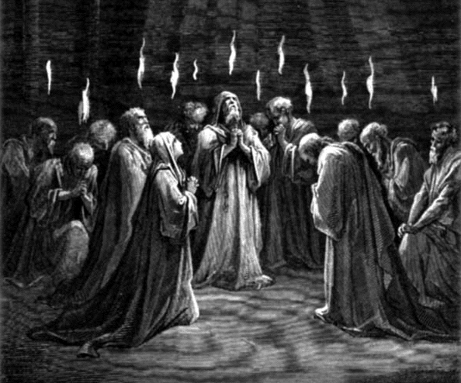
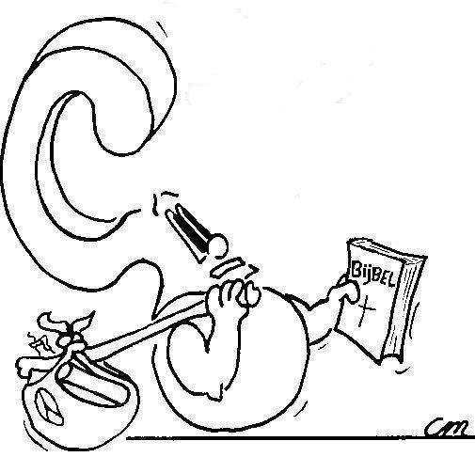
Pentecost
What does it mean that the Spirit came at Pentecost?

Slide 5
Pentecost
The Spirit has three duties:
1. He gives life and existence to all things
Psalm 104:30: “When you send your Spirit, they are created”
2. He communicates the truths of God and existence
2 Peter 1:21: “Men spoke from God as they were carried along by the Holy Spirit”
3. He makes men serve God, granting faith and good works
1 Corinthians 12:3: “No one can say ‘Jesus is Lord’ except by the Holy Spirit
The Spirit has done this since creation for all creation
In the OT the Spirit did this through some believers
In the NT the Spirit does this through all believers
The Spirit has done this since the Plunge into Sin for all God’s children

Slide 6
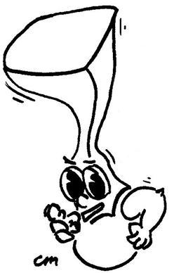
Pentecost
What does it mean that the Spirit came at Pentecost?
The Spirit was poured out on all members of the Church that everyone might have understanding & boldness to tell of God’s wonderful deeds

Slide 7
Sin against the Holy Spirit

Sin against the Holy Spirit is never forgiven.
This sin relates to the second and third works of the Spirit. The sin against the Spirit is:
- refusing to accept and believe the testimony of Scripture
- not following in the path of the Spirit but purposely sinning
Sinning against the Spirit is shaking your fist at God.

Slide 8
The Holy Spirit in action
When it comes to the Trinity, most controversies tend to be about the Holy Spirit, especially what He does.
Following are some of those questions:
1. Does the Spirit still speak to people directly?
2. Do gifts of the Spirit (e.g. faith healing, speaking in tongues) still exist today?

Slide 9
Gifts of the Spirit
The early church experienced many special gifts of the Spirit, as they did not have the Bible.
They are not all as prevalent today, though in the mission field (even Reformed mission fields) miracles do still occur.

Slide 10
Gifts of the Spirit
It is thought that special gifts of the Spirit are not common today is because we have the Bible as the authoritative Word of God.
Established churches (like ours) do not require extraordinary signs to authorize the genuineness of the Gospel.
However, this does not mean that miracles cannot occur in circles like our own. They sometimes do.

Slide 11
Gifts of the Spirit
We note that Scripture never says that all God’s children will experience all gifts of the Spirit.
The one gift of the Spirit all do have in common, is faith expressing itself through love.
Whatever gifts we have from the Spirit - be they special or more ordinary - we are to use them to God’s glory and for the benefit and well-being of God’s people.

Slide 12
A warning
John saw a beast come out of the earth. He wrote:
It performs great signs, even making fire come down from heaven to earth in front of people, and by the signs that it is allowed to work in the presence of the beast it deceives those who dwell on earth, telling them to make an image for the beast that was wounded by the sword and yet lived. (Rev. 13:13-14)
Paul wrote: For such men are false apostles, deceitful workmen, disguising themselves as apostles of Christ. And no wonder, for even Satan disguises himself as an angel of light. (2Cor. 11:13-14).

Slide 13
Bible Study: James 5:13-20
The point of this passage is the power of a prayer uttered in faith.
This power relates in particular to sickness and sin.
Questions to ponder:
- When might a person be so distraught they cannot pray?
- What is the relationship between sickness and sin?
- Where does the oil figure into this?

Slide 14
Bible Study: James 5:13-20
- When might a person be so distraught they cannot pray?
When they feel there is something between them and God that will prevent God from listening to them.
- What is the relationship between sickness and sin?
Sickness need not necessarily be the result of sin.
- Where does the oil figure into this?
Anointing someone with oil is an official way of greeting someone, just like a handshake in our culture (or giving flowers in Dutch culture).

Slide 15
Cessationism
Cessationism is the teaching that the Bible is a finished book. The Spirit will not have us add or take away from the Bible.
Hence we reject all those who claim they have received messages from God which should be added to the Bible (e.g. Mohammed [Islam], Joseph Smith [Mormons])
This is not to say that the Spirit cannot speak to people in a personal way. However, that’s something between them and the Spirit, no one else.

Slide 16
Miracles – Christian Broadcasting Network
Notes:
5:35

