Slide 1
Catechism Essentials of Faith
Lesson 11
The World of Spirits

Slide 2
Hy 53:3&4
And though this world, with devils filled,
should threaten to undo us,
we will not fear, for God has willed
his truth to triumph through us.
The prince of darkness grim,
we tremble not for him;
his rage we can endure,
for lo! his doom is sure;
one little word shall fell him.

Slide 3
Hy 53:3&4
That word above all earthly powers –
no thanks to them – abideth;
the Spirit and the gifts are ours
through him who with us sideth.
Let goods and kindred go,
this mortal life also;
the body they may kill,
God’s truth abideth still;
his kingdom is forever.

Slide 4
The world of spirits
The teachings of Scripture on the world of spirits is summarized in Belgic Confession Article 12.
We’ll read the article and discuss the questions.

Slide 5
Spirits
Nicea: We believe in one God, … Creator of all things visible and invisible
Creation:
- inanimate / non-living things
- plants: after their own kind
- animals: after their own kind
- spirits: serving beings without body
- man: image of God
Spirits are
- NOT bodiless (deceased) people
- NOT deformed or lower gods
- BUT beings with a distinct nature

Slide 6
Spirits
X
Originally all were created good.
Rebellion
- a sizeable minority of spirits rebelled against God
- Bible does not tell the story, just the fact (Jude :6)
- happened before man rebelled against God (Gen 3:1; Rev 12:9)
Two sorts
- the good angels
- the fallen angels, devils or demons

Slide 7
Terminology
Good angel
- from Greek “angelos” = messenger
- Hebrew “malach” = messenger (Malachi=My messenger)
as “angel” is the ordinary word for “messenger” not every “angel” in the Bible needs to be a spirit, people can be called “angels” too (like the prophet Malachi)
Demon, devil, evil spirit
- devil is from Greek “diabolos” = to throw through
- demon is from Greek “daimoon” = evil spirit

Slide 8
Types
Angels
- Archangels = chiefs of angels
- cherubs = bodyguard angels (Hebrew “sword”)
- seraphs = praising angels (Hebrew “fire”)
- guardian angels? Per nation (Daniel 10), per person (Matthew 18:10)
Demons
- chief of demons is Satan, a fallen archangel
- further not very clear
There is a lot we don’t know but it seems that there is a world out there as complex as our own.

Slide 9
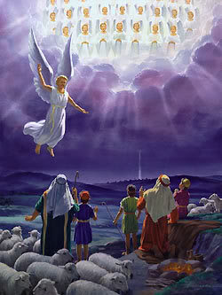
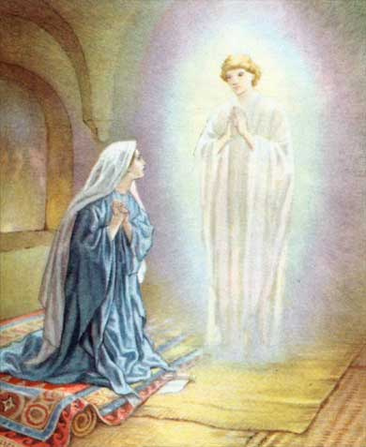
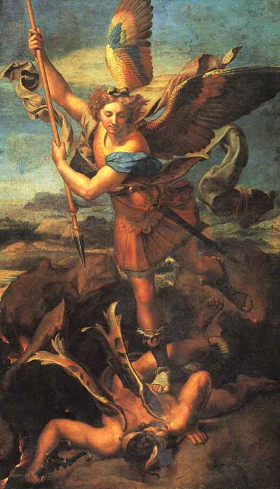
Tasks of good angels
To praise and glorify God
To convey God’s messages
To protect God’s people

Slide 10
Angelic persons we know by name
Gabriel (Hero of God)
- chief of the messenger angels
Michael (Who is like God?)
- chief of the soldier angels
- Prince of God’s people
The Angel of the LORD
- only in Old Testament
- sometimes identified with God, sometimes different
- many assume He is the Lord Jesus before incarnation
Satan (accuser)
- chief of the demons

Slide 11
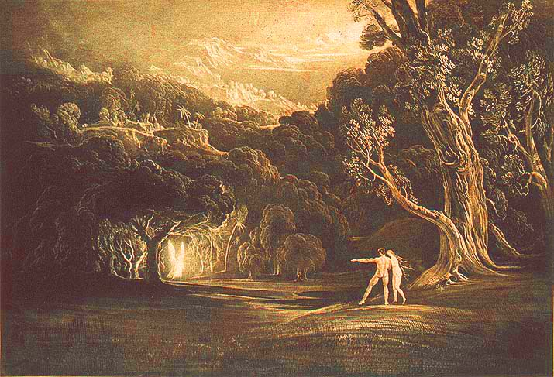
An angel guards the way to Paradise

Slide 12
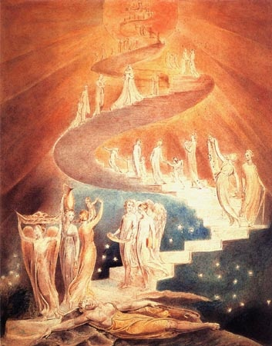
Jacob’s ladder

Slide 13
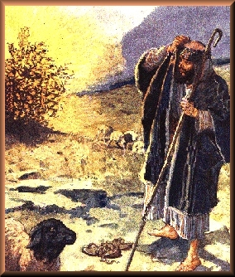
The burning bush

Slide 14
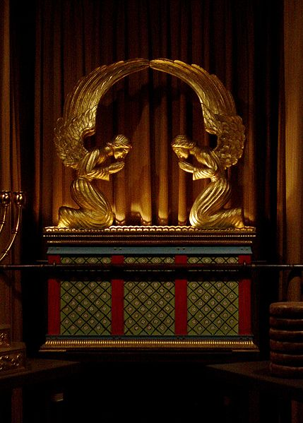
The ark of the covenant

Slide 15
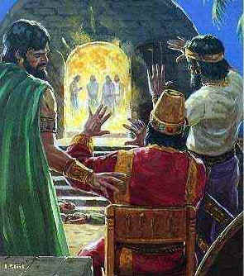
Daniel’s friends in the furnace

Slide 16
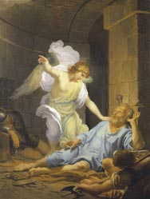
Peter’s release from prison

Slide 17
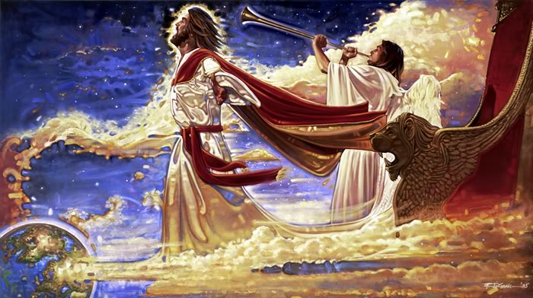
Christ’s return

Slide 18
Spirits - appearance
Spirits have no body
When they are ‘seen’ they appear as God gives them appearance
Appearances found in the Bible
- As people
- As people with wings (2, 4, or 6)
- As humans with animal parts (generally face)
- As a burning bush?
- Indescribable (Ezekiel 1)
- As a serpent (devil)
- As a monster (dragon)

Slide 19
Spirits - history
On occasions refered to in Old Testament
Very active when Jesus was on earth
Spirits interacted with our world, often without us knowing and realizing it
Satan had challenged God over Job’s faith (Job 1-2)
Satan and Michael fought over the body of Moses (Jude)
Some devil managed to delay Gabriel in coming to Daniel; Michael had to free Gabriel (Daniel 10)

Slide 20
Spirits today
the world of spirits is as real in the present as it was in the past
the activity of evil spirits is curtailed, but not absent
modern witchcraft (Wicca) is in fact a form of spirit-worship
by created order, people are higher in rank than angels
on account of the fall, we have lost our authority
in Christ as perfect man we regain our authority

Slide 21
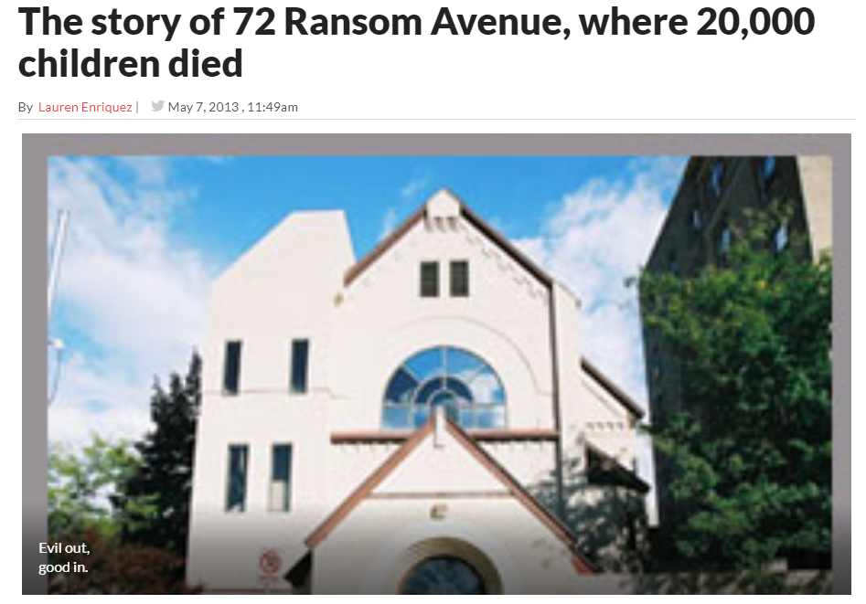
Spirits today

Slide 22
Demon oppression
Demons can only control a person if they are let in
Think of demons as terrorists: very limited in activity, active where they get room
The symptoms for psychological disorders and demon oppression are often similar
psyche = spirit of man
our understanding of our own spiritual nature is very limited
it is simplistic to argue all psychological disorders are proof of demon oppression
it is simplistic to argue all demon oppression is psychological disorder

Slide 23
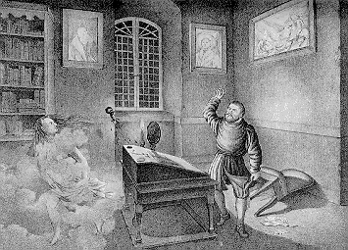
Demon oppression
Excorcism is the act of driving out a demon from a person
In Roman Catholic church: a ministry of the church couched in rituals
In Reformed Churches
demon oppression is rarely encountered (the mission field is the exception)
liberation is sought through prayer

