Slide 1
Catechism The Source of Faith
Lesson 13 – LD 25a & BC 3,4 & 6
The Bible (1)

Slide 2
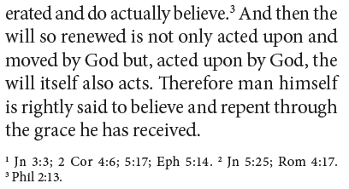
Homework lesson 11 qn 2
From CoD 3&4 art. 12
God’s grace gives us faith and makes us believe.
Put another way:
God does not believe for us
God has us believe

Slide 3
Psalm 119:40
Your word, it is a lamp to guide my feet,
a lantern shining on the path before me.
I’ve sworn an oath and here my vow repeat
to keep the laws that of your love assure me.
I suffer in affliction and defeat;
true to your promise, comfort and restore me.

Slide 4
Belgic Confession
√ Article 2: How God makes Himself known to us
Article 3: The Word of God
Article 4: The canonical books
Article 5: The authority of Holy Scripture
Article 6: The difference between the canonical and apocryphal books
Article 7: The sufficiency of Holy Scripture

Slide 5
Special Revelation
General Revelation: for everyone
Special Revelation: to particular people
Throughout time, special revelation has taken on various forms.
Long ago, at many times and in many ways, God spoke to our fathers by the prophets, but in these last days he has spoken to us by his Son,
Hebrews 1:1,2a

Slide 6
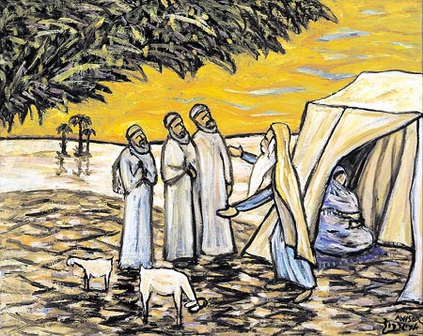
In personal appearances

Slide 7
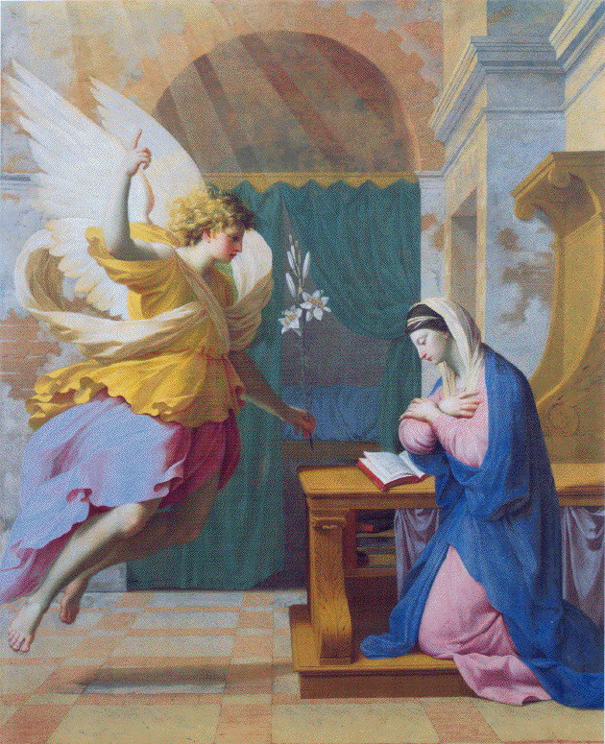
Through angels

Slide 8
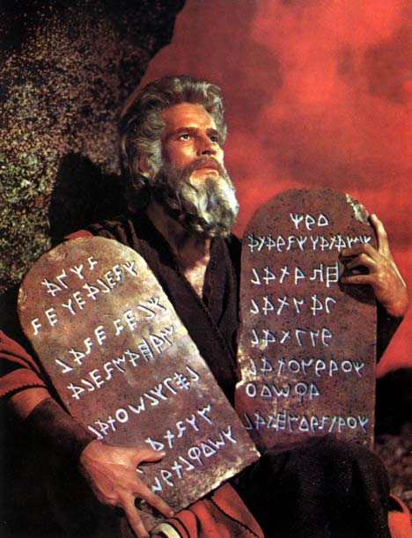
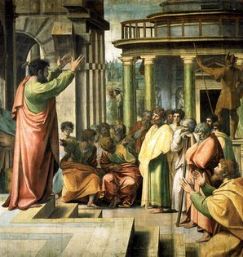
Via people (prophets, apostles)

Slide 9
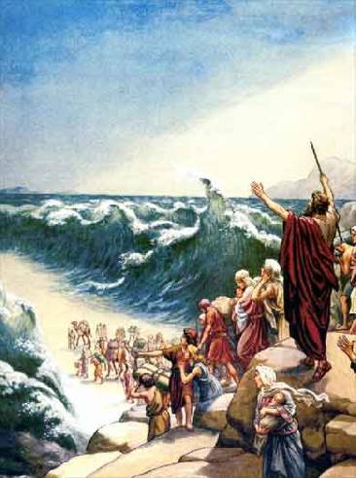
By miraculous deeds

Slide 10
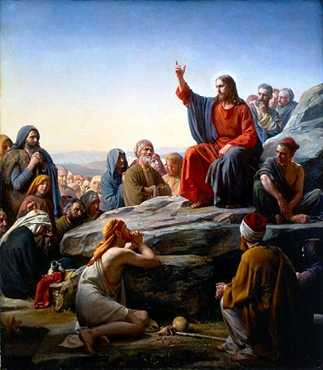
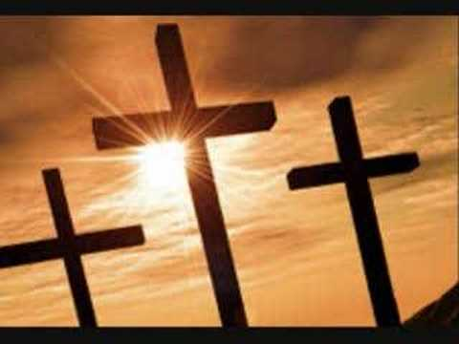
In Jesus Christ

Slide 11
Pentecost

After the Paradise-Flood era and the Babel experience, God limited special revelation to just one people: Abraham’s descendants, the Israelites.
With Pentecost this was reversed.
God’s Word is now for all the nations.
He declares his word to Jacob,
his statutes and rules to Israel.
He has not dealt thus with any other nation;
they do not know his rules.
Psalm 147:19,20

Slide 12
Bible - Origin
Creation
Abraham
David
Christ
Us
2000
1000
0
2000
Moses writes Genesis-Deuteronomy
John writes Revelation
Malachi writes Malachi

Slide 13
From spoken to written

As special revelation took place, God had some of it committed to writing.
Over 1500 years the Bible grew to be what it is now.
As we live after Christ and the apostles, in the last days, there is no more need for extra special revelation.
Never have human beings determined what belongs to the Bible. At most they have said what does not belong to the Bible.

Slide 14
Bible Study: Various
1. Breathed out by God
2. Teaching, reproof, correction, and training in righteousness
3. They are not cleverly devised myths
4. God through the Holy Spirit
5. Yes (note the expression “other Scriptures”)

Slide 15
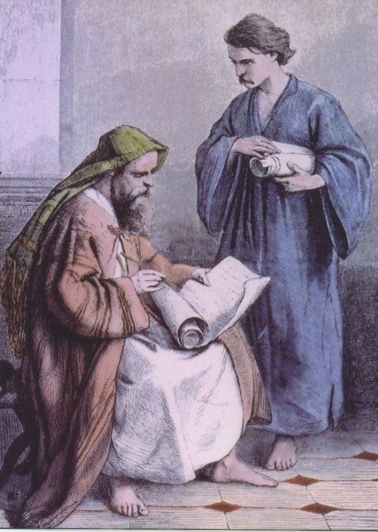
Organic Inspiration

God did not use people the way people use computers for word processing.
God used people with their God-given skills in their God-controlled circumstances to commit His Word to writing.

Slide 16
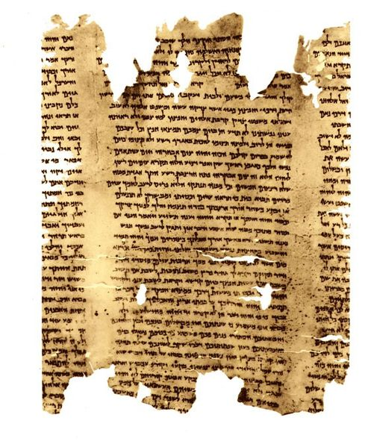
The original Bible
The Bibles we have are translations of documents in three languages:
Old Testament: Hebrew and Aramaic
New Testament: Greek
For both Testaments, an “original document” has been put together in book form, with notes indicating where the old documents vary from each other.
Dead Sea Scroll
Isaiah

Slide 17
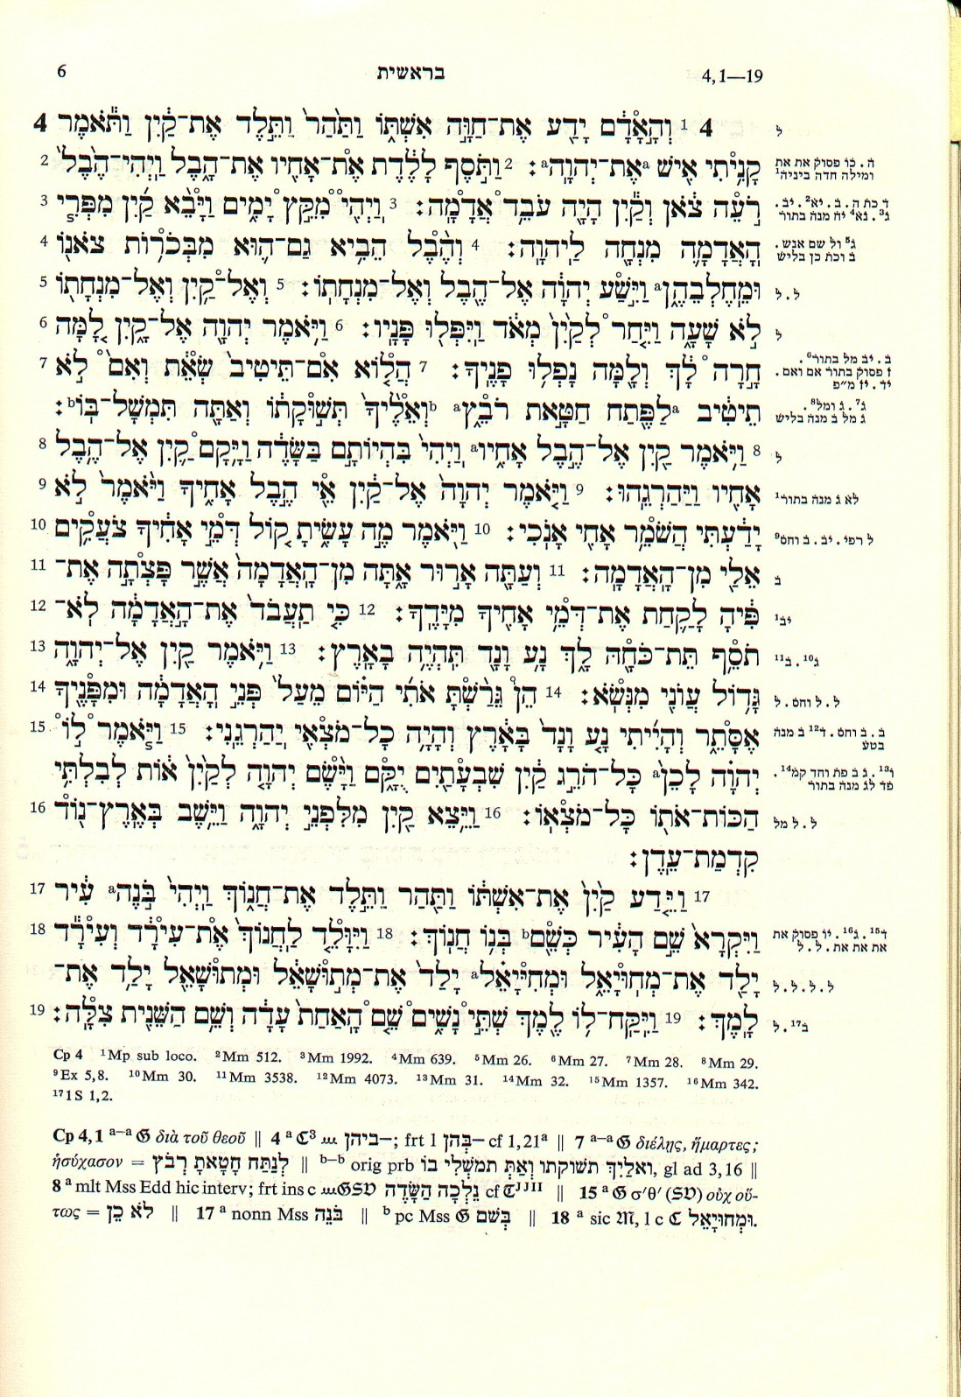
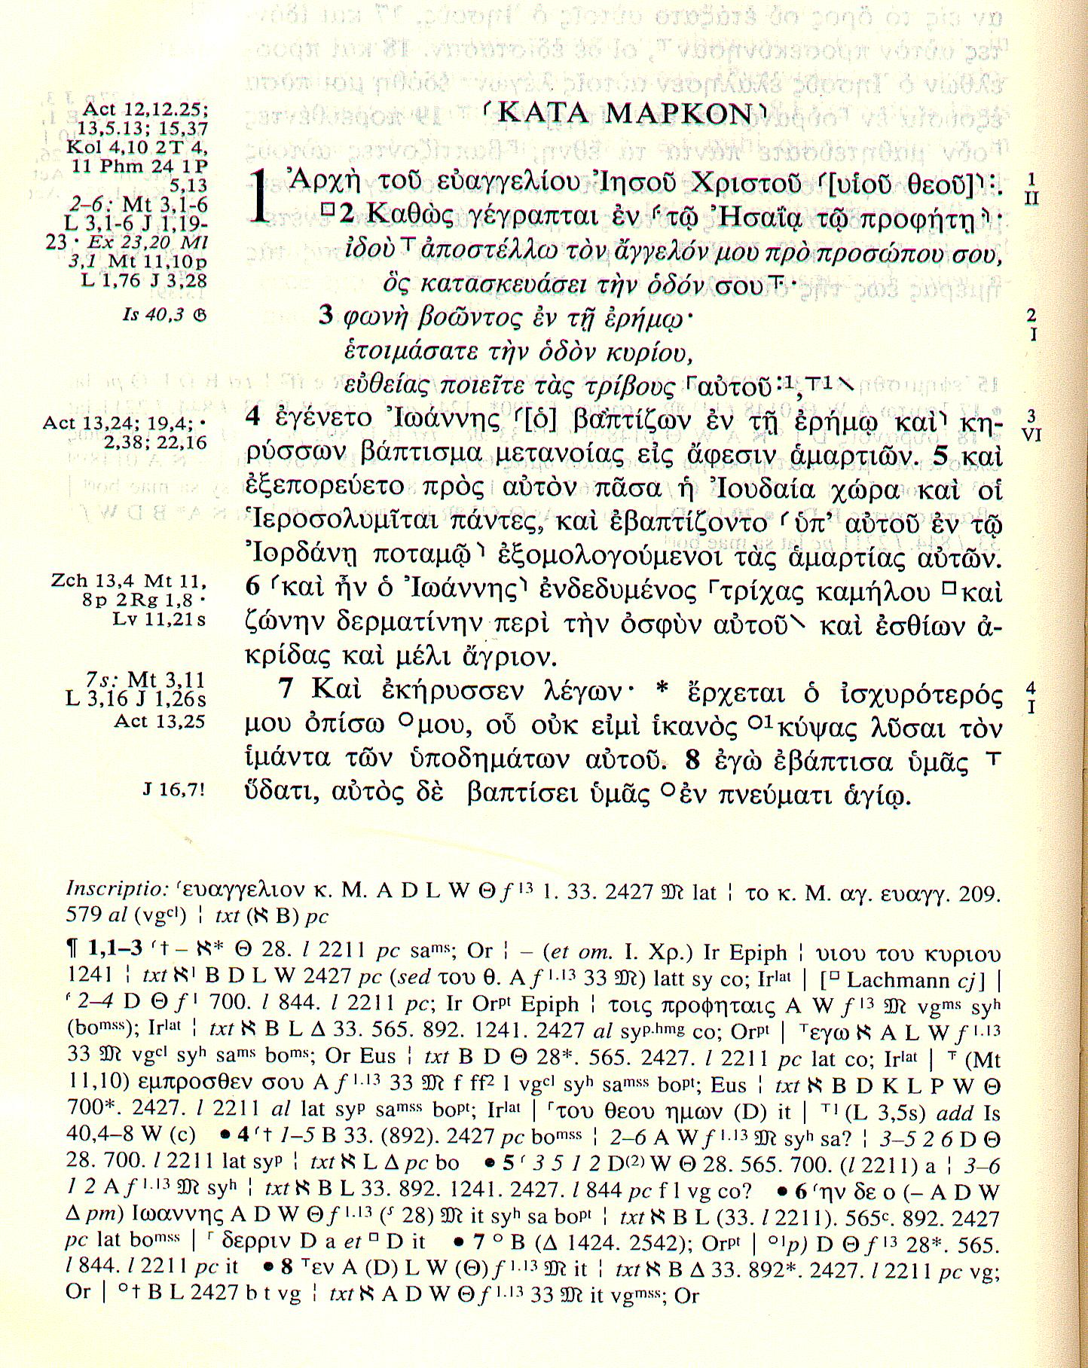
Text
Text
Critical Apparatus
Critical Apparatus

Slide 18
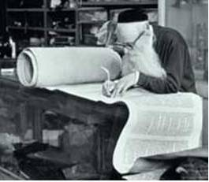
Proving the age of the Bible - OT
Jews very strict about copying.
Three mistakes – destroy the scroll
Around 1000 AD original determined,
everything else is destroyed.

Slide 20
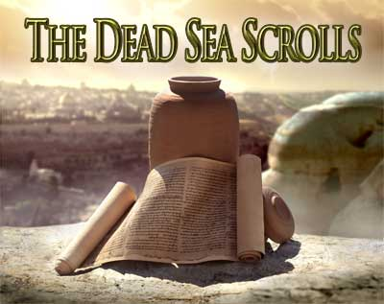
Proving the age of the Bible - OT
1947: discovery of Dead Sea Scrolls
Date back beyond 100 BC
Oldest documents we have of Biblical texts
Differences were minimal, just spelling changes.

Slide 21
Proving the age of the Bible - NT
NT books copied profusely; we have 1000s of copies.
The oldest manuscripts (some even with corrections on them) date back to 100 AD.
The textual variations in the New Testament documents is much greater than for the Old Testament.
However, the substance of these differences does not effect the message of the text. (E.g. one document may say “ostrich” where another has “owl” – Isaiah 13:21)

Slide 22
The Bible is old and accurate

There is no reason to doubt the age and accuracy of the Bible.
For the Old Testament:
- the Jews were very careful in copying
- the Dead Sea scrolls confirmed their accuracy
For the New Testament:
- there are thousands of manuscripts
- differences between manuscripts are insignificant

Slide 23
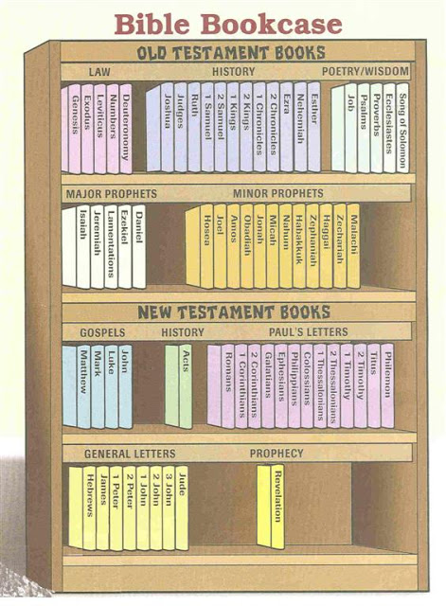
The Books of the Bible

“Bible” is from the Greek BIBLIA = books.
The Bible is actually a library of books.
The canon (standard) of the Bible consists of a total of 66 books.
Books belonging to the Bible are said to be canonical.

Slide 24
Apocrypha

There have been attempts to add certain books to the Bible (Old Testament).
The Roman Catholic Church considers these books biblical.
They call these the Deuterocanonical books, the second canon.
We call them the apocrypha: the obscure books.
There are various reasons to doubt this books:
- they contradict the canonical books
- they are of a later date
- they are not written in Hebrew

