Slide 1
Catechism The Source of Faith
Lesson 14 – LD 25a & BC 5,7
The Bible (2)

Slide 2
Psalm 119:34
Forever fixed in heaven is your word;
firm is your promise through the generations.
The earth, by you established, has endured;
you are the faithful God of my salvation.
By your appointment all stands firm, O LORD,
for you are served by all of your creation.

Slide 3
Belgic Confession
√ Article 2: How God makes Himself known to us
√ Article 3: The Word of God
√ Article 4: The canonical books
Article 5: The authority of Holy Scripture
√ Article 6: The difference between the canonical and apocryphal books
Article 7: The sufficiency of Holy Scripture

Slide 4
Why should people believe the Bible?
- Age? The Bible is a very old book.
- Popularity? The Bible is most widely read book in the world
- Being special? The Bible as a collection of books is quite unlikely: written over 1500 years and consistent all the way through.
- It works? The Bible contains many guidelines that have proven over time to work. It’s message of love and loyalty is to be appreciated.
- Because the church says so?

Slide 5
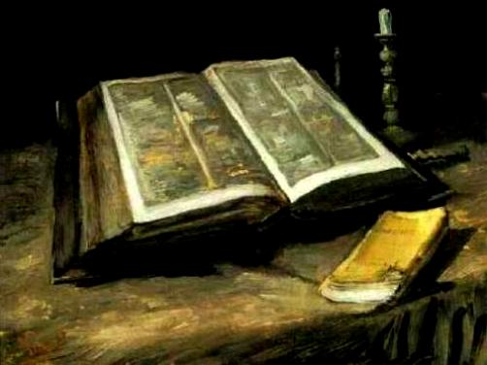
Why believe the Bible?

We can mention all sorts of reasons with varying weight. Age, popularity, it’s a special book, what it says works, the church says so.
However, the one reason that counts is:
The Bible is God’s Word to us, the Holy Spirit says so in our hearts.

Slide 6
Authenticating the Bible
How do you know something is real, authentic?
You do tests.
For people: Passwords, PIN, signatures, fingerprints and iris-scan.
For pure gold: you bite it or treat it with acid
For food: you taste it
Can the Bible be proven to be authentic, to be God’s Word?

Slide 7
Self-authenticating

In principle, the Bible authenticates itself.
It says of itself that it is true.
Besides this test, there is the test of prophecy:
Are the things foretold being fulfilled?
See Deuteronomy 18:21-22
And if you say in your heart, ‘How may we know the word that the LORD has not spoken?’— when a prophet speaks in the name of the LORD, if the word does not come to pass or come true, that is a word that the LORD has not spoken; the prophet has spoken it presumptuously. You need not be afraid of him.
Deuteronomy 18:21-22

Slide 8
Authority
As The Bible is God’s Word
and as God has all authority
therefore The Bible has authority.
Because the Bible has absolute authority, we are to listen to the Bible, whether we like it or not.
As you get older and have more life experience, you also appreciate more and more how right the Bible is about things.

Slide 9
Confession: BC article 5 & 7
1. a. Because the church receives and approves them
b. because the Holy Spirit witnesses in our hearts that they are from God
c. because it proves itself: the things foretold in these books are being fulfilled
2. The second.
3. All that man must believe in order to be saved.
4. “all the things the Bible teaches”
5. 1 John 4:1 and 2 John 1:10

Slide 10
Enough?
Does the Bible teach us all we need to know?
For people do like adding to the Bible.
Roman Catholic Protestants Anabaptists
Church (e.g. Charismatics)
Bible + Tradition Bible only Bible + special revelations

Slide 11
Sufficient!

The Bible teaches all we need to know to be saved.
The Bible is thus sufficient.
In fact, it is forbidden to add or subtract from the Bible!
I warn everyone who hears the words of the prophecy of this book: if anyone adds to them, God will add to him the plagues described in this book, and if anyone takes away from the words of the book of this prophecy, God will take away his share in the tree of life and in the holy city, which are described in this book.
Revelation 22:18-19

Slide 12
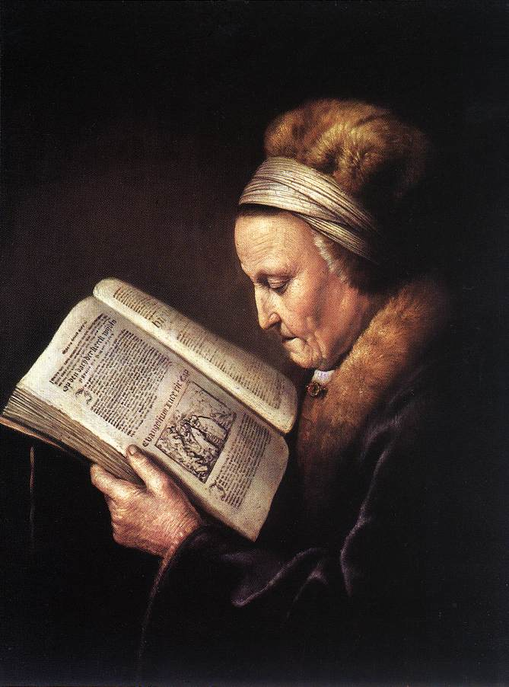
Inerrancy, Infallibility

Inerrancy is from “without error”
Infallibility is from “without failing”

Slide 13
Mistakes?
Does the Bible contain mistakes?
There are bits of information in the Bible which don’t seem to make sense.
When we see inconsistencies, we need to ask ourselves:
- can we translate the original text properly?
- can we understand why it says what it says?
- is the Bible telling us truths, or telling us truthfully what a person said?

Slide 14
Errors?
When Jacob went to Egypt
70 people: Genesis 46:27 and Exodus 1:5.
75 people: Acts 7:14.
Did Jacob sit up on the bed or lean on his staff?
Genesis 48:2: on the bed
Hebrews 11:21: on top of his staff

Slide 15
Errors?
When Jacob went to Egypt
70 people: Genesis 46:27 and Exodus 1:5.
75 people: Acts 7:14.
Scholars suspect the ‘base document’ for the
Hebrew text dropped the word for “and five”.
Did Jacob sit up on the bed or lean on his staff?
Genesis 48:2: on the bed
Hebrews 11:21: on top of his staff

Slide 16
Errors?
When Jacob went to Egypt
70 people: Genesis 46:27 and Exodus 1:5.
75 people: Acts 7:14.
Scholars suspect the ‘base document’ for the
Hebrew text dropped the word for “and five”.
Did Jacob sit up on the bed or lean on his staff?
Genesis 48:2: on the bed
Hebrews 11:21: on top of his staff
In Hebrew, bed = MITTAH, staff = MATTEH.
And usually Hebrew does not have the vowels.

Slide 17
Errors?
At what time of the day was Jesus crucified?
Mark 15:25: at the third hour
John 19:14: well after the sixth hour
How many angels at the tomb?
1: Matthew 28:2,5; Mark 16:5
2: Luke 24:4; John 20:12

Slide 18
Errors?
At what time of the day was Jesus crucified?
Mark 15:25: at the third hour
John 19:14: well after the sixth hour
John uses Roman time (begin counting at midnight)
Mark uses Jewish time (begin counting at dawn)
How many angels at the tomb?
1: Matthew 28:2,5; Mark 16:5
2: Luke 24:4; John 20:12

Slide 19
Errors?
At what time of the day was Jesus crucified?
Mark 15:33: at the third hour
John 19:14: after the sixth hour
John uses Roman time (begin counting at midnight)
Mark uses Jewish time (begin counting at dawn)
How many angels at the tomb?
1: Matthew 28:2,5; Mark 16:5
2: Luke 24:4; John 20:12
Two. Some of the women may have recollected just
seeing one, which Matthew and Mark report.

Slide 20
Inerrancy, Infallibility

Inerrancy is from “without error”
Infallibility is from “without failing”
In the strictest sense of the term, it would not be right to say that our current Bible is without errors. But the Bible does achieve what it sets out to achieve. As such, it is infallible.
Many people who use the word “inerrant” actually mean “infallible”.
The point is: you can trust the Bible, what it says is true.

Slide 21
Clarity

The Bible is clear in its general message.
True, not every part of the Bible is easily understood. It may take some hard study!
But when it comes to the message, it is very obvious what the Bible is telling us.
Write down in a few sentences what you think the Bible is clearly telling us.

Slide 22
The clear message of the Bible
The Bible tells us:
- God made all things good, also us people
- We disobeyed God, fell into sin and can be self-centred
- In OT history God teaches us we cannot save ourselves
- The Father sent His Son, Jesus Christ, to save us
- Jesus saves us by His death and resurrection
- The Father and the Son send the Holy Spirit to make us again what we are supposed to be
- God is reconquering the world for love
- God will bring about a new creation

Slide 23
Ancient Words

