Slide 1
Catechism Defending the Faith
Lesson 14
Providence

Slide 2
Psalm 145:2
Men will, O Lord, your wondrous works relate,
and I will on your splendour meditate.
They of your glorious deeds will speak at length,
while I declare your awesome acts of strength.
They will acclaim your goodness with rejoicing,
sing of your justice, joyful praises voicing.
Great is your love and boundless your compassion;
slow is your wrath in dealing with transgression.

Slide 3
Gaining or Losing Information
Notes:
6:20

Slide 4
Faith in science?
Science observes present realities
Science uses logic to theorize about the future and the past
The movement is from ‘hypothesis’ to ‘theory’
A ‘hypothesis’ is a possible explanation
A ‘theory’ is an explanation that has been tested thoroughly and withstood tests
Science thus assumes continuity
But can science reach beyond a divine creative moment?
e.g. Can science tell us what the world looked like before the flood?
.e.g Can science tell us what our bodies will look like in the new creation (cf. 1Cor 15:35-53)

Slide 5
Science and Revelation
Science is a human activity
We are creatures, limited in our abilities
We are sinful, skewed in our intentions and thoughts
Revelation is a divine activity
God is creator, all-knowing
God is perfect, all-good
Believing is a human activity
We need the Spirit to understand God’s revelation
We do well to be humble

Slide 6
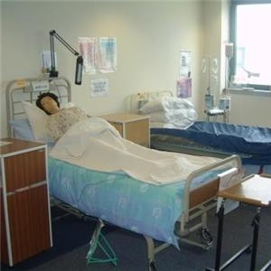
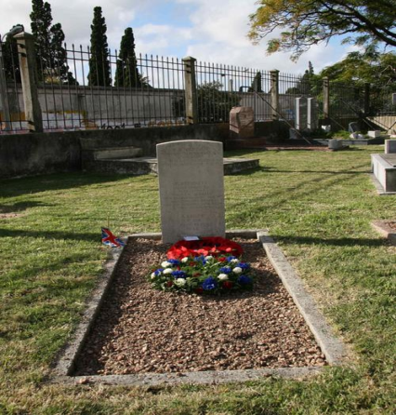
Providence
By “providence” we mean the reality that God provides all things.
As Almighty God He is in control.
As Faithful Father He is lovingly involved.
And we know that for those who love God all things work together for good, for those who are called according to his purpose.
Romans 8:28

Slide 7
Providence
We read together Psalm 88
And then discuss the questions

Slide 8
God and Adversity (evil)
In Him I trust so completely
as to have no doubt
that he will provide me
with all things necessary for body and soul,
and will also turn to my good
whatever adversity He sends me
in this life of sorrow.

Slide 9
God and Adversity (evil)
and so governs them that
leaf and blade,
rain and drought,
fruitful and barren years,
food and drink,
health and sickness,
riches and poverty,
indeed, all things,
come to us not by chance
but by His fatherly hand.

Slide 10
God and Adversity (evil)
And we know that for those who love God all things work together for good, for those who are called according to his purpose.
Romans 8:28
The LORD gave and the LORD has taken away
Job 1:21
I form light and create darkness,
I make well-being and create calamity
I am the LORD, who does all these things. Isaiah 45:7
Does disaster come to a city unless the LORD has done it?
Amos 3:6

Slide 11
A grave – Reyanna Francina Janssen
Died and born, May 10, 2014.

Slide 12
God and Adversity (evil)
All things (Rom 8:28) come from God’s fatherly hand
From God’s hand:
- God knows and plans everything, He is never caught by surprise
- God is Almighty, He can deal with everything
From Father’s hand:
- God loves me as His creature and His saved child
- all things ultimately work for my good (Rom 8:28)
Hence, I don’t have to be afraid – not ever!
When I am afraid, I will trust in You.
Psalm 56:3

Slide 13
Appreciating God’s Providence
Patient in adversity
- it’s very easy to distrust God when things are not ok.
- do not neglect to ask God for help
Thankful in prosperity
- it’s very easy to not need God when things are ok
- do not neglect to give God thanks
Why would the Catechism first mention adversity and then prosperity?

Slide 14
Asking “why?”
People who struggle with issues in their lives will have the urge to ask the ‘why’ question.
Job had that.
Job 3: Why was I born to see this misery?
Job 10: Why is God doing all this to me?
It is often thought that people are not allowed to ask the why question. After all, God is sovereign, He decides, His will be done (even if I don’t like it).

Slide 15
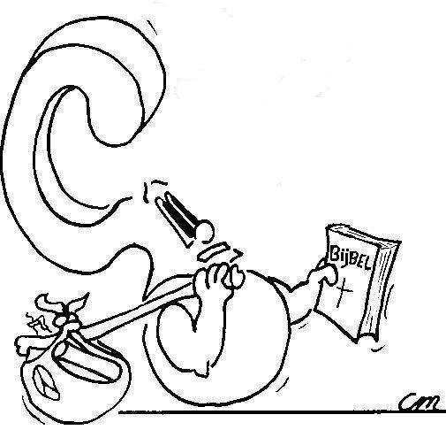
Asking “why?”
What do you think: are people allowed to ask the why question in prayer?
If yes, how should God respond?
If not, why not?

Slide 16
We won’t understand until…

Slide 17
The why question
People feel the urge to ask the why question.
Even Jesus did: “Why have You forsaken Me?”
Some will say: we can ask the why question in the sense of “whereto”, not in the sense of “wherefore”.
Others will note: asking the why question is articulating your feelings, a way of processing emotions. Asking the question does not obligate God to responding.

Slide 18
The why question
Both responses have merit to them.
God does at times have bad things happen to us in order to tell us something. There’s the “whereto”.
God has no issues with Job asking what he did.
Job 42:7 Job had spoken rightly of God
But God did have issues with Job expecting a response.
Job 40:2: Job is not to contend with God
Job 42:6: Job repents of accusing God

Slide 19
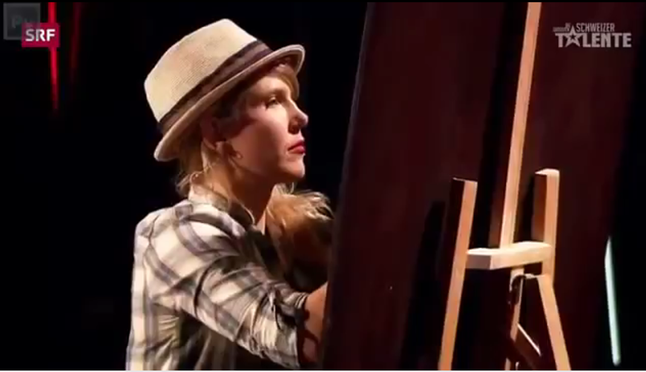
One day we’ll see why

