Slide 1
Catechism The Substance of Faith
Lesson 16 – LD 9&10
God Almighty: our Creator & our Father

Slide 2
Psalm 104:1
O bless the LORD, my soul, and praise his name.
O LORD, how great you are, how bright your fame!
You who are clothed in majesty and splendour,
enrobed in light, to you my praise I render.
The heavens you have stretched out like a tent,
your palace founded on the firmament.
Clouds are your chariots, storms lend you their pinions;
winds are your heralds, fire and flame your minions.

Slide 3
Where does it all come from?
Today, most people hold to one of two theories.
There was nothing, it exploded, and this universe began to evolve.
There was nothing, God spoke, and this universe came to be
The Big Bang Theory
The Creation Theory

Slide 4
Creation
The very first verse of the Bible tells us:
The heavens and the earth: that’s quite a lot.
And God did it in just six days!
In the beginning, God created the heavens and the earth.
Genesis 1:1
For in six days the Lord made heaven and earth, the sea, and all that is in them,
Exodus 20:11

Slide 5
The universe
The universe is huge!
If the earth were a pinhead, the sun would be a baseball. And there are stars so big, they would then be the size of the grounds of the Langley Events centre.
Earth to sun: 3500 years walking
Earth to next star: 1,750,000,000 years walking!
And there are billions of galaxies with billions of stars.
Now think, God made all of that!!!

Slide 6
Creator
God is Creator: He made all things.

Slide 7
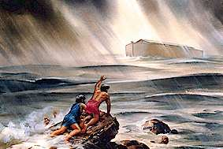
Bible Study: Genesis 6-9

Slide 8
Bible Study: Genesis 6-9
1. It grieved Him to His heart.
2. 40 days and nights of rain, to blot out every living creature He had made from the face of the earth.
3. Noah and his family (8 people), seven (pairs) of all clean animals, two of all unclean animals.
4. A covenant.
5. That He would never destroy life from the face of the earth like this again.
6. The rainbow
7. Verse 12: all future generations Verse 16: everlasting covenant

Slide 9
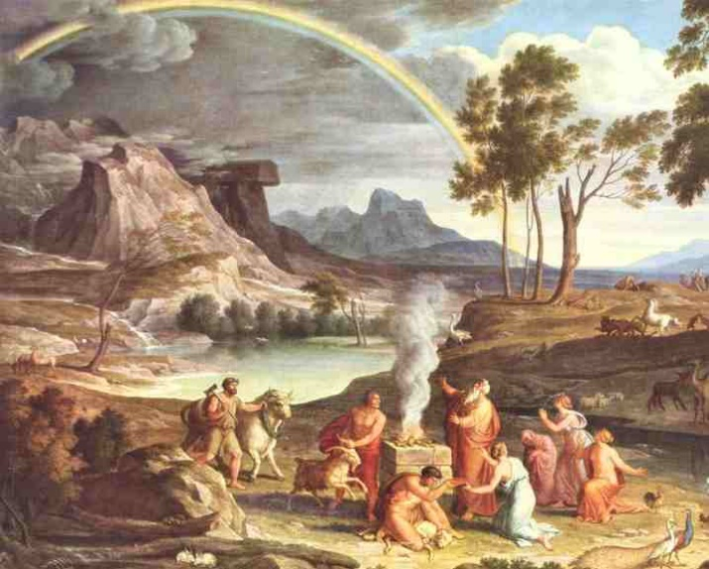
The Flood

God could have destroyed this world
He chose not to.
Instead, He washed creation clean and made a new start.
And God made a covenant with Creation:
He promised to sustain Creation forever.

Slide 10
Providence

For living beings, God’s sustaining includes that He provides for their food.
We speak of God’s providence.
Providence has the word “provide” in it.
God looks into the future to see our needs, and then ensures that those needs are provided for.
Pro vide
Forwards
Seeing

Slide 11
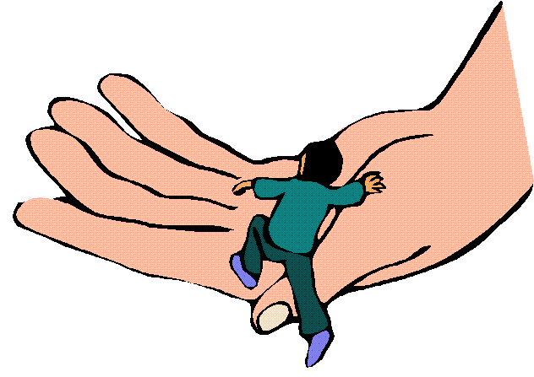
Sustainer & Provider
God is Creator: He made all things.
God is Sustainer & Provider:
He provides for all things to continue.

Slide 12
Government

God is in complete control of all things that happen.
Nothing happens by chance.
God’s rule is detailed: He knows the number of hairs on your head!
God’s rule is comprehensive: it covers everything.
Are not two sparrows sold for a penny? And not one of them will fall to the ground apart from your Father. But even the hairs of your head are all numbered. Matthew 10:29-30
I am the Lord, and there is no other. I form light and create darkness; I make well-being and create calamity; I am the Lord, who does all these things. Isaiah 45:6b-7
Notes:
Discussion question: How does God relate to evil?

Slide 13
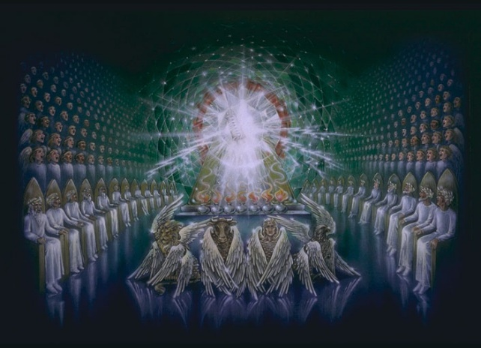
Our God

God is Creator: He made all things.
God is Sustainer & Provider:
He provides for all things to continue.
God is Governor:
He controls all things that happen.

Slide 14
This Almighty God is our Father!!!
God is Creator: He made all things.
God is Sustainer & Provider:
He provides for all things to continue.
God is Governor:
He controls all things that happen.

Slide 15
Footprints (3:25)

Slide 16
For the sake of Christ

God is a Father to all.
But God’s Fatherhood will only be for the good of those who respond to it with love and loyalty.
Those who don’t, experience His Fatherly anger.
No one is loving and loyal of themselves. Only because of Christ does this become possible.
It is through Christ alone that God can and will be our Father, caring for us forever.
The Almighty Creator, Sustainer, Provider, and Governor of all things is, for Christ’s sake, my God and my Father.

