Slide 1
Catechism The Contents of Faith
Lesson 17 – LD 11
Call Him Jesus

Slide 2
Hymn 20:1,4
A great and mighty wonder
upon the earth was done
when Mary, virgin mother,
gave birth to God’s own Son.
Repeat the song again:
“To God on high the glory,
and peace on earth to men!”

Slide 3
Hymn 20:1,4
Since he came us to ransom,
let him now be adored,
the King once born in Bethl’hem,
our Saviour and our Lord.
Repeat the song again:
“To God on high the glory,
and peace on earth to men!”

Slide 4
Names

What’s in a name?
In the Bible: there’s lots to a name.
Let’s check out the meanings of some names.
Adam means
Eve means
Abraham means
Nabal means
Shear-Jashub means
Melchizedek means
Man (human)
mother of all living
father of many
fool
a remnant shall return
king of righteousness

Slide 5
Giving your child a name

Sometimes parents gave their children a name as a sign of a state of affairs or a promise from God.
Noah means
Ishmael means
Isaac means
Esau means
Jacob means
Samuel means
Ichabod means
Lo-Ruhama means
Relief, rest, comfort
God hears (will hear)
He laughs
hairy
heel-grabber, cheat
God has heard
The glory has gone
No mercy

Slide 6
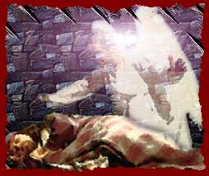
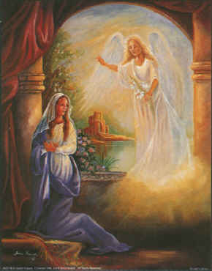
Bible Study: Matt 1 and Luke 1,2

Slide 7
Bible Study: Matt 1 and Luke 1,2
1. Joseph
2. Jesus
3. He will save His people from their sins
4. Joseph

Slide 8
Bible Study: Matt 1 and Luke 1,2
5. Mary
6. Gabriel
Hero of God
7. Jesus
8. On the eighth day
9. It does not say who did it, just that it was done as the angel had instructed.

Slide 9
Greek and Hebrew

The Old Testament is written (mainly) in Hebrew.
The New Testament is written in Greek.
Hebrew and Greek names don’t always quite match.
Just like Dutch and English ones: Klaas becomes Clarence or Claude, Jantje becomes Jean, Geeske becomes Grace, and Wim becomes Bill.
Or Chinese and English ones, or Arabic and English ones, or Korean and English ones, or…
Jesus is a Greek name. It was commonly used for boys with the Hebrew name Joshua (Yeshuah).

Slide 10
Etymology

Interestingly, both the names Jesus and Joshua come from the Greek and Hebrew words for “to save”.
Greek: “to save” is soozein
Hebrew: “to save” is yasha.
Yeshuah literally means “Yah(weh) will save”
“Kind of”, for, in Greek, the name does not have “Yah” in it.
Jesus = Joshua (kind of)

Slide 11
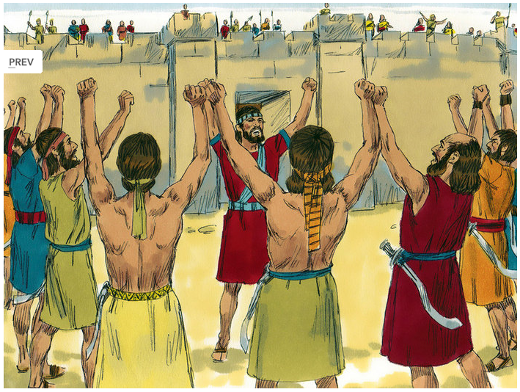
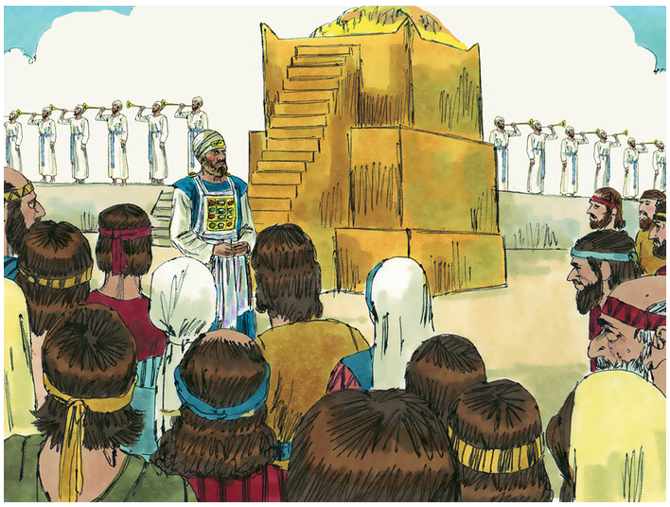
Who was Joshua?
Joshua was the man who succeeded the Great Prophet Moses.
Joshua delivered Israel from her enemies and got her settled in the Promised Land.
Another Joshua was the high priest following the Exile.

Slide 12
Jesus’ task
What had the angel said about what Jesus would do?
What impression would this have given the Jews?
He will be great and will be called the Son of the Most High. And the Lord God will give to him the throne of his father David, and he will reign over the house of Jacob forever, and of his kingdom there will be no end.”
Luke 1:32-33

Slide 13
Jesus’ task

Joshua had been the man by whom God had brought Israel into Canaan.
David had been the man by whom God had given Israel the complete promised land.
Jesus had the same name as Joshua and was heir to the throne of David.
Many Jews figured Jesus would be the one to deliver them from the Romans.

Slide 14
Jesus’ task

But the angel had also said:
Jesus would save people from sin and the devil.
And He would do it Himself. (Mind you, Jesus is Yahweh)
She will bear a son, and you shall call his name Jesus, for he will save his people from their sins.”
Matthew 1:21

Slide 15
Heidelberg Catechism
29. Q. Why is the Son of God called Jesus, that is, Saviour?
A. Because He saves us from all our sins,
and because salvation is not to be sought or found
in anyone else.

Slide 16
Don’t tell them...

Jesus often forbade people who realized that He was the Messiah from God to tell this.
Why did He do that?
Jesus did not want people to see Him as the wrong type of Messiah. He had not come to deliver the Jews from the Romans, but to deliver humanity from sin and Satan!
Notes:
Discuss if time permits

