Slide 1
Catechism Essentials of Faith
Lesson 6
The Trinity

Slide 2
Hymn 6:2
Praise God the Father, great in majesty;
praise God the Son, who came to save his own;
praise God the Spirit, sent from heaven’s throne,
that he our guide and comforter might be.
Praise Father, Son, and Spirit, Three in One.

Slide 3
Equal and not equal
We distinguish between the ontological and economical sides to the Trinity.
Ontological (the way something is)
Father, Son and Spirit are equal in essence. All three are to be worshipped and adored.
Economical (the way it works)
The Father as the ‘planner’ directs
The Son as the ‘contractor’ facilitates
The Spirit as the ‘builder’ executes
Ontologically equal, economically subordinate.

Slide 4
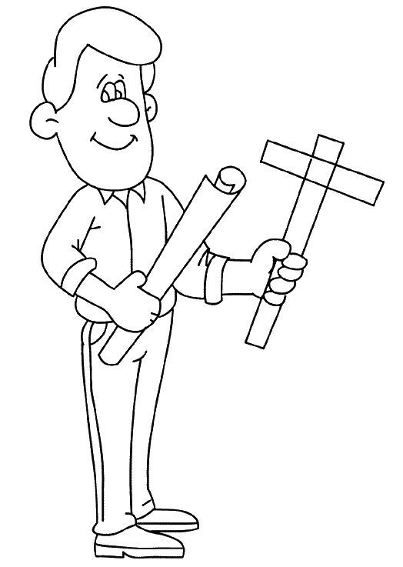
Equal and not equal
We distinguish between the ontological and economical sides to the Trinity.
Economical (the way something works)
The Father as the ‘planner’ directs
The Son as the ‘contractor’ facilitates
The Spirit as the ‘tradesman’ executes
Ontologically equal, economically subordinate.

Slide 5
Equal and not equal
Notes:
5:40

Slide 6
Heresies
Unitarianism: there is only one God and one Person
Jews, Jehovah’s Witnesses & Mormons are Unitarians
Modalism: The three Persons are three phases in the one God
Just like a person is a child, then middle aged, and then a senior.
Subordinationism: The three Persons are ontologically subordinated to each other.
Originally Anabaptists (=Mennonites) believed this.

Slide 7
Heresies
Unitarianism: there is only one God and one Person
Modalism: The three Persons are three phases in God
Subordinationism: The three Persons are ontologically subordinated to each other.
The Reformed position is referred to as relational subordinationism. This is the same as saying the Trinity is ontologically equal but economically subordinated.
This is different from the Roman Catholic view of the Trinity, which denies all subordination!

Slide 8
Scripture proofs
The following passages refer to the Father, Son, and Spirit as distinct individuals.
Matthew 3:16-17: following the baptism of Jesus
Matthew 28:19b: the baptism formula
2 Corinthians 13:14: the blessing formula

Slide 9
Scripture proofs
The following passages refer to the Father, Son, and Spirit as distinct individuals.
Matthew 3:16-17: following the baptism of Jesus
Matthew 28:19b: the baptism formula
2 Corinthians 13:14: the blessing formula
And when Jesus was baptized, immediately he went up from the water, and behold, the heavens were opened to him, and he saw the Spirit of God descending like a dove and coming to rest on him; and behold, a voice from heaven said, “This is my beloved Son, with whom I am well pleased.”

Slide 10
Scripture proofs
The following passages refer to the Father, Son, and Spirit as distinct individuals.
Matthew 3:16-17: following the baptism of Jesus
Matthew 28:19b: the baptism formula
2 Corinthians 13:14: the blessing formula
baptizing them in the name of the Father and of the Son and of the Holy Spirit,

Slide 11
Scripture proofs
The following passages refer to the Father, Son, and Spirit as distinct individuals.
Matthew 3:16-17: following the baptism of Jesus
Matthew 28:19b: the baptism formula
2 Corinthians 13:14: the blessing formula
The grace of the Lord Jesus Christ and the love of God and the fellowship of the Holy Spirit be with you all.

Slide 12
Scripture Proofs
The following passages indicate there is but one essence that is God.
1 Corinthians 8:4: No God but one
1 Timothy 2:5: There is one God

Slide 13
Scripture Proofs
The following passages indicate there is but one essence that is God.
1 Corinthians 8:4: No God but one
1 Timothy 2:5: There is one God
Therefore, as to the eating of food offered to idols, we know that “an idol has no real existence,” and that “there is no God but one.”

Slide 14
Scripture Proofs
The following passages indicate there is but one essence that is God.
1 Corinthians 8:4: No God but one
1 Timothy 2:5: There is one God
For there is one God, and there is one mediator between God and men, the man Christ Jesus,

Slide 15
Scripture Proofs
The following passages indicate each Person is God
The Father is God: Ephesians 1:2
God our Father
The Son is God: Titus 2:13
Our great God and Saviour, Jesus Christ
The Holy Spirit is God: 1 Corinthians 2:10-11
No one knows the thoughts of God except the Spirit of God.

Slide 16
Scripture Proofs
The following passages indicate economic subordination
The Son obeys the Father: John 5:30
“I seek not my own will but the will of him who sent me”
The Spirit obeys the Father and the Son: John 16:13,15
The Spirit of truth … will not speak on his own authority, but whatever he hears he will speak … All that the Father has is mine, therefore I said that he (the Spirit) will take what is mine and declare it to you.

Slide 17
Significance
God is Three in One: Father, Son and Holy Spirit. Love and loyalty within the Trinity is perfect.
Humans were created in God’s image.
Humanity is Two in One: male (husband) and female (wife).
Love and loyalty within marriage is to be perfect.
The Trinity is the perfect example of love and loyalty which we are to follow.

