Slide 1
Catechism The Workshop of Faith
Lesson 16
The Church: Her Attributes

Slide 2
Hymn 61:2
Watch o’er your church, O Lord, in mercy;
save it from evil, guard it still.
Perfect it in your love, unite it,
cleansed and conformed unto your will.
As grain, once scattered on the hillsides,
was in the broken bread made one,
so from all lands your church be gathered
into your kingdom by your Son.

Slide 3
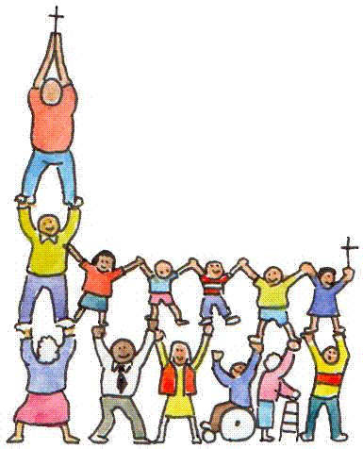
The Church is the people
When we say “church” we often think of the location where the building is.
But the “church” is not the building.
The church is the assembly or congregation of people belonging to God.

Slide 4
Etymology (where words come from)
belonging to the Lord
Church
kuriakos
Ecclesia
ek kaleo
to call out/from
to bring/come together
Congregation
con gregare

Slide 5
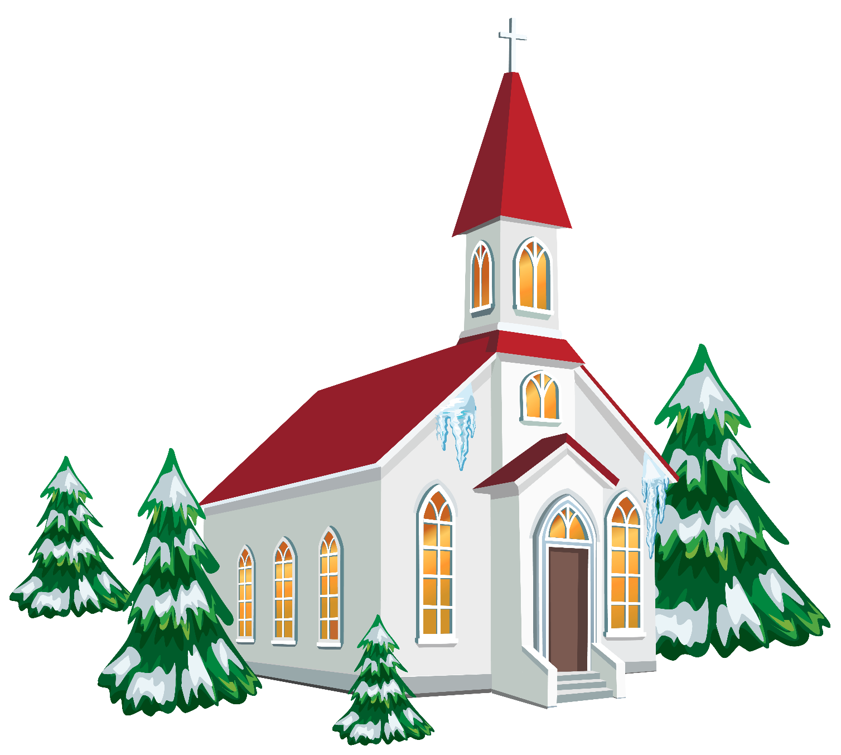
Bible Study: Ephesians 2:11-22

Slide 6
Bible Study: Ephesians 2:11-22
As God has one people, the church should be multi-ethnic.
Because ethnicities are often at war with each other. Thus, for example, the Israel and Gentiles
The prophets and apostles, with Jesus as cornerstone. Prophets: testified to Christ before He came Apostles: testified to Christ after He came
That the Church is God’s creation, built on the Bible and built to be a house for the Spirit who wrote the Bible (i.e. all the focus is on the Gospel)

Slide 7
Why I hate religion (4:03)

Slide 8
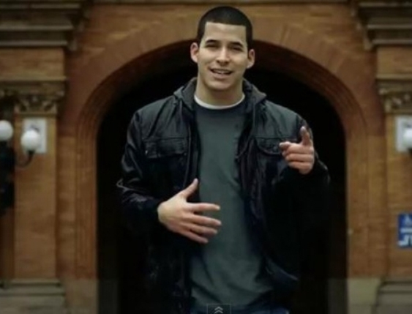
Apology
This is Jefferson Bethke, his artist name is Bball. Jefferson is originally from Seattle.
Jefferson got a lot of flack for this clip. He issued an apology on his blog about a month after uploading it. He acknowledged that his choice of words had been “poor”. He explained that the “religion” he was rebelling against was a man-made, legalistic system.
Jefferson makes many good points but his clip is typical for a young person: full of passion and insufficiently nuanced.
(And you are about to be such young people…)

Slide 9
Aspects to the Church
With respect to the Church we distinguish these aspects:
The attributes of the Church
These describe what the church is
The ministries of the Church
These describe what the church does
The marks of the Church
These describe whether the church measures up to the standard.

Slide 10
The 4 attributes of the Church
With the Nicene Creed we confess the Church to have these four attributes:
One - the unity of the church
Holy - the sanctity of the church
Catholic - the universality of the church
Apostolic - the apostolicity of the church
These attributes describe what the church is
- in principle (before God);
- in practice should strive to be (in this world).

Slide 11
Be what you are
A believer is free from the power of sin.
Hence a believer should live without sin.
But believers do still sin.
Hence: there is tension between what we are in Christ and what we are in reality.
The church is four things
Hence the church should be four things
But this world is a broken world.
Hence: there is tension between what the church is in Christ and what the church is in reality.

Slide 12
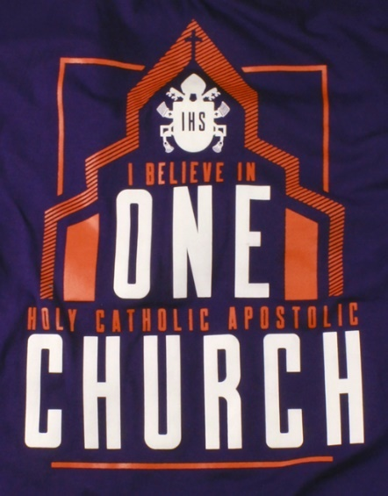
One Church
God has only one covenant with humanity.
Not two: Israel and Christianity
Not many: whatever faith you are
Not nationally: Dutch, Sudanese, Chinese, etc.
Not historically: CanRC, URC, FRC, OPC, PCA,…
The oneness of the church drives all attempts to seek unity with others.
And I have other sheep that are not of this fold. I must bring them also, and they will listen to my voice. So there will be one flock, one shepherd.
John 10:16

Slide 13
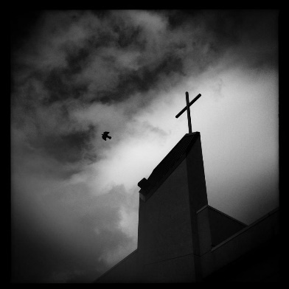
Holy Church
Holy means special, different.
The Church is holy because she is the only group of people that belong to the one true God and His Son.
This holiness will show itself in the Church being obedient and faithful to God in all she is & does.
The holiness of the church drives the attempt to be without sin.
But you are a chosen race, a royal priesthood, a holy nation, a people for his own possession, that you may proclaim the excellencies of him who called you out of darkness into his marvelous light. 10 Once you were not a people, but now you are God's people; once you had not received mercy, but now you have received mercy. 1 Peter 2:9-10

Slide 14
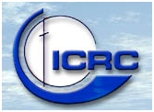
Catholic Church
The word “catholic” means “throughout the whole”; an English equivalent is “universal”.
The Church is not tied to a specific people, to the exclusion of others. The Church is for all people of all places and all ages and all levels of society.
The universality of the church drives the outreach of the church.
Truly I understand that God shows no partiality, 35 but in every nation anyone who fears him and does what is right is acceptable to him.
Acts 10:34b-35

Slide 15
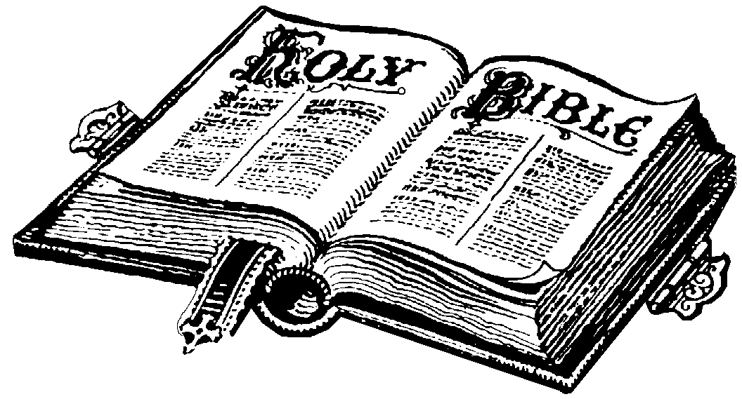
Apostolic Church
The Church is Apostolic or Christian because she is ruled by the Word of Christ alone. The Church is Bible believing.
The Church will seek to understand the Scriptures and uphold it’s teaching.
The apostolicity of the church drives the confessing of the Church, and her separation from false teaching.
…the household of God, which is the church of the living God, a pillar and buttress of the truth.
1 Timothy 3:15b

