Slide 1
Catechism The Workshop of Faith
Lesson 19
The Church: Government (1)

Slide 2
Psalm 115:5
O Israel, trust only in the Lord!
Praise him, your help and shield, with one accord;
his power will protect you.
O house of Aaron, put in God your trust;
all you who fear him, in the Lord find rest
when woes and cares afflict you.

Slide 3
Three Basic Forms of Government
Presbyterial-synodal (by elders in assemblies)
Policy of the church is determined by the leadership, who represent Christ. The people have the right to be heard in decisions taken.
Congregational (by believers)
Congregational meetings determine the policy of the church. The leadership functions as executives and managers.
Episcopal (by bishops)
Policy of the church is determined by an external body. The local leadership functions as executives and managers. The congregation is recipient (consumer).

Slide 4
Pros & Cons
Presbyterial-synodal (by elders in assemblies)
Balance of power among officers and rulers and ruled.
Least susceptible to apostasy.
Congregational (by believers)
Infighting and power struggles (independent churches)
In a practical sense leads to dictatorship
Susceptible to apostasy
Episcopal (by bishops)
The church does not do what the people want (Anglican)
One church domineers over others (Rome)
Susceptible to apostasy

Slide 5
Epsicopal, Presbyterial, Congregational Church Government
X
Bishops
Presbyters (priests)
Laity (people)
Elders + Church
Deacons member
X X X
Churchmembers
We are therefore Christ’s ambassadors, as though God were making His appeal through us...
2 Corinthians 5:20
To the elders among you, I appeal as a fellow elder,...
1 Peter 5:1

Slide 6
Local Church Government
Local church government can come in three forms:
- Congregationalism: rule by the people
- Presbyterialism: rule by elders
- Episcopalianism: rule from beyond
Most Reformed Churches practice presbyterial church government.
Some tend towards congregationalism, others to episcopalianism.
Canadian Reformed Churches are “middle of the road”.

Slide 7
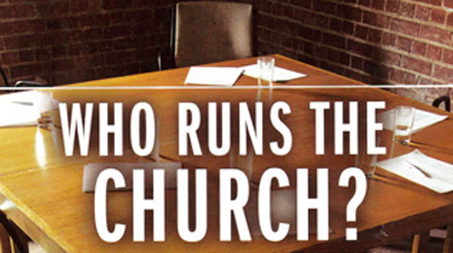
Belgic Confession 30-32
We read together BCoF articles 30-32.
And then we’ll discuss the questions

Slide 8
Discussion
Relationship between the congregation and eldership:
The eldership hears the congregation and then decides on the issue.
Issue of women voting
Women are not to have authority in the church (1 Timothy 2:12).
Hearing the congregation is not the same as granting the congregation authority
Who is the “congregation”?
Those assembled as representing households (families, pastoral units).

Slide 9
Government organized
The basic document for the government of our church is known as the Church Order.
The form of our Church Order goes back to the Reformed Churches in the Netherlands. It is commonly referred to as the Church Order of Dort, after the Synod of Dort 1618-19, which adopted it.
The Church Order can be found in the back of a Book of Praise. It can also be viewed at www.canrc.org & www.officebearers.com. As it can change every general synod (once every 3 years), the ones published at the end of the Acts of General Synod and on the web-sites will be the most up-to-date version.

Slide 10
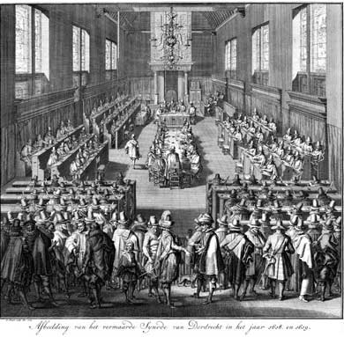
Introducing the Church Order
See Book of Praise, page 629
If you have questions about something relating to the CO email Rev. J. and it will be dealt with in a coming lesson.

