Slide 1
Catechism The Workshop of Faith
Lesson 19
The Church: Government (2)

Slide 2
Belgic Confession 30-32
We read together BCoF articles 30-32.
And then we’ll discuss the questions

Slide 3
Discussion
Relationship between the congregation and eldership:
The eldership hears the congregation and then decides on the issue.
Issue of women voting
Women are not to have authority in the church (1 Timothy 2:12).
Hearing the congregation is not the same as granting the congregation authority
Who is the “congregation”?
Those assembled as representing households (families, pastoral units).

Slide 4
Government organized
The basic document for the government of our church is known as the Church Order.
The form of our Church Order goes back to the Reformed Churches in the Netherlands. It is commonly referred to as the Church Order of Dort, after the Synod of Dort 1618-19, which adopted it.
The Church Order can be found in the back of a Book of Praise. It can also be viewed at www.canrc.org & www.officebearers.com. As it can change every general synod (once every 3 years), the ones published at the end of the Acts of General Synod and on the web-sites will be the most up-to-date version.

Slide 5
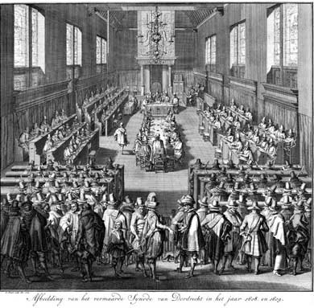
Introducing the Church Order
See Book of Praise, page 629
If you have questions about something relating to the CO email Rev. J. and it will be dealt with in a coming lesson.

Slide 6
The offices
On many issues of church government, the New Testament is vague.
Most concrete information is found in the Pastoral Epistles.
Hence, the way churches are run today can vary from place to place and culture to culture, without being unbiblical.
Discussion:
Why might the NT be vague on church government?

Slide 7
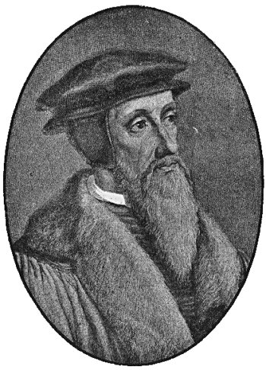
From Calvin to CanRC
Ministers
Teachers
Elders
Deacons
Visitors

Slide 8
From Calvin to CanRC
Ministers
Professor
Ministers
Teachers
Catechizer
Elders
Elders
Deacons
Deacons
Visitors
Meal Train

Slide 9
Tasks
The tasks which the three office bearers have in our churches are described in BC article 31, in the Church Order and in the forms for ordination:
Ministers:
- preach and teach + supervise faith matters
Elders:
- supervise faith matters
Deacons:
- facilitate material matters
- (just charity or also Committee of Administration?)

Slide 10
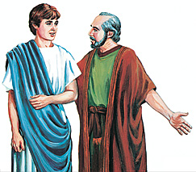
Bible Study: 1Timothy and Titus

Slide 11
Bible Study: 1Timothy and Titus
1. Pre-requisites for elders and deacons
2. If you can’t manage your own family, how can you be expected to manage God’s family?
3. Pre-requisites for elders
4. Because the churches in Crete were small and just being instituted, elders would have done the work of deacons.
5. (a) To encourage others by sound doctrine (b) To refute those who oppose sound doctrine
(Check out the Form for Subscription – back of BoP)

Slide 12
Officers and Meetings
In our system of church government we have
Consistory: Minister + Elders
Deaconry: Deacons
“Council”: Consistory with Deacons
A “congregational meeting” is actually a meeting of the council to which the congregation has been invited.
Note: all meetings are public meetings. However, many agenda items are dealt with in “closed” sessions.
Each body tends to meet once a month.

Slide 13
Calling
Internal call: a person must have the internal conviction that the Lord is calling them to office.
External call: a person must be lawfully called by the church to serve in office.
Tension can arise between the experience of the internal and external call.
You may feel you should serve, but you are never asked.
You are asked, but you don’t feel up to it.
Discussion

Slide 14
The election procedure By congregation by council
Recommendation
1
Presentation
2
Consultation
Appointment
Approbation
3
Ordination

Slide 15
For life or for a term?
The Reformed tend to have elders/deacons for a set term, with rest periods and re-elections.
Presbyterians tend to have elders/deacons for life, with passive and active periods.
The Reformed system decreases the risk of hierarchy.
The Presbyterian system ensures more continuity.
To become an office-bearer in a Presbyterian church tends to be a more rigorous process.

