Slide 1
Catechism The Workshop of Faith
Lesson 21
The Church: Government (3)

Slide 2
Psalm 111:1
O give the Lord wholehearted praise!
In thankful song my voice I raise
within the righteous congregation.
Great are the doings of the Lord,
and all to whom they joy afford
will study them with dedication.

Slide 3
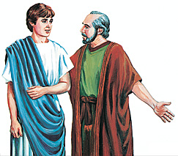
Bible Study: 1Timothy and Titus

Slide 4
Bible Study: 1Timothy and Titus
1. Pre-requisites for elders and deacons
2. If you can’t manage your own family, how can you be expected to manage God’s family?
3. Pre-requisites for elders
4. Because the churches in Crete were small and just being instituted, elders would have done the work of deacons.
5. (a) To encourage others by sound doctrine (b) To refute those who oppose sound doctrine
(Check out the Form for Subscription – back of BoP)

Slide 5
Officers and Meetings
In our system of church government we have
Consistory: Minister + Elders
Deaconry: Deacons
“Council”: Consistory with Deacons
A “congregational meeting” is actually a meeting of the council to which the congregation has been invited.
Note: all meetings are public meetings. However, many agenda items are dealt with in “closed” sessions.
Each body tends to meet once a month.

Slide 6
Calling
Internal call: a person must have the internal conviction that the Lord is calling them to office.
External call: a person must be lawfully called by the church to serve in office.
Tension can arise between the experience of the internal and external call.
You may feel you should serve, but you are never asked.
You are asked, but you don’t feel up to it.
Discussion

Slide 7
The election procedure By congregation by council
Recommendation
1
Presentation
2
Consultation
Appointment
Approbation
3
Ordination

Slide 8
For life or for a term?
The Reformed tend to have elders/deacons for a set term, with rest periods and re-elections.
Presbyterians tend to have elders/deacons for life, with passive and active periods.
The Reformed system decreases the risk of hierarchy.
The Presbyterian system ensures more continuity.
Becoming an office-bearer in a Presbyterian church tends to be a more rigorous process.

Slide 9
Calling
Internal call: a person must have the internal conviction that the Lord is calling them to office.
External call: a person must be lawfully called by the church to serve in office.
Tension can arise between the experience of the internal and external call.
You may feel you should serve, but you are never asked.
You are asked, but you don’t feel up to it.
Discussion

Slide 10
The election procedure By congregation by council
Recommendation
1
Presentation
2
Consultation
Appointment
Approbation
3
Ordination

Slide 11
For life or for a term?
The Reformed tend to have elders/deacons for a set term, with rest periods and re-elections.
Presbyterians tend to have elders/deacons for life, with passive and active periods.
The Reformed system decreases the risk of hierarchy.
The Presbyterian system ensures more continuity.
To become an office-bearer in a Presbyterian church tends to be a more rigorous process.

Slide 12
Church Structure
General Synod
Regional Synod
Classis
Classis
church
church
church
church
church
church
church
church
church
church
church
church
church
church
church
Classis
church
Regional Synod
church
Classis
church
church
church
church
church
church
church
church
church
church

Slide 13
Regional Church Structure
Every local church is a complete church
6-12 local churches meet in a classis
2-6 classes meet in a regional synod
All regional synods meet in a general synod
And federations of churches meet once every four years in a conference called the International Conference of Reformed Churches.

Slide 14
Willoughby Heights CanRC
The Willoughby Heights Canadian Reformed Church
- belongs to Classis Pacific-West
with: Cloverdale, Houston, Langley, Refuge, Smithers, & Surrey
- which belongs to Regional Synod West
with: Classis Pacific-East, Classis Alberta, and Classis Manitoba
- which belongs to the general synod of the Canadian Reformed Churches
with: Regional Synod East

Slide 15
New Westminster URC
The New Westminster United Reformed Church
- belongs to Classis Western Canada
with: Abbotsford, Surrey, Kelowna, Smithers, Telkwa, Grande Prairie, Neerlandia, Edmonton, Lacombe, Leduc, Ponoka, Calgary, Lethbridge, Regina, Winnipeg, Thunder Bay
- which belongs to the synod of the United Reformed Churches
with: classis Southwest Ontario, classis Ontario east, classis central US, classis Eastern US, classis Michigan, classis Pacific Northwest, classis Southwest US

Slide 16
Broader assemblies
A classis, regional synod, and general synod are not higher assemblies but broader assemblies.
At a classis, all churches are equal.
At a regional synod, all churches are equal.
At a general synod, all churches are equal.
At a CanRC broader assembly, the members speak and vote according to conscience, not instruction.
Thus the members of a broader assembly are not representatives of their churches or classes.
In many other churches it works a little differently.

Slide 17
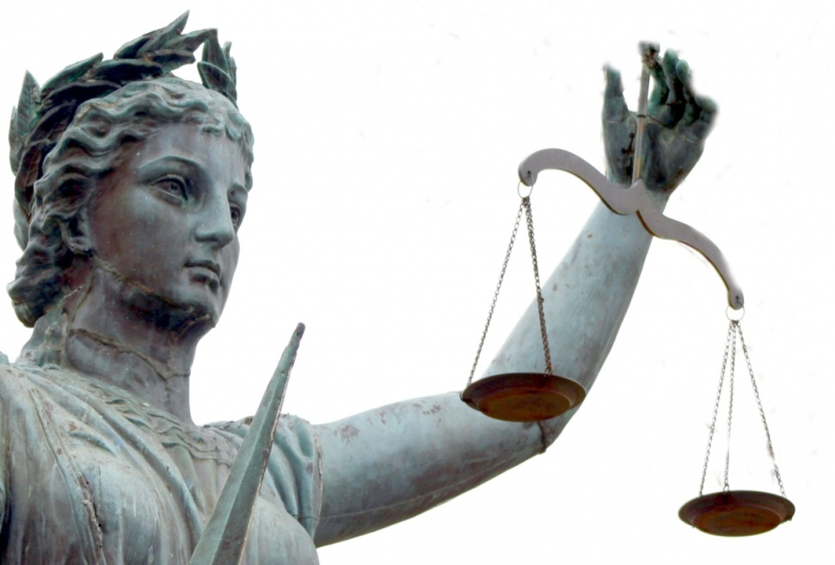
Acts 10 & 11; Acts 15
Accountability is the reason for church government.

Slide 18
Acts 10 & 11; Acts 15
The men from Cornelius and some of the brothers from Joppa.
The believers from among the circumcised who had come with Peter (Jews)
It is not absolute; Peter involves others in deciding the question.
The circumcision party in the Jerusalem church
That even an apostle is accountable to the church
These six brothers from Joppa
Silence. (Peter’s actions receive approval.)

Slide 19
Acts 10 & 11; Acts 15
The church in Antioch through its elders
The apostles and elders
Simeon Peter’s experience in Caesarea
The Bible (Amos 9:11-12)
Churches always need to communicate with each other and be accountable to each other
NO.

Slide 20
Broader Assemblies
The broader assemblies are
- conferences where churches assist each other
- bodies with jurisdiction in those areas in which churches give them jurisdiction by agreement
Note: these assemblies can legislate, judge, and execute as determined by the local churches.

Slide 21
Main Tasks
A classis:
- assists local churches and holds them accountable to each other
- serve as first court of appeal
- examines ministers-to-be
A regional synod:
- serves as second court of appeal
- assists classes in matters relating to ministers

Slide 22
Main Tasks
A general synod:
serves as final court of appeal
deals with issues pertaining to churches in common
- doctrine (e.g. women voting)
- worship (e.g. Book of Praise)
- government (e.g. Church Order)
deals with relationships with other groups of Churches & the government
deals with things best done together (e.g. Seminary)

