Slide 1
Catechism The Substance of Faith
Lesson 23 – LD 17
The Christ Lives!

Slide 2
Hymn 32:1 & 3
Christ the Lord is ris’n today, Alleluia!
All creation join to say, Alleluia!
Raise your joys and triumphs high, Alleluia!
Sing, you heav’ns, and earth, reply, Alleluia!
Christ’s redeeming work is done, Alleluia!
Fought the fight, the battle won, Alleluia!
Death in vain forbids him rise, Alleluia!
Christ has opened paradise, Alleluia!

Slide 3
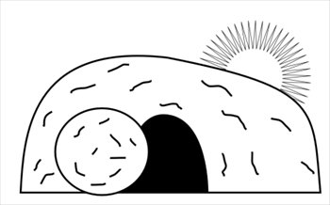
Humiliation - Exaltation
Divine glory
Incarnation
Suffering
Died
Resurrection

Slide 4
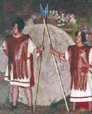
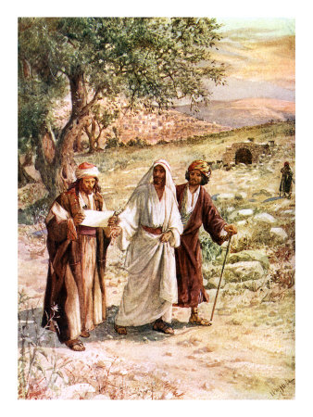
Unexpected?!
The Jews were aware that Jesus had claimed to come to life once he had died. That’s why they posted the Roman soldiers at the grave and had it sealed.
The followers of Jesus did not take the resurrection into account at all. They figured it was all over. They did not expect a resurrection.
For example, the two travelers to Emmaus should not have been confused but they were.

Slide 5
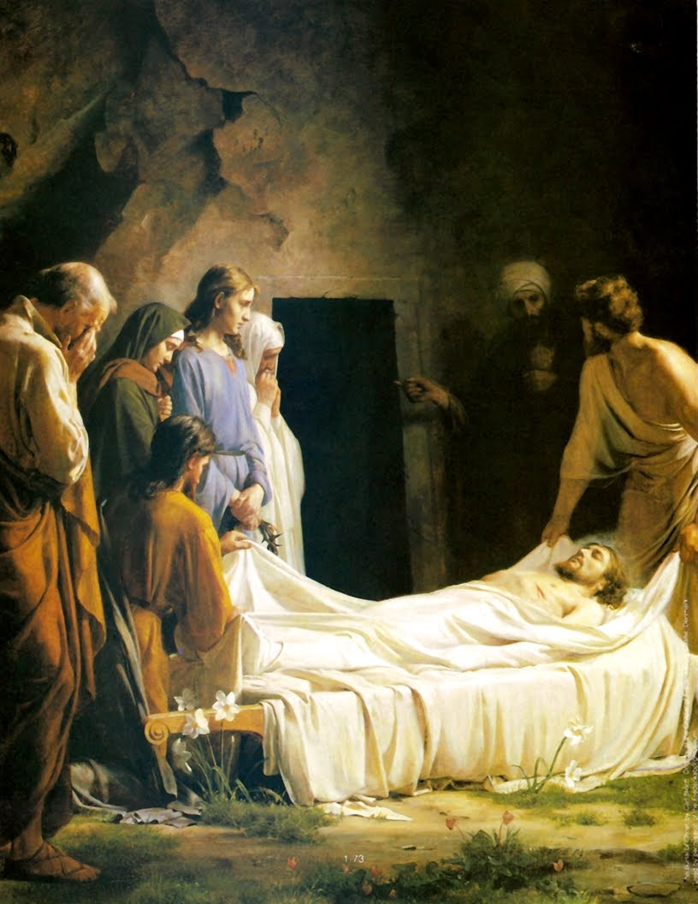
Should they have expected it?
Read Matthew 17:22-23
What does the reaction of the disciples tell you?
Read John 19:38-42
What did Joseph, Nicodemus, and the women expect?

Slide 6
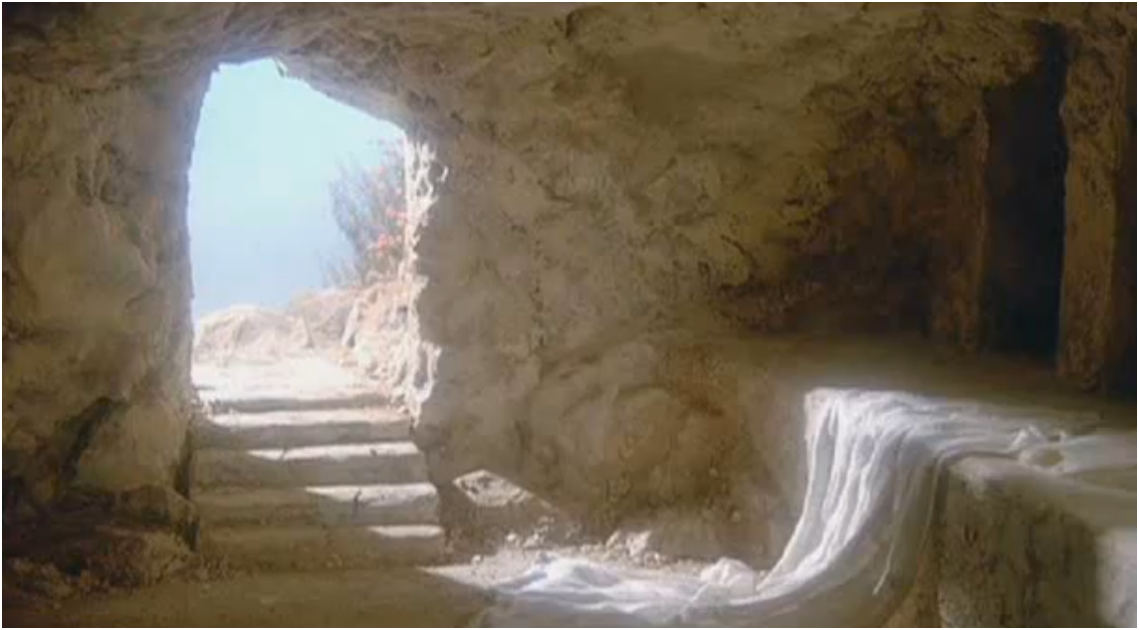
Bible Study: John 20:1-23

Slide 7
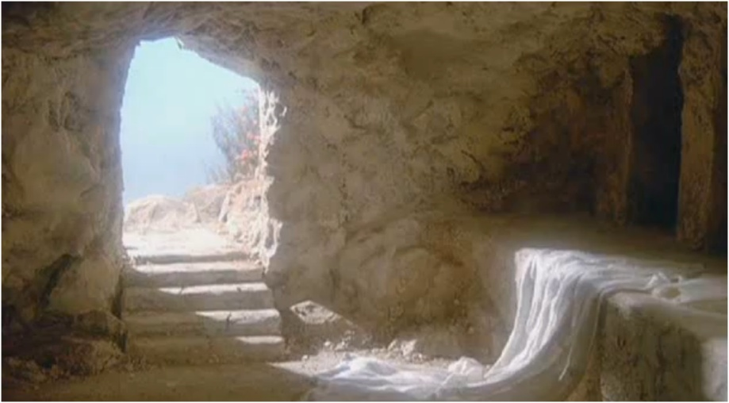
Bible Study: John 20:1-23
1. The stone had been removed from the tomb entrance.
2. Peter and John (= disciple whom Jesus loved)
3. Because other women had been with her at the tomb. (They’d gone to look for other disciples).
4. If the body has been stolen, the burial cloths would be gone too (and certainly not neatly folded up!)

Slide 8
Bible Study: John 20:1-23
5. That Jesus was alive.
6. She was crying and too distraught. Besides, she got distracted by another person.
7. Jesus.
8. The disciples (except Thomas)
9. His sides and His hands.

Slide 9
Many appearances
1 Corinthians 15:3-8 lists many of the appearances:
- Peter
- the Twelve
- 500 people at once
- James
- all the apostles
- Paul
Others may be added:
- the women
- Mary Magdalene
- Emmaus travellers
- with Thomas
- a # while fishing
Why so many?
Because the resurrection of Jesus would be hard to believe. Besides, many considered a bodily resurrection ridiculous (see Acts 17:32)

Slide 10
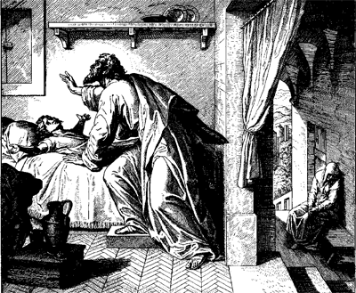
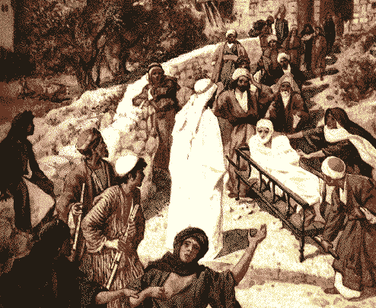
Not the first…
Jesus was not the first to resurrect from the dead.
In the Old Testament it happened to:
- the boy of Zarephath (Elijah)
- the son of Shunammite woman (Elisha)
- the man thrown in Elisha’s grave
In the New Testament it had already happened to:
- the widow’s son of Nain
- the daughter of Jairus
- Lazarus, the friend of Jesus

Slide 11
Not the first, yet different
There are at least three differences between other resurrections and that of Jesus on the third day.
1. 1Cor 15:42-44: Jesus was raised with an immortal body. While the others died again, He can not.
2. 1Cor 15:15: Jesus was raised by God, not by someone on behalf of God.
3. Mark 16:9: Jesus also rose by His own power.
Thus it is clear: Jesus Christ conquered death

Slide 12
Hence, for us…

In regard to death
There is no need to be afraid of it
In regard to hell
We won’t have to go there
In regard to God and sin
Christ can tell the Father to forgive us

Slide 13
Love Crucified Arose

Slide 14
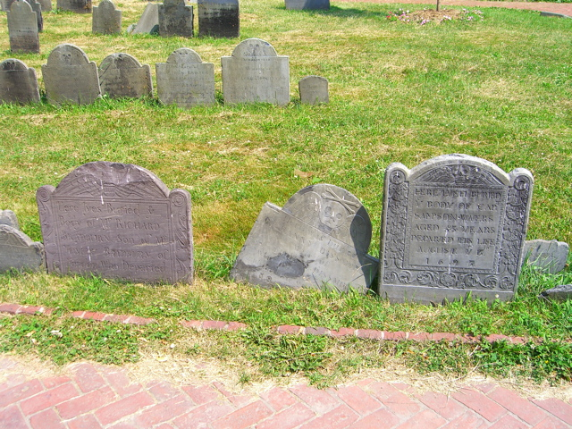
Catechism
42. Q. Since Christ has died for us, why do we still have to die?
A. Our death is not a payment for our sins,
but it puts an end to sin
and is an entrance into eternal life.

Slide 15
New life!
We were buried therefore with him by baptism into death, in order that, just as Christ was raised from the dead by the glory of the Father, we too might walk in newness of life. …
But now that you have been set free from sin and have become slaves of God, the fruit you get leads to sanctification and its end, eternal life.
Romans 6:4,22
The new life we are to live is a life free from the influence of sin.
And we have the promise of eternal life
- no more sin whatsoever!
- immortality, we’ll never die!

Slide 16
Catechism
45. Q. How does Christ’s resurrection benefit us?
A. First, by His resurrection He has overcome death, so that He could make us share in the righteousness which He had obtained for us by His death.
Second, by His power we too are raised up to a new life.
Third, Christ’s resurrection is to us a sure pledge of our glorious resurrection.
Justification
Sanctification
Glorification

Slide 17
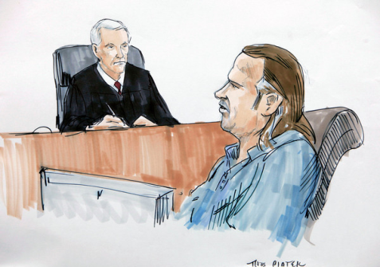
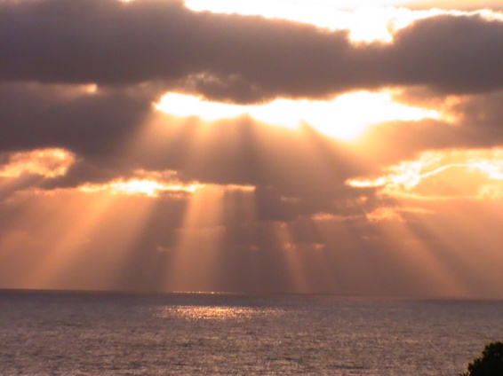
The benefits of the resurrection
1. Christ can make sure we are forgiven.
Justification.
2. Christ raises us to a life in which we conquer sin.
Sanctification.
3. We know for sure that one day we too will live forever
Glorification.

