Slide 1
Catechism The Substance of Faith
Lesson 24 – LD 18
Gone to Heaven

Slide 2
Hymn 40:1,2
The Lord ascended up on high,
the Lord has triumphed gloriously,
in pow’r and might excelling.
The grave and hell were captive led
when he went up, our glorious Head,
to his eternal dwelling.

Slide 3
Hymn 40:1,2
The heav’ns with joy received their Lord,
by saints, by angel hosts adored.
O day of exultation!
O earth, adore your glorious King!
Let us of his ascension sing
with joy and adoration.

Slide 4
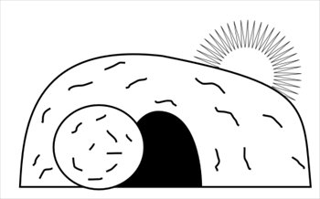
Humiliation - Exaltation
Divine glory
Incarnation
Ascension
Suffering
Died
Resurrection

Slide 5
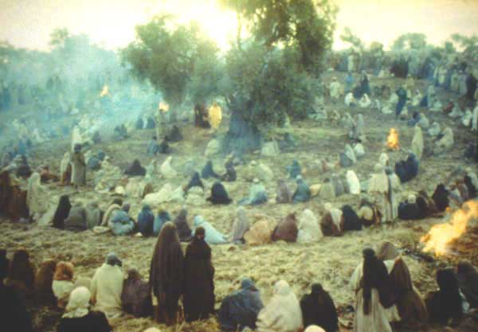
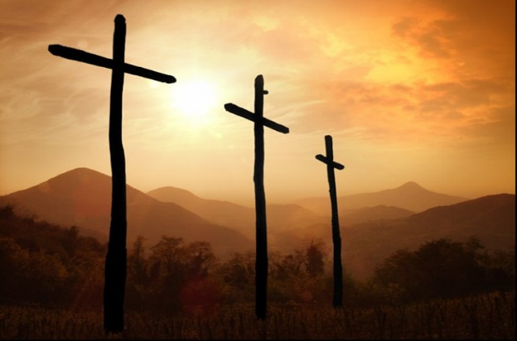
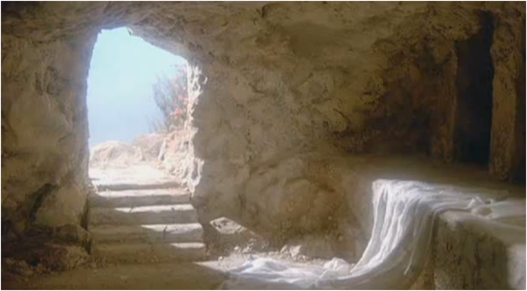
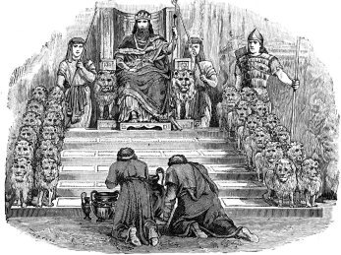
What would be next?
The experience of the disciples:
- The ministry in Israel
- Suffering and death
- Resurrection
What would follow next?
Read: Acts 1:6-8
Answer: questions

Slide 6
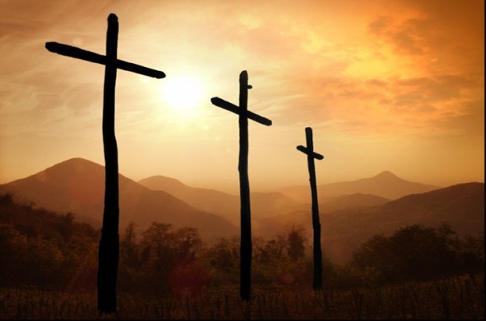
Witnesses

Acts 1:6-8
1. Whether the kingdom would be restored to Israel now.
2. That’s for God to know, not for people.
3. Through the power of the Holy Spirit.
4. His witnesses.

Slide 7
Christians are witnesses

Witness: a person who sees something happen and is able to describe it to other people.
In a legal setting: someone who testifies to the truth of happenings and situations
The Greek word for witness is marturos, from which our word martyr comes. A martyr is a witness who pays dearly for his testimony.

Slide 8
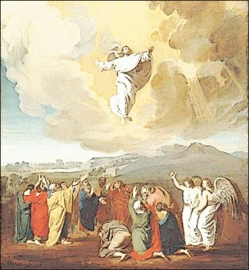
Bible Study: Ascension

Slide 9
Bible Study: Ascension
1. Blessing the disciples
2. Priest
3. Worship him (and only God is to be worshiped)
4. They were very joyful

Slide 10
Bible Study: Ascension
5. Yes
6. A cloud came and picked Him up.
7. The cloud is the glory of God, it is God’s vehicle, his mode of transport.
8. It showed that God approved of Jesus and would grant him glory.
9. He would return the same way they had seen him leave.
10. He would return on the cloud, the vehicle of God.

Slide 11
Left Alone?

Jesus said: And behold, I am with you always, to the end of the age.
Matthew 28:20b
Jesus is a human being. Humans cannot be in two places at once. If Jesus was in heaven, He cannot be on earth.
So, did Jesus not keep his promise? Yes, He did.
Jesus is also God. God can be in many places at once. As God, Jesus is always with us.

Slide 12
Catechism
47. Q. Is Christ, then, not with us until the end of the world, as He has promised us?
A. Christ is true man and true God.
With respect to His human nature
He is no longer on earth,
but with respect to
His divinity, majesty, grace, and Spirit
He is never absent from us.

Slide 13
Calvinists and Lutherans

Calvinists and Lutherans differ with each other on the ascension of Christ.
Lutherans believe that, when Jesus ascended into heaven, His human nature took on divine properties.
- omni-presence, so as to be present in the bread and wine
Problem: does this mean we will become divine too? Then how would God be unique?
Calvinists (like ourselves) believe that Christ’s human and divine natures remain totally distinct.

Slide 14
Catechism
48. Q. But are the two natures in Christ not separated from each other if His human nature is not present wherever His divinity is?
A. Not at all, for His divinity has no limits and is present everywhere.
So it must follow that His divinity is indeed beyond the human nature which He has taken on and nevertheless is within this human nature and remains personally united with it.

Slide 15
Back in heaven

HEAVEN
Son of God
Son of God and
Son of Man
Conceived by the Spirit
Born of the Virgin Mary
Ascension of Jesus Christ
EARTH
When Jesus returned to heaven, he was not only God, he was also a man of flesh and blood.
We have our flesh in heaven!
Right now Jesus in heaven is BOTH GOD AND HUMAN

Slide 16
Catechism
46. Q. What do you confess when you say, He ascended into heaven?
A. That Christ,
before the eyes of His disciples,
was taken up from the earth into heaven,
and that He is there for our benefit
until He comes again
to judge the living and the dead.

Slide 17
In heaven to work
Romans 8:34: He speaks to God the Father in our favour, pleading for us.
John 14:2&3: He is preparing a place for us to be in the future
John 16:7: He is sending the Holy Spirit to the church
Hebrews 1:3-4: He sits in heaven as ruler
Revelation 5:6-7, 6:1ff: He controls the unfolding of history

