Slide 1
Catechism The Substance of Faith
Lesson 25 – LD 19
He Comes to Judge

Slide 2
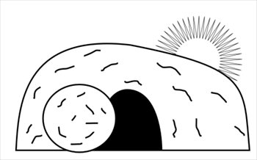
Humiliation - Exaltation
Divine glory
Divine
& Human glory
Return
Incarnation
Ascension
Suffering
Died
Resurrection

Slide 3
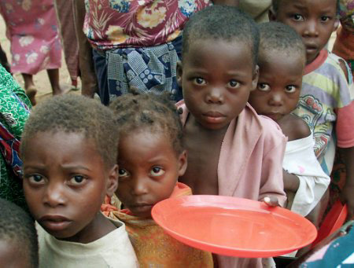
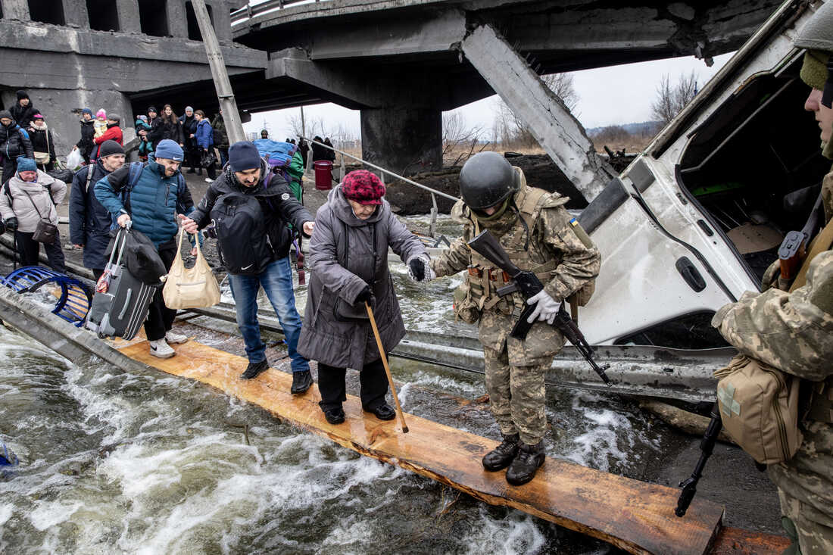
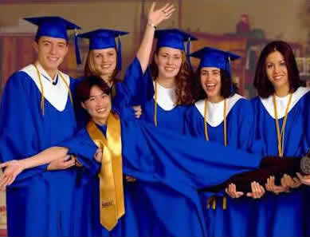
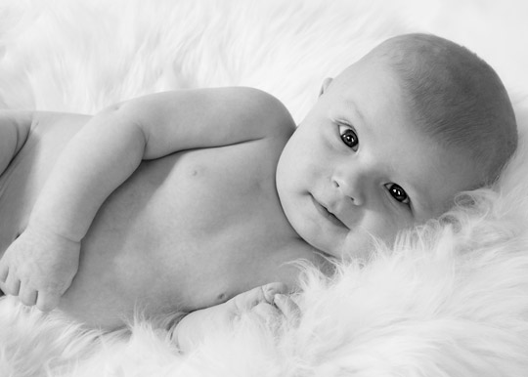
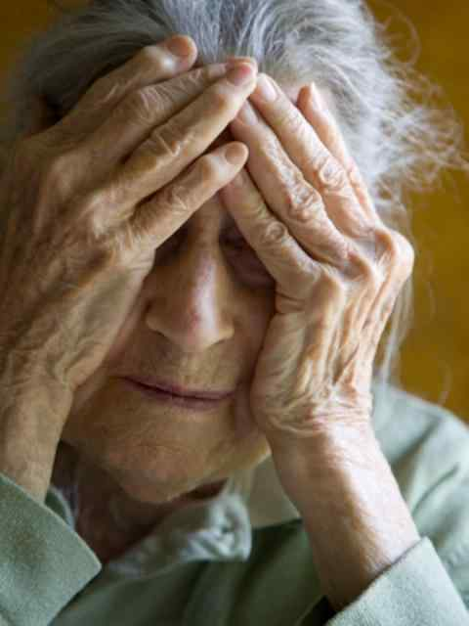
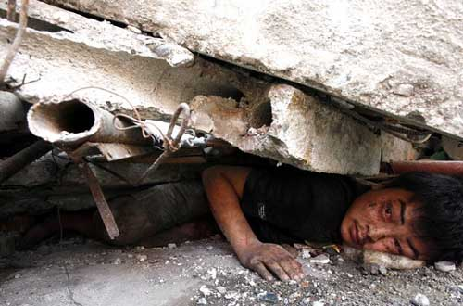
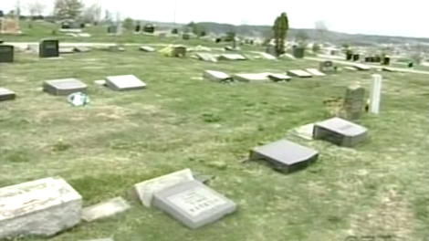
Coming?
Would you like the Lord Jesus to come back soon?

Slide 4
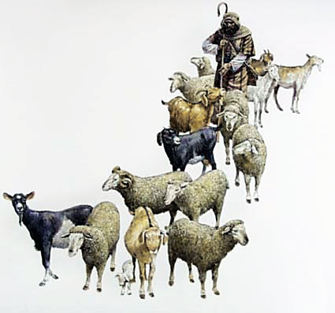
Bible Study: Matthew 25:31-46

Slide 5
Bible Study: Matthew 25:31-46
1. “glory / glorious throne” and “Before Him all the nations will be gathered”
2. Believers
3. Unbelievers
4. Sheep tend to be docile creatures that are obedient; goats tend to be head- strong creatures that do their own (usually destructive) thing.
5. The kingdom of God
6. Eternal life in a new creation

Slide 6
Bible Study: Matthew 25:31-46
7. Because they showed their love for Christ by showing love for fellow human beings
8. To hell
9. Because they lived self-centred lives and did not show love for others.

Slide 7
The basic question

When Christ judges us, He will look at how we have interacted with God and with fellow human beings.
We were made in God’s image.
This means, we are to show love and loyalty.
The basic question in our lives is: do we show love and loyalty to God and to fellow man?

Slide 8
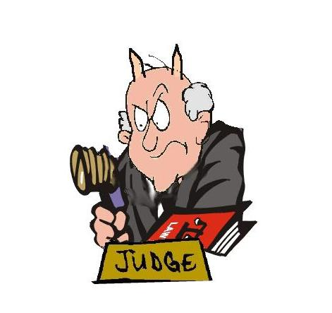
Being sure
You can’t always trust a judge, certainly not in the society of Jesus’ time.
So how can we be sure of Christ’s judgement?
1. Christ is our Lord: He loves us for He owns us
2. Christ Himself paid the penalty, He has permission from the Father to clear us of all guilt.

Slide 9
Catechism
52. Q. What comfort is it to you that Christ will come to judge the living and the dead?
A. In all my sorrow and persecution I lift up my head and eagerly await as judge from heaven the very same person who before has submitted himself to the judgment of God for my sake, and has removed all the curse from me.
He will cast all his and my enemies into everlasting condemnation, but he will take me and all his chosen ones to himself into heavenly joy and glory.

Slide 10
The final judgement
The Bible gives us a number of glimpses into how the final judgement will be.
Revelation 20:11-15
- the books: the ‘histories’ of individual persons
- Book of life: List of citizens
- Second death = eternally dying (absolute loneliness and pain)

Slide 11
The final judgement
Is your name in the Book of Life?
No
Yes
Are your deeds perfectly good?
Are your deeds perfectly good?
Justice
Yes
Grace
No
No
Yes
Eternal death
Eternal life

Slide 12
The final judgement
Is your name in the Book of Life?
No
Yes
Are your deeds perfectly good?
Are your deeds perfectly good?
Justice
Yes
Grace
No
No
Christ
Yes
Eternal death
Eternal life

Slide 13
The final judgement

Revelation 20 indicates the final outcome is based on our names being in the Book of Life.
Matthew 25 relates it to our activities in life.
If your name is in the Book of Life, you will be showing love and loyalty in this earthly life. (why?)
- our works are not perfect, hence, we cannot earn eternal life
- they are what we long for and strive after, and do through the power of the Spirit, hence they are an indication of our status before God

Slide 14
When?
No one knows the day or moment…
Let us then be ever watchful…
While we do not know the exact moment, we do know there will be signs preceding the coming.
Many Christians also believe the Bible tells us in what sequence things will happen.
These theories are versions of “millennialism” or “chiliasm”.

Slide 15
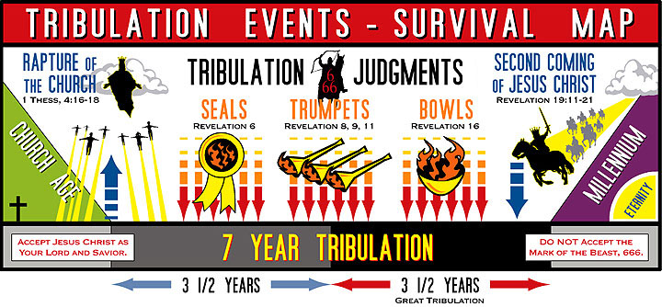
Example of a tribulation map

Slide 16
Millennialism
The problem with millennialism is that they confuse what is symbolical with what is literal. It treats the Bible like a jigsaw puzzle.
When reading the Bible it is important to discern the type of thing you are reading.
E.g. when we say a car cuts a corner, we don’t mean the car took out a knife and cut a corner out of the road. We understand this is figurative language.
We know God has no body, yet we speak of God’s hand, God’s arm, God seeing things, God hearing things.

Slide 17
Two views
The majority of Reformed people will hold to nunc-millennialism (often referred to as a-millennalism). They will argue most of Revelation is happening now.
A minority holds to a form of preterism. They will argue that Revelation applies mostly to the fall of Jerusalem in 70 AD.
Both believe the 1000 year reign runs from Pentecost to the Return of the Lord Jesus.
More on this in the senior catechism classes.

Slide 18
Coming?
Would you like the Lord Jesus to come back soon?

