Slide 1
The Fruit of Faith: LD 32-44
Conversion: do good!
Lesson 09 – LD 33

Slide 2
Psalm 15:1,3
Who, Lord, may live on Zion’s height,
within your tent, your holy dwelling?
He who does what is just and right,
whose walk is blameless in your sight,
all falsehood from his ways repelling.

Slide 3
Psalm 15:1,3
He who keeps oaths at any cost,
who seeks no int’rest for his lending,
nor takes a bribe to harm the just.
He’ll stand unshaken, richly blest
with grace and favour never-ending.

Slide 4
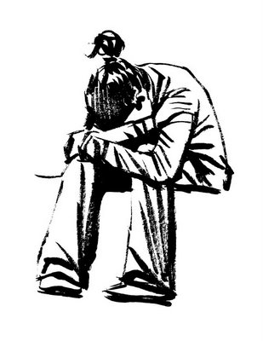
How are we to do it?
It’s hopeless, it’s totally hopeless. I can’t do any good…
Do the questions on the worksheet

Slide 5
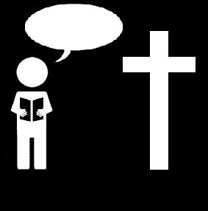
How are we to do it?
Q&a 86: Yes, we must do good works
Q&a 5: No, we cannot keep God’s law perfectly
Q&a 8: Totally unable to do any good and inclined to all evil
Q&a 8: When we are regenerated by the Spirit of God
No one understands, no one seeks for God.
All have turned aside, together they have become worthless;
no one does good, not even one.
Romans 3:11-12

Slide 6
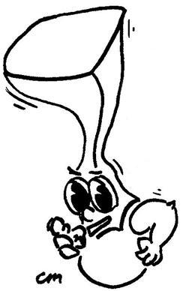
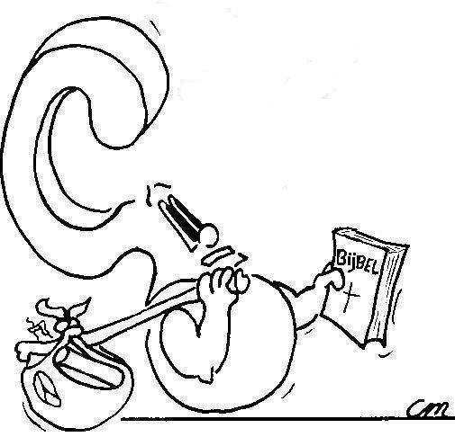
By becoming born again through the Holy Spirit. .. This shows when you avoid sin and do good.

How do I become capable of doing good?

Slide 7
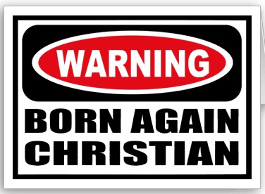
Terms

Born again (or born from above): to start a new life
Regeneration: becoming born again
Conversion: changing from one thing to another
Jesus answered him, “Truly, truly, I say to you, unless one is born again he cannot see the kingdom of God.”
John 3:3

Slide 8
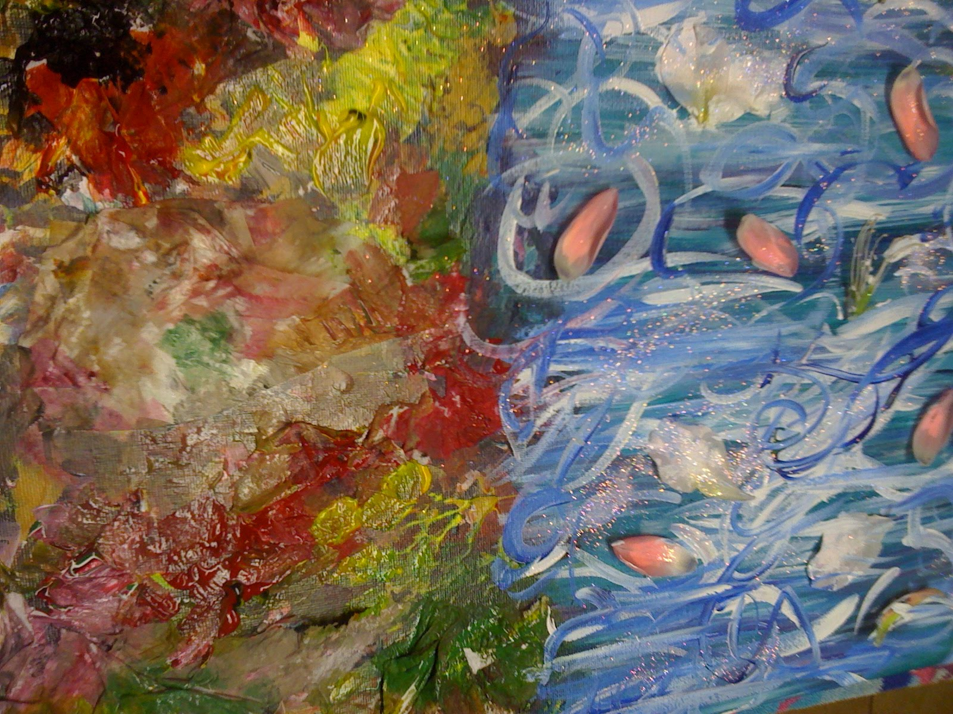
Bible Study: Colossians 3:1-14

Slide 9
Bible Study: Colossians 3:1-14
1. things above, where Christ is
2. sexual immorality, impurity, passion (=lust), evil desire, covetousness (=greed).
3. anger, wrath, malice, slander, obscene talk
4. our old self with its practices
5. the new self, which is being renewed
6. Compassionate hearts, kindness, humility, meekness, and patience
7. as the Lord has forgiven us
8. love
9. it binds everything together in perfect unity.

Slide 10
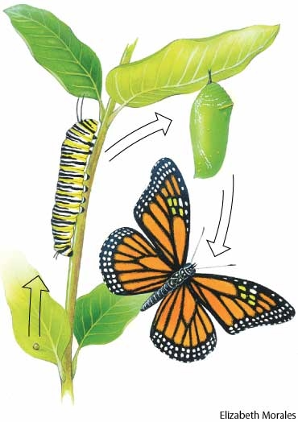
The transformation (1)
88. Q. What is the true repentance or conversion of man?
A. It is the dying of the old nature and the coming to life of the new.

Slide 11
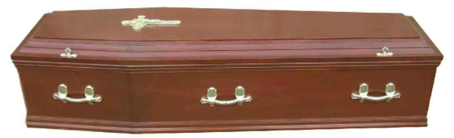
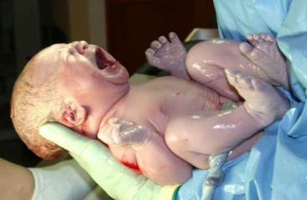
The transformation (2)
88. Q. What is the true repentance or conversion of man?
A. It is the dying of the old nature and the coming to life of the new.
89. Q. What is the dying of the old nature?
A. It is to grieve with heartfelt sorrow that we have offended God by our sin, and more and more to hate it and flee from it.
90. Q. What is the coming to life of the new nature?
A. It is a heartfelt joy in God through Christ,
and a love and delight to live according to the will of God in all good works.

Slide 12
The transformation (3)
88. Q. What is the true repentance or conversion of man?
A. It is the dying of the old nature and the coming to life of the new.
89. Q. What is the dying of the old nature?
A. It is to grieve with heartfelt sorrow that we have offended God by our sin, and more and more to hate it and flee from it.
90. Q. What is the coming to life of the new nature?
A. It is a heartfelt joy in God through Christ,
and a love and delight to live according to the will of God in all good works.
X
X

Slide 13
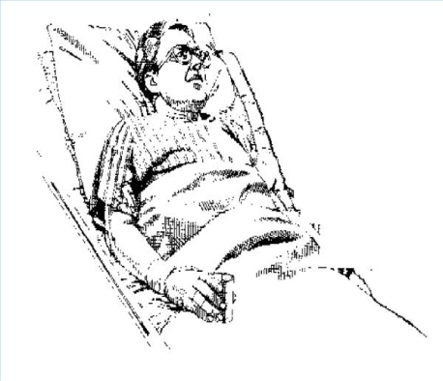
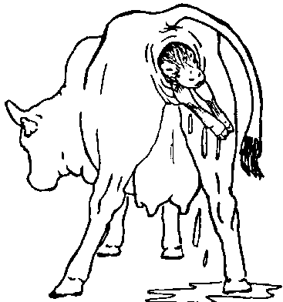
The transformation (4)
88. Q. What is the true repentance or conversion of man?
A. It is the dying of the old nature and the coming to life of the new.
89. Q. What is the dying of the old nature?
A. It is to grieve with heartfelt sorrow that we have offended God by our sin, and more and more to hate it and flee from it.
90. Q. What is the coming to life of the new nature?
A. It is a heartfelt joy in God through Christ,
and a love and delight to live according to the will of God in all good works.

Slide 14
The transformation (5)

By way of illustration
- we’re not the caterpillar
- we’re not the butterfly
- we’re the pupa in the chrysalis
us being converted; us now
our old nature; before we believed
our new nature; once Jesus has returned

Slide 15
The transformation (6)

Conversion is
- the dying of the old nature
- you’re fighting against sin
- but you haven’t won yet (old nature is not dead)
- the coming to life of the new nature
- you do your best to do good deeds
- but nothing you do is perfect (new nature is not born yet)

Slide 16
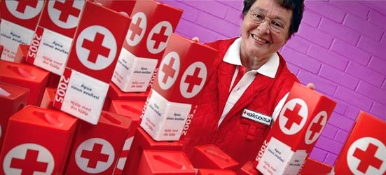
What is good?
A believer and an unbeliever both donate $100 to the Red Cross.
Are both doing a good work?

Slide 17
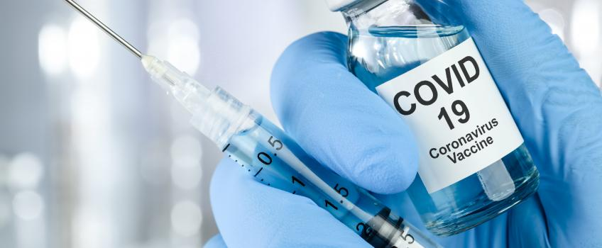
What is good?
Should you get vaccinated against certain illnesses?
Some think it’s important. To them, getting vaccinated is good.
Other’s think it’s not worth it, even exposing yourself to unknown problems. To them, not getting vaccinated is good.
Milk is good for you, as long as you don’t have lactose allergies.
“Good” is always a relative concept.

Slide 18
Good works…
91. Q. But what are good works?
A. Only those which are done
out of true faith,
in accordance with the law of God,
and to His glory,
and not those based on our own opinion or on precepts of men.

Slide 19
What is good?

91. Q. But what are good works?
A. Only those which are done
a. out of true faith,
b. in accordance with the law of God, and
c. to His glory,
and not those based on our own opinion or on precepts of men.
All three (a,b&c) conditions must be fulfilled before God considers a work ‘good’.

Slide 20
God tells us this in His law. And that’s what the next 11 catechism lessons will be about.
So what does God want us to do?

