Slide 1
The Fruit of Faith: LD 32-44
♥
Set Free to Serve
Lesson 10
LD 34a

Slide 2
Hymn 11:1,2,9
1.Hear how the Lord on Sinai’s mountain
addressed the people of his choice;
with them his cov’nant he established.
They in the thunder heard his voice.
2. “I am the Lord, your God and Saviour,
who out of slav’ry set you free,
who brought you from the land of Egypt.
Have, then, no other gods but me.

Slide 3
Hymn 11:1,2,9
9. O Lord, let your commandments teach us
our sins and misery to know,
that we, delivered from all evil,
to you our thankfulness may show.

Slide 4
IT’S THE LAW!
What emotions do you associate with the word “law”?
Many people think Christianity is restrictive: all those do’s and don’ts.
Do you feel that way about it?

Slide 5
IT’S THE LAW!

Slide 6
IT’S THE LAW!

How safe would you feel if there were no traffic laws?
What is usually the problem with our dislike for laws?
We don’t understand why the laws exist (e.g., certain taxes). Or we feel that the laws are too extreme (e.g., speed limits).

Slide 7
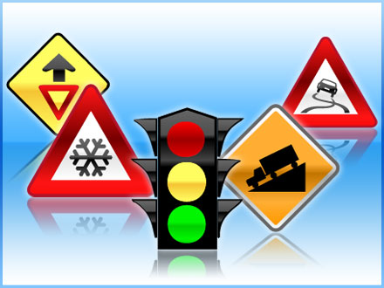
Law of freedom
James refers to the law as “the law of freedom”
Just as traffic laws make it possible to move around safely, so God’s law makes it possible to live safely in Creation.

Slide 8
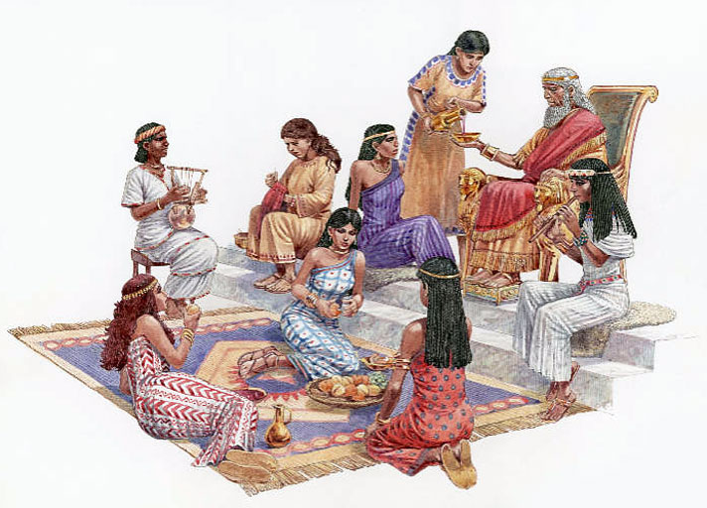
Bible Study: 1 Kings 11:1-13

Slide 9
Bible Study: 1 Kings 11:1-13
1. Son of David, king of Israel
2. He loved many foreign women
3. He was no longer fully devoted to the Lord. He began to worship other gods.
4. No.
5. The Lord was upset and became angry.
6. He would tear most of the kingdom away from Solomon and give it to a servant
7. Yes
because Solomon’s kingship had been given by the Lord and the Lord had said to Solomon earlier that He would bless Solomon if Solomon was faithful to God.

Slide 10
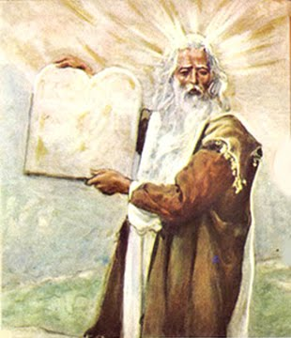
Covenant

The ten commandments are the “law of the covenant”.
A covenant is a regulated relationship of promises and requirements between two or more parties.
Illustration:
Marriage is a covenant between a man and a woman.

Slide 11
Covenant

God promises protection & demands obedience
Man promises obedience & requests protection
Man trusts that God will do as He has said (= faith).
Third, since every covenant contains two parts, a promise and an obligation, we are, through baptism, called and obliged by the Lord to a new obedience.
Form for Baptism

Slide 12
Guideline

We were created to love and be loyal.
To do good is hitting the target of love dead-centre.
To sin is to miss the target.
There are “good deeds” and “misdeeds”.
The Law is God’s guideline for hitting the target of love dead-centre.
Good deed
Sin
♥

Slide 13
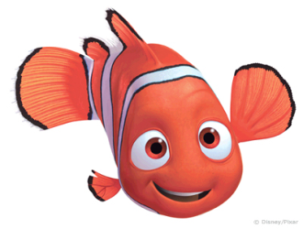
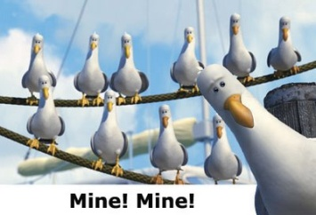
The law is to us what water is to a fish

Slide 14
God introduces Himself

I am the LORD (Yahweh)
Yahweh, the great I AM, the everpresent one, always faithful
your God
Almighty, powerful, no one tells Me what to do, I tell everybody what to do (and I’m on your side)
who brought you out of Egypt, out of the land of slavery
I saved you from evil oppression to give you a good life, listen to Me and things will go well for you.

Slide 15
God introduces Himself

I am the LORD
this makes sense for us
your God
this makes sense for us
who brought you out of Egypt, out of the land of slavery
how does this make sense for us?
We have been saved from slavery to sin and the devil. In the law, Egypt is for us a symbol of evil.

Slide 16
The Hymn 11 project
Hymn 11 is a rhymed version of the Law.
But it’s not one stanza per part.
The Hymn 11 project is about creating a hymn that has one stanza per part.
So we need to tweak stanza 2…

Slide 17
The Hymn 11 project
I am the Lord, your God and Saviour,
who out of slav’ry set you free,
who brought you from the land of Egypt.
Have, then, no other gods but me.
E.g.
I am the LORD, your God and Saviour
Who out of slav’ry set you free
Redeemed by blood you’re saved from evil.
And so our covenant will be.
preface
1st commandment

Slide 18
The ten commandments
1. Have faith in God
2. Respect God as He
3. Respect God’s
4. Respect time: use it for God
5. Respect
6. Respect
7. Respect
8. Respect
9. Respect another’s
10. Be satisfied (don’t just act it)
1. Have faith in God alone
2. Respect God as He wants it done
3. Respect God’s Name
4. Respect time: use it for God
5. Respect authority
6. Respect life
7. Respect intimate love
8. Respect possessions
9. Respect another’s honour
10. Be satisfied (don’t just act it)

