Slide 1
The Fruit of Faith: LD 32-44
♥
Serve God Alone
Lesson 11
LD 34b

Slide 2
Psalm 96:3
3. All gods revered by other nations
are merely idols, man’s creation.
Our God made all the heav’ns’ extent,
and glory dwells within his tent.
Before him kneel in adoration.

Slide 3
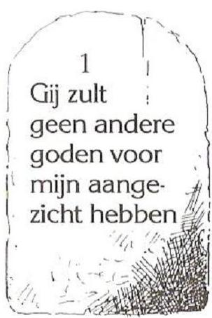
1st commandment
You shall have no other gods before Me
Serve other gods instead of God
Don’t
Serve other gods alongside God
Do
Serve God alone

Slide 4
Just one God

In ancient times all the nations had many gods.
Israel was an odd nation in this respect.
- It had only one God
- It didn’t even have an image of God

Slide 5
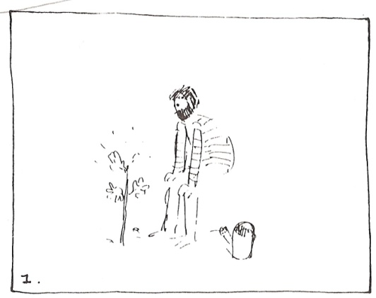
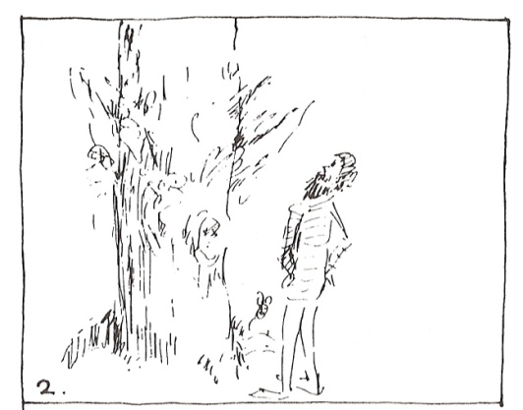
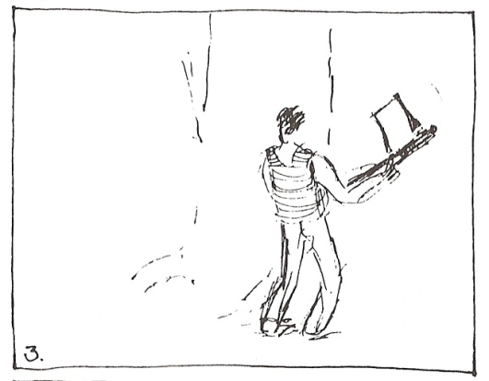
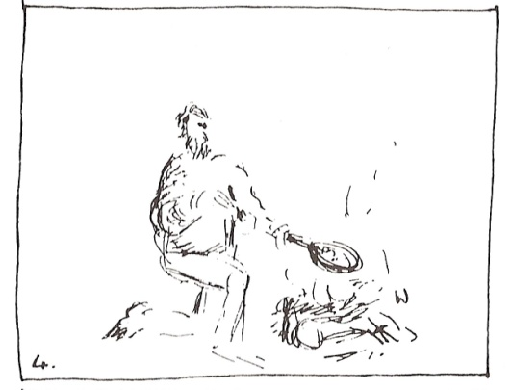
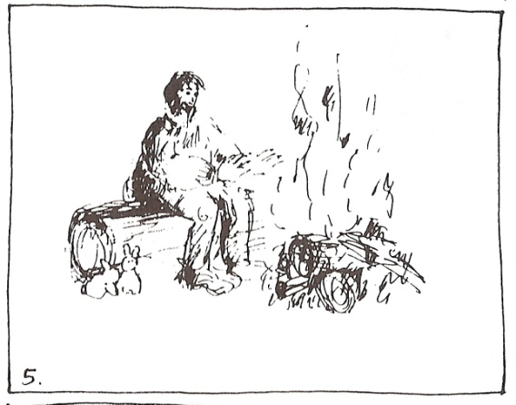
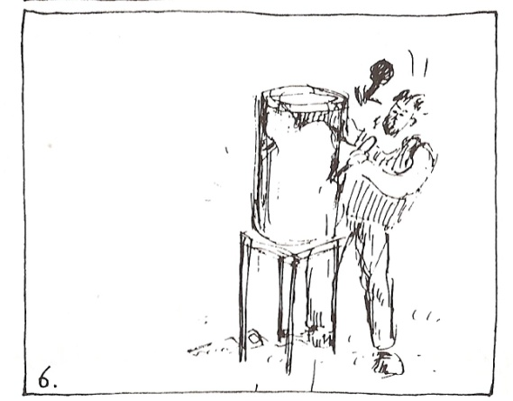
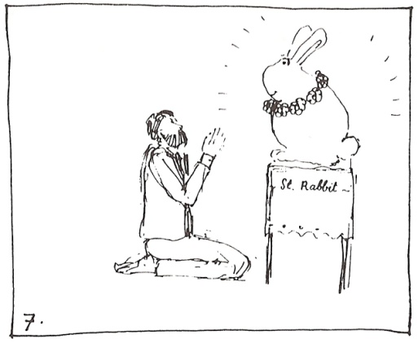
Bible Study: Isaiah 44:14-20
On your sheet, write alongside each picture part of a text from Isaiah 44:14-20

Slide 6
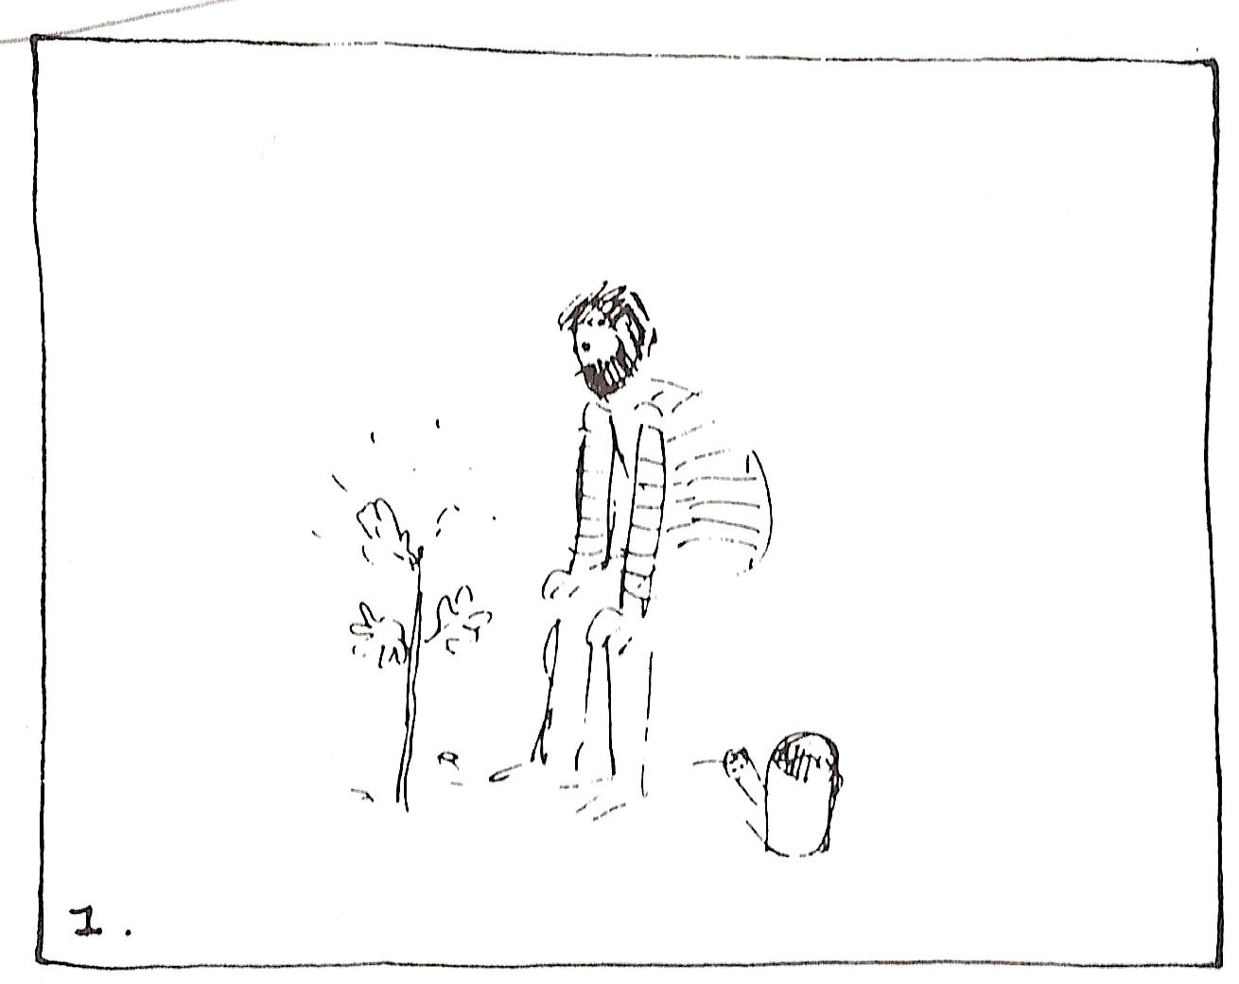
Isaiah 44:14
He chooses a cypress tree or an oak … He plants a cedar

Slide 7
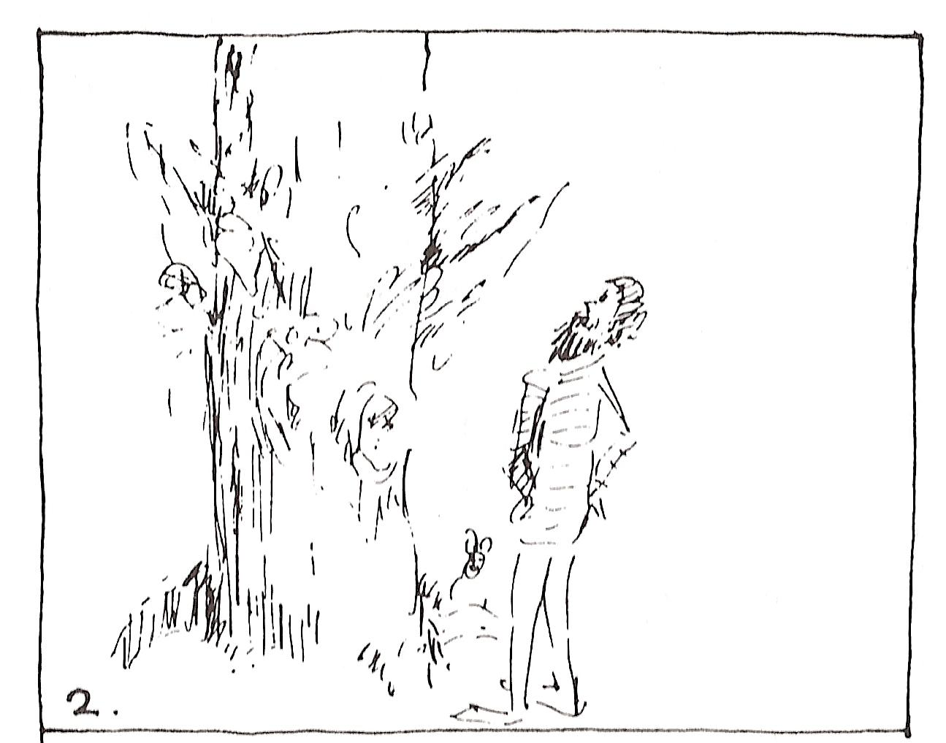
Isaiah 44:14
He lets it grow strong among the trees of the forest. … the rain nourishes it.

Slide 8
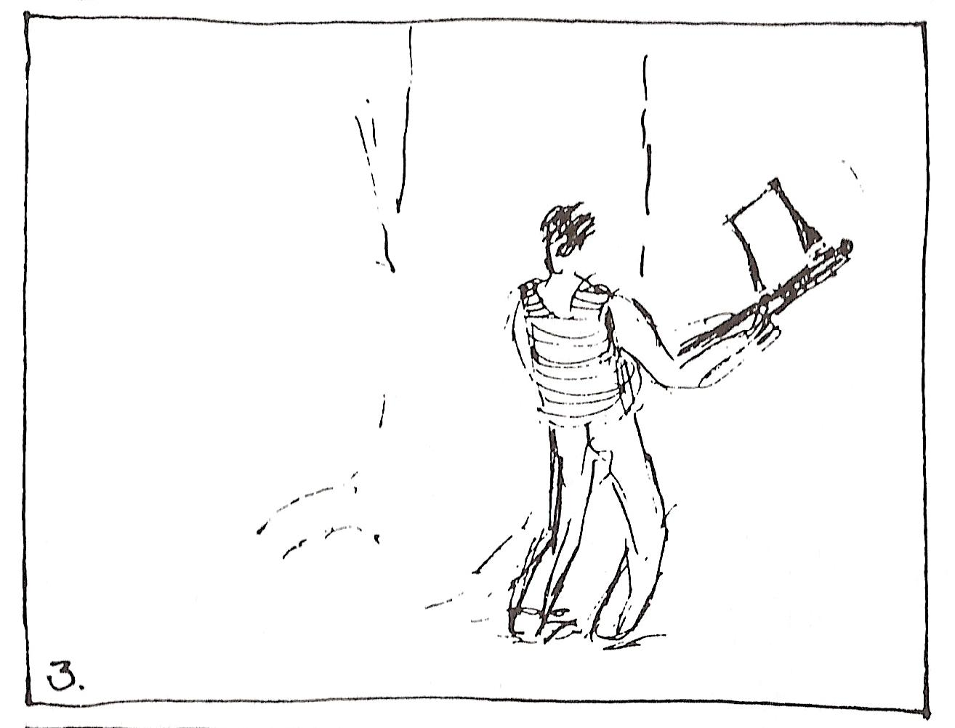
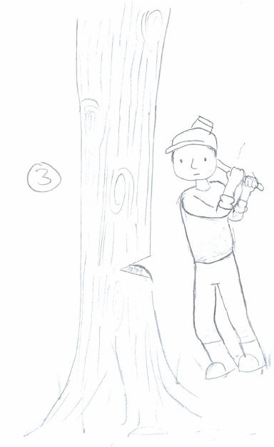
Isaiah 44:14
He cuts down cedars,

Slide 9
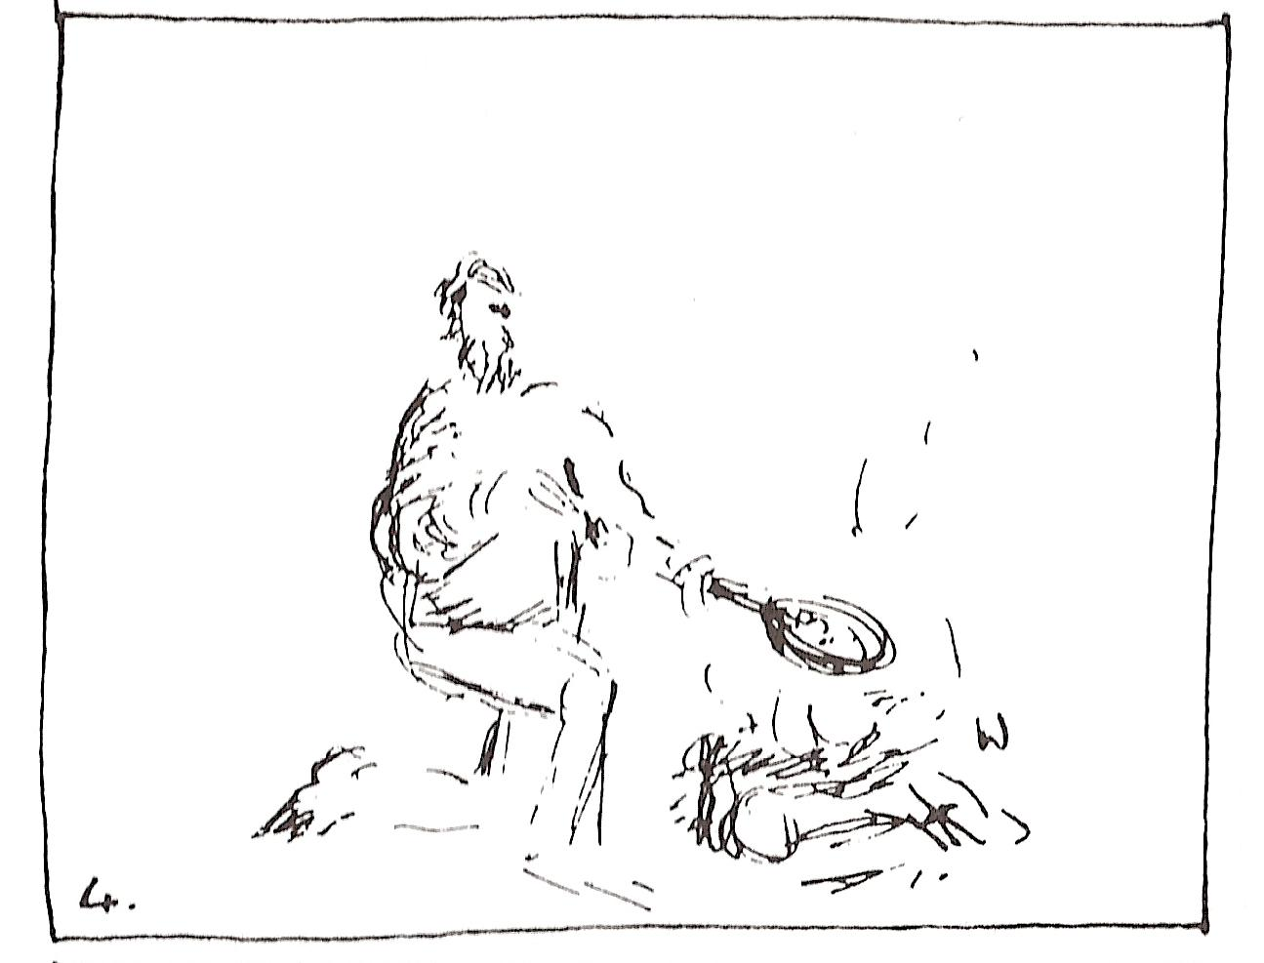
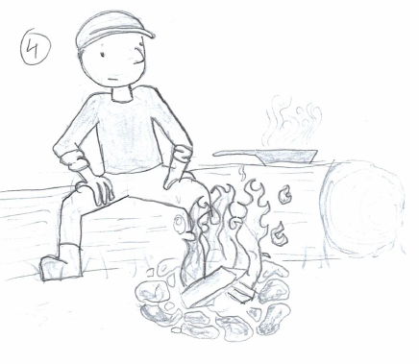
Isaiah 44:15-16
Then it becomes fuel for a man. … Half of it he burns in the fire. Over the half he eats meat;

Slide 10
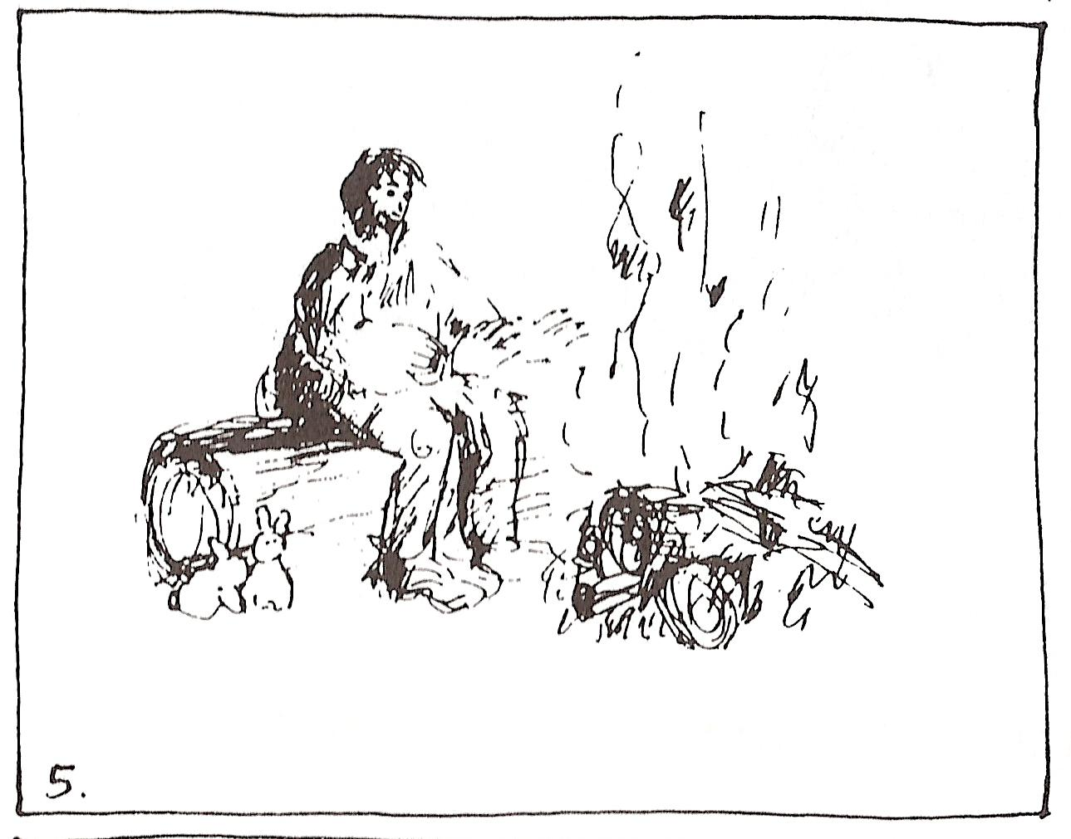
Isaiah 44:16
Also he warms himself and says,
“Aha, I am warm, I have seen the fire!”

Slide 11
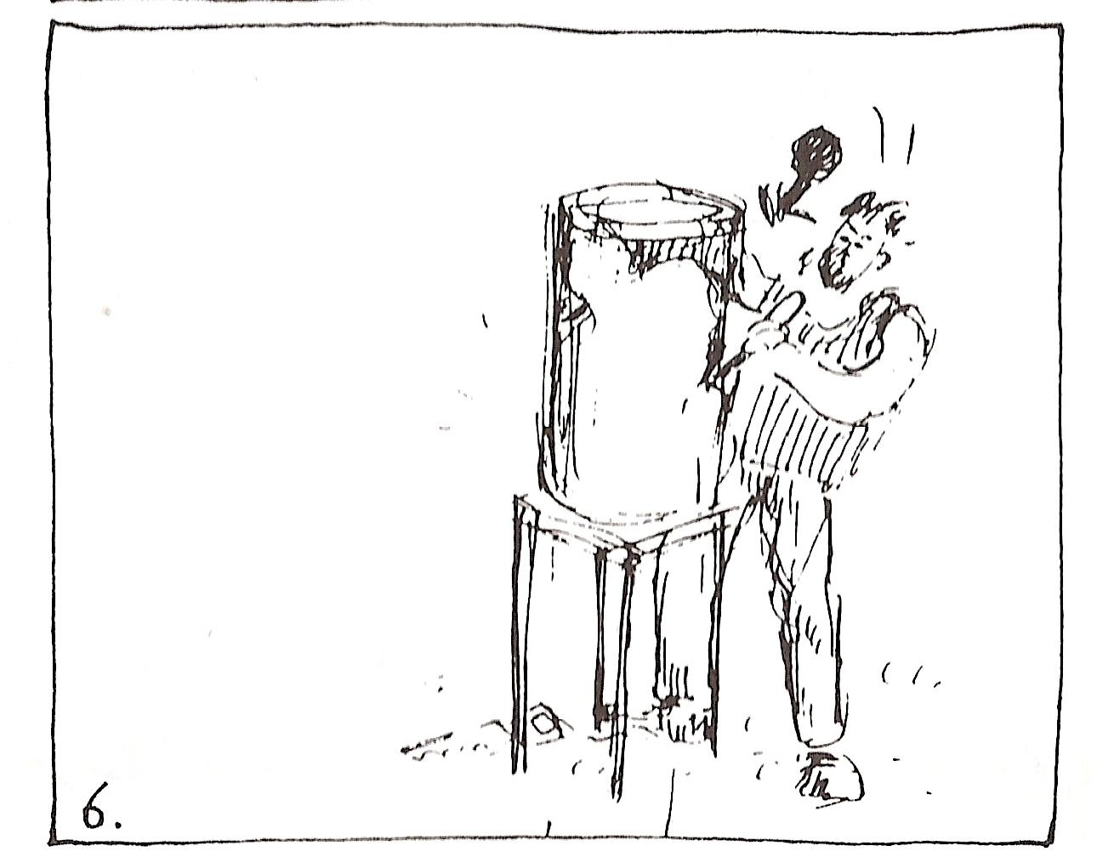
Isaiah 44:17
And the rest of it he makes into a god, his idol,

Slide 12
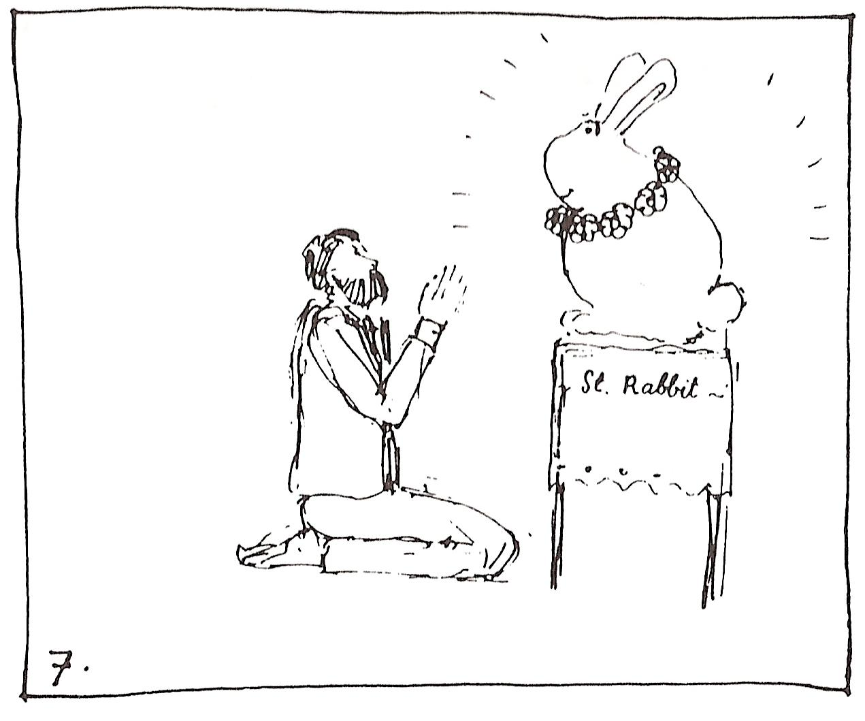
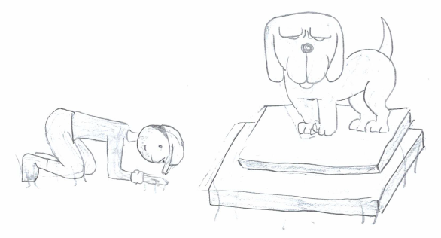
Isaiah 44:17
and falls down to it and worships it. He prays to it and says, “Deliver me, for you are my god!”

Slide 13
They know not, nor do they discern, for he has shut their eyes, so that they cannot see, and their hearts, so that they cannot understand. No one considers, nor is there knowledge or discernment to say, “Half of it I burned in the fire; I also baked bread on its coals; I roasted meat and have eaten. And shall I make the rest of it an abomination? Shall I fall down before a block of wood?”
Isaiah 44:18-19
8. A deluded heart has led him astray

Slide 14
Idolatry
Ahab is king of the northern ten tribes, Israel. He married Jezebel, who comes from Sidon by Tyre.
Jezebel does not believe in Israel’s God, Yahweh. She only believes in her own god, Baal.
Ahab and Israel still believe in Yahweh. But they also believe in Baal. Thus the prophet Elijah tells them: “How long will you waver between two opinions?”
(This can also be translated as: How long will you dance with two partners?)

Slide 15
Forms of idolatry

Idolatry can be
1. Having something as god instead of the LORD
2. Having something as god along side the LORD
instead of
along side
LORD
Baal
LORD
Baal
or:
+

Slide 16
How it should be

As the name Elijah suggests:
EL I JAH
God my Yahweh
LORD

Slide 17
Idolatry

Slide 18
Look up Deuteronomy 4:19-20
How do people today worship sun, moon and stars?

Slide 19
Astrology and Horoscopes

Astro-logy
star
word, message
Astrology = the message of the stars
Many people believe that the position of the stars contain a personal message
Astrologers draw horoscopes: they look at the position of the stars and determine what the message for certain people is.
Astrologers in the Bible include the wise men from the east at Christ’s birth, and the Chaldeans in Daniel’s time.

Slide 20
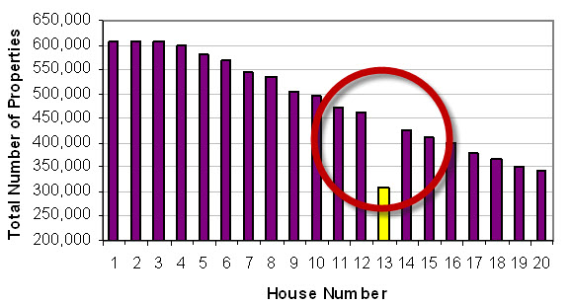
Superstition

Superstition is believing something that has been proven to be not true.
Examples:
- walking under a ladder
- seeing a black cat
- the number 13 is unlucky
- having a mascot
- Baptism and Lord’s Supper?

Slide 21
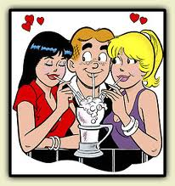
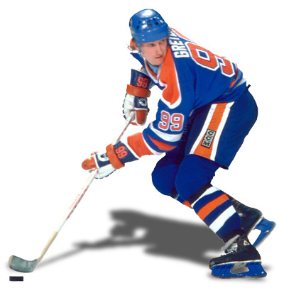
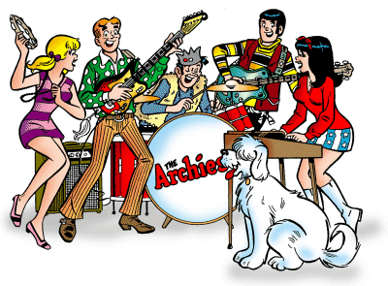
Modern idols

Riches
Relation-ships
Sports
Power,
influence
Pleasure

Slide 22
Who might challenge the LORD God for your attention and worship?
Riches
Relation-ships
Sports
Power,
influence
Pleasure

Slide 23
1st commandment

You shall have no other gods before Me
Serve other gods instead of God
Don’t
Serve other gods alongside God
Do
Serve God alone

Slide 24
The Hymn 11 project
Hymn 11 is a rhymed version of the Law.
But it’s not one stanza per part.
The Hymn 11 project is about creating a hymn that has one stanza per part.
So we need to tweak stanza 2…

Slide 25
The Hymn 11 project
I am the Lord, your God and Saviour,
who out of slav’ry set you free,
who brought you from the land of Egypt.
Have, then, no other gods but me.
E.g.
I am the LORD, your God and Saviour
Who out of slav’ry set you free
Redeemed by blood you’re saved from evil.
And so our covenant will be.
preface
1st commandment

