Slide 1
The Fruit of Faith: LD 32-44
♥
Worship God as He wants it done
Lesson 12 – LD 35

Slide 2
Hymn 11:3
3. “You shall not make or serve an idol:
a jealous God am I, the LORD.
I punish evildoers’ offspring
but cherish those who heed my word.

Slide 3
2nd commandment
You shall have no carved images
Make images of God
Don’t
Worship God in a wrong way
Do
Worship God as He has commanded

Slide 4
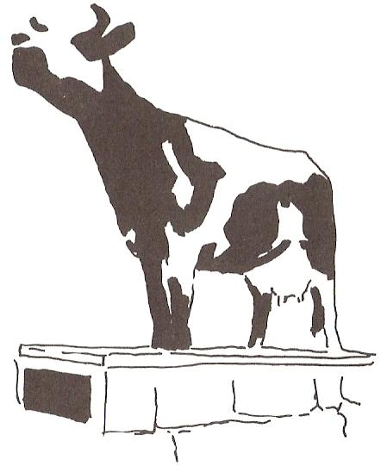
Bible Study: Exodus 32 & 1 Kings 12

Slide 5
Bible Study: Exodus 32:1-8
1. Because they didn’t know what had happened to Moses
2. Like a calf
3. “This is your God*, O Israel, who brought you up out of Egypt.” *The Hebrew word for ‘God’ is a plural, and can thus be translated with ‘God’ or ‘gods’
4. The LORD
5. No

Slide 6
Bible Study: 1 Kings 12:26-32
1. He was afraid the kingdom would revert to David’s house.
2. Two golden calves
3. “Here is your God*, O Israel, who brought you up out of Egypt.” *The preferred translation
4. One in Bethel (south), the other in Dan (north)
5. No.
6. a. He built extra shrines b. He appointed his own priests c. He set up his own religious calendar

Slide 7
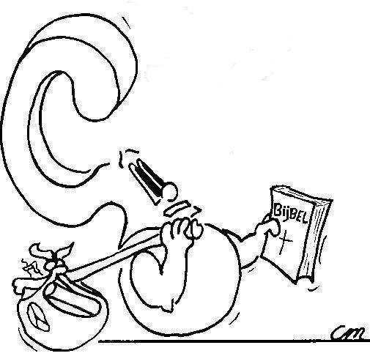
1st or 2nd?
No other gods.. . . Do not make an idol. . . . What is the difference between the 1st and 2nd commandments?

Slide 8
1st and 2nd - the difference
1 Kings 16:31
Ahab not only considered it trivial to commit the sins of Jeroboam son of Nebat, but he also married Jezebel daughter of Ethbaal king of the Sidonians and began to serve Baal and worship him.
1. Serve the LORD God alone
2. Worship the LORD God as He has commanded

Slide 9
1st and 2nd - the difference

The first commandment is about worshiping the LORD God alone, not having other gods instead of or besides the Lord.
The second commandment is about worshiping the LORD God in the right way, not as we would like to do it but as He wants us to do it.
Those who worship another god or the LORD+another god sin against the first commandment.
Those who worship the LORD (alone) but in their own way rather than God’s way, sin against the second commandment.

Slide 10
1st and 2nd - the difference

The 1st commandment is about
WHO
you are to worship
The 2nd commandment is about
HOW
you are to worship

Slide 11
Against 1st or 2nd commandment?
Worship Jupiter
“God is never angry, only loving”
Putting your trust in money
Never ask God to forgive sins
Golden calf
A church service without sermon
Consulting spirits
1
2
1
2
2
2
1

Slide 12
Worship

A worship service is a moment where God meets with His people. This meeting is at His invitation.
A worship service is a celebration of God’s goodness and greatness. Hence God decides how it takes place.
While God does allow much room for human input, it will always have to be within the confines of what God has commanded and forbidden.
This is known as the Normative Principle of Worship.

Slide 13
Worship

The program for a worship service is called ‘liturgy’. (From a Greek word meaning, ‘service’)
A worship service has the character of a conversation between God and His people.
The minister represents God. In some instances (e.g., prayer) the minister speaks on behalf of the people.

Slide 14
The Liturgy
Call to Worship
Declaration of Dependence
Salutation (greeting)
Singing
Law
Singing
Prayer
Scripture reading
Singing
Text + Sermon
Singing
Prayer
Confession of Faith
Thank offering
Singing
Benediction (blessing)
- God
- People
- God
- People
- God
- People/God (assurance of forgiveness)
- People
- God
- People
- God
- People
- People
- People
- People
- People
- God

Slide 15
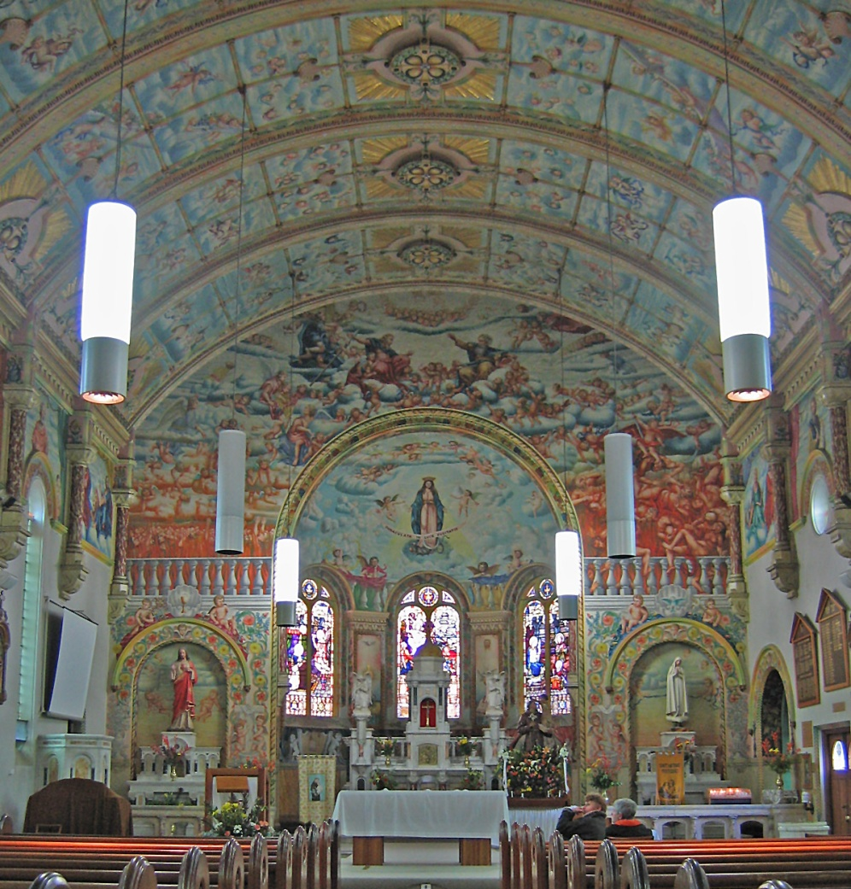
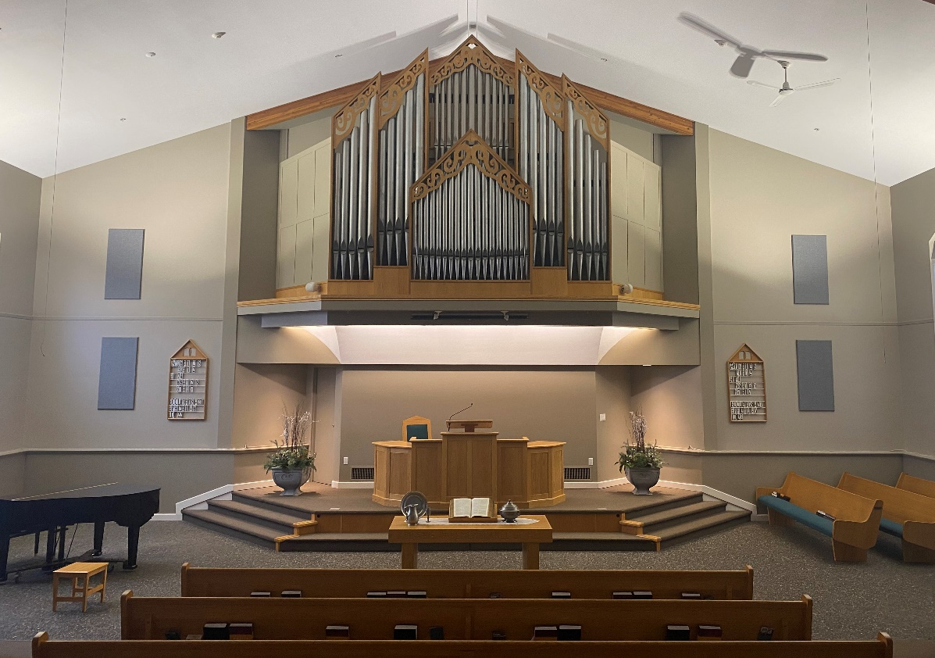
The visual side to worship

Slide 16
heaven
this world
hell

Slide 17
Visuals

Our worship services are very sober. We tend to be anti-image, no bands, etc.
A point of debate is the use of visual means for the purposes of instruction:
- props during the sermon
- power-point during the sermon
Visuals during services are only okay if they support the service and do not detract from the instruction by the Word.

Slide 18
2nd commandment

You shall have no carved images
Make images of God
Don’t
Worship God in a wrong way
Do
Worship God as He has commanded

