Slide 1
The Fruit of Faith: LD 32-44
♥
Use God’s Name With Care
Lesson 13 – LD 36-37

Slide 2
Hymn 11:4
Invoke the LORD with fear and rev’rence;
you shall not take his name in vain.
The LORD your God will not hold guiltless
those who his holy name profane.

Slide 3
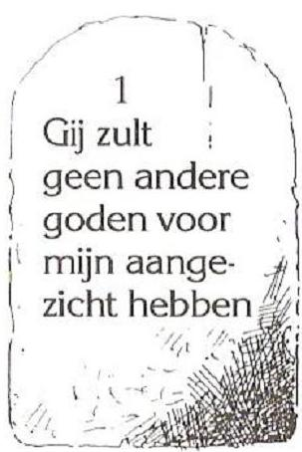
3rd commandment
Use God’s Name with care
Make misuse of God’s Name
Use God’s Name unnecessarily (swearing)
Don’t
Remain silent when others misuse God’s Name
Do
Use God’s Name with respect

Slide 4
God’s Names

Hebrew English Points to in normal
letters
Elohim
Adonaj
Yahweh
Hebrew English Points to in normal
letters
Elohim God Power-Creator
Adonaj Lord Might-King
Yahweh LORD Love and loyalty -Father

Slide 5
God’s Names

Because of the third commandment, the Jews were afraid to use God’s Name at all.
“If we don’t say it, we won’t misuse it.”
Every time they saw the Name “YHWH” in their Bible, they would thus say “Adonaj”.
When vowels were added to the Hebrew Bible, Jews hinted at this practice by putting the vowels of Adonaj with the letters of YHWH.

Slide 6
God’s Names

a o a
Y H W H
. a d o n a j
Y + a + H + o + W + a + H = Yahowah
Non-Hebrews who could read the letters but knew little of the language, thus thought the name was Jehovah.
An example of such “non-Hebrews” are the Jehovah’s Witnesses

Slide 7
Bible Study: Various
1. God
2. LORD God
3. God Almighty
El-Shaddai
4. The God of your father, the God of Abraham, the God of Isaac and the God of Jacob
I AM WHO I AM
5. The LORD of hosts & the God of Jacob
God in relation to creation
God in relation to His people

Slide 8
Bible Study: Various
6. The Father, the Son, the Holy Spirit
Just one. (It says “Name”, not “Names”!)
7. Alpha and Omega
Who is, and was, and is to come (= I AM WHO I AM)
The Almighty

Slide 9
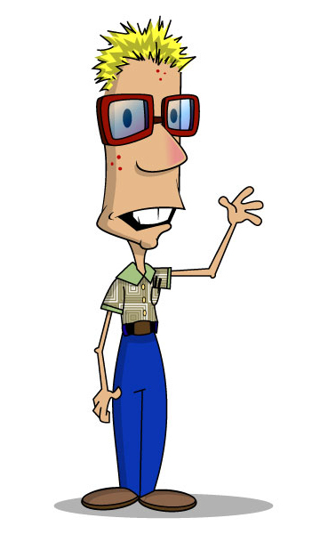
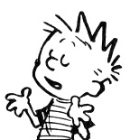
Using God’s Name
An appeal to authority is often used to add power to your words.
Climate change will destroy the world in 50 years. That’s what my five year old said.

Slide 10
Using God’s Name
An appeal to authority is often used to add power to your words.
Climate change will destroy the world in 50 years. That’s what the Weather Network said.

Slide 11
Using God’s Name
An appeal to authority is often used to add power to your words.
Climate change will destroy the world in 50 years. That’s what a panel of United Nations climatologists said.

Slide 12
Using God’s Name
An appeal to authority is often used to add power to your words.
Girls must wear skirts. That’s what the Bible says.
Does the Bible say that? If not, this statement is sin against the third commandment.

Slide 13
Using God’s Name
An appeal to authority is often used to add power to your words.
You have to marry me. The Holy Spirit told me.
Did God really do that? If not, this statement is sin against the third commandment.

Slide 14
Using God’s Name

An appeal to authority is often used to add power to your words.
People may use an appeal to God to add power to their words. They may say “the Bible says” when the Bible doesn’t say, or “God told me” when God didn’t tell them.
Be very careful how you appeal to the authority of God when substantiating a claim.
We are NOT to make misuse of God’s Name.

Slide 15
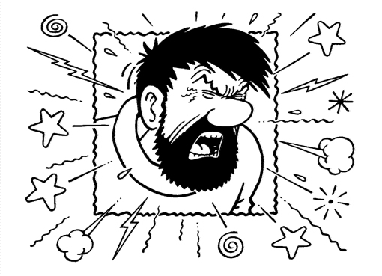
“Empty” or “in vain”
Another way to misuse God’s Name is to no purpose. We usually call it swearing or profane language.

Slide 16
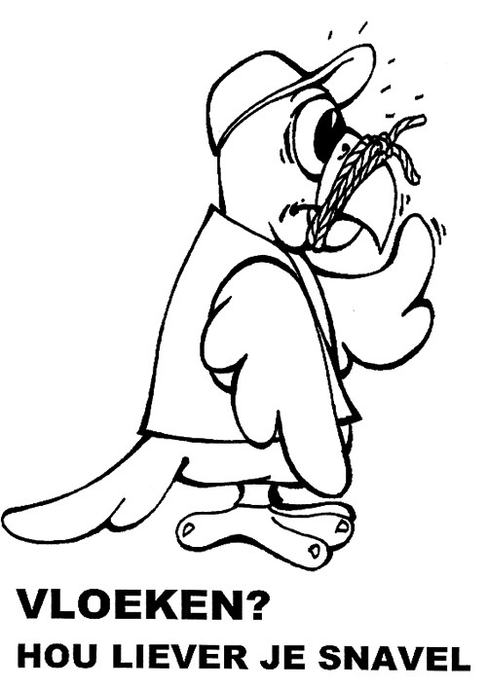
What did you say?
There are different levels of bad language.
Coarse language
Shit, bugger, the “f” word
Corrupted curses and coarse language
Gee, golly, crikey, heck,
Full blown curses
“Jesus Christ”, OMG=“O my God”
Swear?
Shut your beak!
Let loose a curse and something breaks

Slide 17
What did you say?
Let no corrupting talk come out of your mouths, but only such as is good for building up, as fits the occasion, that it may give grace to those who hear.
Ephesians 4:29
Let there be no filthiness nor foolish talk nor crude joking, which are out of place, but instead let there be thanksgiving.
Ephesians 5:4

Slide 18
Empty use of God’s Name

Another way to misuse God’s Name is to no purpose. We usually call it swearing or profane language.
Swearing in the Christian tradition actually has its origin with Roman Catholics.
Swearing comes down to an unnecessary use of God’s Name in a situation. One uses God’s Name while there is no need for it at all.
A Dutch Cardinal (Roman Catholic VIP) once said he figured swearing is okay for Roman Catholics. “It shows that God is very present in our lives, and dear to us.”

Slide 19
3rd commandment

Use God’s Name with care
Make misuse of God’s Name
Use God’s Name unnecessarily (swearing)
Don’t
Remain silent when others misuse God’s Name
Do
Use God’s Name with respect

