Slide 1
The Fruit of Faith: LD 32-44
♥
Catch your breath and worship God
Lesson 14 - LD 38

Slide 2
Hymn 11: 4th commandment
Observe the Sabbath, keep it holy;
you and your house that day shall rest.
On six days only shall you labour;
the seventh day the LORD has blessed.
For in six days the LORD created
All things, the seventh day He ceased.
He rescued you from slavish labour
Thus you shall rest, both man and beast.

Slide 3
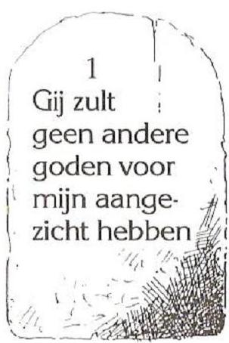
4th commandment
Remember to keep the Sabbath
Don’t
Make the seventh day a day like any other
Use the seventh day to catch your breath
Do
Use the seventh day to commemorate God

Slide 4
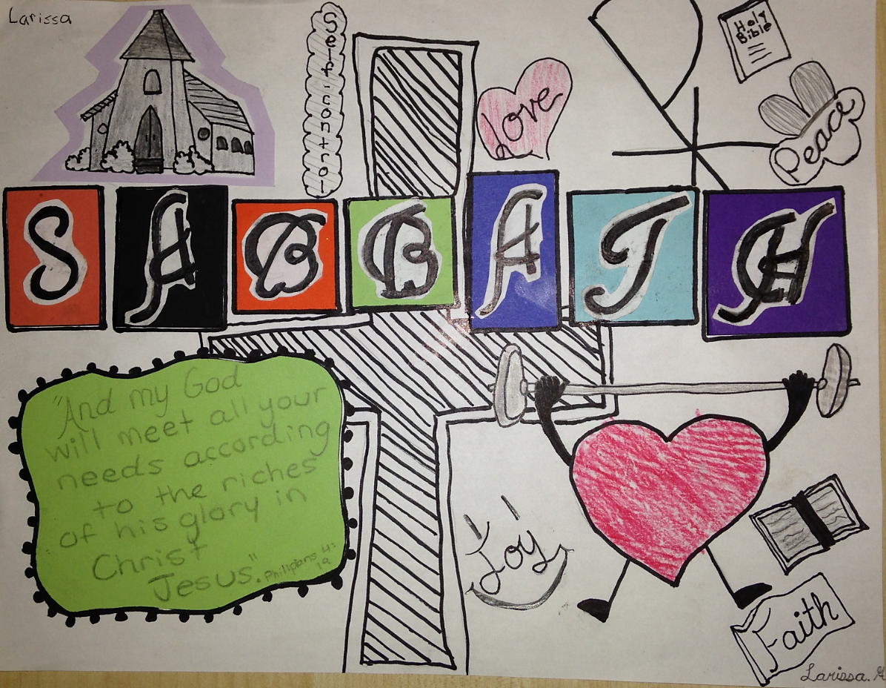

Slide 5
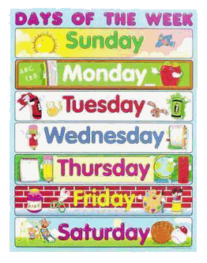
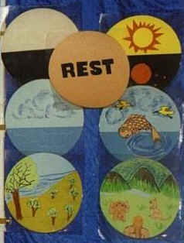
Four concepts

1. Week
a period of seven days
modelled on Creation
First, not last!

Slide 6
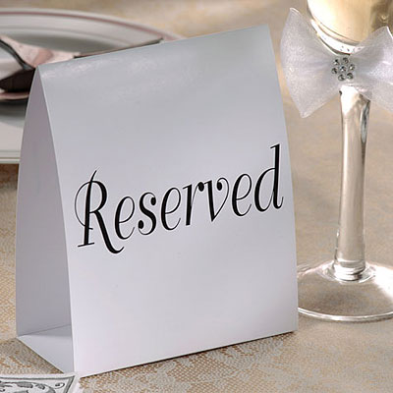
Four concepts

2. Holy
to be special, different, devoted to God
Note: God made the Sabbath a holy day before there was any sin! (Genesis 2:3)

Slide 7
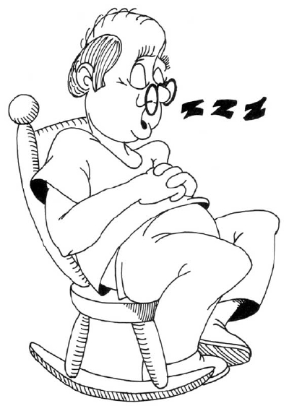
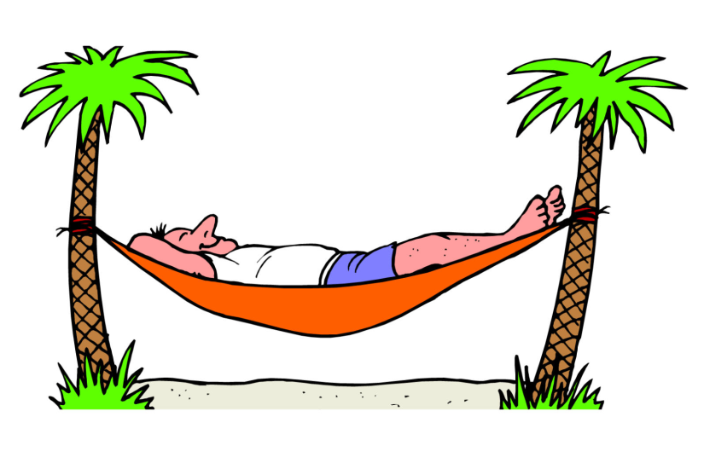
Four concepts

3. Sabbath
Hebrew “shabbat” = to stop doing something
In relation to “work” it means “rest”
Not the name of a weekday but of a type of day
(Just like the English word “holiday”)

Slide 8
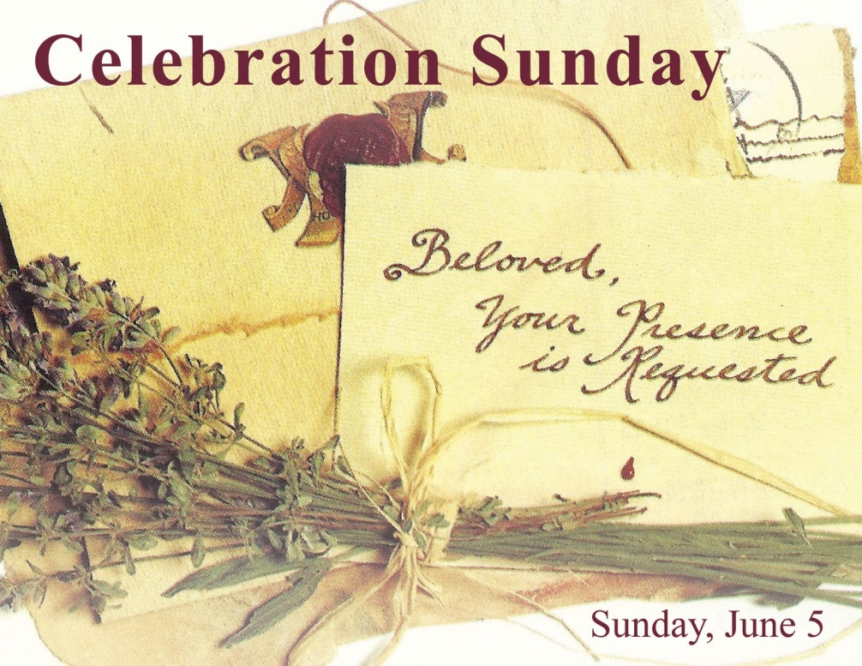
Four concepts

4. Remember, Celebrate
to call to mind, give special attention to, rejoice over something.

Slide 9
Bible Study: Ex 20 and Deut 5
We’re doing the questions together.
1. The Lord worked six days to create everything, and then rested on the seventh day. We are God’s image, so we do as God did.
2. The Lord has set Israel free from slavery in Egypt. God does not want His people to work like slaves, they are to enjoy life.
3. Yes, because we are still in God’s image.
4. Yes, because we have been set free from slavery to sin. God wants us to be free, to enjoy life.

Slide 10
Catechism
What does God require in the fourth commandment?
First, that the ministry of the gospel and the schools be maintained
and that, especially on the day of rest, I diligently attend the church of God to hear God’s Word, to use the sacraments, to call publicly upon the LORD, and to give Christian offerings for the poor.
Second, that all the days of my life I rest from my evil works, let the LORD work in me through His Holy Spirit, and so begin in this life the eternal Sabbath.
1
2
3

Slide 11
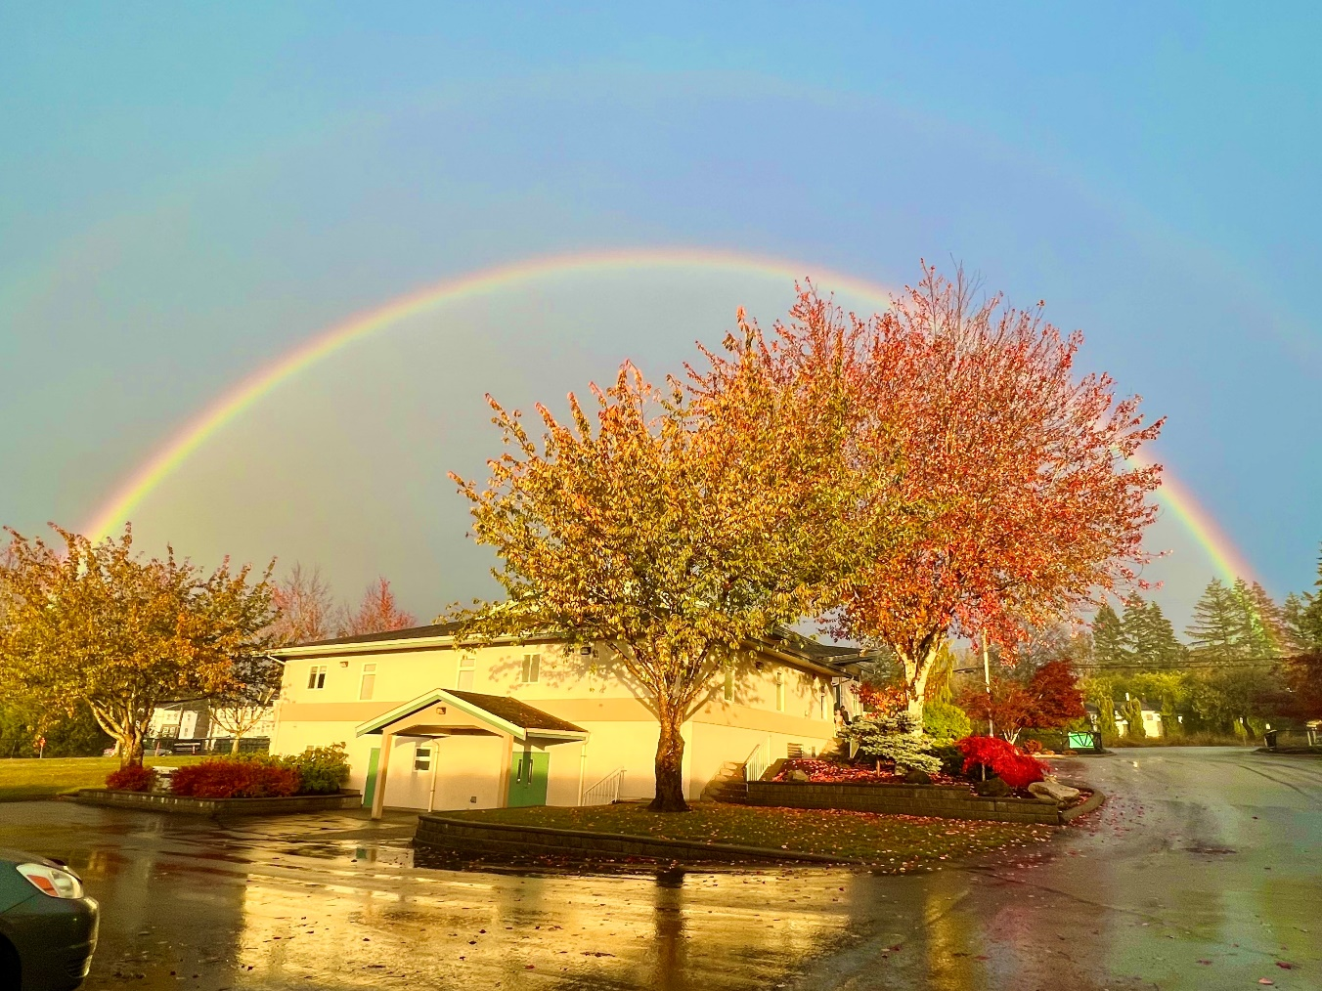
Ministry of Gospel and schools

1
The fourth commandment “to rest” is linked to the mission mandate “to preach the Gospel” because preaching takes place especially on God’s day

Slide 12
Ministry of Gospel and schools

1
Thus God’s people are to make sure
- the preaching happens: facilities in which to preach, suitable time for preaching, and people who preach
- education with a view to preaching takes place: the ‘schools’ here include the seminaries.
- education is also a form of ‘preaching’: we are taught to understand how this world is God’s world, and what role we are to play in it.

Slide 13
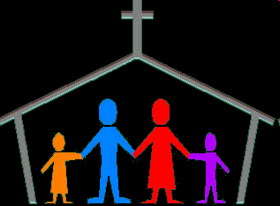
Time to hear the preaching

2
The preaching of the gospel is also to be heard.
God commands us to take time out from our daily routines and think about the issues of life, as well as commemorate God’s great deeds.
A holy day = a special day

Slide 14
Take Your Rest

3
God does not want us to be a slave to our daily activities. Hence He commands us to catch our breath, to take a break from our daily busy-ness.
The deeper meaning to this is to take a break from your “natural” activities: to do sin.
After all, eternal life is described as an eternal sabbath: forever stopping to sin!

Slide 15
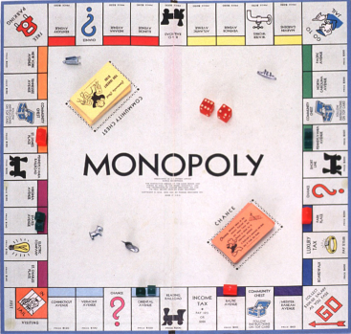
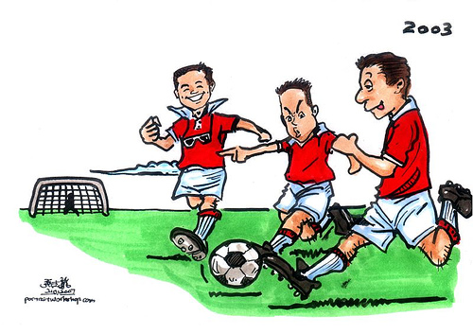
Do’s and don’ts

Every family has its own rules as to what is and what is not allowed on Sunday
Family rules with respect to the Sunday should be determined by questions such as
is an activity restful or intense?
does it increase or decrease attention for God?
is it ‘normal’ or ‘special’?

Slide 16
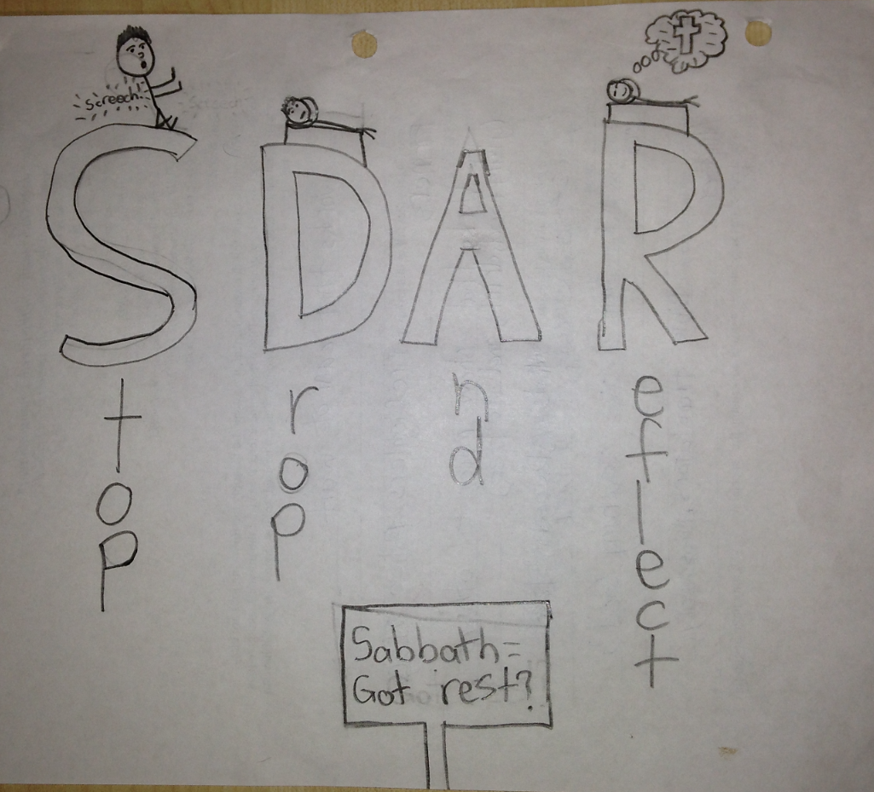

Slide 17
Advertise
We see lots of advertising telling us to exercise and keep fit.
Design a poster to promote the ‘special day’ of the fourth commandment (finish for homework).

Slide 18
4th commandment
Remember to keep the Sabbath
Don’t
Make the seventh day a day like any other
Use the seventh day to catch your breath
Do
Use the seventh day to commemorate God

