Slide 1
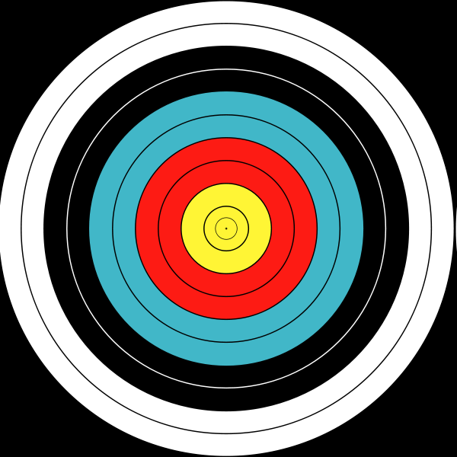
The Fruit of Faith: LD 32-44
♥
Respect for Life
Lesson 16 – LD 40

Slide 2
Psalm 25:10
10.Guard my life! Do not neglect me:
let me not be put to shame.
May integrity protect me,
for my hope is in your name.
Trusting in your power supreme,
I await my liberation.
God, your Israel redeem
from distress and tribulation.

Slide 3
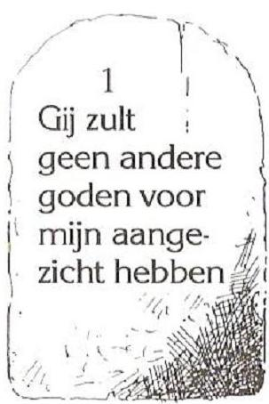
6th commandment
You shall
not murder
hate
injure
bully
Don’t
call names
kill unjustly
love
assist
protect
Do
praise
make to live

Slide 4
What does it say?

You shall not kill - never-ever?
You shall not murder - only murder?
The word in the Hebrew original is very special.
Strictly speaking it means “put to death without cause”, “kill unlawfully”.
The 6th commandment is not an absolute, total prohibition on killing.
It prohibits taking life for the wrong reason.

Slide 5
Types of “killing”
“Putting to death without cause” or “killing unlawfully” comes in four types:
murder
voluntary manslaughter
involuntary manslaughter
accidental homicide

Slide 6
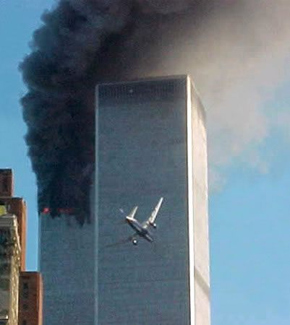
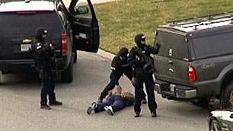
Murder

Definition: to kill someone with a plan
Illustrations:
- gang related homicide
- terrorist attack (9/11)
- assassinations

Slide 7
Voluntary manslaughter
Definition: to kill someone without a plan
Illustrations:
- senseless violence
- rioting
- killing during a crime (e.g. theft)

Slide 8
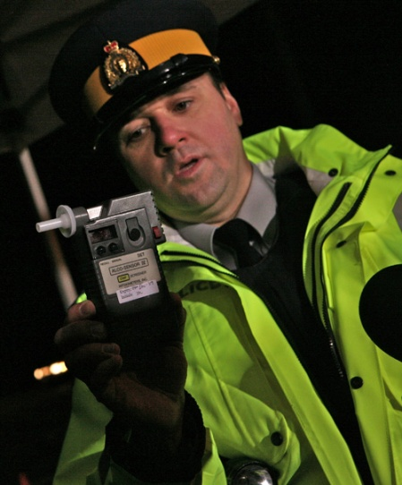
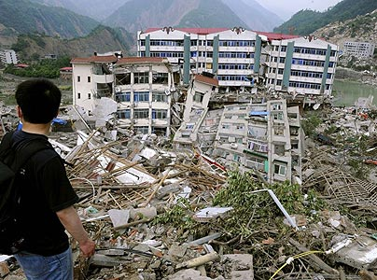
Involuntary manslaughter
Definition: make a mistake which causes someone else’s death
Illustrations:
Death caused by drunk-driving or running red lights
Ignoring building codes

Slide 9
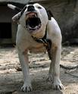
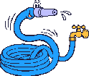
Accidental homicide
Definition: a legal action on your part which leads to the death of another
Illustrations:
Your dog bites a child to death
The delivery-boy trips over your garden-hose, hits his head on a rock and dies.

Slide 10
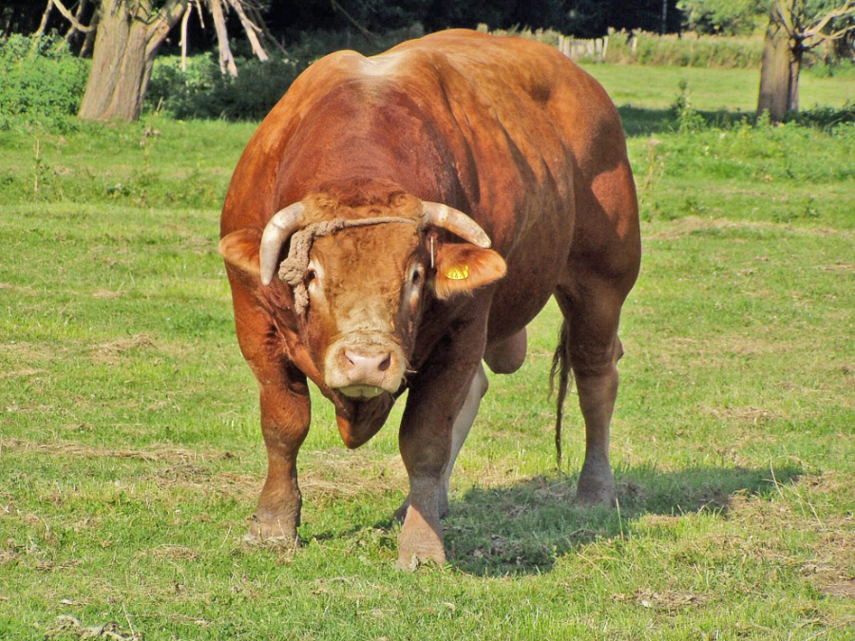
Bible Study: Exodus 21

Slide 11
Bible Study: Exodus 21
1. Death penalty
2. Flee to a city of refuge (a type of house arrest)
3. Death penalty
4. If you know that your bull has the habit of goring
5. Death penalty or money penalty (fine)

Slide 12
Bible punishments for “killing”
“Putting to death without cause” or “killing unlawfully” comes in four types:
murder: death penalty
voluntary manslaughter: death penalty
involuntary manslaughter: death penalty or fine
accidental homicide: “house” arrest

Slide 13
Alcohol

Slide 14
Alcohol
Alcohol alters your mood, perception, and ability to do things
Excessive use leads to health issues (liver, brain)
Alcohol can be addictive
As the Bible does not forbid the use of alcohol - Jesus Himself drank wine - does this mean you may drink as much as you like?

Slide 15
Alcohol

Biblical Principle: life belongs to God, not to us
Enjoy life and take God’s will into account
Only start drinking when your body will not be adversely effected by it (late teens, early twenties). (Legal drinking age in BC is 19, in many States it’s 21.)

Slide 16
Recklessly endanger myself

Slide 17
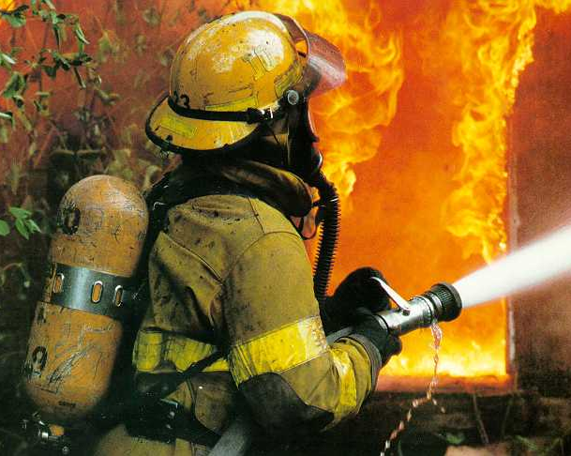
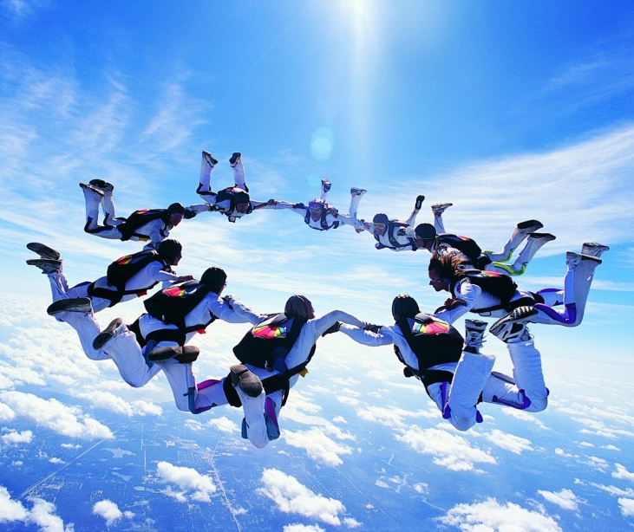
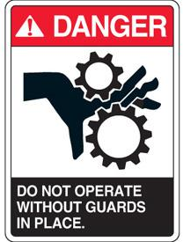
Recklessly endanger myself
There are many situations which bring with them the risk of harm and even death
A fireman entering a burning building
Bungeejumping, sky-diving, snow-mobiling in the backcountry
Working with saws or in a dusty environment

Slide 18
Recklessly endanger myself

Biblical Principle: life belongs to God, not to us
There are situations in which this is allowed
God’s Son became a human being in order to die
When there is more chance of saving lives than losing it
There are situations in which this is not allowed
when the chance of dying is great and the only reason for doing it, is enjoyment
when one is not being careful
Where lies the boundary between what is and what is not allowed?

Slide 19
Smoking and drugs
Smoking and drugs puts dangerous chemicals in your body that change you
they can affect your sense of perception and judgment,
they can make you sick (especially cancer)
An additional issue is addiction:
Central to your life becomes the need to satisfy

Slide 20
Smoking and drugs

Biblical Principle: life belongs to God, not to us
God wants us to be perfect, also perfectly healthy
The use of cancer-causing drugs or abuse of addictive drugs is thus forbidden
A difficult question is whether one may use drugs with such an evil side for good.
smoking calms the nerves
morphine gives pain relief
medicinal marijuana

Slide 21
6th commandment
You shall
not murder
hate
injure
bully
Don’t
call names
kill unjustly
love
assist
protect
Do
praise
make to live

