Slide 1
The Fruit of Faith: LD 32-44
♥
Respect for Love
Lesson 17 – LD 41

Slide 2
Hymn 11: new stanza
Give love and loyalty expression,
Adult’ry you shall not commit.
Be pure in thought, in word and actions.
The marriage cov’nant: honour it.

Slide 3
7th commandment
You shall
not commit adultery
Don’t
be self-centred in your relationships
Do
be lovingly loyal and loyally loving

Slide 4
To be in love with someone To love someone (aka infatuation)
Self-centred (my need) Other-centred
Loyalty not required Loyalty is required
♥

Slide 5
Marriage defined

An institution of God in which one man and one woman bind themselves to each other, forming a life-unit in which love and loyalty receive ultimate expression.

Slide 6
Marriage defined

An institution of God in which one man and one woman bind themselves to each other, forming a life-unit in which love and loyalty receive ultimate expression.
Who instituted marriage?
God
Who can be married to each other?
One man and one woman
What does a marriage form?
A single life-unit
What is marriage the ultimate expression of?
Love and loyalty

Slide 7
Purpose of Marriage
An institution of God in which one man and one woman bind themselves to each other, forming a life-unit in which love and loyalty receive the ultimate expression.
What is the main purpose of marriage?

Slide 8
Purpose of Marriage

An institution of God in which one man and one woman bind themselves to each other, forming a life-unit in which love and loyalty receive the ultimate expression.
Main Purpose: To give love and loyalty their ultimate expression

Slide 9
Pillars of Marriage

A marriage is supported by two pillars, two ‘l’s
1. You love one another
2. You are loyal to each other
love
loyalty

Slide 10
Purpose of Marriage

An institution of God in which one man and one woman bind themselves to each other, forming a life-unit in which love and loyalty receive the ultimate expression.
Main Purpose: To give love and loyalty their ultimate expression
Further purposes:
- to continue the human race (have and raise children)
- to rule over, care for and use God’s creation

Slide 11
Bible Study: Genesis 2:18-24

Slide 12
Bible Study: Genesis 2:18-24
1. That man was alone
2. To see what he would name them
3. That there was no one to help him
4. From the rib (side) of man
5. She was from the same flesh and bone
6. One flesh
7. God
Note: the word “help” is used elsewhere in reference to God (e.g. Ps. 146:5).

Slide 13
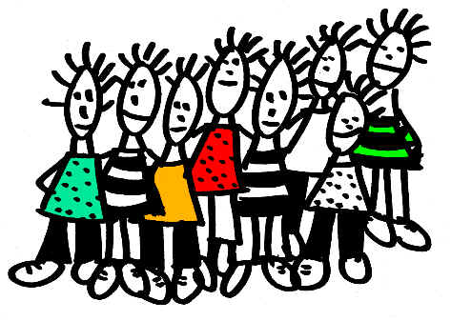
Marriage and Friendship

Marriage Friendship
Institution of God Institution of men
Rules of God Rules of friends
- 1 man and 1 woman - 2 or more people
- in place until death - can always stop

Slide 14
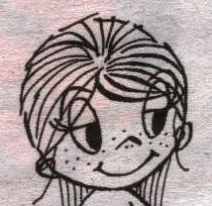
Different

Men and women are different
not just physically, in their appearance
also spiritually, in how they think
Males tend to be physical, practical
Guys want to do stuff together
Females tend to be emotional, relational
Girls want to be together

Slide 15
Attraction

When in their teens most people feel growing attraction for the other gender
This feeling of attraction is normal: God made it
The Fall into Sin distorted this attraction:
Same sex attraction, gender confusion
Lust instead of love
Men want to possess but girls are not things!
Women want to influence but guys are not tools!
Lust in thought and deed is called unchastity
The solution
Keep to God’s institution
Be other-centred in your relationship.

Slide 16
love and loyalty

A good marriage
is not about
what you get
but about
what you give
Be the image of God, who is perfectly loving &
steadfastly loyal!
love
loyalty

Slide 17
7th commandment
You shall
not commit adultery

Don’t
be self-centred in your relationships
Do
be lovingly loyal and loyally loving

