Slide 1
The Fruit of Faith: LD 32-44
♥
Respect for possessions
Lesson 18 – LD 42

Slide 2
Psalm 62:6
6.Put no false hope and confidence
in robbery and violence;
do not take pride in theft and plunder.
Although your riches may increase,
they will not give you rest and peace.
Why set your heart on earthly splendour?

Slide 3
8th commandment
You shall
not steal
Don’t
take what God gave to another
Do
be satisfied with what God has given you

Slide 4
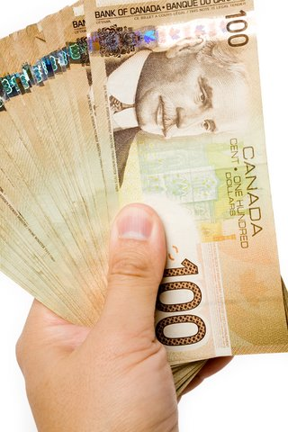
To have much
What would you do if suddenly
you were given $50,000?

Slide 5
Ownership

God created man to be His steward, His manager. Our possessions are not ours but God’s
God
entrust
give account
man
rule, use
serve, help
creation

Slide 6
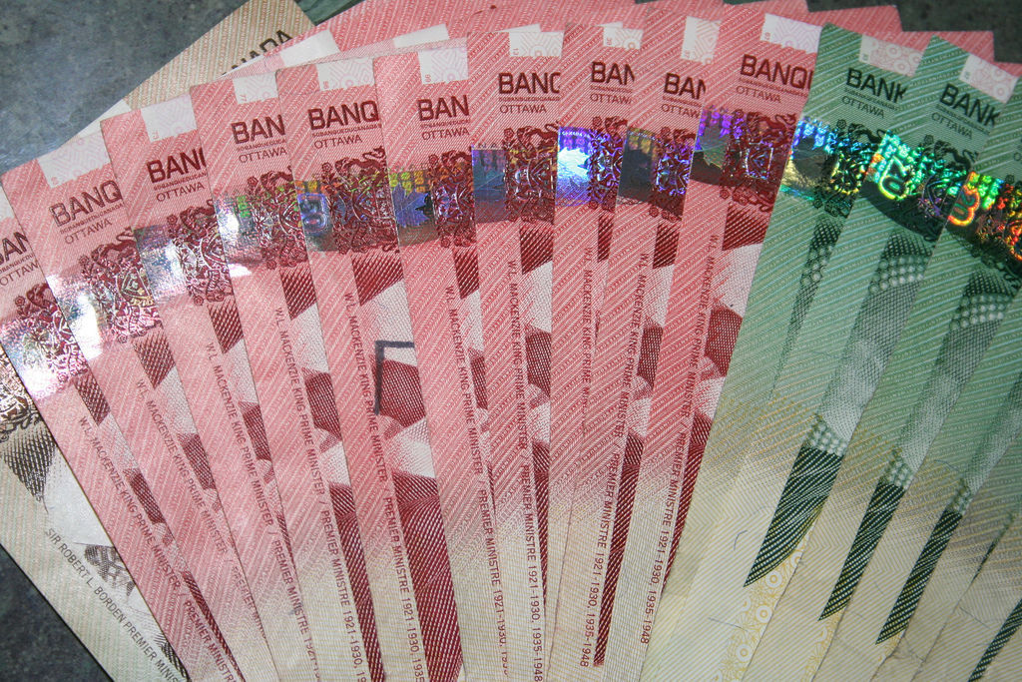
Bible Study: 1 Timothy 6:6-10

Slide 7
Bible Study: 1 Timothy 6:6-10
1. Godliness with contentment
2. Nothing
3. Nothing
4. Food and clothing (clothing = shelter, protection)
5. Into temptations and a trap, and into many foolish and harmful desires
6. the love of money
7.They have wandered from the faith and pierced themselves with many griefs
8. No, it says to want to be rich is wrong.

Slide 8
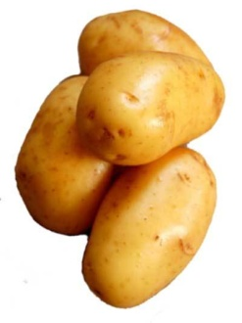
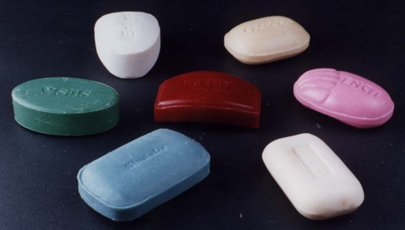
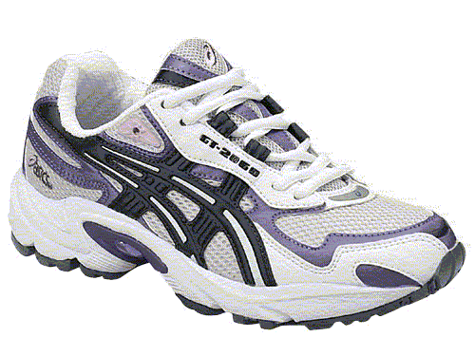
Necessity or Luxury? Discuss
Bread
Potatoes
Donut
Apple
Candy
Coke
Water
Alcohol
Shoes
Go to movies
House
Car
Smartphone
Computer
Bed
Schoolbag
Soap
Ski-trip
Saturday off
Go to church

Slide 9
What does God forbid in the eighth commandment?
A. God forbids not only outright theft and robbery
but also such wicked schemes and devices as
false weights and measures, deceptive merchandising, counterfeit money, and usury;
we must not defraud our neighbour in any way,
whether by force or by show of right.
In addition God forbids all greed
and all abuse or squandering of His gifts.

Slide 10
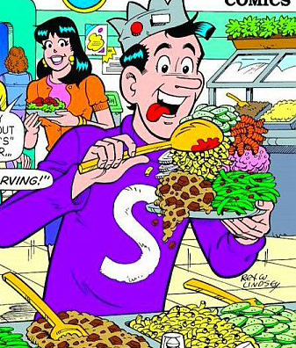
Greed is sin

To have as many possessions or as much money as possible.
It could be
only save your money and never spend.
Have others pay for you and never pay for others.
The greedy think only of themselves

Slide 11
Squandering is sin

Have possessions and use money to no real purpose
It means you only spend, never save, never think of the future
The squandering don’t even care for themselves

Slide 12
Usury is sin

To earn money in a mean way
To use others for your own ends
For example: loaning someone $10 and asking $20 in return.
Those committing usury think only of themselves

Slide 13
Robbery is sin

Taking something that belongs to someone else
Fraud: to take money or something without delivering or doing what was promised
Thievery: physically taking something from someone else when you’re not allowed to

Slide 14
Caring is good

Work, so as to be able to take care of yourself
Look after the needs of those who cannot take care of themselves

Slide 15
Possessions and Attitudes

Slide 16
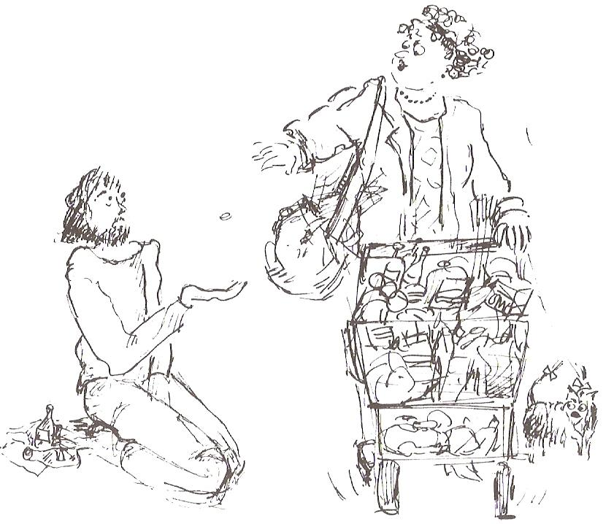
What is this lady doing right? What is this lady doing wrong?

Slide 17
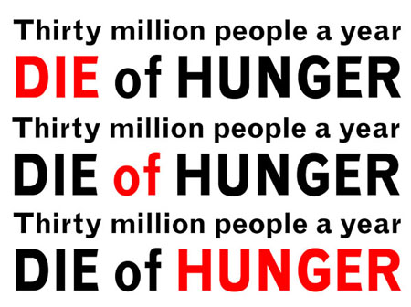
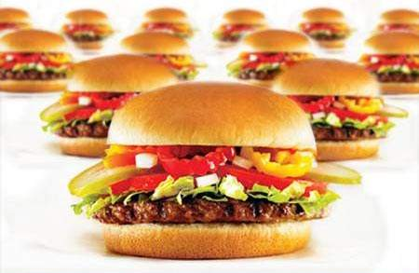
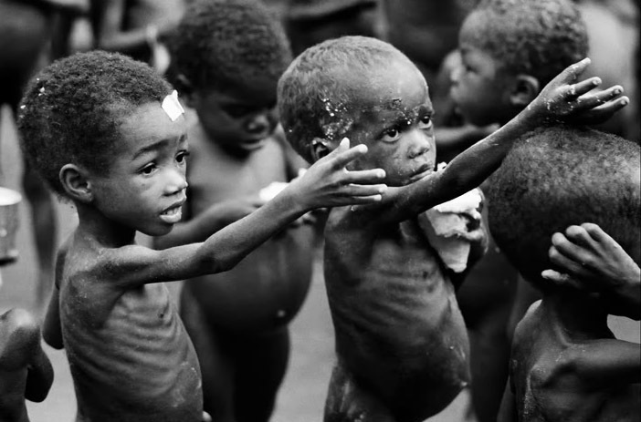
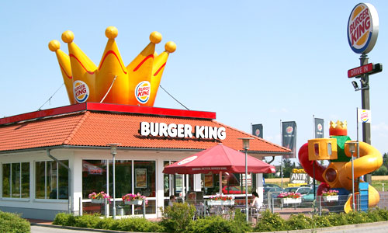
Finding balance…

Slide 18
Stewardly

God calls us to be stewardly
To do our best to support ourselves
To do our best to support those for whom we are responsible
To do our best to care for those who cannot care for themselves
Good stewards take good care of themselves and all those entrusted to their care. And God has made us humans responsible for all of creation.

Slide 19
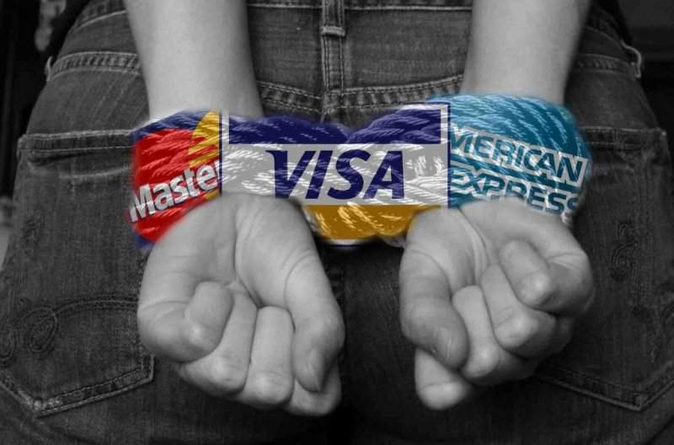
Debt is Bondage

Slide 20
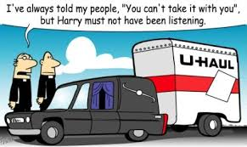
Don’t be
GREEDY
but be
GENEROUS
To begin with, it’s all God’s
And in the end, it’s all God’s


Slide 21
8th commandment

You shall
not steal
Don’t
take what God gave to another
Do
be satisfied with what God has given you

