Slide 1
The Fruit of Faith: LD 32-44
♥
Respect for possessions
Lesson 18 – LD 42

Slide 2
Psalm 62:6
6.Put no false hope and confidence
in robbery and violence;
do not take pride in theft and plunder.
Although your riches may increase,
they will not give you rest and peace.
Why set your heart on earthly splendour?

Slide 3
8th commandment
You shall
not steal
Don’t
take what God gave to another
Do
be satisfied with what God has given you

Slide 4
Ownership

God created man to be His steward, His manager. Our possessions are not ours but God’s
God
entrust
give account
man
rule, use
serve, help
creation

Slide 5
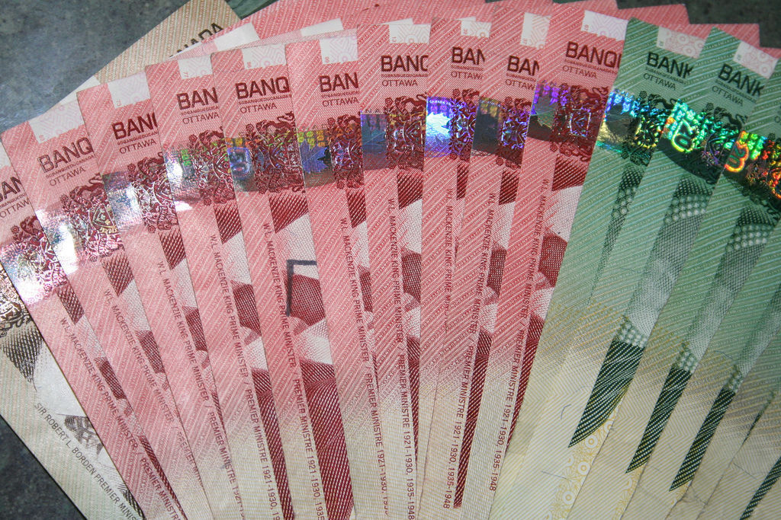
Bible Study: Proverbs on riches

Slide 6
Bible Study: Proverbs on riches
1. A slack hand
A diligent hand (hardworking hands)
2. Riches
Righteousness (doing the right thing)
3. Many friends (but would they be true friends?)
4. Poor
Rich
5. A good name
6. Borrower … Lender

Slide 7
Bible Study: Proverbs on riches
7. a. He who oppresses the poor to increase his own wealth
b. He who gives (gifts, bribes) to the rich
8. Not forever
9. He did not want to feel like he did not need the LORD
He did not want to dishonour God’s name by stealing

Slide 8
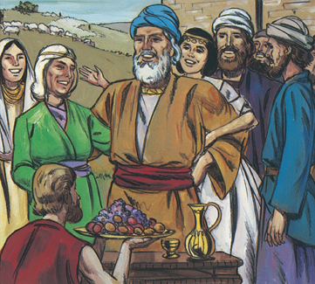
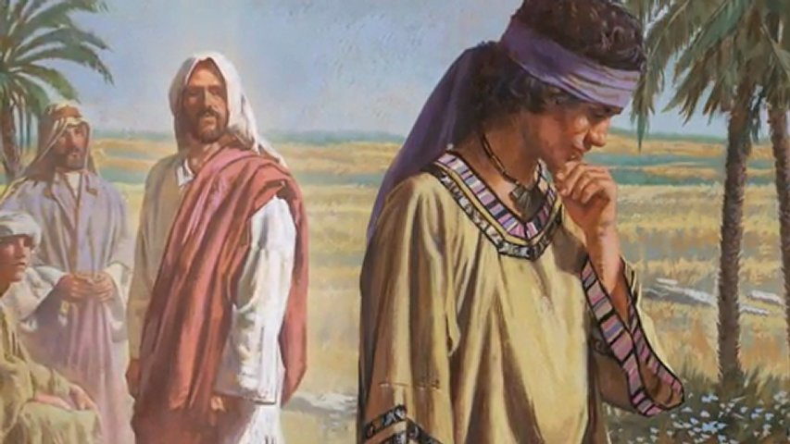
1 Timothy 6:10
For the love of money is a root of all kinds of evil. Some people, eager for money, have wandered from the faith and pierced themselves with many griefs.
1 Timothy 6:10
What is a root of all kinds of evil?
Not: MONEY (Job was rich & kind)
But: THE LOVE OF MONEY (as was the case for the rich young ruler)

Slide 9
A root of all evil

How does the love of money lead to sin against
- the 2nd commandment?
- the 4th commandment?
- the 6th commandment?
- the 9th commandment?
(If you don’t know your commandment numbers, look them up in your Book of Praise, Lord’s Day 34)

Slide 10
A root of all evil

How does the love of money lead to sin against
- the 2nd commandment: use religion to make
yourself rich
- the 4th commandment?
- the 6th commandment?
- the 9th commandment?
(If you don’t know your commandment numbers, look them up in your Book of Praise, Lord’s Day 34)

Slide 11
The root of all evil

How does the love of money lead to sin against
- the 2nd commandment: use religion to make
yourself rich
- the 4th commandment: work on Sunday to earn
more money
- the 6th commandment?
- the 9th commandment?
(If you don’t know your commandment numbers, look them up in your Book of Praise, Lord’s Day 34)

Slide 12
The root of all evil

How does the love of money lead to sin against
- the 2nd commandment: use religion to make
yourself rich
- the 4th commandment: work on Sunday to earn
more money
- the 6th commandment: wish someone were dead
to get the inheritance
- the 9th commandment?
(If you don’t know your commandment numbers, look them up in your Book of Praise, Lord’s Day 34)

Slide 13
The root of all evil

How does the love of money lead to sin against
- the 2nd commandment: use religion to make
yourself rich
- the 4th commandment: work on Sunday to earn
more money
- the 6th commandment: wish someone were dead
to get the inheritance
- the 9th commandment: lie on your T4 (tax forms)
(If you don’t know your commandment numbers, look them up in your Book of Praise, Lord’s Day 34)

Slide 14
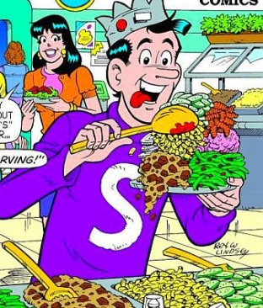
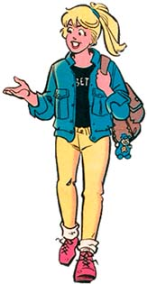
Possessions and Attitudes

Greed: “I want more.” You only care for yourself.
2. Squandering: “Here, have it.” You don’t care for yourself.
3. Usury: Abuse the needy to become rich. You only care for yourself.
4. Robbery: take another’s for yourself. You only care for yourself.
5. Caring: looking after your own needs and those of others.

Slide 15
Stewardly

God calls us to be good stewards
To do our best to support ourselves
To do our best to support those for whom we are responsible
To do our best to care for those who cannot care for themselves
People are allowed to be rich (Job and Solomon were)
Being prepared to live without luxury does not mean you have to.
But being rich should never be
- at someone else’s expense (i.e. don’t steal)
- that needs of others are ignored (i.e. do care)

Slide 16
Budget
A budget is a plan for how much money you receive and spend.
You cannot spend what you don’t receive.
Income tends to be of three sorts
Money you earn through work
Money given to you (e.g. allowance, scholarship)
Money you borrow (credit cards, loans)
Your budget should only count on earnings
Borrow money only for things you absolutely need (house, and sometimes car). Watch out for credit.
Borrowed money comes back to bite you!

Slide 17
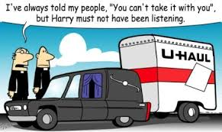
Don’t be
GREEDY
but be
GENEROUS
To begin with, it’s all God’s
And in the end, it’s all God’s

