Slide 1
The Fruit of Faith: LD 32-44
♥
Respect for personal honour
Lesson 19 – LD 43

Slide 2
Psalm 12:1,4
1.Help us, O Lord! The godly all have vanished;
gone are the faithful who your judgments seek.
Men lie to one another, truth is banished;
with flatt’ring lips and double heart they speak.
4.The words of promise which the Lord has spoken
are purest silver seven times refined.
His cov’nant stands from age to age unbroken;
he is our God, in truth and faith enshrined.

Slide 3
9th commandment
You shall
not testify falsely
condemn another without hearing
Don’t
twist another’s words
speak evil of another
lie about another
uphold another’s honour
Do
do justice to others

Slide 4
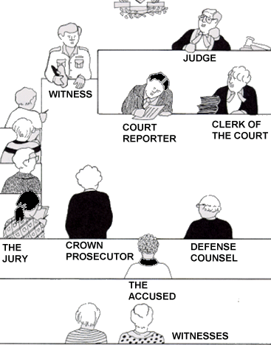
In court
The 9th commandment uses the situation of a court room to indicate how we are to speak about each other

Slide 5
A court room
Whatever role we play in regards to a matter, we are to speak the truth and seek the common good of all (including God)

Slide 6
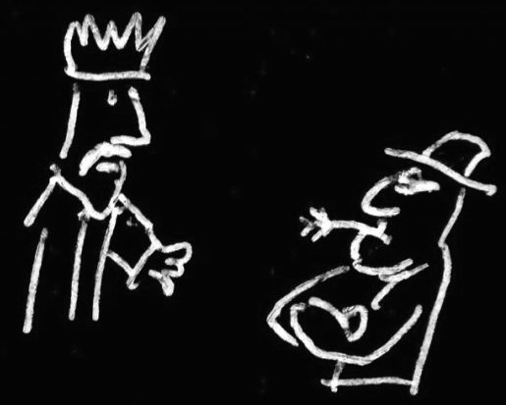
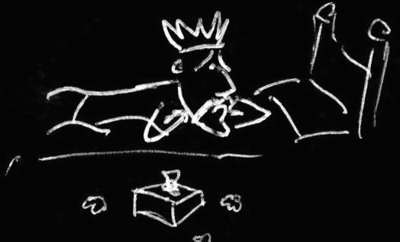
Bible Study: 1 Kings 21:1-16
1. Ahab and Naboth
2. His vineyard
3. Because he had inherited from his forefathers
4. Sullen and angry
5. Jezebel, his wife
6. Because Ahab was king
7. She wrote letters in Ahab’s name

Slide 7
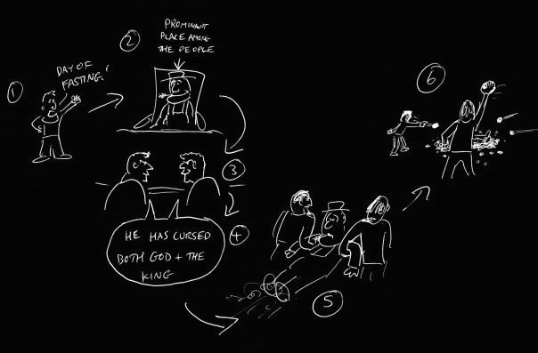
Bible Study: 1 Kings 21:1-16
8. To have false witnesses who could help get Naboth condemned to death
9. Yes
10. Cursing both God and the king
11. He was stoned to death
12. He took the vineyard
13. Naboth
Everybody else

Slide 8
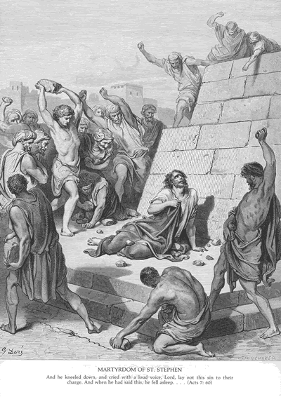
Condemned unfairly
There are many accounts in the Bible of people who were unjustly condemned.
Among them are
David, when persecuted by Saul
The prophet Jeremiah
John the Baptist
The Lord Jesus Christ
The deacon Stephen

Slide 9
Gossip

Slide 10
The issue

We are to do all we can to protect the name of other people.
This promotes love and loyalty in society.
How does it feel to be the victim?
You feel like you might as well be dead.
How does it feel to be the perpetrator?
You’re never sure when people will take revenge.

Slide 11
Love the truth or the neighbour?
Two friends are in a car. The driver is drunk. He runs a red light and causes a fender-bender. As the police are on their way, the driver says to his (sober) friend: can we pretend you were driving?
What would you do?

Slide 12
Love the truth or the neighbour?
Two friends are in a car. The driver is drunk. He runs a red light and causes a fender-bender. As the police are on their way, the driver says to his (sober) friend: can we pretend you were driving?
What would you do?
When this story was told to a group of Dutch people and Korean people, it turned out that
The Dutch would refuse
The Koreans would agree
And both claimed the other group would be lying.

Slide 13
Telling a lie to protect the neighbour
During World War 2, many people in The Netherlands went into hiding.
If the Germans came knocking on your door and asked: is anybody hiding here, were you allowed to lie and say “no”? People of the Netherlands Reformed Congregations would tell the truth. People of the Reformed Churches would tell a lie.
Who did right and who did wrong?

Slide 14
Telling a lie to protect the neighbour
During World War 2, many people in The Netherlands went into hiding.
If the Germans came knocking on your door and asked: is anybody hiding here, were you allowed to lie and say “no”? People of the Netherlands Reformed Congregations would tell the truth. People of the Reformed Churches would tell a lie.
It’s not always wrong to tell an untruth.

Slide 15
Not telling a truth
Peter and George are having a coffee together. They’re talking about Jack. George doesn’t like Jack and is always talking Jack down. Jack is trying to get his driver’s license and Peter knows he’s failed twice already. George doesn’t know this. When George comments on how hopeless Jack can be, Peter says nothing about Jack having failed his driver’s test twice already.
It’s not always wise to tell a truth.

Slide 16
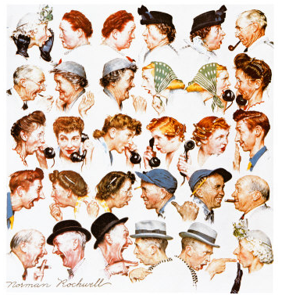

Slide 17
How shall we speak?

The 9th commandment teaches us
To love our neighbour and the truth together
When you speak, consider
- What does the most justice to the truth
- What does the least damage to myself and my neighbour

Slide 18
9th commandment

You shall
not testify falsely
condemn another without hearing
Don’t
twist another’s words
speak evil of another
lie about another
uphold another’s honour
Do
do justice to others

