Slide 1
The communication of Faith: LD 45-52
Pray: You Need To
Lesson 21 – LD 45

Slide 2
Psalm 141:1,7
1.Hasten, Lord! Hear my supplication.
O let my prayer like incense rise;
receive as evening sacrifice
the hands I lift in adoration.
7.Lord, my eyes I fix now directly
on you, my helper in the strife.
Save me from danger, guard my life;
in your unfailing love, protect me.

Slide 3
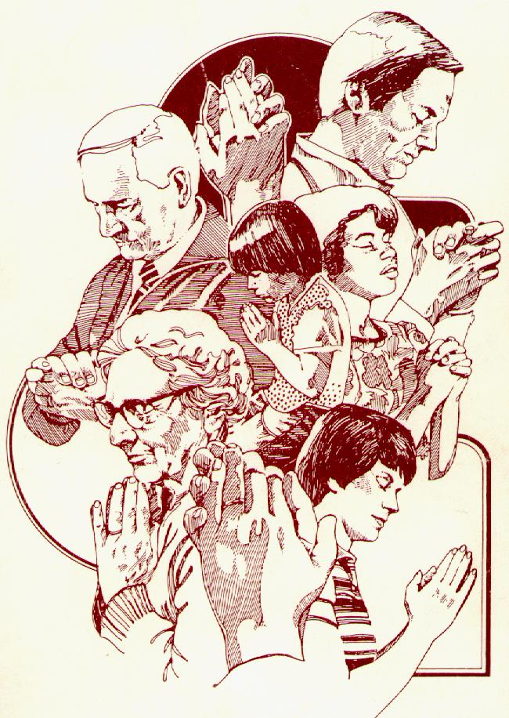
When?
Praying is second nature to Christians.
But when and why do we pray?
Is it out of custom or because you feel the need to talk with God?
Do the exercise on the sheet
Pray continually
1 Thessalonians 5:17

Slide 4
Why we pray
God
God’s Word
Prayer
God’s Commandments
Good
Works
Believer

Slide 5
Why?

In His Word, God commands people to do good.
No one can do good without God’s involvement.
That’s why people pray:
to be aware of their need for God and
to ask God to be involved in their lives.
God’s good commandments
&
Man’s inability to do good
⬇
prayer

Slide 6
Not optional
116.Q. Why is prayer necessary for Christians?
A. Because prayer is the most important part
of the thankfulness which God requires of us.
Moreover, God will give His grace and the Holy Spirit
only to those who
constantly and with heartfelt longing
ask Him for these gifts and thank Him for them.

Slide 7
What is prayer?

Prayer is NOT
- a personal wish-list (I want…)
- a list of demands (God, You have to…)
- a shot in the dark (Maybe You will…)
Rather: Prayer is focused on God’s desires
The person praying is a sinner speaking to holy God.
The person praying is to have faith in God

Slide 8
Bible Study: Luke 11:1-13

Slide 9
Bible Study: Luke 11:1-13
1. The disciples asked Him to teach them.
2. Because some manuscripts don’t have the full text.
3. For Yours is the kingdom, and the power, and the glory forever. Amen.
4. Always be confident that God will give you what you ask.
5. Verses 9-10 make that clear
6. God doesn’t trick you when responding to prayer

Slide 10
117.Q. What belongs to a prayer which pleases God and is heard by Him?
A. First,
we must from the heart call upon the one true God only, who has revealed Himself in His Word, for all that He has commanded us to pray.
Second,
we must thoroughly know our need and misery, so that we may humble ourselves before God.
Third,
we must rest on this firm foundation that, although we do not deserve it, God will certainly hear our prayer for the sake of Christ our Lord, as He has promised us in His Word.

Slide 11
A proper prayer

pray only to God
be humble before God
have faith in God

Slide 12
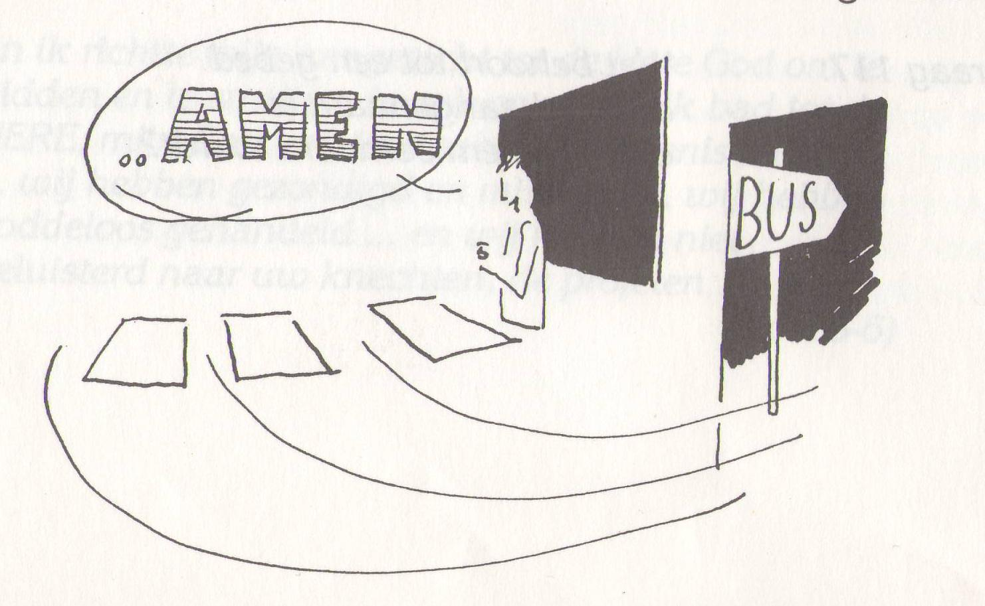
A quick prayer okay?

Slide 13
The Lord’s Prayer
that’s what life is all about
Our Father who is in heaven
Hallowed be
Your Name
Your Kingdom Come
Your will be done, on earth as it is in heaven
Give us And forgive us And lead us not
this day our debts as we into temptation
our daily have forgiven our but deliver us
bread debtors from evil
For Yours is the Kingdom, the power, and the glory, forever
Amen
thereto
thereto
thereto
&
&
For

Slide 14
Praying by your fingers

Middle finger.
Bad.
Ring. Love others
Point it out.
Thumbs up.
Great.
Pinky. Least important.
forgive, renew
thanks
others
praise
myself

Slide 15
The parts to prayer
Thank you LORD, for this and that
LORD, I’m sorry. Please, forgive and change me.
LORD, please be with ...
LORD, you are great.
forgive
LORD, be with me too
thanks
others
praise
myself

Slide 16
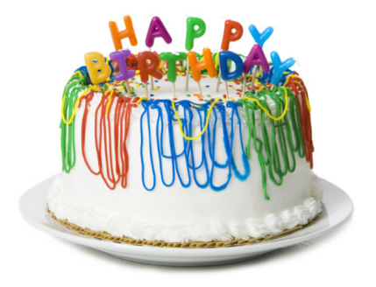
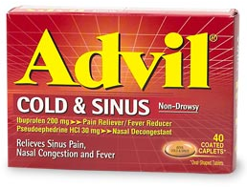
What shall we pray for?


