Slide 1
The Fruit of Faith: LD 32-44
♥
Respect for personal honour
Lesson 19 – LD 43

Slide 2
Psalm 12:1,4
1.Help us, O Lord! The godly all have vanished;
gone are the faithful who your judgments seek.
Men lie to one another, truth is banished;
with flatt’ring lips and double heart they speak.
4.The words of promise which the Lord has spoken
are purest silver seven times refined.
His cov’nant stands from age to age unbroken;
he is our God, in truth and faith enshrined.

Slide 3
9th commandment
You shall
not testify falsely against your neighbour
condemn another without hearing
Don’t
twist another’s words
speak evil of another
lie about another
uphold another’s honour
Do
do justice to others

Slide 4
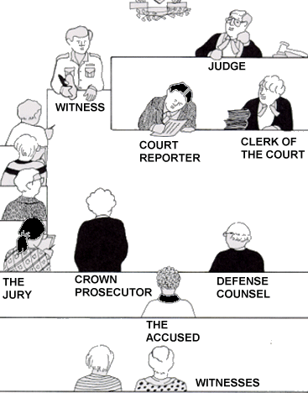
A court room
The 9th commandment uses the situation of a court room to indicate how we are to speak about each other

Slide 5
Bible Study: 1 Kings 21
What does God command in the 9th commandment?
I must not
1 give false testimony against anyone,
2 twist anyone’s words,
3 not gossip or slander,
4 nor condemn or
5 join in condemning anyone rashly and unheard.
_ Ahab
_ Jezebel
_ The elders and leaders
_ The worthless men
_ The people

Slide 6
Bible Study: 1 Kings 21
What does God command in the 9th commandment?
I must not
1 give false testimony against anyone,
2 twist anyone’s words,
3 not gossip or slander,
4 nor condemn or
5 join in condemning anyone rashly and unheard.
2 Ahab
3 Jezebel
4 The elders and leaders
1 The worthless men
5 The people

Slide 7
The issue

We are to do all we can to protect the name of other people.
This promotes love and loyalty in society.
How does it feel to be the victim?
You feel like you might as well be dead.
How does it feel to be the perpetrator?
You’re never sure when people will take revenge.

Slide 8
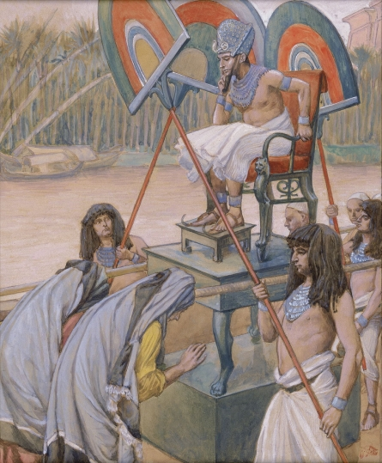
Bible Study: Exodus 1:15-21
1. They were midwives
2. boys; girls
3. God
4. No
5. No
6. That the babies were already born before the midwives arrived

Slide 9
Bible Study: Exodus 1:15-21
7. Yes
8. God blessed both the people and the midwives
9. A white lie

Slide 10
Other examples of white lies
Rahab, when she hid the spies and told the Jericho police the spies had fled the city. Thus she saved the spies.
David, when he is fleeing from Saul and tells the priest he needs bread and a weapon because he is on a special mission. Thus he tried to prevent the priests from becoming his accomplices.
Jesus, when He said He would not go to the feast, but He did. Thus He prevented upheaval. (Note: Most translations of John 7:8 read that Jesus said he was not yet going to the feast. )

Slide 11
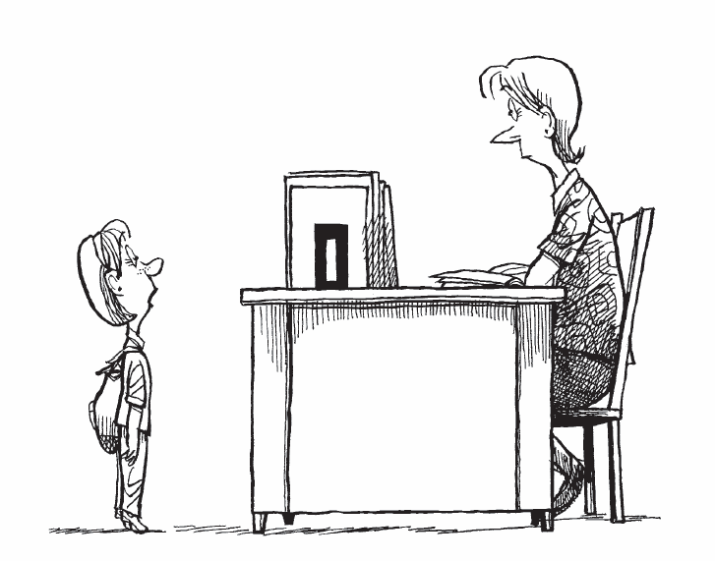
The 9th commandment

(Untrue) Excuses
To your advantage but no consequence for another
Telling something not true
Our computer didn’t work, so I couldn’t do my homework

Slide 12
The 9th commandment

Lying
To your advantage and the disadvantage of another
Telling something not true
Johnny tore up my homework sheet, so I couldn’t do my homework.

Slide 13
The 9th commandment

Gossip
Of no consequence for you but to the disadvantage of another, telling something true
Jacky is so poor she has newspaper under her clothes to keep warm

Slide 14
The 9th commandment

Slander
Of no consequence for you but the disadvantage of another, telling something not true
Anne never eats her lunch, she always throws it in the garbage.

Slide 15
The 9th commandment

Tall story
Of no consequence for anyone,
Telling something not true
My Dad is so strong, he could lift this desk with one finger.

Slide 16
The 9th commandment

Whistle blowing
Possibly to your disadvantage and certainly to someone else’s, telling something true
Peter and Bert are bullying Esther every day on the bus.

Slide 17
The 9th commandment

White lie
Of no consequence for you but the advantage of another, telling something not true
Anne was really sick yesterday, so she couldn’t do her homework

Slide 18
Ways of speaking
Disadvantage (x) advantage (✓) no consequences (-)
Consequences for: yourself another true?
Excuses
Lying
Gossip
Slander
Tall story
Whistle blowing
White lie
✓
-
x
✓
x
x
-
x
✓
-
x
x
-
-
x
x
x
✓
-
✓
x

Slide 19
Ways of speaking
Disadvantage (x) advantage (✓) no consequences (-)
Consequences for: yourself another true?
Excuses
Lying
Gossip
Slander
Tall story
Whistle blowing
White lie
✓
-
x
✓
x
x
-
x
✓
-
x
x
-
-
x
x
x
✓
-
✓
x

Slide 20
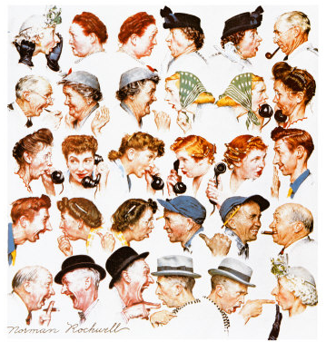
How shall we speak?

The 9th commandment teaches us
To love our neighbour and the truth together
When you speak, consider
- What does the most justice to the truth
- What does the least damage to myself and my neighbour

Slide 21
9th commandment
You shall
not testify falsely against your neighbour
condemn another without hearing
Don’t
twist another’s words
speak evil of another
lie about another
uphold another’s honour
Do
do justice to others

