Slide 1
The Fruit of Faith: LD 32-44
♥
Give God Your Heart
Lesson 20 – LD 44

Slide 2
Psalm 119:1
1. How blessed are those upright in their way,
who keep the Lord’s decrees with dedication
and in their walk of life his law obey.
How blest are those who with determination,
wholeheartedly, seek him by night and day
and look to him for guidance and salvation.

Slide 3
10th commandment
You shall
not even desire wrong
Don’t
want to do wrong things
Do
do want to keep all God’s commandments

Slide 4
Desires

There are good and bad desires
Thus there is nothing wrong with desiring itself
The Lord forbids the type of desiring that does damage to God or a person

Slide 5
From desire to act
Desire thought act
I want an I need to I get a job
iPad get money
This applies to both good and bad desires

Slide 6
Desire – thought - act
------other commandments-----
Desire thought act
I want an I need to I get a job
iPad get money & earn money
--10th commandment---

Slide 7
Example: 10th and 8th commandment
------8th commandment-----
Desire thought act
I want an ----------- ------------
iPad ----------- ------------
--10th commandment---

Slide 8
Example: 10th and 8th commandment
------8th commandment-----
Desire thought act
I want an The store I steal
iPod has plenty an iPad
--10th commandment---

Slide 9
Example: 10th and 6th commandment
------ 6th commandment -----
Desire thought act
I hate ---------- ----------
Remka ---------- ----------
--10th commandment---

Slide 10
Example: 10th and 6th commandment
------ 6th commandment -----
Desire thought act
I hate I can make I keep calling
Remka her life her names
miserable
--10th commandment---

Slide 11
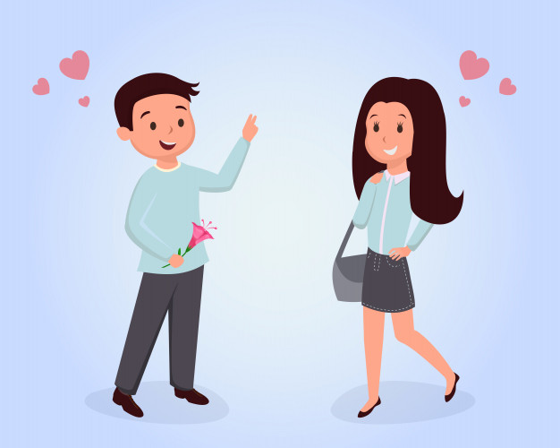
Example: 10th and 7th commandment
------ 7th commandment -----
Desire thought act
I want to ---------- ----------
date Jenny ---------- ----------
but she
likes Peter
--10th commandment---

Slide 12
Example: 10th and 7th commandment
------ 7th commandment -----
Desire thought act
I want to I’ve got to I give Jenny
date Jenny get Jenny money and
but she to like me say bad things
likes Peter about Peter
--10th commandment---

Slide 13
Example: 10th and 9th commandment
------ 9th commandment -----
Desire thought act
I want to be ---------- ----------
more popular ---------- ----------
than Jack
--10th commandment---

Slide 14
Example: 10th and 9th commandment
------ 9th commandment -----
Desire thought act
I want to be I need to I spread the
more popular give Jack a story Jack is
than Jack bad name a drug-addict
--10th commandment---
(During political campaigns
these are “attack ads”)

Slide 15
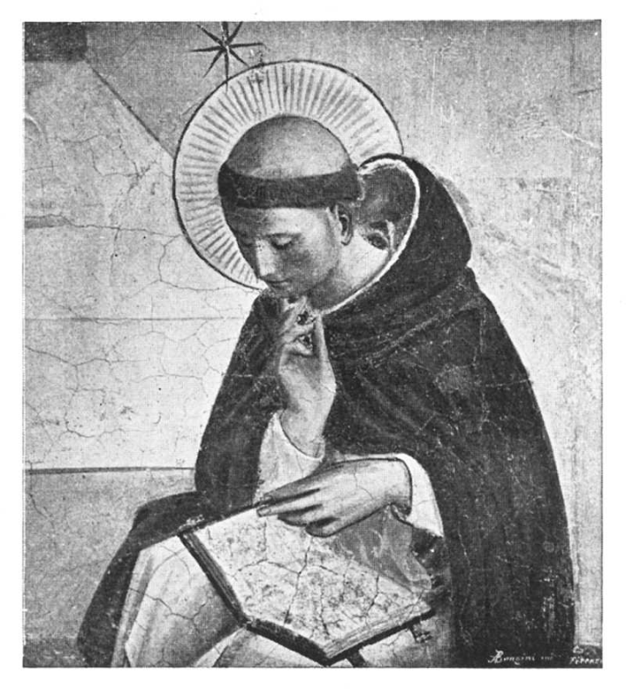
What’s new is

Not just thoughts and actions can be wrong.
Even desiring can be wrong!
God doesn’t just look at the outside.
He judges people by their heart.
Luther called the tenth commandment
the commandment for the pious.
Any idea why that might be?

Slide 16
Bible Study: Romans 7:7-12
1. The law makes known to us what sin is
2. The tenth commandment is about our ‘inside’, not our outside. We can look kind of fine on the outside, but even the converted are still sinful within.
3. (Spiritual) death.
4. It has us look at our desires and causes us to realize how sinful we actually are: dead in our sins.
5. Because it seeks what is good for all: God and all creatures.
6. Sin (our own self-centredness).

Slide 17
God asks everything
What does the tenth commandment require of us?
That not even the slightest thought or desire
contrary to any of God’s commandments
should ever arise in our heart.
Rather, with all our heart
we should always hate all sin
and delight in all righteousness.

Slide 18
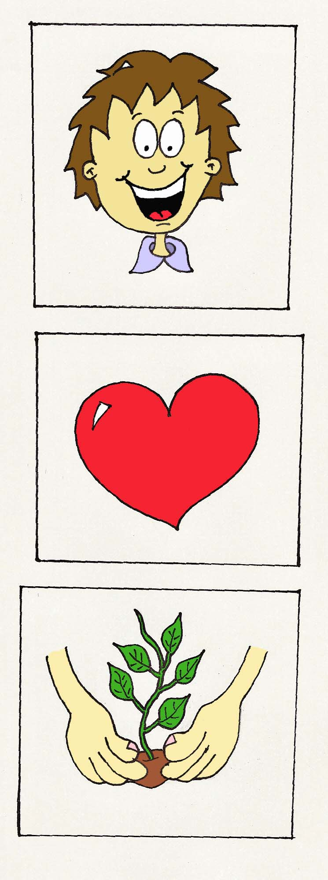
The law makes us pray
Head: Know what God expects
Know the ten commandments
Pray for insight and understanding
Heart: Desire what God expects
Purify and adjust your desires
Pray for a pure and godfearing heart
Hands: Do what God expects
Adjust your thoughts and lifestyle
Pray for power unto love and loyalty

Slide 19
The law makes us pray

No man can keep the commandments of God
Man cannot keep them by nature
Man cannot keep them when converted
Even the best people still sin
We need superhuman power, indeed divine power!
We need the Holy Spirit
Only God can give us the Holy Spirit
And so we ask God to give Him to us,
We PRAY
godly

Slide 20
The law makes us pray

Head: Know what God expects
I have to know the ten commandments
I need to pray for insight and understanding
Heart: Desire what God expects
I have to purify and adjust my desires
I need to pray to want to do what is right
Hands: Do what God expects
I have to adjust my thoughts and lifestyle
I need to pray for power unto love and loyalty

Slide 21
Calvin’s Motto


