Slide 1

The communication of Faith:
LD 45-52
Pray: You Need To
Lesson 21 – LD 45

Slide 2
Psalm 141:1,7
1.Hasten, Lord! Hear my supplication.
O let my prayer like incense rise;
receive as evening sacrifice
the hands I lift in adoration.
7.Lord, my eyes I fix now directly
on you, my helper in the strife.
Save me from danger, guard my life;
in your unfailing love, protect me.

Slide 3
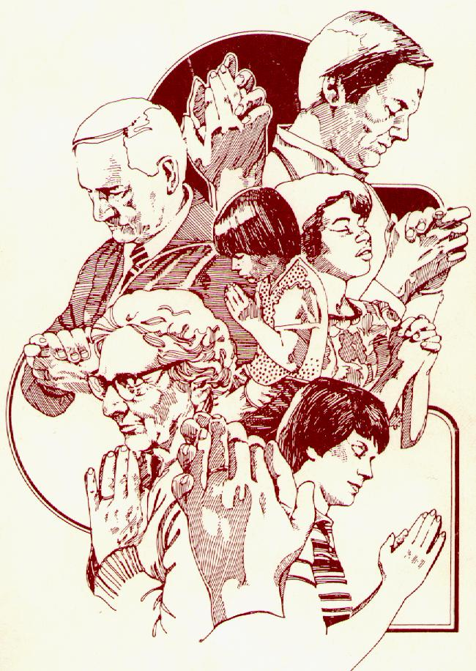
When?
Praying is second nature to Christians.
But when and why do we pray?
Is it out of custom or because you
feel the need to talk with God?
Do the exercise on the worksheet
Pray continually
1 Thessalonians 5:17

Slide 4
Why we pray
God
God’s Word
Prayer
God’s
Commandments
Good
Works
Believer

Slide 5
Why?

In His Word, God commands people to do good.
No one can do good without God’s involvement.
That’s why people pray:
  to be aware of their need for God and
  to ask God to be involved in their lives.
God’s good commandments
+
Man’s inability to do good
=
prayer

Slide 6
Modern thought on prayer
Liberal Christians believe not in God but in faith
To them prayer is talking with yourself.
They consider prayer good, it forces you to think about things.
Is prayer no more than meditation?
Prayer does indeed have you think things through. But it is more: it is talking with a real Person who is your God, both willing and able to help.

Slide 7

Bible Study: Psalm 86
1. A prayer of David
2. Because he is poor and needy
3. Verse 7
4. He is great, the only God, and all will worship Him
5. Teach him God’s way and give him an undivided heart
6. Merciful and gracious, slow to anger, abounding in steadfast love and faithfulness
7. Helped him and comforted him.
Psalm 86 is a good example
of a prayer of someone who is in need.

Slide 8
Not optional
116.Q. Why is prayer necessary for Christians?
A. Because prayer is the most important part
of the thankfulness which God requires of us.
Moreover, God will give His grace and the Holy Spirit
only to those who
constantly and with heartfelt longing
ask Him for these gifts and thank Him for them.

Slide 9
What is prayer?

Prayer is not
- a personal wish-list (I want…)
- a list of demands (God, you have to…)
- a shot in the dark (It can’t hurt to pray and may work)
Rather:
Prayer is focused on God’s desires
The person praying is a sinner speaking to holy God.
The person praying is to have faith in God

Slide 10
117.Q. What belongs to a prayer which pleases God and is heard by Him?
A. First,
we must from the heart call upon the one true God only, who has revealed Himself in His Word, for all that He has commanded us to pray.
Second,
we must thoroughly know our need and misery, so that we may humble ourselves before God.
Third,
we must rest on this firm foundation that, although we do not deserve it, God will certainly hear our prayer for the sake of Christ our Lord, as He has promised us in His Word.

Slide 11
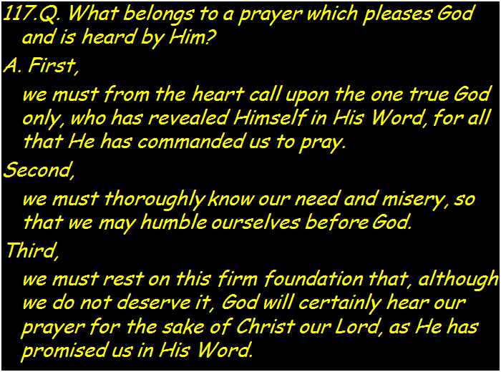
A proper prayer

pray only
to God
be humble before God
have faith in God

Slide 12
The Lord’s Prayer
that’s what life is all about
Our Father who is in heaven
Hallowed be
Your Name
Your Kingdom Come
Your will be done, on earth as it is in heaven
Give us And forgive us And lead us not
this day our debts as we into temptation
our daily have forgiven our but deliver us
bread debtors from evil
For Yours is the Kingdom, the power, and the glory, forever
Amen
thereto
thereto
thereto
&
&
For

Slide 13





Praying by your fingers

Middle finger.
Bad.
Ring. Love others
Point it out.
Thumbs up.
Great.
Pinky. Least important.
forgive
forgive
thanks
others
thanks
others
praise
praise
praise
myself

Slide 14
The parts to prayer
Thank you LORD, for this and that
LORD, I’m sorry. Please, forgive and change me.
LORD, please be with ...
LORD, you are great.
forgive
LORD, be with me too
thanks
others
praise
myself

Slide 15
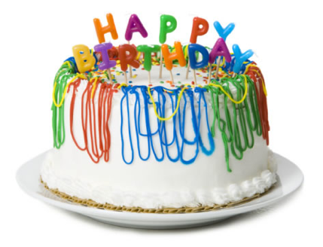



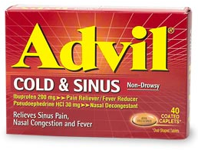
What shall we pray for? (time permitting)

