Slide 1
The communication of Faith: LD 45-52
Our Heavenly Father
Lesson 22 – LD 46

Slide 2
Hymn 63:1
1. Our Father, great in majesty,
enthroned in heaven eternally,
with childlike trust we seek your face,
relying on your love and grace.
In faith and reverence we draw near
for you, in Christ, our prayer will hear.

Slide 3
The Lord’s Prayer
Our Father who is in heaven
Hallowed be
Your Name
Your Kingdom Come
Your will be done, on earth as it is in heaven
Give us And forgive us And lead us not
this day our debts as we into temptation
our daily have forgiven our but deliver us
bread debtors from evil
For Yours is the Kingdom, the power, and the glory, forever
Amen
thereto
thereto
thereto
&
&
For

Slide 4
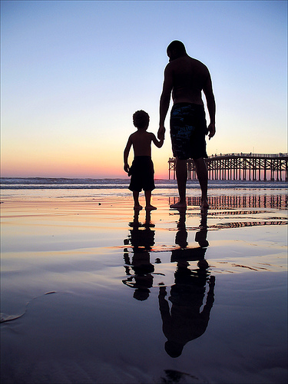
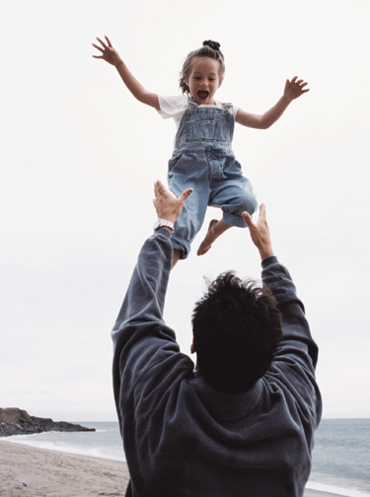
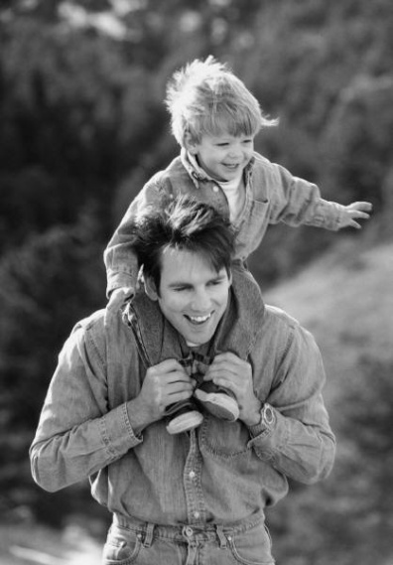
Praying to … whom?
How do you see (picture) God when you pray?
Do the exercise at the top of the worksheet.
He is an awesome God, worthy of respect He is a loving and loyal God, worthy of trust

Slide 5
Bible Study: Isaiah 6 & 63
1. The Lord. On a throne. High and lifted up.
2. Holy, holy, holy is the LORD of hosts, the whole earth is full of His glory.
3. Unclean, very small and frightened.
4. Because he was sinful and God is the King
5. Atonement was made from the altar
6. The steadfast love of the LORD
7. Their saviour
8. Because the Israelites are His people and His children.
Notes:
“LORD of hosts”: Yahweh of the heavenly armies.
Answer to q.7 is v.8b, answer to q.8 is vs.8a

Slide 6
Respect and Trust
respect
trust

Slide 7
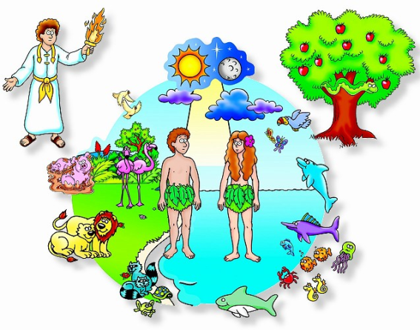
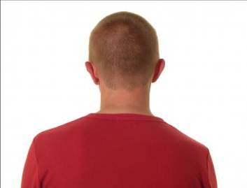
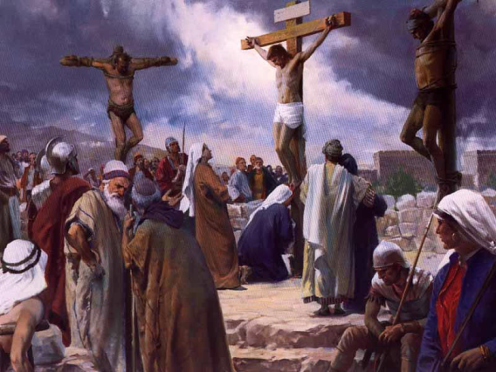
Father

Because we have been created by God, all people are God’s children.
However, by their fallen nature people turn their backs on God, they disown God as Father.
God restores us in the Father-child relationship through Jesus Christ.
Thus believers are children of God only through Christ.

Slide 8
Children of God

Christ is the Son of God.
We are children of God too.
What is the difference between Christ and us?
The difference between Christ and us is the following. Christ is the natural Son of God, like the Father He is God. Today we are children of God by adoption in Christ.

Slide 9
Catechism
120.Q. Why has Christ commanded us to address God as Our Father?
A. To awaken in us at the very beginning of our prayer that childlike reverence and trust toward God which should be basic to our prayer: God has become our Father through Christ and will much less deny us what we ask of Him in faith than our fathers would refuse us earthly things.
121.Q. Why is there added, in heaven?
A. These words teach us not to think of God’s heavenly majesty in an earthly manner, and to expect from His almighty power all things we need for body and soul.
Do the exercise: Fathers and Children

Slide 10
Catechism
120.Q. Why has Christ commanded us to address God as Our Father?
A. To awaken in us at the very beginning of our prayer that childlike reverence and trust toward God which should be basic to our prayer: God has become our Father through Christ and will much less deny us what we ask of Him in faith than our fathers would refuse us earthly things.
121.Q. Why is there added, in heaven?
A. These words teach us not to think of God’s heavenly majesty in an earthly manner, and to expect from His almighty power all things we need for body and soul.
In faith means: with trust, having confidence in, believing in

Slide 11
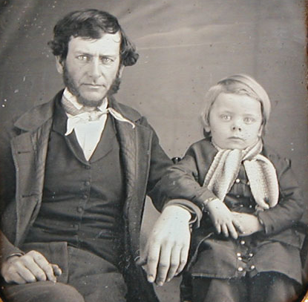
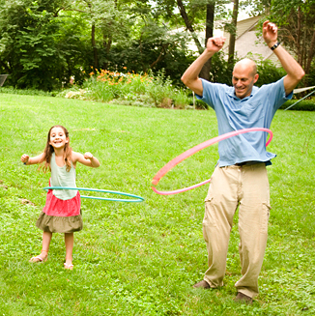
Earthly Fathers and Heavenly Father

God compares Himself with earthly fathers. This means earthly fathers (and mothers) must be mirror images of God.
However, earthly parents are not almighty, and are sinful
Our understanding of God may thus be skewed by the way our parents, especially our fathers, are.
Besides, how fathers are, changes with time...

Slide 12
Earthly Fathers and Heavenly Father
I
my dad
God my Father
God my Father
my dad
I

Slide 13
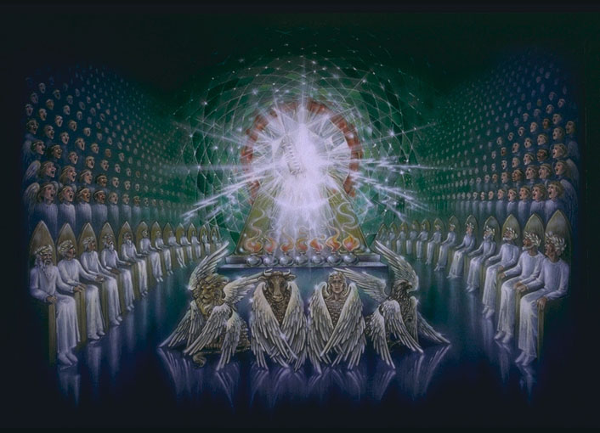
In Heaven

What is meant by God being in heaven?
Not so much a reference to where God is (for God is everywhere)
But a reference to how God is
God is the exalted One, Almighty.

Slide 14
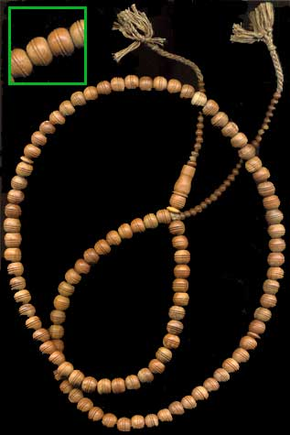
Father?

Muslims pray to Allah.
Their subha (a kind of rosary) has 99 small beads, one for each name of Allah, and one large one, for Allah himself. There’s one name missing: father.
Muslims won’t call Allah father. They are afraid of Allah. Their religion is one of pure submission.
(Islam is Arabic for “submission”.)

Slide 15
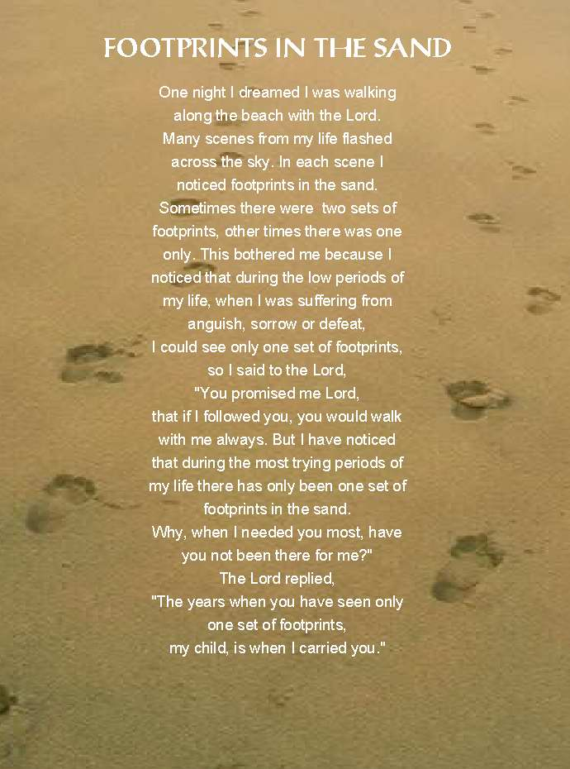
Father!

In the OT we hardly ever read of God being addressed as father. How did the Israelites address God?
Christians pray to God. Christ taught us to address God as Father. Christians have respect for God, their religion is one of love and loyalty.

