Slide 1
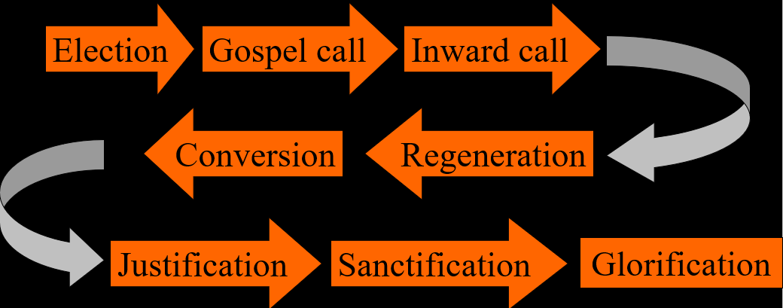
The Order of Salvation
Glorification - Millennialism
Lesson 18

Slide 2
Hymn 70:1,2,3,4
1. Day of judgment! Day of wonders!
Hark! The trumpet’s awesome sound,
louder than a thousand thunders,
shakes the vast creation round.
How the summons will the sinner’s heart confound!
2. See the Judge, our nature wearing,
clothed in majesty divine;
you who long for his appearing
then shall say, "This God is mine!"
Gracious Saviour, own me in that day as thine.

Slide 3
Hymn 70:1,2,3,4
3. At his call the dead awaken,
rise to life from earth and sea;
all the evildoers, shaken
by his looks, prepare to flee.
Careless sinner, what will then become of thee?
4. But to those who have confessèd,
loved and served the Lord below,
he will say, "Come near, you blessèd,
see the kingdom I bestow;
you forever shall my love and glory know."

Slide 4
God’s Picture Book

Most Old Testament Bible books belong to the genre “prophecy”. In the New Testament, there is only one such book: the Revelation of Christ to John.
What is Revelation about? Of all Bible books, the interpretations of this book differ the most, even among Reformed people, even in the CanRC.
Some of those differences relate to Revelation 19-20, about the timing of the various events described there: the 1000 year reign, the tribulation, and the final judgment.

Slide 5
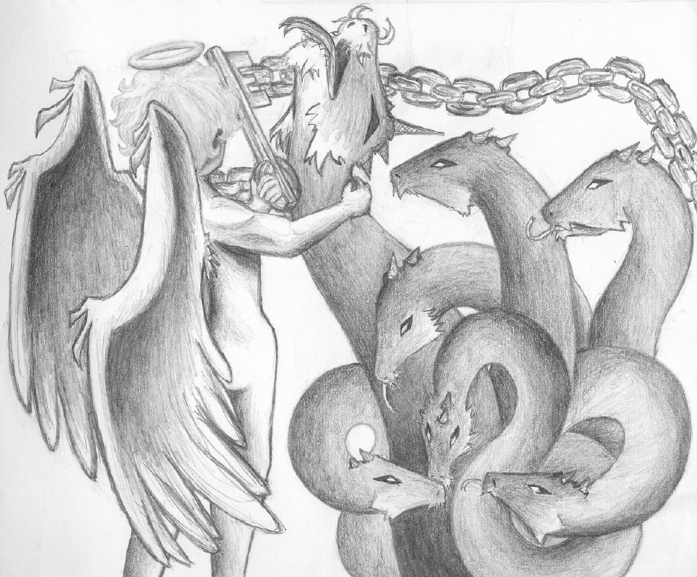
Bible Study: Revelation 20

Slide 6
Bible Study: Revelation 20
1. An angel
2. The Abyss (the bottomless pit)
The place of punishment for devils (hell)
3. The dragon = ancient serpent = devil = Satan
4. Deceive the nations
Convince nations as a whole that God is irrelevant
5. All those who believe in Christ, especially those who have been martyred for the faith
6. The first resurrection
The complete process of conversion and regeneration, also known as the rebirth.

Slide 7
Bible Study: Revelation 20
7. He goes out to deceive the nations, and sets up an army to fight God’s people
8. No
9. Into the lake of burning sulphur
10. All people who have ever lived
11. According to their works
12. When his name is not found in the Book of Life (the citizenship list of the new creation)

Slide 8
Millennialism

Coming from Revelation 20, there are four basic views:
Premillennialism: Christ’s return is before the millennial reign of Christ. The tribulation is a distinct period
Postmillennialism: Christ’s return is after the millennial reign of Christ. The tribulation is a distinct period.
Amillennialism: Christ’s return is after the millennial reign of Christ. The tribulation is not a distinct period.
Preterism: Christ’s return was in 70 AD, after the reign of thousands (not years). The tribulation was before 70 AD.

Slide 9
Older view

Slide 10
Common in evangelical circles (Left Behind by Jerry B. Jenkins and Tim LaHaye)

Slide 11
The two compared…

Slide 12
The Rapture

Slide 13
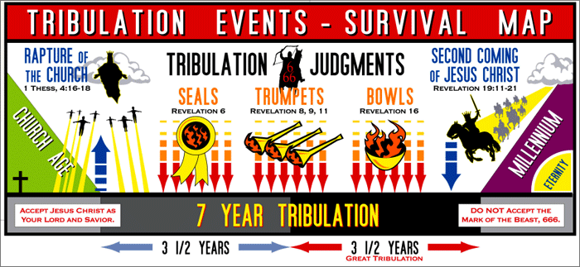
A flyer for those left behind (by premillennialists)

Slide 14
Most Common Reformed view
New Creation
Amillennialism is actually a wrong name, it should be Nunc-millennialism

Slide 15
A comparison

Slide 16
Preterism
New Creation

Slide 17
Rev. Janssen’s view
Revelation was written prior to the destruction of Jerusalem in 70 AD, and is mostly about that event
In other words: Christ came in 70 AD, and there was a Judgment Day then.
Revelation is also about a future, last coming of Christ, when He will usher in the new world.
The Lord Jesus Christ can return any moment.
This position is generally referred to as “partial preterism”.
I tell you the truth, this generation will certainly not pass away until all these things have happened. Matthew 24:34

Slide 18
Rev. Janssen’s view

Slide 19
Two returns of Christ?
When analyzed, Rev. J’s view implies two returns of Jesus Christ. Is that Biblical?
Yes. The nature of prophecy is that it looks from a distance at a mountain range, and all things blend as one.
When Isaiah prophesied of the virgin/young maiden bearing a son, that was a reference to Hezekiah and to Jesus.
The Judgment that came over Israel in 70 AD forewarns the world: the Final Judgment is coming.

