Slide 1
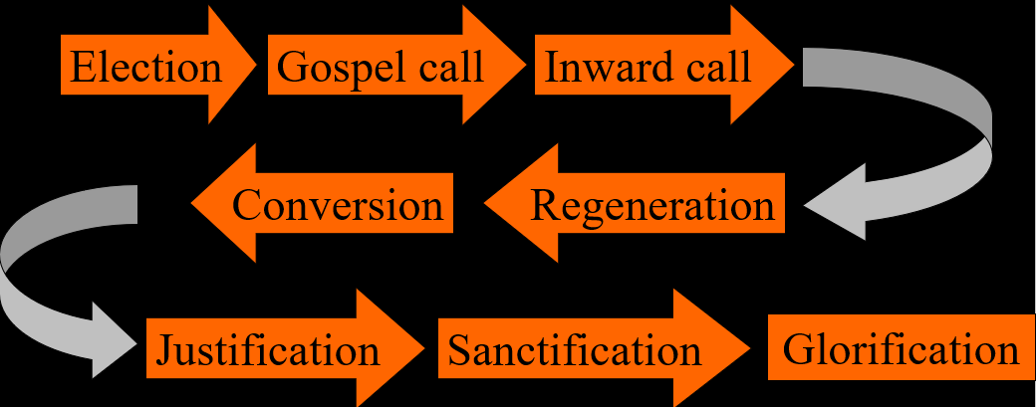
The Order of Salvation
Glorification - Millennialism
Lesson 20

Slide 2
Hymn 68:5,6
5. God his own shall glorify
in a wondrous transformation.
Though not all of us may die,
all shall gain their full salvation
in the twinkling of an eye
when the Lord comes from on high.

Slide 3
Hymn 68:5,6
6. When we hear the trumpet’s sound
and the dead are raised immortal,
we shall see with joy profound
how the grave must serve as portal
leading past all woe and strife
into everlasting life.

Slide 4
Millennialism

Coming from Revelation 20, there are four basic views:
Premillennialism: Christ’s return is before the millennial reign of Christ. The tribulation is a distinct period
Postmillennialism: Christ’s return is after the millennial reign of Christ. The tribulation is a distinct period.
Amillennialism: Christ’s return is after the millennial reign of Christ. The tribulation is not a distinct period.
Preterism: Christ’s return was in 70 AD, after the reign of thousands (not years). The tribulation was before 70 AD.

Slide 5
Older view

Slide 6
Common in evangelical circles (Left Behind by Jerry B. Jenkins and Tim LaHaye)

Slide 7
The two compared…

Slide 8
The Rapture

Slide 9
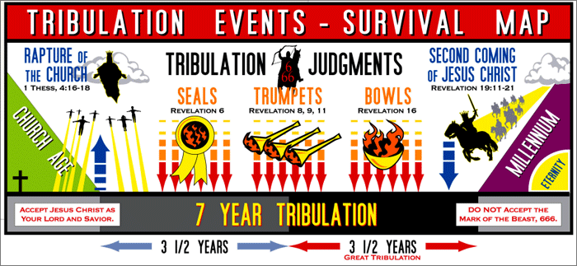
A flyer for those left behind (by premillennialists)

Slide 10
Most Common Reformed view
New Creation
Amillennialism is actually a wrong name, it should be Nunc-millennialism

Slide 11
A comparison

Slide 12
Preterism
New Creation

Slide 13
Rev. Janssen’s view
Revelation was written prior to the destruction of Jerusalem in 70 AD, and is mostly about that event
In other words: Christ came in 70 AD, and there was a Judgment Day then.
Revelation is also about a future, last coming of Christ, when He will usher in the new world.
The Lord Jesus Christ can return any moment.
This position is generally referred to as “partial preterism”.
I tell you the truth, this generation will certainly not pass away until all these things have happened. Matthew 24:34

Slide 14
Rev. Janssen’s view

Slide 15
Two returns of Christ?
When analyzed, Rev. J’s view implies two returns of Jesus Christ. Is that Biblical?
Yes. The nature of prophecy is that it looks from a distance at a mountain range, and all things blend as one.
When Isaiah prophesied of the virgin/young maiden bearing a son, that was a reference to Hezekiah and to Jesus.
The Judgment that came over Israel in 70 AD forewarns the world: the Final Judgment is coming.

