Slide 1
Church and State
Belgic Confession article 36
Lesson 19

Slide 2
Psalm 72:1
1.O God, give to the king your justice,
his son your righteousness.
You are the God in whom our trust is;
your hand alone can bless.
May he, the royal son, be reigning
with judgments true and sure,
to all your people right ordaining,
your justice to the poor.
Read: Romans 13:1-7

Slide 3
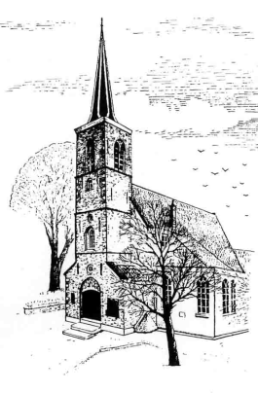
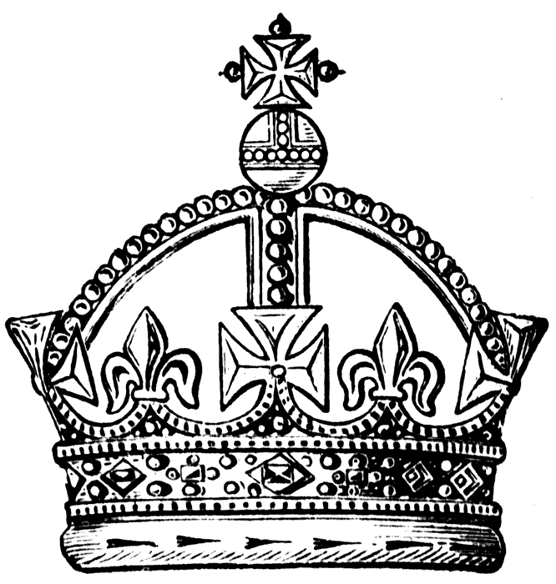
Views
Roman Catholic
Lutheran & Anglican
Anabaptist (old Mennonite)
Reformed / Presbyterian

Slide 4
Belgic Confession article 36
1. Because of the depravity of mankind
2. The sword
3. Public order and the church
4. Everyone.
5. All things that do not disagree with God’s Word
6. To lead a quiet and peaceable life, godly and respectful in every way
7. That of the Anabaptists (Mennonites)

Slide 5
In the confession
Our confessions are doctrinal standards.
Should they contain a statement on the civil government?
Historically they do, because there are different views of the relationship church-state
Substantially they should because
- Scripture does teach us on this
- It impacts hugely on our practice

Slide 6
Origin of Civil Government

The secular theory on the origin of government is the social contract, people voluntarily forming a group and choosing a government.
It basically consists of two parts:
- individuals form a society: they relinquish liberties and take on duties with a view to protection and well-being
- a body within the group is given authority to
- provide structure within the group
- safeguard order within the group
- promote the well-being of the group with a view to outsiders
However, government is NOT man’s invention BUT God’s institution.

Slide 7
Tasks of the Civil Government

1. To order society. Even in a perfect world, there will need to be order. You can’t have everybody doing anything.
2. To restrain the lawlessness of man
Note: Art. 36 BC refers to the “depravity of mankind”. However, even the angels have a system of authority. Thus a civil government would also exist in a perfect society.

Slide 8
Forms of Civil Government
Monarchy: rule by a particular family
Absolute: The monarchy is the only power
Constitutional: The monarchy shares its power with another body
Republican: like a constitutional monarchy, but the ‘monarch’ is actually the “law” (aka “rule of law”)
Dictatorship: like an absolute monarchy, but by an individual
Oligarchy: rule by a select group
Democracy: rule by an elected group
Centralized: power in one place
Decentralized: power shared over various places

Slide 9
The situation of Israel

Israel was both the church and the state.
Thus church and state matters are intertwined.
The form of government is known as Theocracy, “rule by God.”
The king was in every way the direct representative of God, responsible, among other things, for the continuation of worship.
Some Reformed scholars will argue that theocracy is the only form of civil government allowed, even today.

Slide 10
The situation of the NT church

The people of God is not limited to one society, it is found within all societies.
The practices of the church have ‘spiritualized’
- e.g. excommunication has replaced capital punishment
The New Testament does not advocate a particular form of government.
Even the OT doesn’t. Israel may have been theocratic, but before Moses and during the Exile (Daniel!) other forms were allowed to exist.
Traditionally, the Reformed favour a (Christian) monarchy or benevolent dictatorship.
Today there is a preference for democracy.

Slide 11
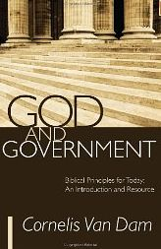
Useful resources
Magazine: Reformed Perspective
Book: God and Government
Organizations:
ARPA – Association for Reformed Political Action
CHP – Christian Heritage Party
Lobby groups such as
WeNeedALaw.ca
Campaign Life Coalition
Canadian Centre for Bio-Ethical Reform

