Slide 1
Church and State
Belgic Confession article 36
Lesson 22

Slide 2
Psalm 72:10
The king whose name we are professing
shall like the sun endure.
In him all nations find their blessing;
their peace will be secure.
Blest be the LORD, for he so glorious
alone does wondrous things.
O God, in all the earth our chorus
with “Amen, Amen” rings.

Slide 3
In the confession
Our confessions are doctrinal standards.
Should they contain a statement on the civil government?
Historically they do, because there are different views of the relationship church-state
Substantially they should because
- Scripture does teach us on this
- It impacts hugely on our practice

Slide 4
Origin of Civil Government

The secular theory on the origin of government is the social contract, people voluntarily forming a group and choosing a government.
It basically consists of two parts:
- individuals form a society: they relinquish liberties and take on duties with a view to protection and well-being
- a body within the group is given authority to
- provide structure within the group
- safeguard order within the group
- promote the well-being of the group with a view to outsiders
However, government is NOT man’s invention BUT God’s institution.

Slide 5
Tasks of the Civil Government

1. To order society. Even in a perfect world, there will need to be order. You can’t have everybody doing anything.
2. To restrain the lawlessness of man
Note: Art. 36 BC refers to the “depravity of mankind”. However, even the angels have a system of authority. Thus a civil government would also exist in a perfect society.

Slide 6
Forms of Civil Government
Monarchy: rule by a particular family
Absolute: The monarchy is the only power
Constitutional: The monarchy shares its power with another body
Republican: like a constitutional monarchy, but the ‘monarch’ is actually the “law” (aka “rule of law”)
Dictatorship: like an absolute monarchy, but by an individual
Oligarchy: rule by a select group
Democracy: rule by an elected group
Centralized: power in one place
Decentralized: power shared over various places

Slide 7
The situation of Israel

Israel was both the church and the state.
Thus church and state matters are intertwined.
The form of government is known as Theocracy, “rule by God.”
The king was in every way the direct representative of God, responsible, among other things, for the continuation of worship.
Some Reformed scholars will argue that theocracy is the only form of civil government allowed, even today.

Slide 8
The situation of the NT church

The people of God is not limited to one society, it is found within all societies.
The practices of the church have ‘spiritualized’
- e.g. excommunication has replaced capital punishment
The New Testament does not advocate a particular form of government.
Even the OT doesn’t. Israel may have been theocratic, but before Moses and during the Exile (Daniel!) other forms were allowed to exist.
Traditionally, the Reformed favour a (Christian) monarchy or benevolent dictatorship.
Today there is a preference for democracy.

Slide 9
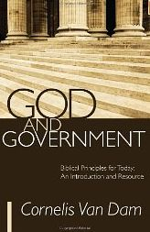
Useful resources
Magazine: Reformed Perspective
Book: God and Government
Organizations:
ARPA – Association for Reformed Political Action
CHP – Christian Heritage Party
Lobby groups such as
WeNeedALaw.ca
Campaign Life Coalition
Canadian Centre for Bio-Ethical Reform

Slide 10
Sphere Sovereignty
Notes:
\

Slide 11
Sphere Sovereignty

The three main spheres are family, church, and state
God and His Christ have supreme sovereignty in each sphere
Psalm 24: The earth is the LORD’s, and all who dwell in it
Ephesians 1: And God has seated Christ far above all rule and authority and power and dominion … and has put all things under His feet.
Each sphere is sovereign in matters belonging to it
For example, vengeance does not belong to humans but to God (Rom 12:19), who uses authorities to execute it (Rom 13:4)
Notes:
There is no denying that there is such a thing as sphere sovereignty.

Slide 12
Sphere Sovereignty: BC 36 – URC version
…And being called in this manner to contribute to the advancement of a society that is pleasing to God, the civil rulers have the task, subject to God’s law, of removing every obstacle to the preaching of the gospel and to every aspect of divine worship.
They should do this while completely refraining from every tendency toward exercising absolute authority, and while functioning in the sphere entrusted to them, with the means belonging to them.
They should do it in order that the Word of God may have free course; the kingdom of Jesus Christ may make progress; and every anti-Christian power may be resisted.

Slide 13
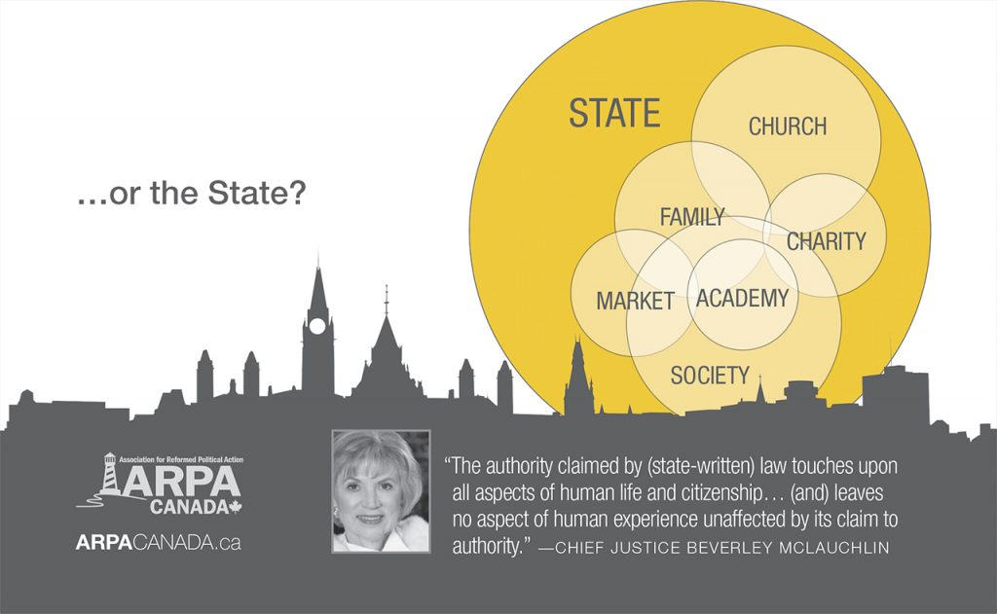
…for the threat is

Slide 14
The Government and the Church

In relation to the church, the government is to
- ensure that religion can be practiced unhindered
- allow for worship on Sunday
- give room for locations of and facilities for worship
- protect the true religion
- other religions are not oppress the true religion.
The extent of “protection” is variously understood by Reformed scholars. In the 20th century it was felt the Reformed of the 16th century had taken it too far. Hence 20 words were removed from art. 36. Others feel they should remain, some of these will favour a theocracy.

Slide 15
The Government and the Church - BC 36
Their task of restraining and sustaining is not limited to the public order but includes the protection of the church and its ministry in order that * the kingdom of Christ may come, the Word of the gospel may be preached everywhere,4 and God may be honoured and served by everyone, as he requires in his Word.
* The following words were deleted here by the General Synod 1905 of the Reformed Churches in the Netherlands (Gereformeerde Kerken in Nederland): all idolatry and false worship may be removed and prevented, the kingdom of antichrist may be destroyed.

Slide 16
The Church and the Government

In relation to the government, the church is to
- pray for all those in authority
- impress upon Christians the necessity of obeying the authorities
- address the government on the spiritual side to issues
In relation to addressing the government, there are various opinions among Reformed scholars. In our churches it is generally argued to be the task of individual Christians; churches are only to facilitate such action. Others feel the church may and should directly address the government on issues.

Slide 17
Limits

Governing authorities are not allowed to dictate to the church what it should teach or believe.
In most modern states a government will not want to do so either.
But in China, the government interferes big time!
The church is not allowed to exercise types of authority that belong to the government.
- A church is not allowed to impose fines, imprisonment, or perform physical punishment.

Slide 18
Participation in politics/society
There are two ‘poles’ between which the Reformed will choose a position.
Christian Heritage Party
Conservative Pary
Isola-tionist
Integra-tionist
Only CanRC
Only Reformed
Only Christians
Wherever the goal is common

Slide 19
Neutral?
Some Reformed scholars argue a government should be neutral, neither favouring nor discouraging a religion.
Others argue a government should not be neutral.
Of these:
- some limit the role of the government to the fifth through ninth commandments
- others argue the third through ninth commandments
- others argue the first through ninth commandments
note: The tenth commandment cannot be ‘policed’.

Slide 20
Practising politics: a case study
A municipal council is to decide whether a particular soccer field can be used for a soccer tournament on a Sunday. The issue is whether the grass can handle it.
A Christian councillor is convinced the grass can handle it. However, he is opposed to the soccer tournament as it is on a Sunday.
Should he vote in favour or against the tournament?

Slide 21
In the confession
Our confessions are doctrinal standards.
Should they contain a statement on the civil government?
Historically they do, because there are different views of the relationship church-state
Substantially they should because
- Scripture does teach us on this
- It impacts hugely on our practice

Slide 22
Origin of Civil Government

The secular theory on the origin of government is the social contract, people voluntarily forming a group and choosing a government.
It basically consists of two parts:
- individuals form a society: they relinquish liberties and take on duties with a view to protection and well-being
- a body within the group is given authority to
- provide structure within the group
- safeguard order within the group
- promote the well-being of the group with a view to outsiders
However, government is NOT man’s invention BUT God’s institution.

Slide 23
Tasks of the Civil Government

1. To order society. Even in a perfect world, there will need to be order. You can’t have everybody doing anything.
2. To restrain the lawlessness of man
Note: Art. 36 BC refers to the “depravity of mankind”. However, even the angels have a system of authority. Thus a civil government would also exist in a perfect society.

Slide 24
Forms of Civil Government
Monarchy: rule by a particular family
Absolute: The monarchy is the only power
Constitutional: The monarchy shares its power with another body
Republican: like a constitutional monarchy, but the ‘monarch’ is actually the “law” (aka “rule of law”)
Dictatorship: like an absolute monarchy, but by an individual
Oligarchy: rule by a select group
Democracy: rule by an elected group
Centralized: power in one place
Decentralized: power shared over various places

Slide 25
The situation of Israel

Israel was both the church and the state.
Thus church and state matters are intertwined.
The form of government is known as Theocracy, “rule by God.”
The king was in every way the direct representative of God, responsible, among other things, for the continuation of worship.
Some Reformed scholars will argue that theocracy is the only form of civil government allowed, even today.

Slide 26
The situation of the NT church

The people of God is not limited to one society, it is found within all societies.
The practices of the church have ‘spiritualized’
- e.g. excommunication has replaced capital punishment
The New Testament does not advocate a particular form of government.
Even the OT doesn’t. Israel may have been theocratic, but before Moses and during the Exile (Daniel!) other forms were allowed to exist.
Traditionally, the Reformed favour a (Christian) monarchy or benevolent dictatorship.
Today there is a preference for democracy.

Slide 27
Useful resources
Magazine: Reformed Perspective
Book: God and Government
Organizations:
ARPA – Association for Reformed Political Action
CHP – Christian Heritage Party
Lobby groups such as
WeNeedALaw.ca
Campaign Life Coalition
Canadian Centre for Bio-Ethical Reform

