Slide 1

The communication of Faith:
LD 45-52
Hallowed be Your Name
Lesson 23 – LD 47

Slide 2
Psalm 99:2,6
2. Let them spread the fame of his awesome name;
holy is the Lord and to be adored.
Let them praise their King, of his justice sing.
Worship him uprightly. He, the King, is mighty.
6. You came to their aid when to you they prayed;
you forgave them then, though you punished sin.
Come to Zion’s hill and perform God’s will;
praise him, high and lowly, for the Lord is holy.

Slide 3
The Lord’s Prayer
Our Father who is in heaven
Hallowed be
Your Name
Your Kingdom Come
Your will be done, on earth as it is in heaven
Give us And forgive us And lead us not
this day our debts as we into temptation
our daily have forgiven our but deliver us
bread debtors from evil
For Yours is the Kingdom, the power, and the glory, forever
Amen
thereto
thereto
thereto
&
&
For

Slide 4
Hallowed

Hallowed is an adjective meaning “respected and important”
Hallowed is related to holy.
In the Bible, holy means “special”, devoted to God
As in the fourth commandment:
Keep the Sabbath day holy
means
Make it a special day, different from the other days

Slide 5
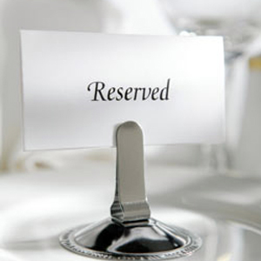
Holy means special. Like having a table reserved for you. That seat at that table is special: it is reserved for you. It is “holy”.

Slide 6
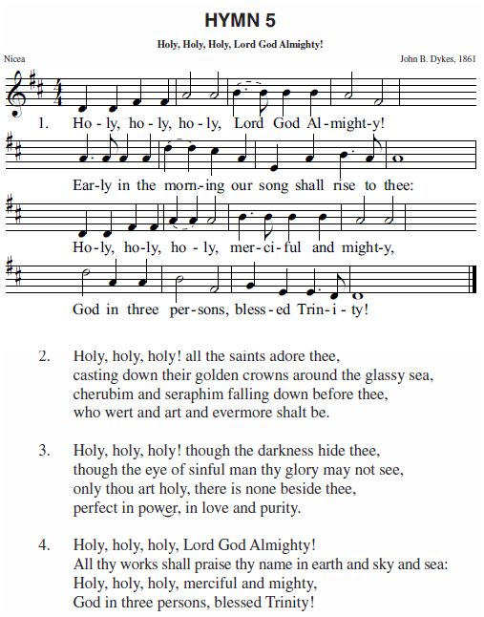
God is holy – do the exercise
"Holy, holy, holy is the LORD of hosts; the whole earth is full of his glory."
Isaiah 6:3
"Holy, holy, holy is the Lord God Almighty, who was and is and is to come."
Revelation 4:8
For I am God, and not a man—the Holy One in your midst.
Hosea 11:9

Slide 7
God is Totally Different

God People
Creator Created
Almighty Weak
Exalted Insignificant
Pure Sinful
The amazing thing is that this holy God is willing to live in the midst of His people!
We should never forget that this is very special.

Slide 8
All related to God is holy
Examples of
A holy person: prophet, priest
A holy place: Jerusalem, temple
A holy act: blessing, sacrifice, baptism
A holy time: worship service, Passover, Christmas
Examples of
A holy person:
A holy place:
A holy act:
A holy time:
But just as he who called you is holy, so be holy in all you do; for it is written: "Be holy, because I am holy."
1 Peter 1:15-16

Slide 9
Catechism
122.Q. What is the first petition?
A. Hallowed be Your name.
That is:
Grant us first of all that we may rightly know You, and sanctify, glorify, and praise You in all Your works, in which shine forth Your almighty power, wisdom, goodness, righteousness, mercy, and truth.
Grant us also that we may so direct our whole life – our thoughts, words, and actions – that Your name is not blasphemed because of us but always honoured and praised.

Slide 10
Know
What is God’s Name?
YAHWEH El Shaddai
LORD God Almighty
Powerful, Able to do whatever He wills to do
I am who I am
Everpresent
Loving and Faithful

Slide 11

El Shaddai

Slide 12
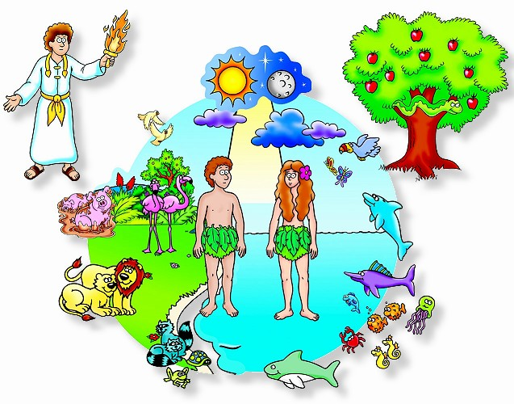
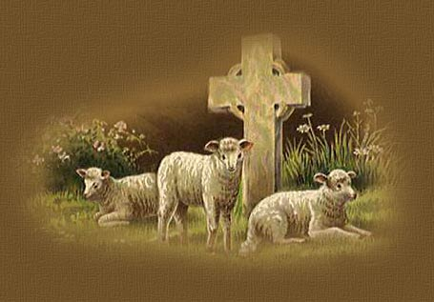
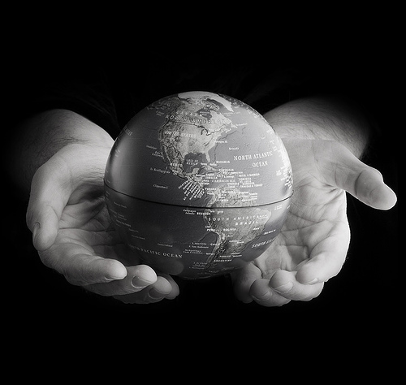

Know

Who God is.
- Loving, caring
- Loyal, faithful
- Almighty
What God does, God’s mighty deeds.
- Creation
- Salvation
- Renewal

Slide 13
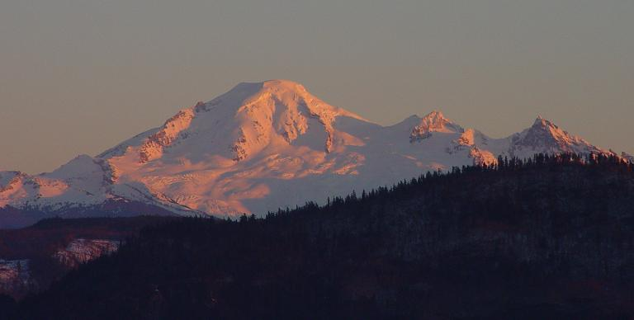
Know – do the exercise

Bible
Church service
Catechism
Nature
Arts
Reflection
...

Slide 14
Catechism
122.Q. What is the first petition?
A. Hallowed be Your name.
That is:
Grant us first of all that we may rightly know You, and sanctify, glorify, and praise You in all Your works, in which shine forth Your almighty power, wisdom, goodness, righteousness, mercy, and truth.
Grant us also that we may so direct our whole life – our thoughts, words, and actions – that Your name is not blasphemed because of us but always honoured and praised.

Slide 15
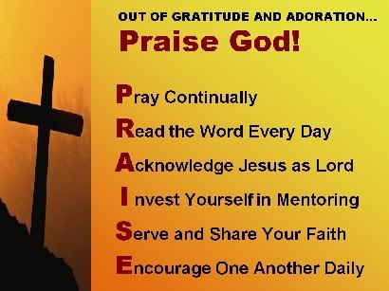
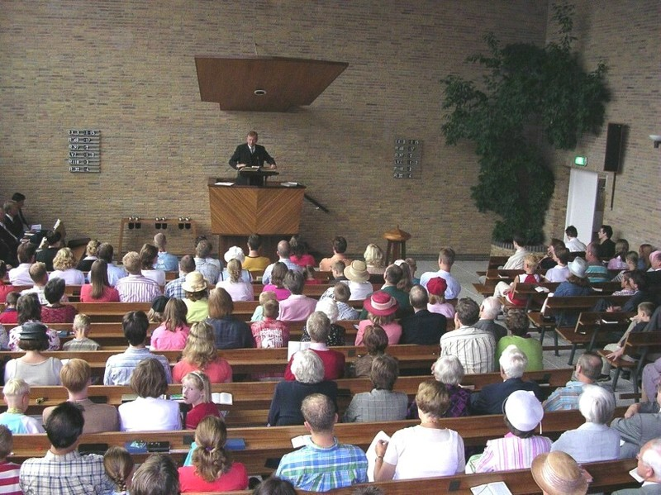
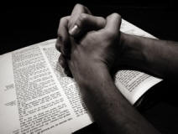
Sanctify, glorify, and praise You

Do the exercise
Take time for God
Worship
Devotions
Realize His involvement
...

Slide 16
Catechism
122.Q. What is the first petition?
A. Hallowed be Your name.
That is:
Grant us first of all that we may rightly know You, and sanctify, glorify, and praise You in all Your works, in which shine forth Your almighty power, wisdom, goodness, righteousness, mercy, and truth.
Grant us also that we may so direct our whole life – our thoughts, words, and actions – that Your name is not blasphemed because of us but always honoured and praised.

Slide 17
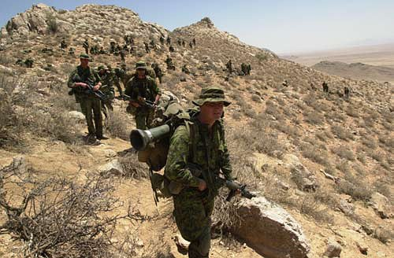
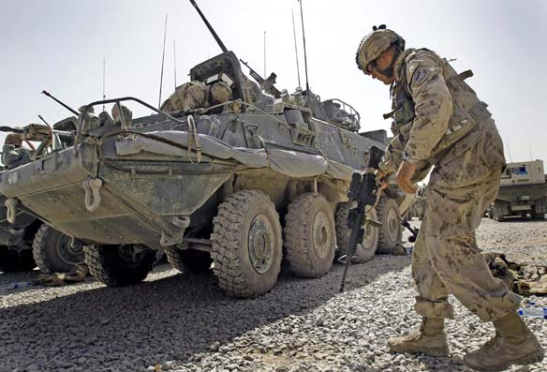
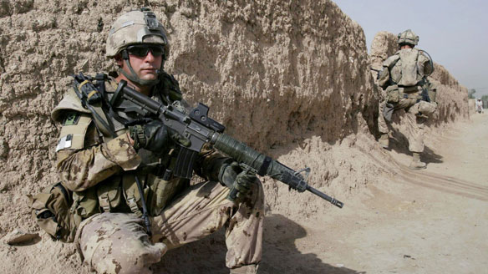
Always honoured and praised

If a Canadian soldier makes a mistake in Iraq, it reflects on the whole nation. If Canadian forces do well in Iraq, it reflects on the whole nation.
If a child does something good or bad, it reflects on his parents and family.
If a Christian does something good or bad, it reflects on God.
In the same way, let your light shine before men, that they may see your good deeds and praise your Father in heaven.
Matthew 5:16

Slide 18
Always honoured and praised

The problem is:
Because of our fallen nature
we are not inclined to do good
Hence we PRAY
Hallowed be Your Name
Show Yourself to be holy through us
For we live: for God’s sake
God’s glory is what life is all about!

