Slide 1
The communication of Faith: LD 45-52
Your Kingdom Come
Lesson 24 – LD 48

Slide 2
Hymn 63:3
Lord, may your kingdom come with haste;
lay Satan’s dark domain to waste.
May you so rule us by your Word
that we acknowledge you as Lord.
Preserve your church, make her complete
until all worship at your feet.

Slide 3
The Lord’s Prayer
Our Father who is in heaven
Hallowed be
Your Name
Your Kingdom Come
Your will be done, on earth as it is in heaven
Give us And forgive us And lead us not
this day our debts as we into temptation
our daily have forgiven our but deliver us
bread debtors from evil
For Yours is the Kingdom, the power, and the glory, forever
Amen
thereto
thereto
thereto
&
&
For

Slide 4
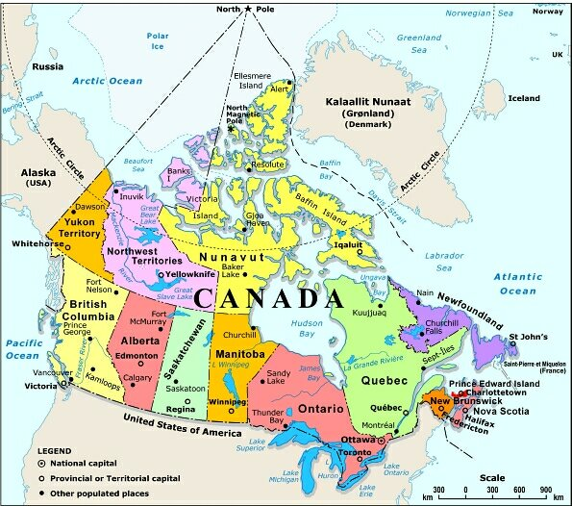
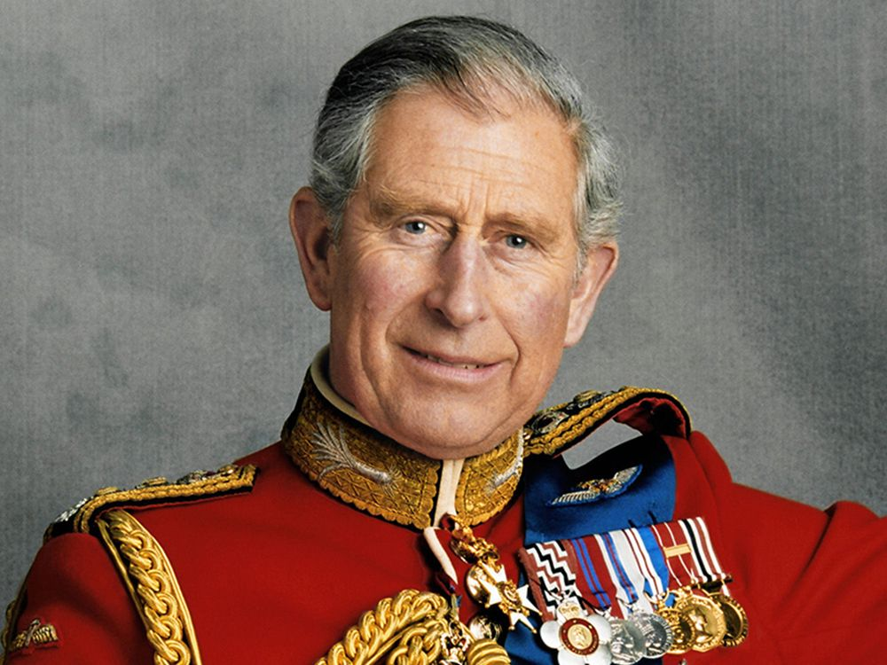
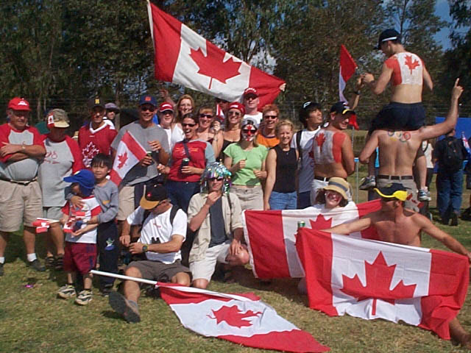
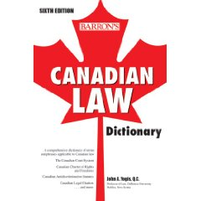
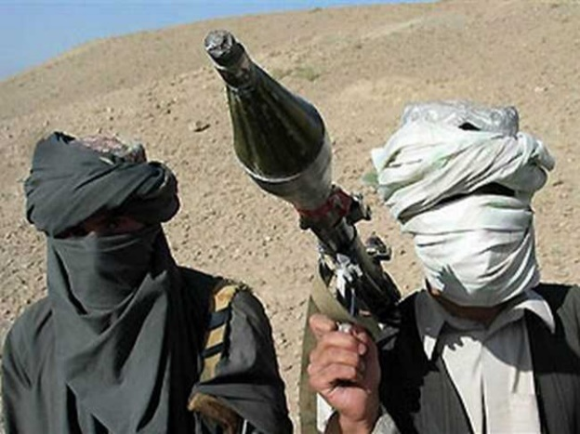
Kingdom
A Kingdom has the follow-ing characteristics:
territory
ruler
enemies
citizens
law

Slide 5
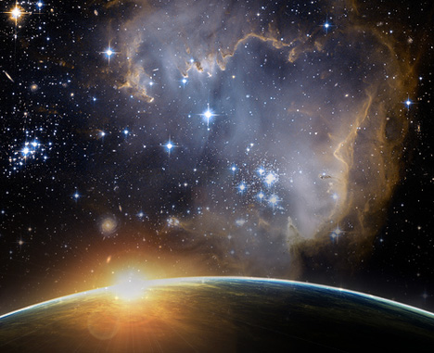
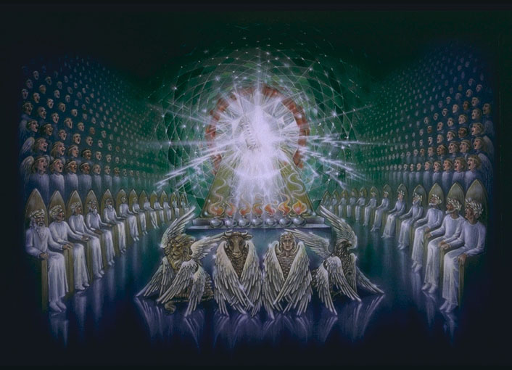
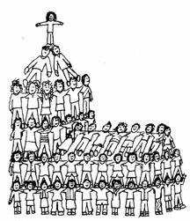
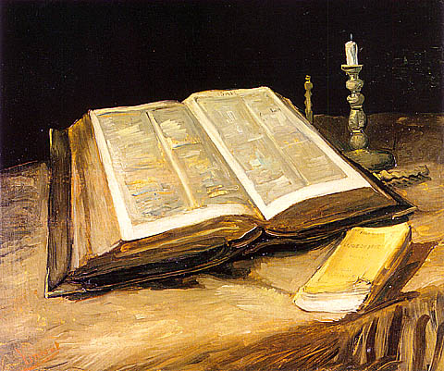
God’s Kingdom
God’s Kingdom has them also:
territory
ruler
enemies
citizens
law

Slide 6
God’s Kingdom

Territory: the universe
Ruler: God
Citizens: Believers
Law: The Bible
Enemies: Unbelievers

Slide 7
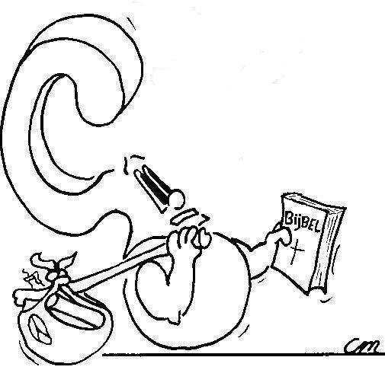
If God is King,.. why do we pray for His Kingdom to come?

Slide 8
God’s coming Kingdom

Things in a kingdom are only in order when:
- the king is respected
- the king is served (the law is obeyed)
- the citizens feel safe and secure
This is not the case in the universe today
- God is officially king, but there are enemies within the borders
- the law (Bible) is not being obeyed
- the citizens (church) are often under attack
Praying for God’s Kingdom to come is praying for the perfect world.

Slide 9
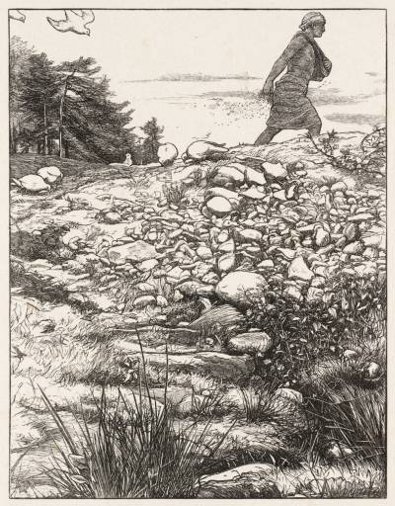
Bible Study: Matthew 13

Slide 10
Bible Study: Matthew 13
1a. fell on the path, eaten by birds
1b. fell among rocks, died back
1c. fell among weeds, choked back
1d. fell in good soil, bore fruit
2a. the devil snatches the message away
2b. troubles turn new-comers off
2c. earthly concerns turn new-comers off
2d. people believe and persevere

Slide 11
Bible Study: Matthew 13
3. Not all Christians are exactly the same: some are ‘better’ Christians (more trusting, more good works) than others. But all are part of the Kingdom.
4. The disciples should not be surprised when many people hear the preaching but do not believe it. Such people are not part of God’s Kingdom. They should also realize that among those who believe there will still be huge differences. Yet they all are part of the Kingdom of God.

Slide 12
Catechism
123.Q. What is the second petition?
A. Your kingdom come.
That is:
So rule us by Your Word and Spirit
that more and more we submit to You.
Preserve and increase Your church.
Destroy the works of the devil,
every power that raises itself against You,
and every conspiracy against Your holy Word.
Do all this
until the fullness of Your kingdom comes,
wherein You shall be all in all.

Slide 13
How does God’s Kingdom come?

For the Kingdom to come, the Kingdom must expand.
Praying for the Kingdom is praying for the Church
- to proclaim the Kingdom of God (as Christ and the apostles did)
- to grow in numbers and in knowledge & understanding
- to be safe
with a view to physical enemies (persecution)
with a view to spiritual enemies (heresies)

Slide 14
Soldiers of the Kingdom
God’s people are not just citizens, they are soldiers.
wage war
conquer
king
leader
Then Jesus came to them and said, "All authority in heaven and on earth has been given to me. Therefore go and make disciples of all nations, baptizing them into the name of the Father and of the Son and of the Holy Spirit, and teaching them to obey everything I have commanded you. And surely I am with you always, to the very end of the age."
Matthew 20:18-20

Slide 15
Outreach and the Kingdom
When speaking of spreading the Gospel we speak of:
Mission: preaching the Gospel to strange cultures, often in far away places
Evangelism: preaching the Gospel to your own culture, close to home
Our main mission activities are Brazil, Prince George, Asia Mission, Mission in Mexico.
Our main evangelism activities are Vacation Bible School, Reading Room project

Slide 16
The second petition

If God is to be hallowed, He is to be respected for Whom He is.
This only happens when His Kingdom is fully present.

