Slide 1
The communication of Faith: LD 45-52
Your Kingdom Come
Lesson 24 – LD 48

Slide 2
Hymn 63:3
Lord, may your kingdom come with haste;
lay Satan’s dark domain to waste.
May you so rule us by your Word
that we acknowledge you as Lord.
Preserve your church, make her complete
until all worship at your feet.

Slide 3
The Lord’s Prayer
Our Father who is in heaven
Hallowed be
Your Name
Your Kingdom Come
Your will be done, on earth as it is in heaven
Give us And forgive us And lead us not
this day our debts as we into temptation
our daily have forgiven our but deliver us
bread debtors from evil
For Yours is the Kingdom, the power, and the glory, forever
Amen
thereto
thereto
thereto
&
&
For

Slide 4
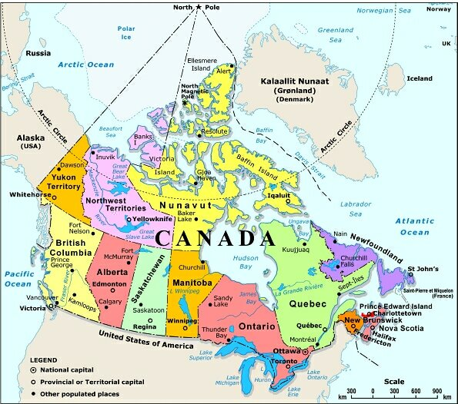
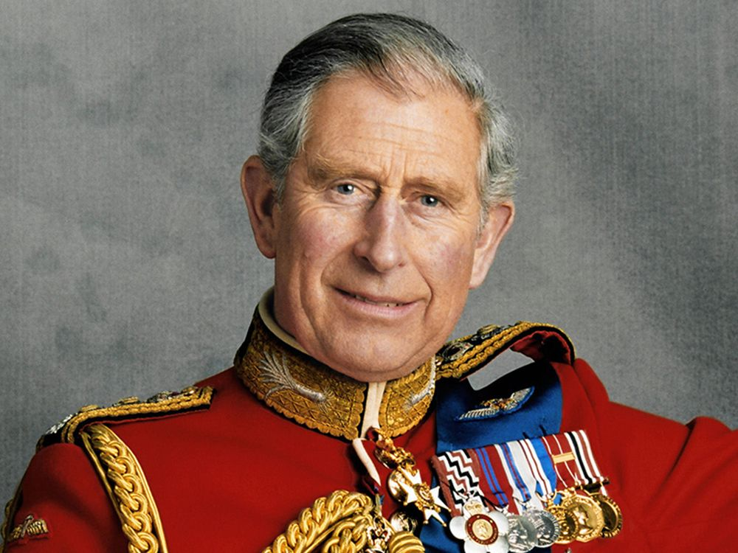
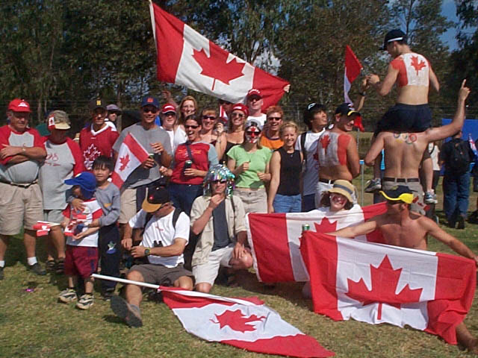
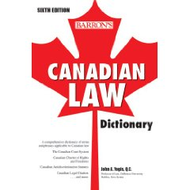
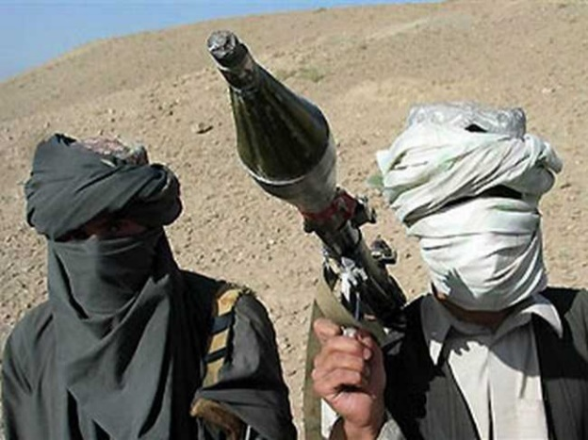
Kingdom
A Kingdom has the follow-ing characteristics:
territory
ruler
enemies
citizens
law

Slide 5
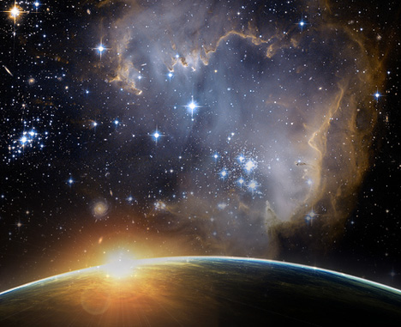
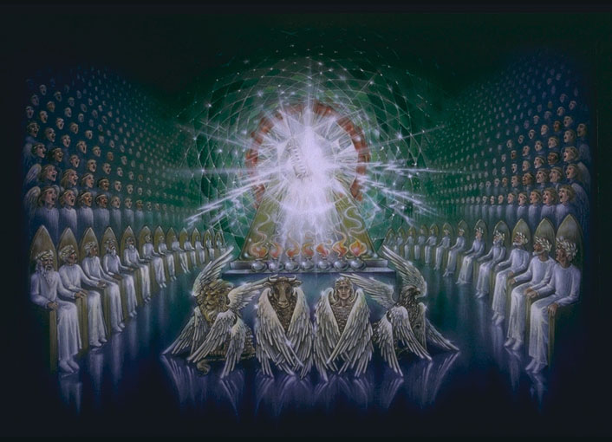
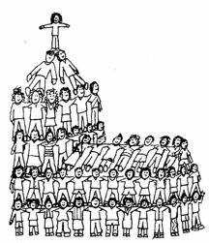
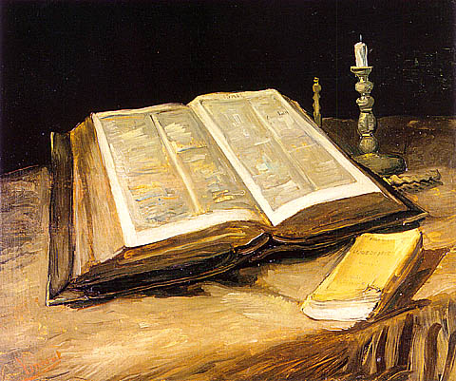
God’s Kingdom
God’s Kingdom has them also:
territory
ruler
enemies
citizens
law

Slide 6
God’s Kingdom

Territory: the universe
Ruler: God
Citizens: Believers
Law: The Bible
Enemies: Unbelievers

Slide 7
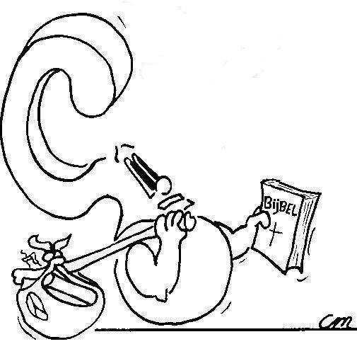
If God is King,.. why do we pray for His Kingdom to come?
Notes:
Discuss – was taught 2 years ago as well..

Slide 8
God’s coming Kingdom

Things in a kingdom are only in order when:
- the king is respected
- the king is served (the law is obeyed)
- the citizens feel safe and secure
This is not the case in the universe today
- God is officially king, but there are enemies within the borders
- the law (Bible) is not being obeyed
- the citizens (church) are often under attack
Praying for God’s Kingdom to come is praying for the perfect world.

Slide 9
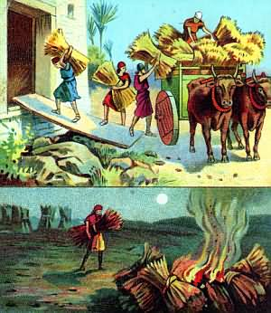
Bible Study: Matthew 13
The sower:………………
The enemy:……………
The grain:………………
The harvest:……………
The field:………………
The harvesters:……
The weeds:………………
The fiery furnace:…
Jesus Christ (Son of Man)
Satan (the devil)
Believers
Judgement Day
The world
The angels
Unbelievers
Hell
The field is the world, not the church or the kingdom of God. God will not destroy unbelievers from the face of the earth until all the believers have borne the fruit of faith.

Slide 10
How does God’s Kingdom come?

For the Kingdom to come, the Kingdom must expand.
Praying for the Kingdom is praying for the Church
- to proclaim the Kingdom of God (as Christ and the apostles did)
- to grow in numbers and in knowledge & understanding
- to be safe
with a view to physical enemies (persecution)
with a view to spiritual enemies (heresies)

Slide 11
Catechism
123.Q. What is the second petition?
A. Your kingdom come.
That is:
So rule us by Your Word and Spirit
that more and more we submit to You.
Preserve and increase Your church.
Destroy the works of the devil,
every power that raises itself against You,
and every conspiracy against Your holy Word.
Do all this
until the fullness of Your kingdom comes,
wherein You shall be all in all.

Slide 12
The Kingdom Coming Today

The spread of the Gospel
- Bible believing churches in all corners of the world
The voice of Christianity in all areas of life
- In governments
- In education & academics
- In trades
- In aid

Slide 13
Soldiers of the Kingdom
God’s people are not just citizens, they are soldiers.
wage war
conquer
king
leader
Then Jesus came to them and said, "All authority in heaven and on earth has been given to me. Therefore go and make disciples of all nations, baptizing them in[a] the name of the Father and of the Son and of the Holy Spirit, and teaching them to obey everything I have commanded you. And surely I am with you always, to the very end of the age."
Matthew 20:18-20

Slide 14
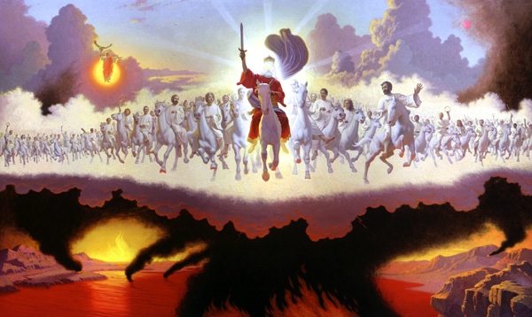
Revelation on God’s War
Revelation is the account of the war waged for God’s Kingdom.
With the Word of God as weapon (sword), Christ and believers go out to conquer the nations. In the meantime the devil is bound, restricted in his activities.
Revelation 19:11-21

Slide 15
Furthering the Kingdom

In Reformed circles there are different approaches to furthering the Kingdom.
“In isolation lies our strength”
create parallel organisations to those of society and present them as an option (e.g. Christian Heritage Party, own schools, Association for Reformed Political Action)
“Be a salting salt”
become part of existing structures and influence them from the inside out (e.g. Conservative Party, Christian schools, Advokat)

Slide 16
Furthering the Kingdom

In many situations, the approach chosen is determined by practical considerations rather than principle considerations.
Both approaches have a risk to them
- isolationism can hinder the outreach of the church (e.g. Netherlands Reformed)
- integration can water down the message of the church (e.g. Christian Reformed)

Slide 17
The second petition

If God is to be hallowed, He is to be respected for Whom He is.
This only happens when His Kingdom is fully present.

