Slide 1
Church and State
Belgic Confession article 36
Lesson 23

Slide 2
Psalm 2:3
O peoples, listen to the LORD’s decree.
I will make known his royal declaration:
“Your Father I become this very day;
you are my Son. To you I give the nations.
Ask what you will: your heritage I’ ll make them;
their lands you will possess, both near and far,
for with a rod of iron you shall break them,
dash them to pieces like a potter’s jar.”

Slide 3
Sphere Sovereignty
Notes:
\

Slide 4
Sphere Sovereignty

The three main spheres are family, church, and state
God and His Christ have supreme sovereignty in each sphere
Psalm 24: The earth is the LORD’s, and all who dwell in it
Ephesians 1: And God has seated Christ far above all rule and authority and power and dominion … and has put all things under His feet.
Each sphere is sovereign in matters belonging to it
For example, vengeance does not belong to humans but to God (Rom 12:19), who uses authorities to execute it (Rom 13:4)
Notes:
There is no denying that there is such a thing as sphere sovereignty.

Slide 5
Sphere Sovereignty: BC 36 – URC version
…And being called in this manner to contribute to the advancement of a society that is pleasing to God, the civil rulers have the task, subject to God’s law, of removing every obstacle to the preaching of the gospel and to every aspect of divine worship.
They should do this while completely refraining from every tendency toward exercising absolute authority, and while functioning in the sphere entrusted to them, with the means belonging to them.
They should do it in order that the Word of God may have free course; the kingdom of Jesus Christ may make progress; and every anti-Christian power may be resisted.

Slide 6
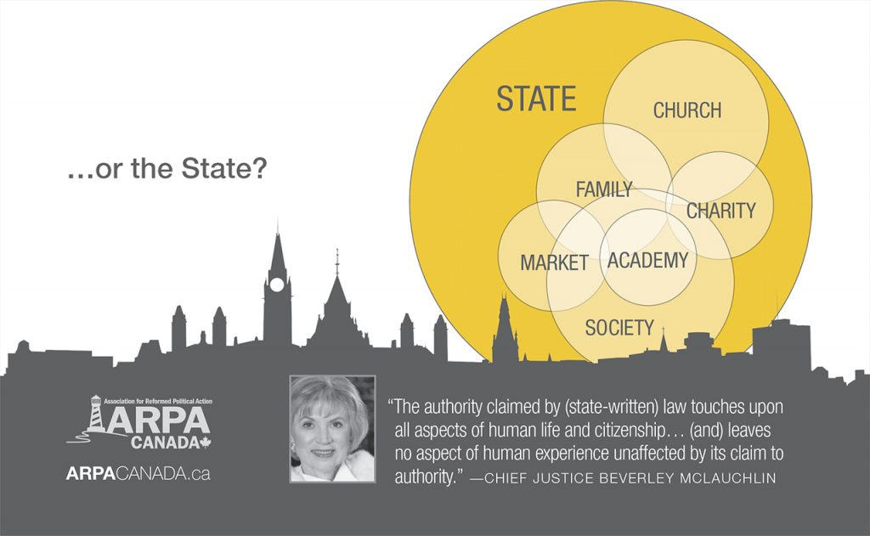
…for the threat is

Slide 7
The Government and the Church

In relation to the church, the government is to
- ensure that religion can be practiced unhindered
- allow for worship on Sunday
- give room for locations of and facilities for worship
- protect the true religion
- other religions are not oppress the true religion.
The extent of “protection” is variously understood by Reformed scholars. In the 20th century it was felt the Reformed of the 16th century had taken it too far. Hence 20 words were removed from art. 36. Others feel they should remain, some of these will favour a theocracy.

Slide 8
The Government and the Church - BC 36
Their task of restraining and sustaining is not limited to the public order but includes the protection of the church and its ministry in order that * the kingdom of Christ may come, the Word of the gospel may be preached everywhere,4 and God may be honoured and served by everyone, as he requires in his Word.
* The following words were deleted here by the General Synod 1905 of the Reformed Churches in the Netherlands (Gereformeerde Kerken in Nederland): all idolatry and false worship may be removed and prevented, the kingdom of antichrist may be destroyed.

Slide 9
The Church and the Government

In relation to the government, the church is to
- pray for all those in authority
- impress upon Christians the necessity of obeying the authorities
- address the government on the spiritual side to issues
In relation to addressing the government, there are various opinions among Reformed scholars. In our churches it is generally argued to be the task of individual Christians; churches are only to facilitate such action. Others feel the church may and should directly address the government on issues.

Slide 10
Limits

Governing authorities are not allowed to dictate to the church what it should teach or believe.
In most modern states a government will not want to do so either.
But in China, the government interferes big time!
The church is not allowed to exercise types of authority that belong to the government.
- A church is not allowed to impose fines, imprisonment, or perform physical punishment.

Slide 11
Participation in politics/society
There are two ‘poles’ between which the Reformed will choose a position.
Christian Heritage Party
Conservative Pary
Isola-tionist
Integra-tionist
Only CanRC
Only Reformed
Only Christians
Wherever the goal is common

Slide 12
Neutral?
Some Reformed scholars argue a government should be neutral, neither favouring nor discouraging a religion.
Others argue a government should not be neutral.
Of these:
- some limit the role of the government to the fifth through ninth commandments
- others argue the third through ninth commandments
- others argue the first through ninth commandments
note: The tenth commandment cannot be ‘policed’.

Slide 13
Neutral? Discuss and debate:
The government should
Only allow Christianity as religion
Finance church buildings
Fine anyone who teaches something against the Reformed confessions
Close all stores on Sunday
Only allow a family with a father and mother to adopt
Outlaw soft drugs (include nicotine?)
Outlaw homosexuality
Stop funding charities
Outlaw attack ads

Slide 14
Practising politics: a case study
A municipal council is to decide whether a particular soccer field can be used for a soccer tournament on a Sunday. The issue is whether the grass can handle it.
A Christian councillor is convinced the grass can handle it. However, he is opposed to the soccer tournament as it is on a Sunday.
Should he vote in favour or against the tournament?

