Slide 1
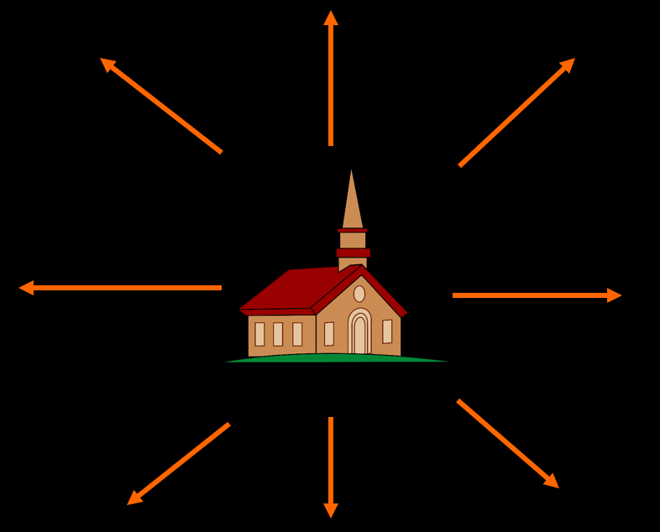
Church - Reach Out!
Mission
Lesson 24

Slide 2
Psalm 67:1
1.May God be merciful and bless us,
and cause his face on us to shine;
may he to us be ever gracious,
illumine us with light divine.
May he to all nations
show his revelation
and his ways unfold.
Great is God our Saviour.
May all see his favour
and his pow’r behold.

Slide 3
What is the Church?

Belgic Confession art. 27
A holy congregation and assembly of true Christian
believers.
Heidelberg Catechism Lord’s Day 21
Communion with Christ
Communion with other believers
Problem: Both definitions look at the church inwardly.
The “in-reach” of the church

Slide 4
In-reach

Slide 5
Out-reach?

Slide 6
Reformed and out-reach

Although the Reformed always recognized the calling to preach the word, traditionally they are not strong on outreach.
Reasons:
Confessional heritage focuses on communion
Church Order neglected evangelism and mission
At times over-emphasis on God’s sovereignty
At times over-emphasis on church growth by covenant.
Practical: too busy with own lives

Slide 7
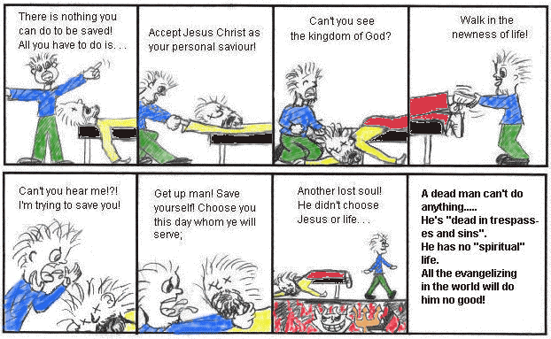
What’s the use?
All the evangelizing in the world will do him no good.

Slide 8
But
The mission command is:
The Church is called to be
a light set on a hill
salt that changes
its surroundings
Go and make disciples of all nations
Matthew 28:19

Slide 9
Bible Study: Philippians 2:1-18
1. the way believers interact with each other
2. deny yourself for the sake of others
3. glorification
4. make salvation happen, make it visible
5. because God works in us both the will and the work
6. the way believers interact towards and with the world
7. So that others might believe and be saved

Slide 10
Emphasis on outreach is increasing

Slide 11
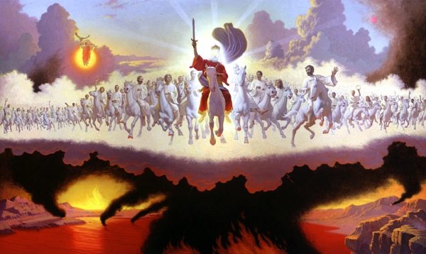
The Church

Exists for 2 reasons, both equally important
The Church is the safe haven for God’s children
Believers form the family of God
Philippians 2:1-11
The Church is the base-station of God’s soldiers
Believers form the army of God
Philippians 2:12-18

Slide 12
Definition

Mission is from the Latin word mitto, to send.
The Greek word is apostello.
A missionary or apostle is thus
someone sent out
The sending out is done with a specific purpose. The one sent out receives a mandate.
This mandate is known as the person’s mission.

Slide 13
The command
“All authority in heaven and on earth has been given to me. Go therefore and make disciples of all nations, baptizing them in the name of the Father and of the Son and of the Holy Spirit, teaching them to observe all that I have commanded you. And behold, I am with you always, to the end of the age.”
Matthew 28:18b-20
"Repent and be baptized every one of you in the name of Jesus Christ for the forgiveness of your sins, and you will receive the gift of the Holy Spirit. 39 For the promise is for you and for your children and for all who are far off, everyone whom the Lord our God calls to himself."
Acts 2:38b-39

Slide 14
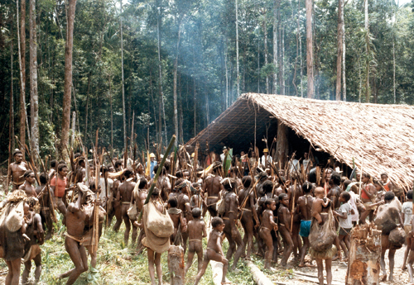
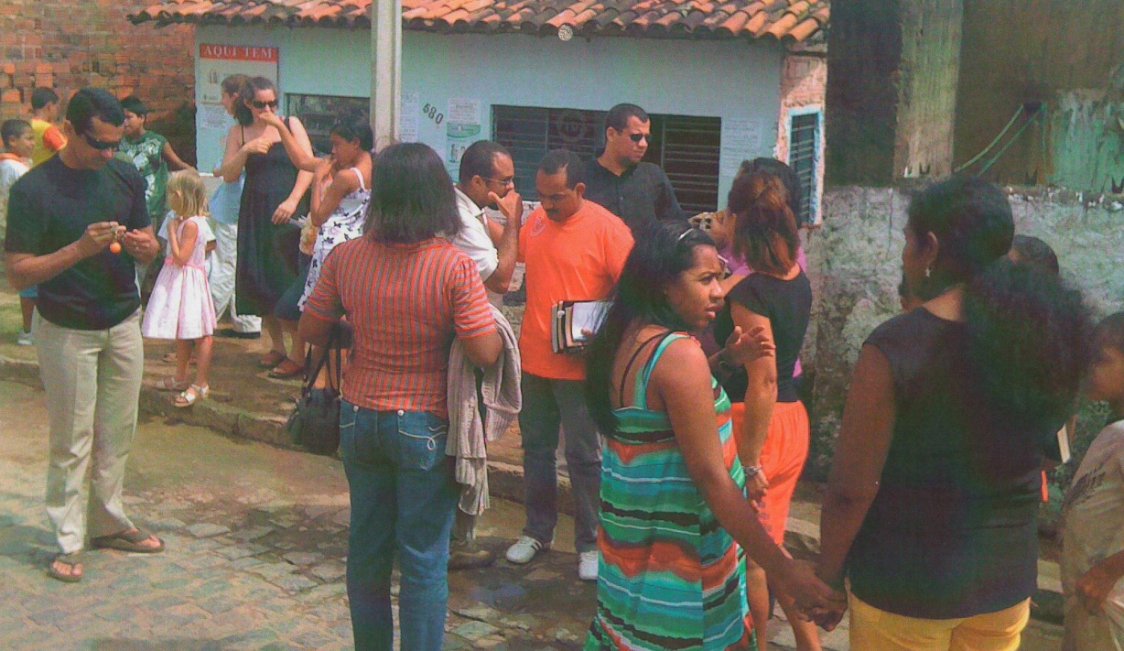
Approaches (1)

Traditionally mission was used to refer to preaching done to institute churches in foreign countries and foreign cultures.

Slide 15
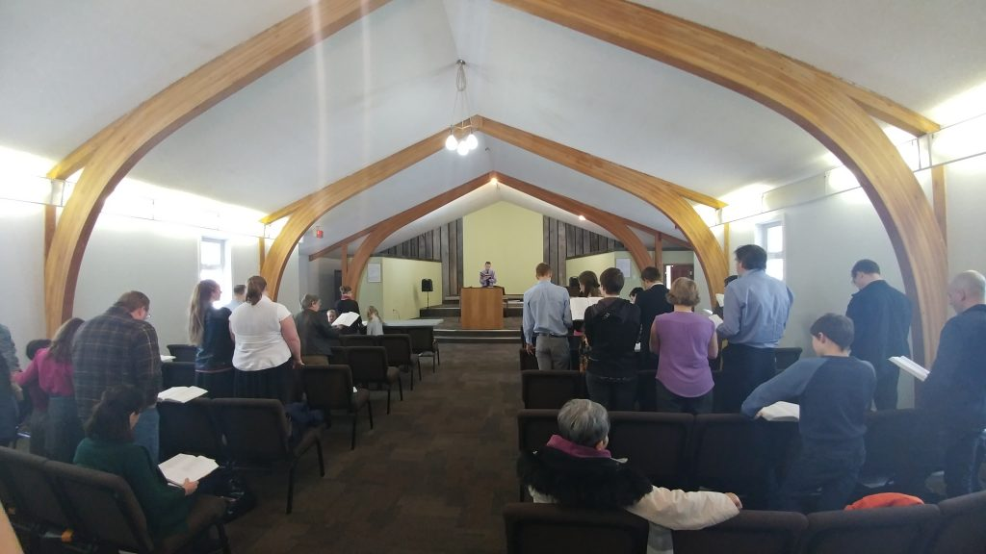
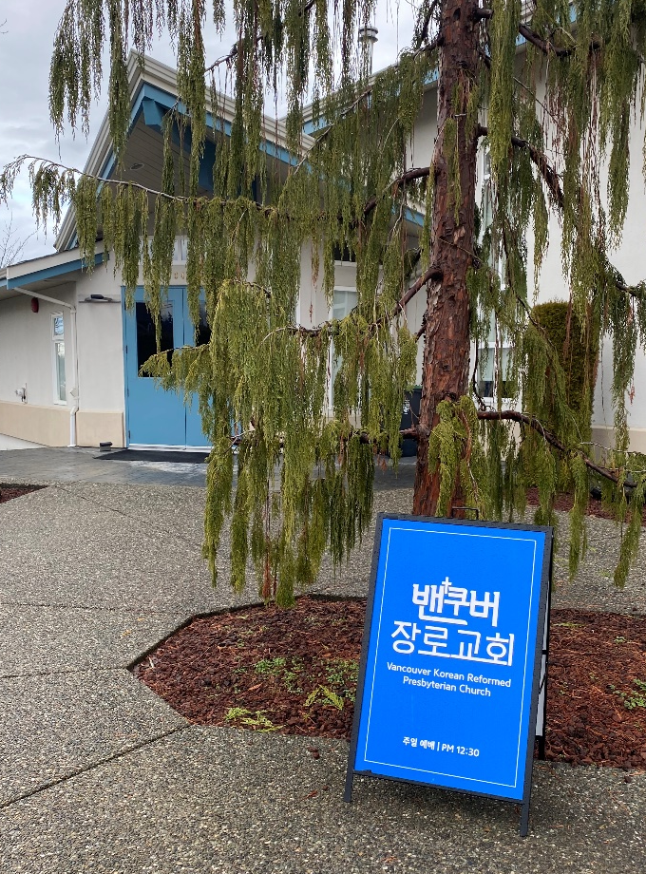
Approaches (2)

However, ‘foreign’ cultures are not always in foreign countries: Sudanese, Punjabi, First Nations, Chinese, Korean, (Dutch?)

Slide 16
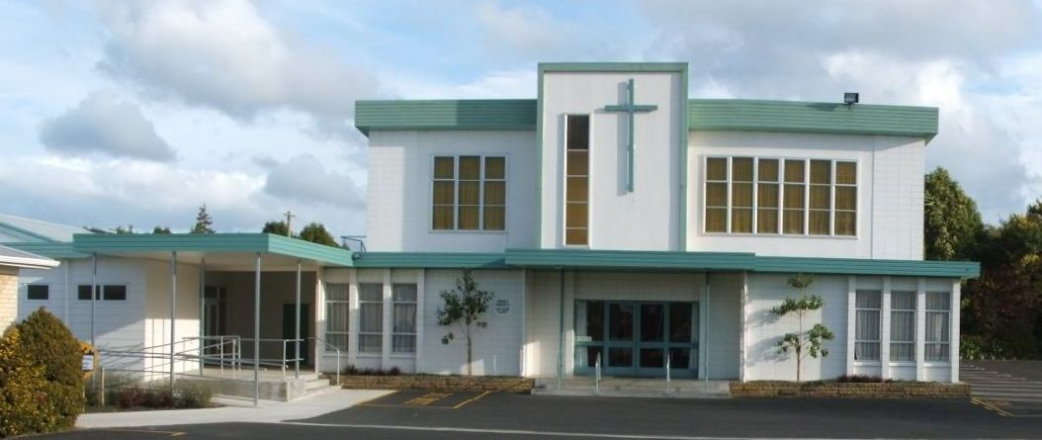
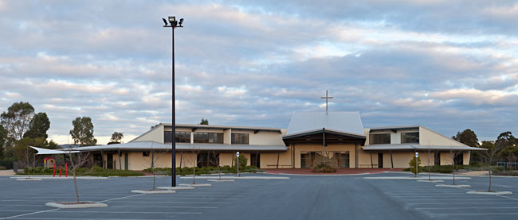
Approaches (3)

And far away countries (states, provinces) are not always foreign cultures: United Kingdom, Australia, New Zealand, Saskatchewan.

Slide 17
Approaches (4)

Today, mission tends to be defined as preaching and teaching with a view to instituting or reforming a church or group of churches in a culture not one’s own.
There are two sorts:
Foreign mission: another culture far away
Home mission: another culture close by

Slide 18
The calling
Church Order of CanRC
ARTICLE 51. Mission
The churches shall endeavour to fulfil their missionary task.
When churches cooperate in this matter, they shall, as much as possible, observe the division into classes and regional synods.

Slide 19
The challenges (1)

The different culture
- what belongs to the essence of the gospel
- what belongs to our own tradition
Examples
- Genevan melodies
- organs during worship
- classis, regional synods, general synods
- going to church on Sunday, twice
- only the minister speaking during worship
- Creeds and Confessions
- owning a Bible and reading it regularly

Slide 20
The challenges (2)

The language
- is what you say the right thing?
- is it possible to convey the Bible in the language of the people you are seeking to reach?
Examples:
what is a shepherd to people who have never seen sheep?
what is a desert wind to people in Canada?
what is “white as snow” to someone in the Sahara desert?
the meaning of terms like “mercy”, “love”, and “justice”
what word do you use for “God” in Islamic countries?

Slide 21
The challenges (3)

Life in general
- living in a culture not your own is very demanding
Examples
- Family situation: lack of medical services, schooling
- Being rich when others are poor (rice-Christians)
- Distance from other family
- General health: usually the tropics has many ‘horrors’

Slide 22
Church plant or Church reform?

No huge ‘blank’ areas in the world today
Not all churches are proper (good) churches
With each mission field the question is
- is Reformed mission in this particular field necessary?
- proclaim the Word to establish a new church?
- give instruction in the Reformed faith to reform existing churches?
In Brazil, our mission policy has changed from church planting to training and church reform.
In China our mission policy is just training and church reform
In Mexico our mission policy is church planting and training

