Slide 1

The communication of Faith:
LD 45-52
Your Will Be Done
Lesson 25 – LD 49

Slide 2
Hymn 63:4
4. O Father, may your will be done
on earth below by everyone.
May we deny our wilful way,
and, without murm’ring, you obey.
In all our duties, Lord, may we,
like heaven’s angels, faithful be.

Slide 3
The Lord’s Prayer
Our Father who is in heaven
Hallowed be
Your Name
Your Kingdom Come
Your will be done, on earth as it is in heaven
Give us And forgive us And lead us not
this day our debts as we into temptation
our daily have forgiven our but deliver us
bread debtors from evil
For Yours is the Kingdom, the power, and the glory, forever
Amen
thereto
thereto
thereto
&
&
For

Slide 4
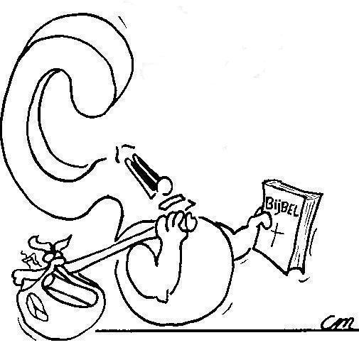

What does “God’s will” in the third petition refer to?

Slide 5
God’s Will

There’s a lot of confusion about the third petition
God’s will could be
  1. What God has decided will happen
Or
  2. What God wants us to do
God’s secret counsel or hidden will
God’s revealed will

Slide 6
God’s Will
Is it:
Lord, I have cancer. Please heal me. However, that might not be Your plan. Your will be done.
Or:
Lord, this Monday I have a big test. Should I study for it on Sunday? Your will be done.
God’s secret counsel or hidden will
God’s revealed will

Slide 7
“As in heaven so on earth”
Would mean: God’s plans are always carried out in heaven, but not on earth.
Would mean: what God wants is always done in heaven, but not on earth.
God’s secret counsel or hidden will
God’s revealed will

Slide 8
Catechism
124.Q. What is the third petition?
A. Your will be done, on earth as it is in heaven.
That is:
Grant that we and all men may deny our own will,
and without any murmuring obey Your will,
for it alone is good.
Grant also that everyone may carry out the duties
of his office and calling
as willingly and faithfully as the angels in heaven.

Slide 9
What is God’s will?
Jane is on holidays with her parents; they are on their way to northern BC. When they make a pit-stop, Jane finds a beautiful camera on a picnic table. They are the only family at the rest area. The family waits 15 minutes, but no one comes to claim the camera.
Now Jane had wanted a camera real badly. Maybe, maybe God put the camera there for her to have. After all, He had her find it. But wouldn’t it be stealing?
Jane prays: “Your will be done.” What is she asking?

Slide 10
What is God’s will?
A young Christian man meets a young Sikh girl and they feel romantically attracted to each other.
The young man struggles with the following question. It was obviously God’s plan for them to meet, and for them to feel romantically attracted to each other. Does this mean it’s okay for them to go out and work towards marriage? Or should he follow the instruction of the Bible to marry only in the Lord (1Cor 7:39) and stop seeing the girl?
The young man prays: “Your will be done.” What is he asking?

Slide 11
Your Will Be Done

IS NOT
a reference to the execution of God’s plan
BUT
a reference to obeying God

Slide 12

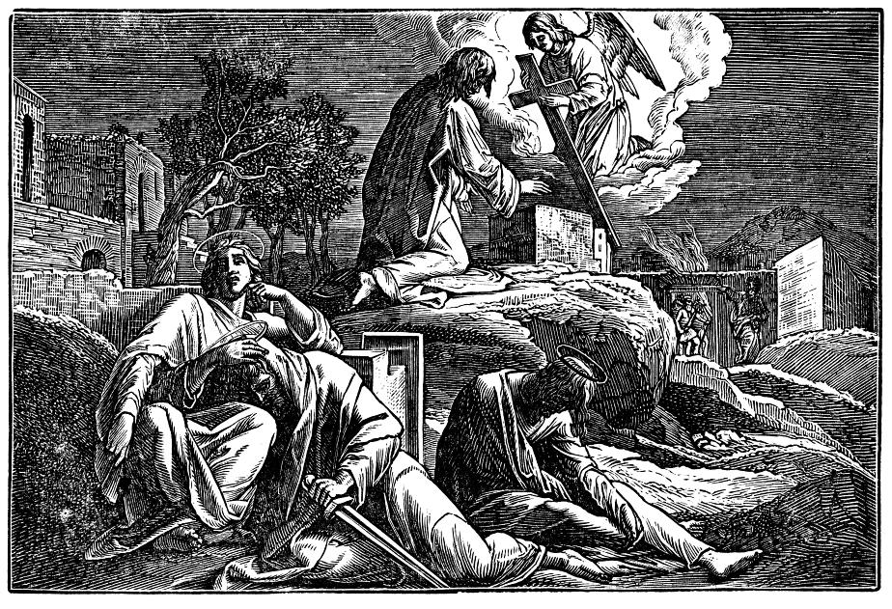
Bible Study: Luk 22 & Hebr 5

Slide 13
Bible Study: Luk 22 & Hebr 5
1. The Mount of Olives
2. Very anxious and troubled, in an agony
3. Remove this cup from Him (not have Him die)
4. Have Me do what You want done.
5. Because of His
reverence
6. Obedience
God’s will is about
obedience

Slide 14
Catechism
124.Q. What is the third petition?
A. Your will be done, on earth as it is in heaven.
That is:
Grant that we and all men may deny our own will,
and without any murmuring obey Your will,
for it alone is good.
Grant also that everyone may carry out the duties
of his office and calling
as willingly and faithfully as the angels in heaven.

Slide 15

Obeying God

People often have excuses for not obeying God.
  - everybody does it
  - I’m not hurting anyone when I do this
  - I do mean well
  - In my case it’s different
  - Okay, it’s wrong. But I’m not an unbeliever
  - We’re all sinful, aren’t we?
Or they obey, even though they
don’t really want to.
But God wants us to serve Him
from the heart.
??????????

Slide 16
In the Lord’s Prayer
We exist that God might be praised and glorified
Your Name be hallowed.
This implies recognizing God for who He is
Your kingdom come
This implies all people doing what God the King wants them to do
Your will be done.

Slide 17
Angels

Angels are beings that have no body.
Like humans and animals, they were created.
There are basically two types of angels:
  - good ones
  - usually these are what we mean by “angels”
  - they are servants of God and help us (Hebrews 1:14)
  - bad ones
  - usually we refer to them as “devils” or “demons”
  - they are opposed to God and His people

Slide 18
The third petition

- Is not about God’s plan but about what God wants us to do.
- Is directly related to us furthering the cause of God’s kingdom and so glorifying His Name.

