Slide 1
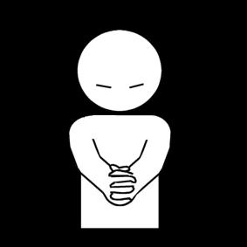
The communication of Faith: LD 45-52
Give us this day our daily bread
Lesson 26 – LD 50

Slide 2
Psalm 146:3
Blest is he who has as helper
Jacob’s God and hopes in him;
he made heaven, earth, and ocean,
shaping all things found in them.
In his faithfulness the Lord
will forever keep his word.

Slide 3
The Lord’s Prayer
Our Father who is in heaven
Hallowed be
Your Name
Your Kingdom Come
Your will be done, on earth as it is in heaven
Give us And forgive us And lead us not
this day our debts as we into temptation
our daily have forgiven our but deliver us
bread debtors from evil
For Yours is the Kingdom, the power, and the glory, forever
Amen
thereto
thereto
thereto
&
&
For

Slide 4
All Things Come From God

God is the source of all things
All look to You to give them food at the proper time.
When You give it to them, they gather it up.
When you open your hand, they are satisfied with good things.
Psalm 104:27-28
We should never forget this. Poor people are more inclined to pray to God for food than rich people. But both rich and poor receive their food from God.
Praying the fourth petition is recognizing that all things come from God.

Slide 5
Catechism
125. Q. What is the fourth petition?
A. Give us today our daily bread.
That is:
Provide us with all our bodily needs
so that we may acknowledge
that You are the only fountain of all good,
and that our care and labour, and also Your gifts,
cannot do us any good without Your blessing.
Grant, therefore, that we may withdraw our trust
from all creatures and place it only in You.

Slide 6
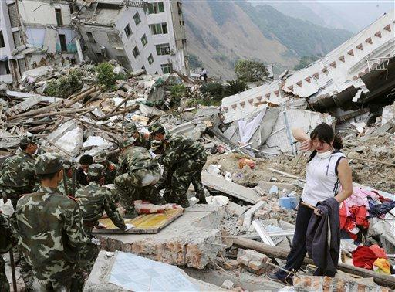
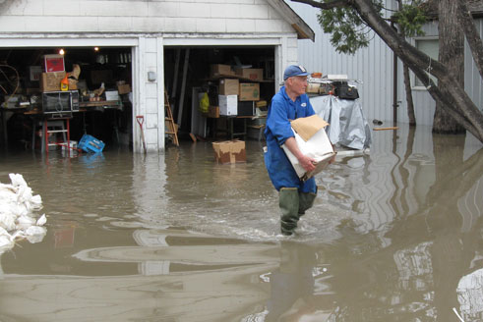
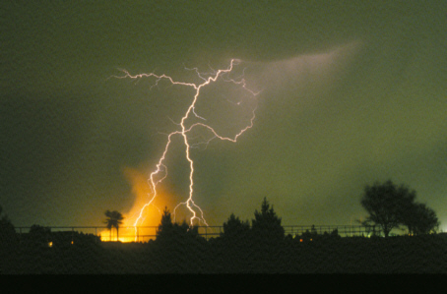
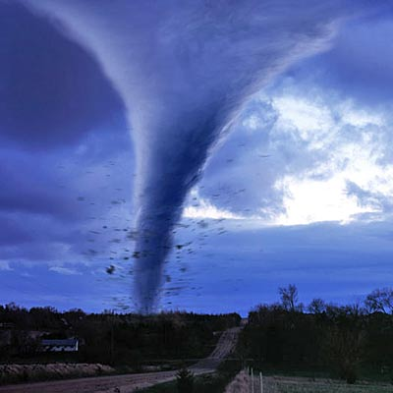
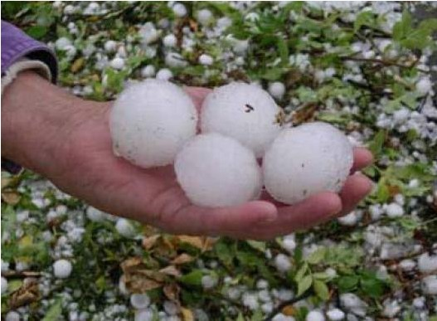
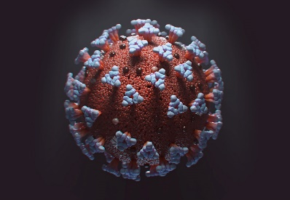
How self-sufficient?

Slide 7
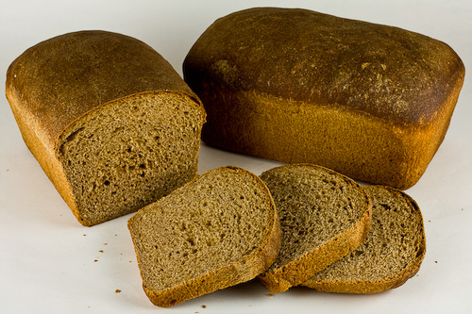
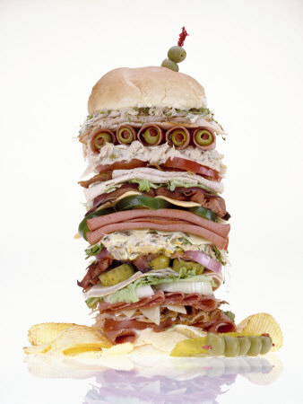
Pray for bread?

In the past, people felt more need for God than today. Today people consider themselves quite self-sufficient.
However, even with all our modern capabilities, we still need the blessing of God to succeed.
The food on our table is not just the result of our labour.
It is the result of God’s blessing on our labour.

Slide 8
Bible Study: Psalm 127:1-2
1. The LORD and the labourers
2. The LORD and the watchmen
3. To rise early and stay up late, toiling for food to eat
4. God will take care of it
5. We need to work. But we should never think that our efforts gain us what we need. God makes it happen.

Slide 9
Catechism
125. Q. What is the fourth petition?
A. Give us today our daily bread.
That is:
Provide us with all our bodily needs
so that we may acknowledge
that You are the only fountain of all good,
and that our care and labour, and also Your gifts,
cannot do us any good without Your blessing.
Grant, therefore, that we may withdraw our trust
from all creatures and place it only in You.

Slide 10
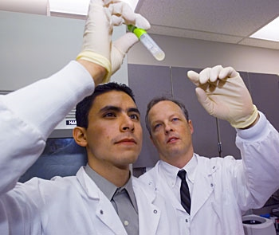
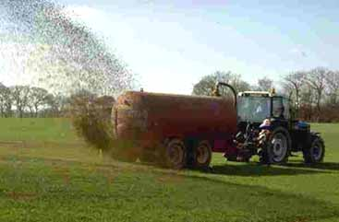
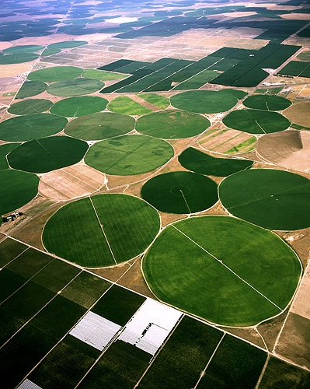
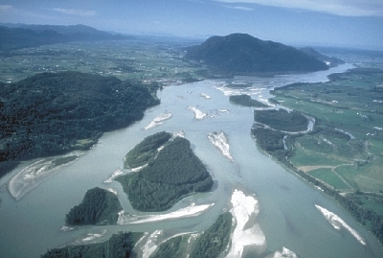
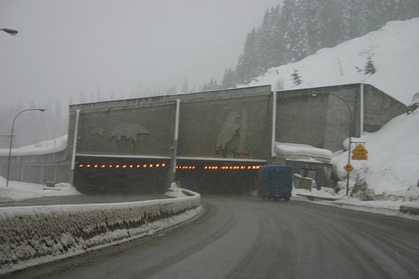
Whom do we trust?

Slide 11
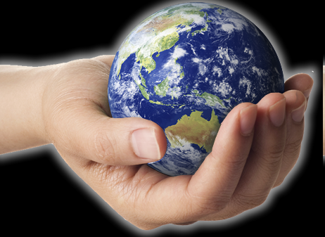
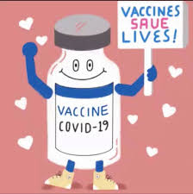
Whom do we trust?

We often think we’re in the hands of people.
But we’re not, we’re in the Hand of God.
We should then also trust in God’s Hand.
?

Slide 12
Whom do we trust?
A Christian patient is operated on by an unbelieving surgeon. The surgery is a success. When the patient is discharged, the surgeon remarks “You’ll probably say God healed you.”
What would be an appropriate response by the Christian?

Slide 13
Give us today
Jen (16) has a job. She’s saving up for college in two year’s time. She knows that College is going to be expensive, more expensive per year than what she can earn in a year.
Opa Klaas has worked all his life. Every year he put away 10% of what he earned into an RRSP account. That way, when he reached 65, he would have extra money to live off.
Discuss: If we ask God to give us bread today are we allowed to save up for the future?

Slide 14
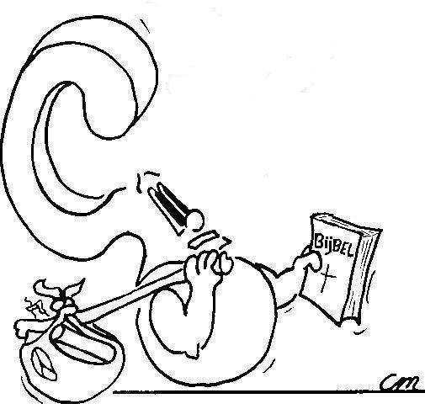
20% of the world’s population owns 80% of the world’s riches. Why doesn’t God share it more equally?
God wants people to share it equally.

Slide 15
Bible Study: Deuteronomy 8
1. Praise the Lord for the good land He has given us
2. By not obeying God’s commands
3. They become proud and forget the Lord
4. My power and the strength of my hands have produced this wealth for me
5. No for it is the Lord who gives the ability to produce wealth
6. You don’t worship the Lord but other gods (e.g. science)
7. He will stop blessing us and will destroy us eternally.

Slide 16
Praying for all men

“Us” in the fourth petition is all people.
We pray that God may give everybody all they need to live.
And if we ourselves have the means to give, we should be generous ourselves.
God gives daily sustenance through
- our own labour
- the care of another
- the generosity of another

Slide 17
The fourth petition

- We acknowledge that in all of life, we need God’s blessing
- We receive our bread to be physically able to do God’s will, to further His Kingdom, to glorify His Name.

