Slide 1
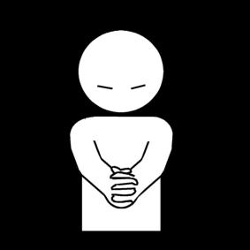
The communication of Faith: LD 45-52
And forgive us our debts
Lesson 27 – LD 51

Slide 2
Psalm 32:1
1.Blest is the man whose trespass is forgiven,
whose sins are covered in the sight of heaven;
against whom you, O Lord, will graciously
not count his guilt and his iniquity.
Blest he who with a heart contrite and lowly
confesses all his sins, O Lord most holy;
who does not secretly your laws transgress,
whose spirit harbours no deceitfulness.

Slide 3
The Lord’s Prayer
Our Father who is in heaven
Hallowed be
Your Name
Your Kingdom Come
Your will be done, on earth as it is in heaven
Give us And forgive us And lead us not
this day our debts as we into temptation
our daily have forgiven our but deliver us
bread debtors from evil
For Yours is the Kingdom, the power, and the glory, forever
Amen
thereto
thereto
thereto
&
&
For

Slide 4
Never skipped...
Reformed people will rarely skip the 5th petition in their prayers.
We feel the need for forgiveness so much, we’ve even created a closing sentence for our prayers about it, just in case we missed it...
All this we pray, in the forgiveness of all our sins, for Jesus’ sake. Amen.

Slide 5
Do we take it seriously?
I am sinful, inclined to all evil. I make mistakes and have my faults, like all other people. I need forgiveness. Good thing I can ask God for it. And God loves to forgive, for He is love.
“Lord, forgive my sins.” There, done.

Slide 6
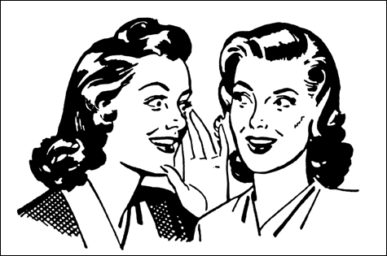
Do we feel guilty?
We feel the need to ask for forgiveness.
But when praying for forgiveness, have we thought about what the sins are that need forgiving?
A minister once spoke with a lady, known to be a gossip.
Lady (mournfully): “Reverend, I’m just a poor sinner.”
Minister: “I know. I’ve been told that.”
Lady (angrily): “Who said that about me?”
How guilty does this lady feel?

Slide 7
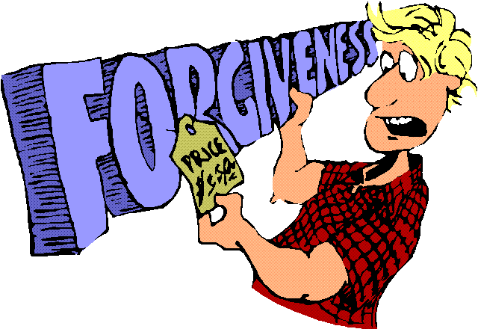
Praying the 5th petition

In the Reformed tradition, praying for forgiveness is considered very necessary.
This can lead to a request for forgiveness:
- too easily made
- made without a true sense of guilt.

Slide 8
Catechism
126.Q. What is the fifth petition?
A. Forgive us our debts, as we also have forgiven our debtors.
That is:
For the sake of Christ’s blood,
do not impute to us, wretched sinners;
any of our transgressions,
nor the evil which still clings to us,
as we also find this evidence of Your grace in us
that we are fully determined wholeheartedly
to forgive our neighbour.

Slide 9
Terms (Remember this?)
Good: suited for purpose, hence
To do good: an act of love and loyalty, you hit the target bulls eye
To sin: to miss the target, an act of self-centredness
Law (Torah): guideline for shooting at the target of love and loyalty
♥

Slide 10
Sin

Sins exist in three types:
- Transgressions: things we do which we ought not to do
- Shortcomings: things we do not do which we ought to do
- Original Sin: our natural inclination to act in a self-centred way
Transgressions and Shortcomings are actual sins, sins we do.
Original sin is sin we are.
Transgressions are also known as sins of commission
Shortcomings are also known as sins of omission.

Slide 11
Sin
Original
Actual
Transgressions
Shortcomings

Slide 12
Debts / Guilt

Christ taught us to pray, not
“Forgive us our sins”
but
“Forgive us our debts”
The word ‘debts’ takes us deeper than ‘sins’.
It’s not just about having done something wrong (as with speeding).
It’s more about having caused hurt (as with bullying).
Through sin, we incur guilt, we create debt. We’re not paying God the love we should be.

Slide 13
Forgive us our debts means

Forgive us all the wrongs we did
Forgive us all our lack of love
Forgive us all our evil desires
Forgive us all we owe You.
Transgressions
+
Shortcomings
+
Original sin
=
Debts

Slide 14
Be TRULY sorry
Source: Third Millennium – Apostles’ Creed video 6

Slide 15
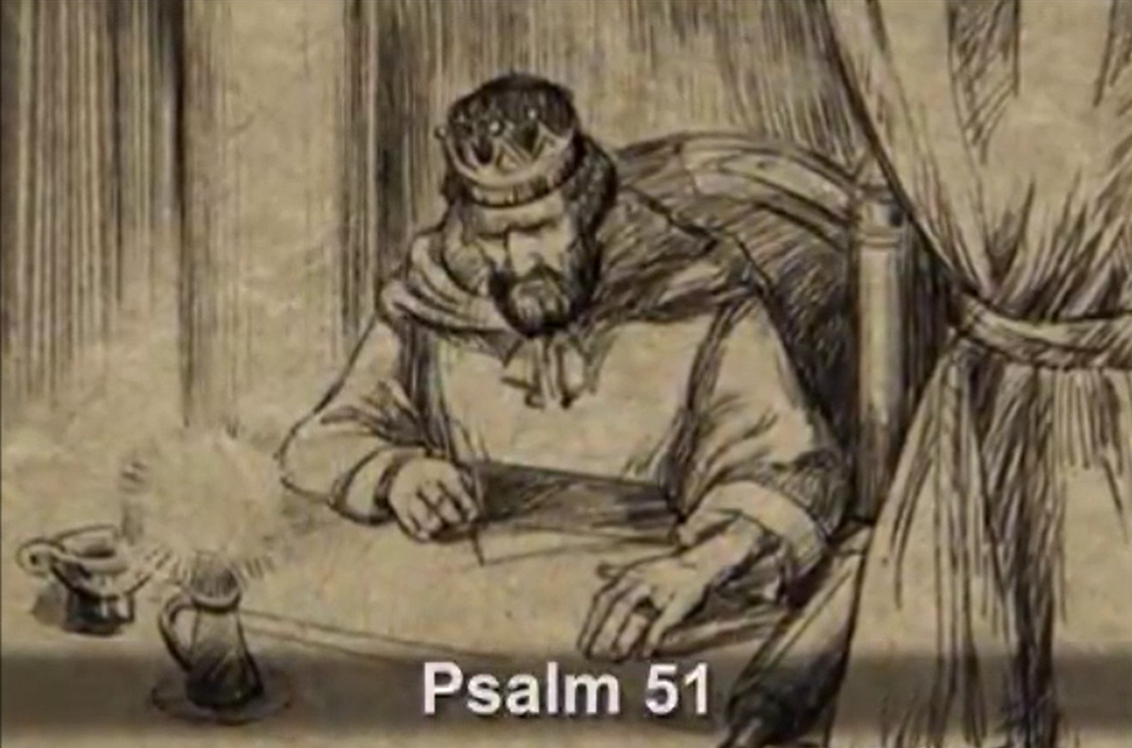
Bible Study: Psalm 51

Slide 16
Bible Study: Psalm 51
1. Having committed adultery with Bathsheba
2. Transgressions (v1), iniquity (v2), sin (v2), evil (v4)
3. Original sin (sinful from the time my mother conceived me)
4. A broken spirit, a broken and contrite heart
5. Cleanse, wash, hide your face, blot out, do not cast me away, save me
6. Sacrifices themselves do not take away sins. They are only meaningful if there is a right attitude.

Slide 17
Why God is allowed to forgive

Slide 18
Mean what you pray

God wants us to pray from the heart.
To ask for forgiveness means first:
- knowing what sin is (lack of love and loyalty)
- realizing what your sins are
- shame on account of your sins
- hating your sins
- realizing how God views sins (Christ had to die!)
Only then can we pray for forgiveness

Slide 19
The fifth petition

- We are to praise God’s Name
- Sins bring dishonour to God’s Name
- We need to be forgiven, if God is to let us live and praise Him

