Slide 1
The communication of Faith: LD 45-52
And lead us not into temptation…
For Yours is the Kingdom...Amen
Lesson 28 – LD 52

Slide 2
Hymn 63:7,8
7. Into temptation lead us not,
lest we in Satan’s snares be caught.
Uphold us by your Spirit’s might;
put mortal enemies to flight.
May we against our foes contend
and be victorious in the end.

Slide 3
Hymn 63:7,8
8. Yours is the kingdom, yours the might,
and yours alone the glory bright!
All this we ask of you, our King,
for you are Lord of everything
in this age and eternally.
Amen, Amen, so shall it be!

Slide 4
The Lord’s Prayer
Our Father who is in heaven
Hallowed be
Your Name
Your Kingdom Come
Your will be done, on earth as it is in heaven
Give us And forgive us And lead us not
this day our debts as we into temptation
our daily have forgiven our but deliver us
bread debtors from evil
For Yours is the Kingdom, the power, and the glory, forever
Amen
thereto
thereto
thereto
&
&
For

Slide 5
Addicted to sin
With the fifth petition we’ve prayed for forgiveness
But, God doesn’t want there to be sin to forgive!
Now we happen to be, by nature, addicted to sin
Only with God’s help can we kick our addiction.
That’s what the sixth petition is about.
God, help me stop sinning.

Slide 6
Catechism
127.Q. What is the sixth petition?
And lead us not into temptation, but deliver us from the evil one. That is:
In ourselves we are so weak that we cannot stand even for a moment.
Moreover, our sworn enemies – the devil, the world, and our own flesh – do not cease to attack us.
Will You, therefore, uphold and strengthen us by the power of Your Holy Spirit, so that in this spiritual war we may not go down to defeat, but always firmly resist our enemies, until we finally obtain the complete victory.

Slide 7
Temptation?

James writes:
So how come we ask God not to lead us into temptation?
We ask God not to give the devil the opportunity to tempt us beyond our strength. We don’t say “God, do not tempt us” but “God, do not put us in a situation of temptation”
Let no one say when he is tempted, “I am being tempted by God,” for God cannot be tempted with evil, and he himself tempts no one. But each person is tempted when he is lured and enticed by his own desire. James 1:13-14

Slide 8
Catechism
127.Q. What is the sixth petition?
And lead us not into temptation, but deliver us from the evil one. That is:
In ourselves we are so weak that we cannot stand even for a moment.
Moreover, our sworn enemies – the devil, the world, and our own flesh – do not cease to attack us.
Will You, therefore, uphold and strengthen us by the power of Your Holy Spirit, so that in this spiritual war we may not go down to defeat, but always firmly resist our enemies, until we finally obtain the complete victory.

Slide 9
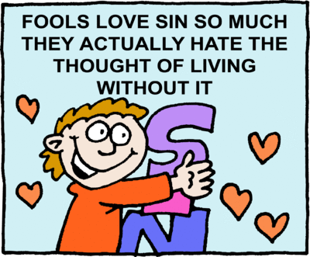
A matter of life or death

Those who harden themselves in sin, that is, do not give up their sinful ways, will NOT see life.
Fighting against sin is a matter of life or death!
But we are weak and our enemies are strong.
Hence we pray: Lord, help us fight this battle.

Slide 10
Catechism
127.Q. What is the sixth petition?
And lead us not into temptation, but deliver us from the evil one. That is:
In ourselves we are so weak that we cannot stand even for a moment.
Moreover, our sworn enemies – the devil, the world, and our own flesh – do not cease to attack us.
Will You, therefore, uphold and strengthen us by the power of Your Holy Spirit, so that in this spiritual war we may not go down to defeat, but always firmly resist our enemies, until we finally obtain the complete victory.

Slide 11
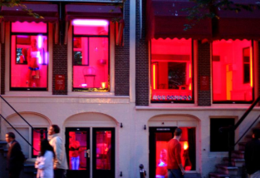
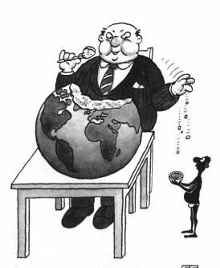
Three enemies

The devil
Tries to convince us of falsehoods
Lures us with empty pleasures
The world
Would have us be self-centred, focusing on own desires
Own flesh

Slide 12
Three enemies
The devil The world Own flesh
Satanism Drugs Selfishness
Islam Porn Greed
Jehovah’s Pleasure Hunger for Witnesses power

Slide 13
Bible Study: Romans 8:5-17
1. Death
2. Life
3. Cannot please God
4. By the Spirit
5. If Christ is in you.
6. If you live according to the flesh (sinful nature)
7. If by the Spirit you put to death the deeds of the body
8. The Spirit Himself

Slide 14
The Trinity and petitions 4,5 & 6
God the Father and our physical needs
God the Son and payment for sin
God the Spirit and renewal of life

Slide 15
Catechism
128.Q. How do you conclude your prayer?
A. For Yours is the kingdom and the power and the glory for ever.
That is:
All this we ask of You because, as our King,
having power over all things,
You are both willing and able
to give us all that is good,
and because not we but Your holy name
should so receive all glory for ever.

Slide 16
The doxology

The last line of the Lord’s Prayer is called the doxology: a word of praise.
It also forms the foundation for our prayer.

Slide 17
The doxology

We ask things of God because
His is the Kingdom: He’s the boss
His is the Power: He’s Almighty (able)
His is the Glory: All things are for His sake
Forever: It will always be thus.

Slide 18
Catechism
129.Q. What does the word Amen mean?
A. Amen means:
It is true and certain.
For God has much more certainly heard my prayer
than I feel in my heart that I desire this of Him.

Slide 19
Amen

Does NOT mean “Finished” or “May it be so”
Amen is a Hebrew word, related to aman, to believe and amath, truth.
Amen in English means “it is true and certain, I believe it.”
At the end of a prayer it means: “God has heard me and will most definitely respond.”

Slide 20
The 6th petition and close

- Help us in the fight against sin
- We ask all this of You as You are in control, all-powerful, and life is all about You.
- That’s the way of it!!!

