Slide 1
The communication of Faith: LD 45-52
And forgive us our debts
Lesson 27 – LD 51

Slide 2
Psalm 32:1
1.Blest is the man whose trespass is forgiven,
whose sins are covered in the sight of heaven;
against whom you, O Lord, will graciously
not count his guilt and his iniquity.
Blest he who with a heart contrite and lowly
confesses all his sins, O Lord most holy;
who does not secretly your laws transgress,
whose spirit harbours no deceitfulness.

Slide 3
The Lord’s Prayer
Our Father who is in heaven
Hallowed be
Your Name
Your Kingdom Come
Your will be done, on earth as it is in heaven
Give us And forgive us And lead us not
this day our debts as we into temptation
our daily have forgiven our but deliver us
bread debtors from evil
For Yours is the Kingdom, the power, and the glory, forever
Amen
thereto
thereto
thereto
&
&
For

Slide 4
Never skipped...
Reformed people will rarely skip the 5th petition in their prayers.
We feel the need for forgiveness so much, we’ve even created a closing sentence for our prayers about it, just in case we missed it...
All this we pray, in the forgiveness of all our sins, for Jesus’ sake. Amen.

Slide 5
Do we take it seriously?
I am sinful, inclined to all evil. I make mistakes and hae my faults, like all other people. I need forgiveness. Good thing I can ask God for it. And God loves to forgive, for He is love.
“Lord, forgive my sins.” There, done.

Slide 6
Do we feel guilty?
We feel the need to ask for forgiveness.
But when praying for forgiveness, have we thought about what the sins are that need forgiving?
A minister once spoke with a lady, known to be a gossip.
Lady (mournfully): “Reverend, I’m just a poor sinner.”
Minister: “I know. I’ve been told that.”
Lady (angrily): “Who said that about me?”
How guilty is does this lady feel?

Slide 7
Praying the 5th petition

In the Reformed tradition, praying for forgiveness is considered very necessary.
This can lead to a request for forgiveness:
- too easily made
- made without a true sense of guilt.

Slide 8
Catechism
126.Q. What is the fifth petition?
A. Forgive us our debts, as we also have forgiven our debtors.
That is:
For the sake of Christ’s blood,
do not impute to us, wretched sinners;
any of our transgressions,
nor the evil which still clings to us,
as we also find this evidence of Your grace in us
that we are fully determined wholeheartedly
to forgive our neighbour.

Slide 9
Do not impute

Impute = to say that someone is responsible for something, to attribute
To ask for forgiveness is
- to acknowledge that we are guilty
- to ask that we be treated as if not guilty
God acts as if we are without guilt because Christ has suffered for our guilt.
Forgiveness implies: our sins are imputed to Christ, Christ’s obedience is imputed to us.

Slide 10
To forgive is…

Often people say “to forgive is to forget”
God will “no more remember my sins”
Discuss: Would this mean “forget” or “ignore”?
God ignores our sins if we confess them and seek forgiveness.
If we stop confessing and seeking forgiveness, then God will hold us accountable for our sins. (Matthew 18:32-35)

Slide 11
Why God can forgive

Slide 12
Be TRULY sorry
Source: Third Millennium – Apostles’ Creed video 6

Slide 13
Mean what you pray

God wants us to pray from the heart.
To ask for forgiveness means first:
- knowing what sin is (lack of love and loyalty)
- realizing what your sins are
- shame on account of your sins
- hating your sins
- realizing how God views sins (Christ had to die!)
Only then can we pray for forgiveness

Slide 14
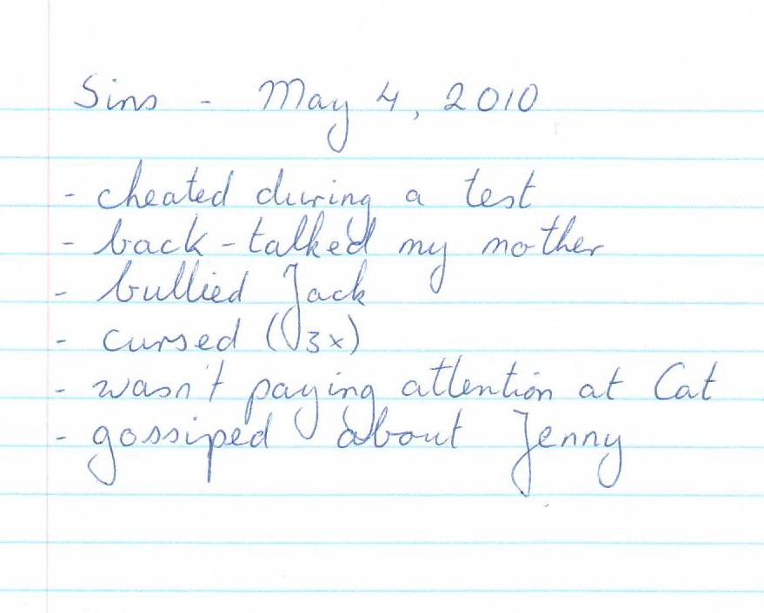
A sin diary
A highschool student had the habit of keeping track of all his sins. He’d write them down in a ‘sin pad’. At the end of the day, he would read the sins out loud, and ask for forgiveness. When he’d said ‘amen’, he’d tear the page out of the pad and put it through the shredder.
Do questions on sheet.

Slide 15
Catechism
126.Q. What is the fifth petition?
A. Forgive us our debts, as we also have forgiven our debtors.
That is:
For the sake of Christ’s blood,
do not impute to us, wretched sinners;
any of our transgressions,
nor the evil which still clings to us,
as we also find this evidence of Your grace in us
that we are fully determined wholeheartedly
to forgive our neighbour.

Slide 16
…as we have forgiven our debtors

This line may seem puzzling to a Reformed person.
God grants forgiveness out of grace, I don’t earn it.
Yet this seems to say “God will only forgive you if you forgive others.”
However, that’s not what is says.
It says: “God, forgive me, for You are a forgiving God. I am convinced of this, because You even make me willing to forgive others.”

Slide 17
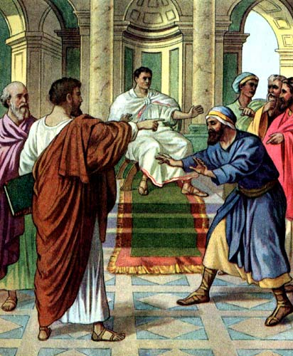
Bible Study: Matthew 18:21-35
1. Seventy times seven times
2. Always be prepared to forgive
3. An attitude of love and concern
4. The wrongs humans do to each other do not compare with the wrongs we do to God.
5. God forgives us so much, we should always be willing to forgive.

Slide 18
When should we forgive?

God does not forgive all sins ever committed.
He only forgives the sins of those who are truly sorry for their sins, ask for forgiveness, and strive to live better lives.
God is, however, willing to forgive all sins.
We are to reflect God in this.
We should always be willing and ready to forgive.
But forgiveness need only be given when the person who has caused us hurt is truly sorry, asks for forgiveness, and strives to live a better life.

Slide 19
The fifth petition

- Sins bring dishonour to God’s Name
- We need to be forgiven, if God is to let us live and praise Him

