Slide 1
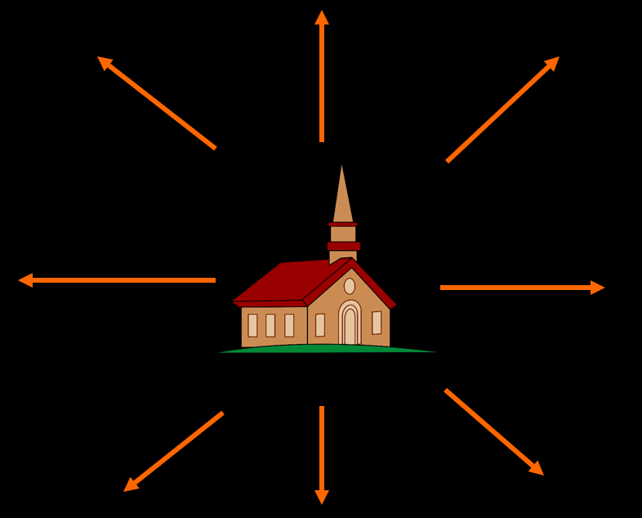
Church - Reach Out!
Mission
Lesson 25

Slide 2
Hymn 81:1,2
1. O for a thousand tongues to sing
my great Redeemer’s praise,
the glories of my God and King,
the triumphs of his grace!
2. My gracious Master and my God,
assist me to proclaim,
to spread through all the earth abroad,
the honours of your name.

Slide 3
The calling
Church Order of CanRC
ARTICLE 51. Mission
The churches shall endeavour to fulfil their missionary task.
When churches cooperate in this matter, they shall, as much as possible, observe the division into classes and regional synods.

Slide 4
The challenges (1)

The different culture
- what belongs to the essence of the gospel
- what belongs to our own tradition
Examples
- Genevan melodies
- organs during worship
- classis, regional synods, general synods
- going to church on Sunday, twice
- only the minister speaking during worship
- Creeds and Confessions
- owning a Bible and reading it regularly

Slide 5
The challenges (2)

The language
- is what you say the right thing?
- is it possible to convey the Bible in the language of the people you are seeking to reach?
Examples:
what is a shepherd to people who have never seen sheep?
what is a desert wind to people in Canada?
what is “white as snow” to someone in the Sahara desert?
the meaning of terms like “mercy”, “love”, and “justice”
what word do you use for “God” in Islamic countries?

Slide 6
The challenges (3)

Life in general
- living in a culture not your own is very demanding
Examples
- Family situation: lack of medical services, schooling
- Being rich when others are poor (rice-Christians)
- Distance from other family
- General health: usually the tropics has many ‘horrors’

Slide 7
Church plant or Church reform?

No huge ‘blank’ areas in the world today
Not all churches are proper (good) churches
With each mission field the question is
- is Reformed mission in this particular field necessary?
- proclaim the Word to establish a new church?
- give instruction in the Reformed faith to reform existing churches?
In Brazil, our mission policy has changed from church planting to training and church reform.
In China our mission policy is just training and church reform
In Mexico our mission policy is church planting and training

Slide 8
Evangelism defined

Evangelisation is proclaiming the gospel to those in the vicinity of a local church, so as to draw God’s elect into that local church.

Slide 9
Our past
In many regions of The Netherlands, it was (and is) quite normal for almost everybody to belong to your church (or a church your church is split from).
Hence ‘local outreach’ didn’t really exist. It couldn’t.
It has meant that ‘outreach’ in our churches focuses traditionally on mission.
And if there was evangelisation it generally meant reaching out to the odd person who had left the church.

Slide 10
Our past
The immigrants came into a new situation.
In some places, the Dutch situation continued (e.g. Holland in Michigan and Neerlandia in Alberta).
But in most places, the Dutch formed a minority within an existing community.
At first the Dutch were isolationist. This is typical for immigrants. Besides, there was a language barrier (it took us 20 years to begin worshipping full time in English!)
Now that we’re into a third and fourth generation church, this is changing.

Slide 11
Our history

Traditionally: focused on foreign outreach
Little experience with local outreach
Immigrants came into a new situation.
At first immigrants were isolationist, now they are becoming more outreaching.
The Willoughby Heights CanRC has a special challenge.
We are church in the Bible belt of BC, surrounded by many conservative Christians rather similar to ourselves.

Slide 12
Bible Study: Ephesians 2:11-22
1. The Gentiles
2. The Jews
3. By the blood of Christ.
4. To create in Himself one man from the two, so making peace
5. Strangers and aliens
6. Fellow citizens and household members
7. Just one.
8. Multi-cultural

Slide 13
Our activities

Supervised by the Home Mission Committee
Vacation Bible School: reach out in the community to children and their parents.
Seasonal projects
Baby bottle campaign (May – June)
Hampers for needy moms (December)
Internet:
Reformed Perspective: www.reformedperspective.ca
Participation in the public square?
Politics, ARPA, WeNeedALaw…
Flag Display

Slide 14
Additional activities?

Christianity Explored and Discipleship Explored
Nightshift
Currently works in Surrey
A second location in Langley, involves Langley & Refuge CanRC
Catechism classes for those not familiar with the Christian Religion but wishing to become members of the local church
Board Games night in Surrey-Maranatha
Special worship services for outsiders? (1Corinthians 14:24-25).

Slide 15
Relational Evangelisation

It is through contacts of local church members that others are best drawn to the church.
This is why church committees are often called
“Evangelism Support Committee”
If God is number one in your life, and meeting Him (worship) is the highlight of your week, wouldn’t you want all your friends to share in that?

Slide 16
Relational Evangelisation
Discussion questions
1. Is it okay to start a relationship purely with a view to evangelisation?
2. Would you want to take friends and acquaintances from outside our church to our worship services?

Slide 17
Notes:
Rote Learn: 3:17

Slide 18
Keith Green – Asleep in the Light

